Slide 1
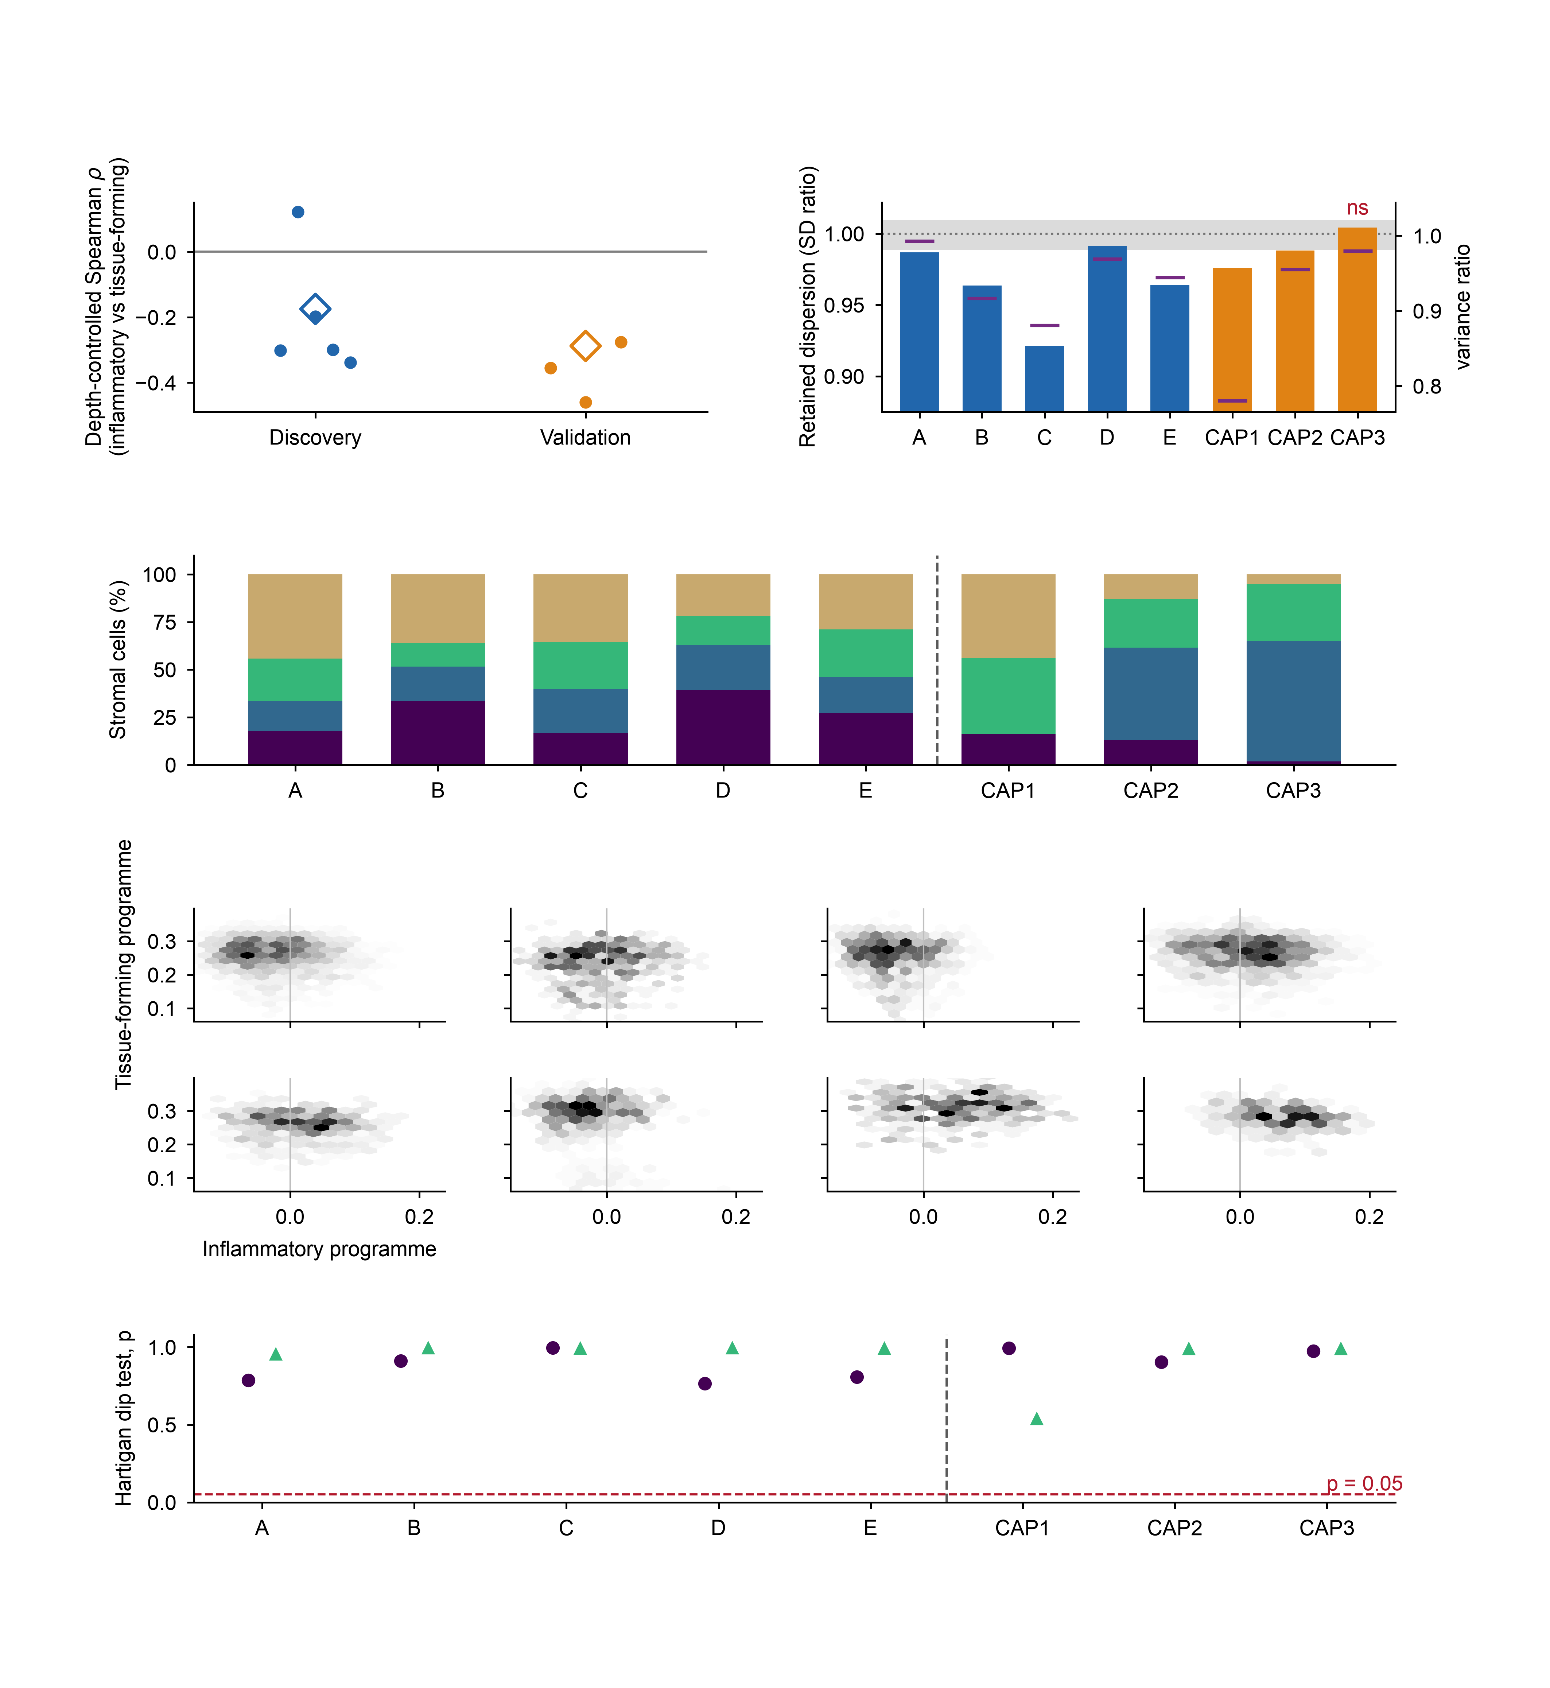
a
B
b
C
CAP3
A
E
CAP1
D
CAP2
Discovery lesions
Validation lesions
permutation null (95%)
null mean
unrelated factors (mean of 10)
Discovery pooled
Validation pooled
c
Cell states
(n=3)
(n=5)
Discovery
Validation
(2,314)
(739)
(1,018)
(1,418)
(726)
(860)
(566)
(353)
inflammatory
intermediate
tissue-forming
other
d
A n=2,314
B n=739
C n=1,018
D n=1,418
E n=726
CAP1 n=860
CAP2 n=566
CAP3 n=353
e
Inflammatory programme
Tissue-forming programme

