Slide 1
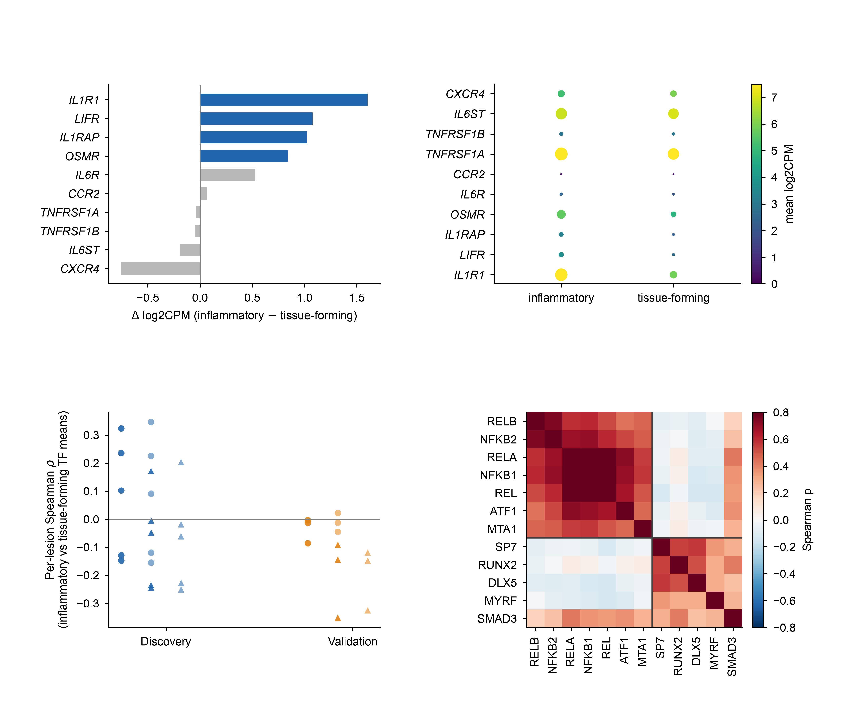
a
Discovery, pseudobulk (5 lesions)
b
NF-κB family set / with SMAD3
alternative set (ATF1, MTA1) / with SMAD3
NF-κB family set / without SMAD3
alternative set (ATF1, MTA1) / without SMAD3
c
d
TF activity correlation (discovery)
(n=5)
(n=3)

