Slide 1
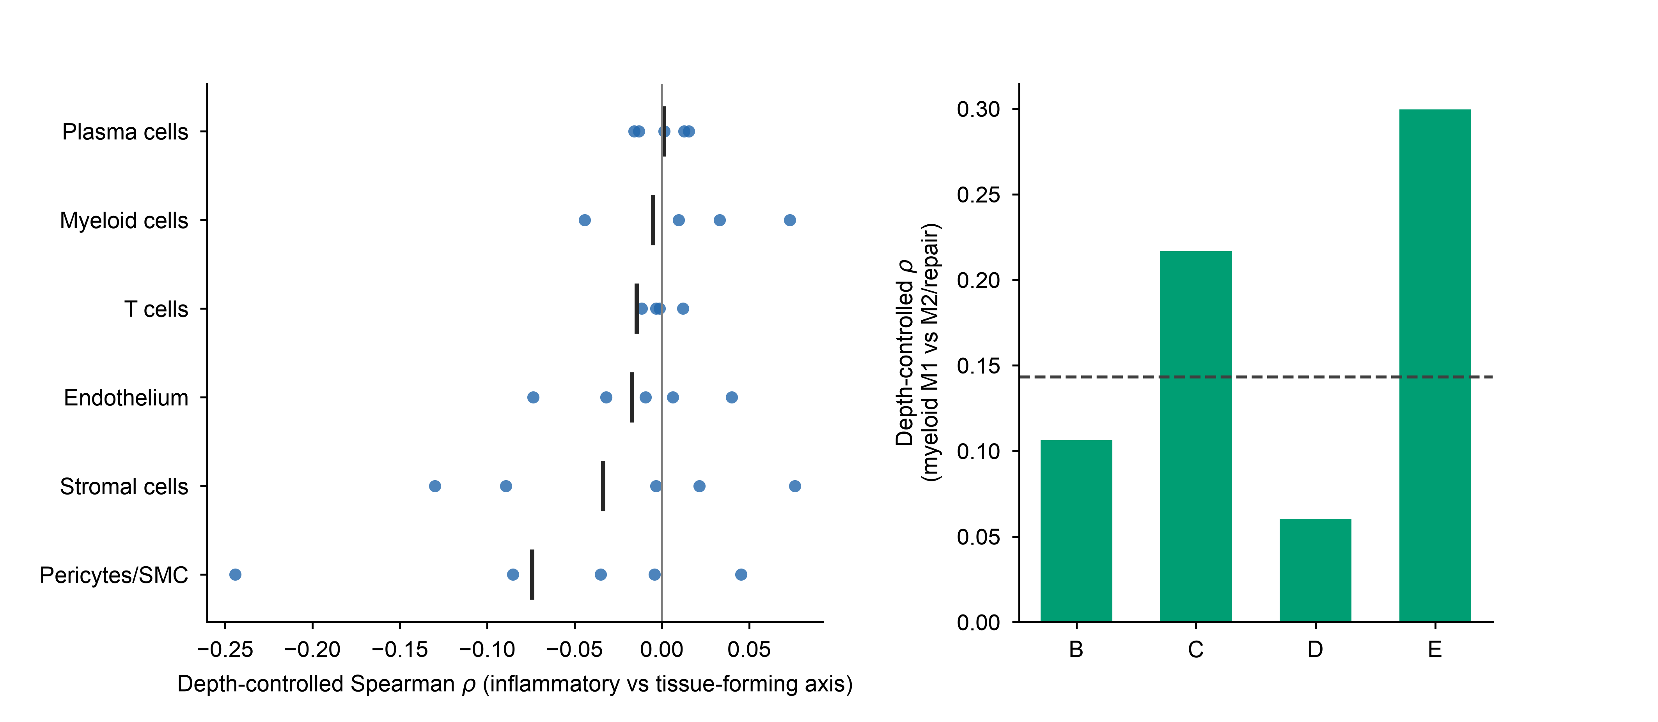
a
b
Myeloid cells: intrinsic axes

