Slide 1
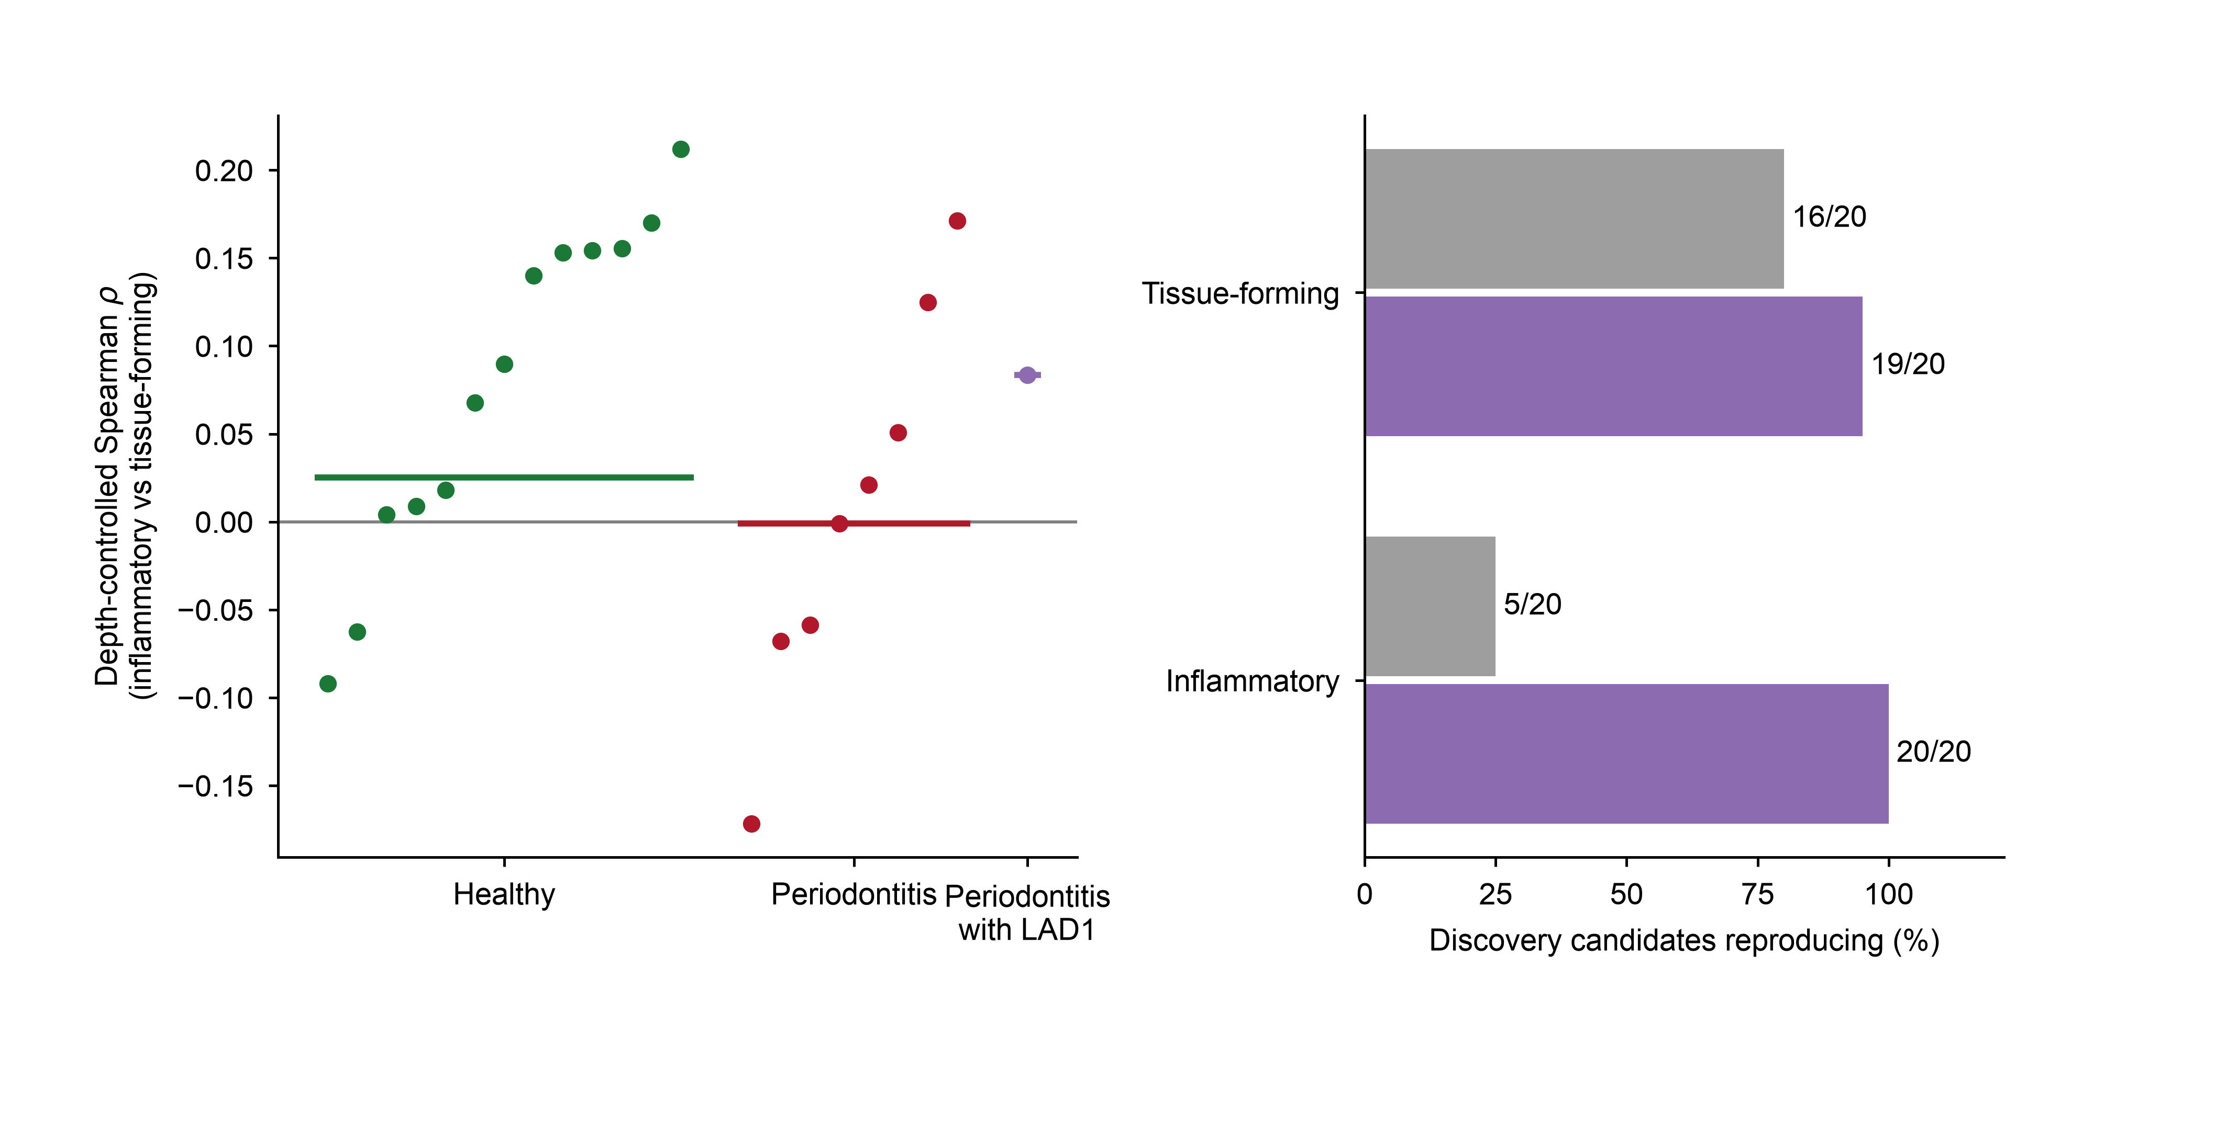
a
GSE164241 gingiva
b
Candidate reproduction
+0.08
pooled +0.03
pooled −0.00
(13 donors)
(8 donors)
(1 donor)
same sign as discovery
consistent across all donors

