Slide 1
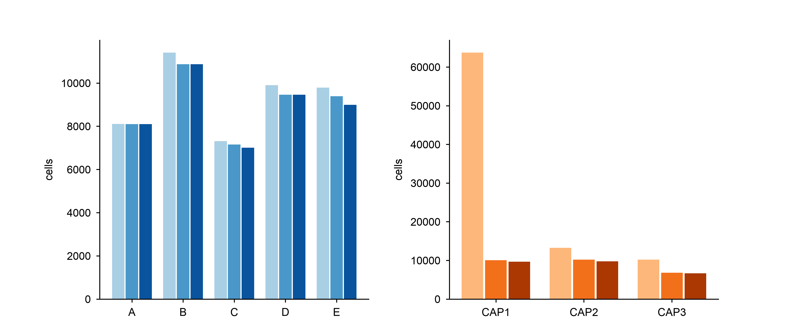
a
Discovery (5 lesions)
b
Validation (3 lesions)
raw
raw (≥100 UMIs)
QC pass
QC pass
singlets
singlets

