Slide 1
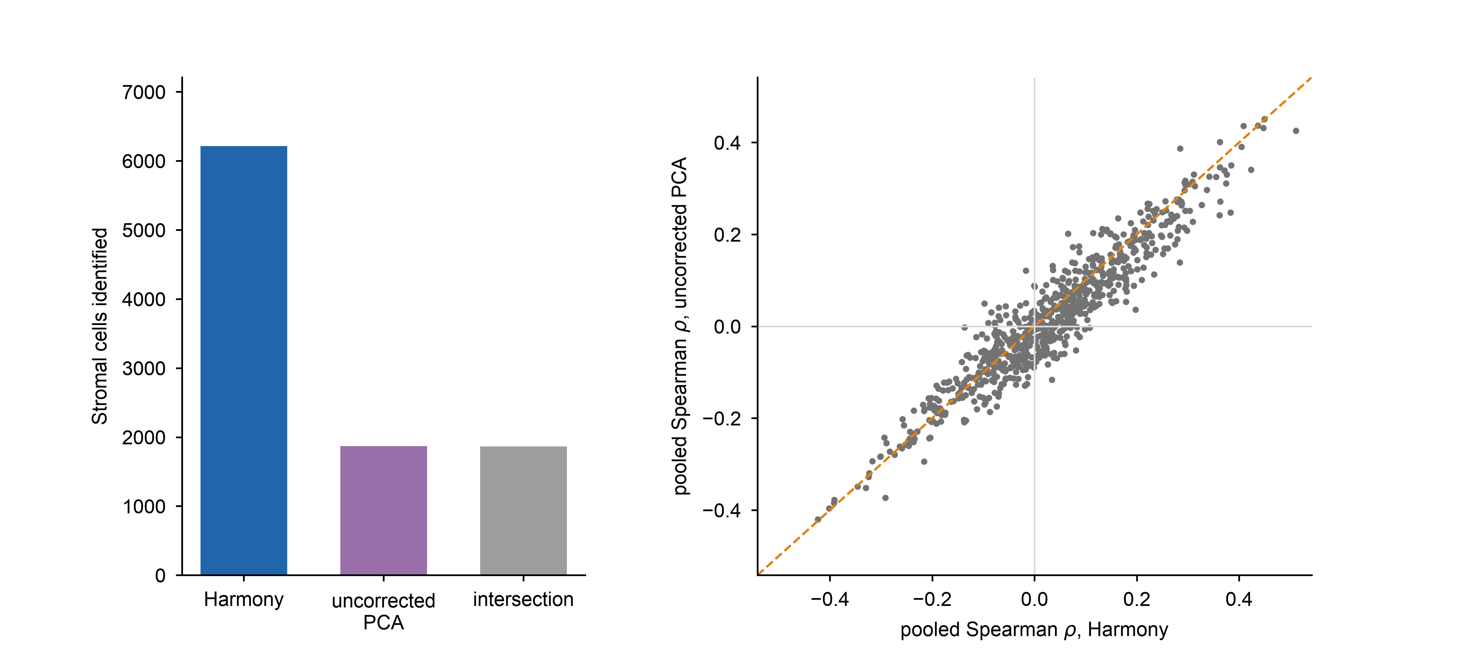
a
b
6,215
1,868
1,865

