Slide 1
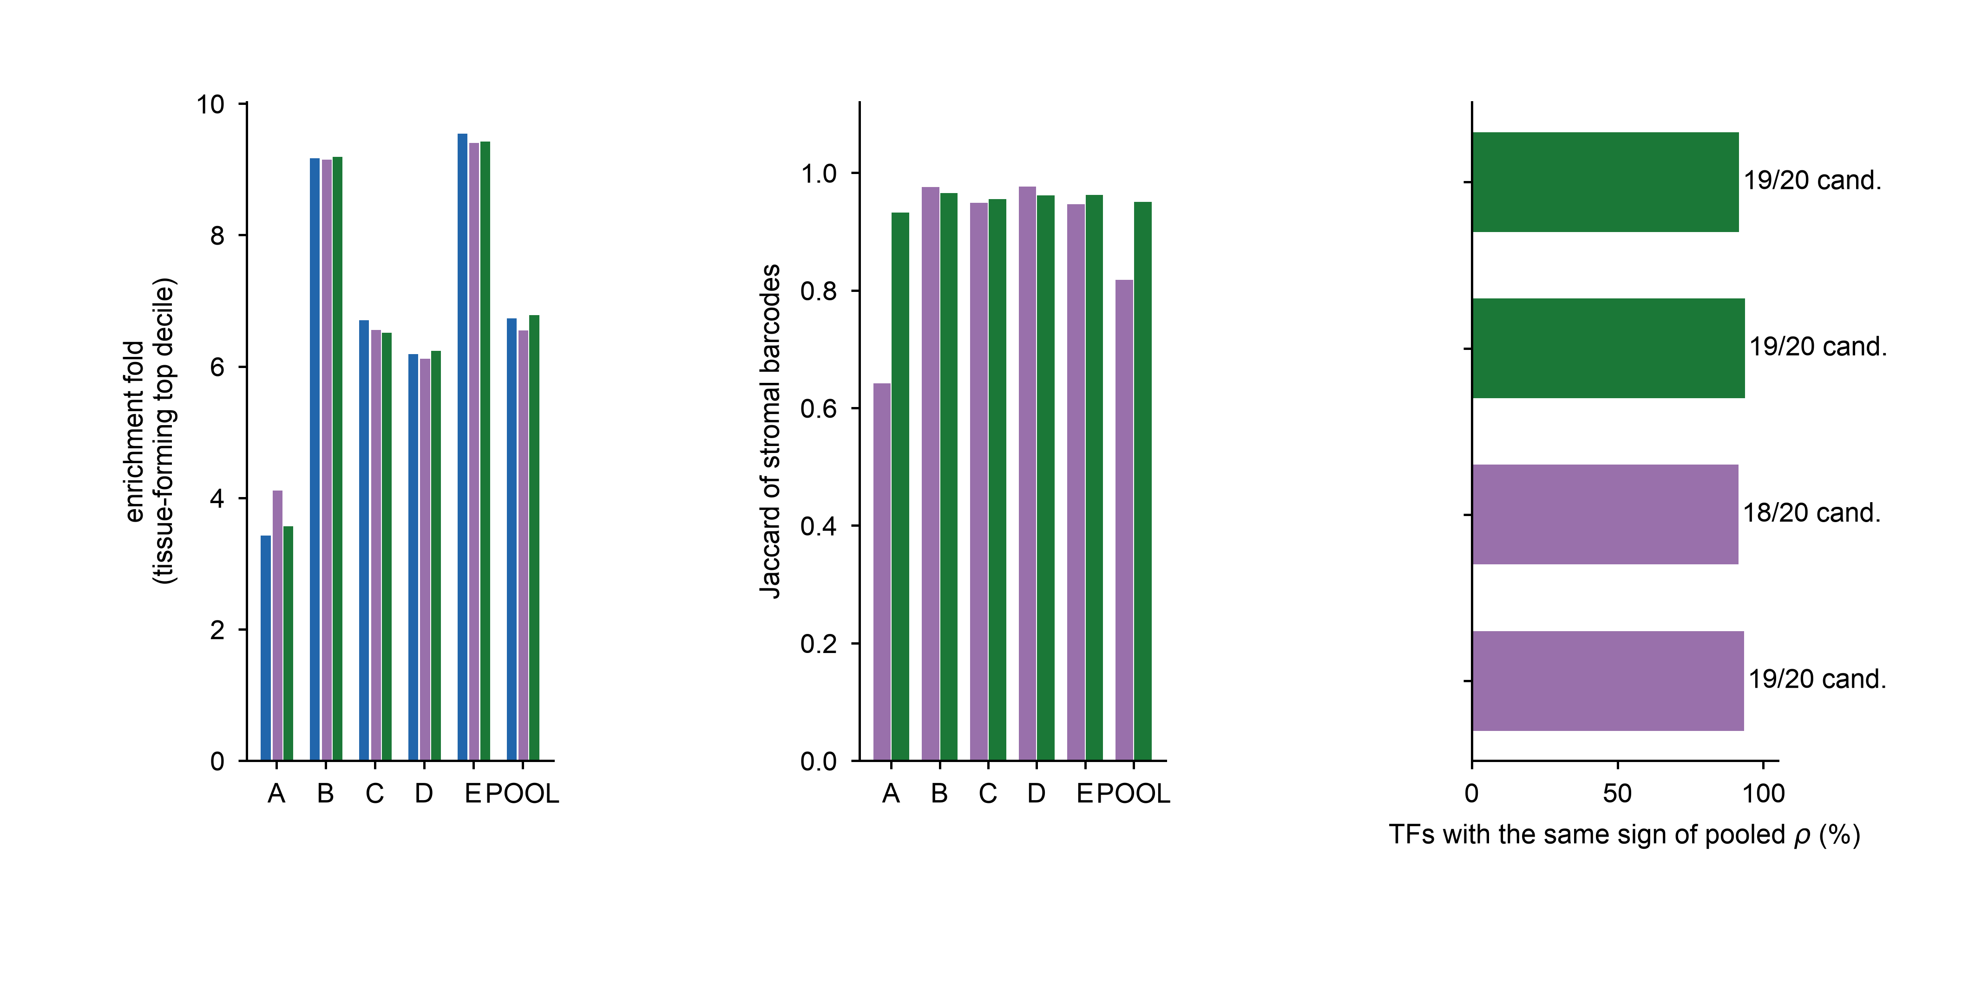
a
Enrichment
b
Stromal-set agreement
c
TF screen agreement
author matrix
re-quantified, all barcodes
Tissue-forming programme
matrix barcodes
re-quantified, matrix barcodes
Inflammatory programme
matrix barcodes
Tissue-forming programme
all barcodes
Inflammatory programme
all barcodes
vs re-quantified, all barcodes
vs re-quantified, matrix barcodes

