Slide 1
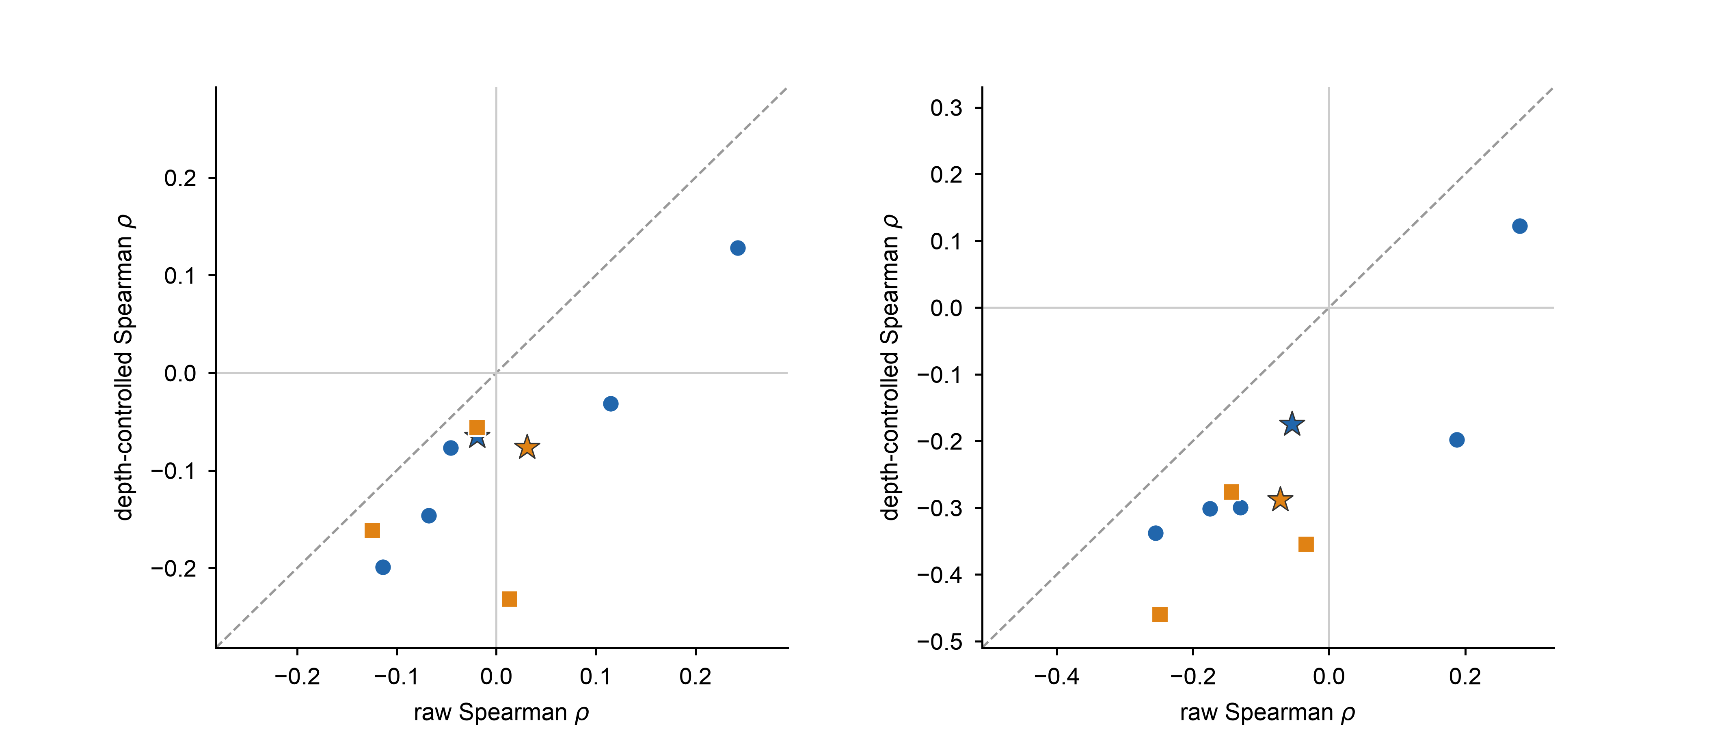
a
single-axis definition
b
composite definition
discovery (per lesion)
discovery (pooled)
validation (per lesion)
validation (pooled)

