Slide 1
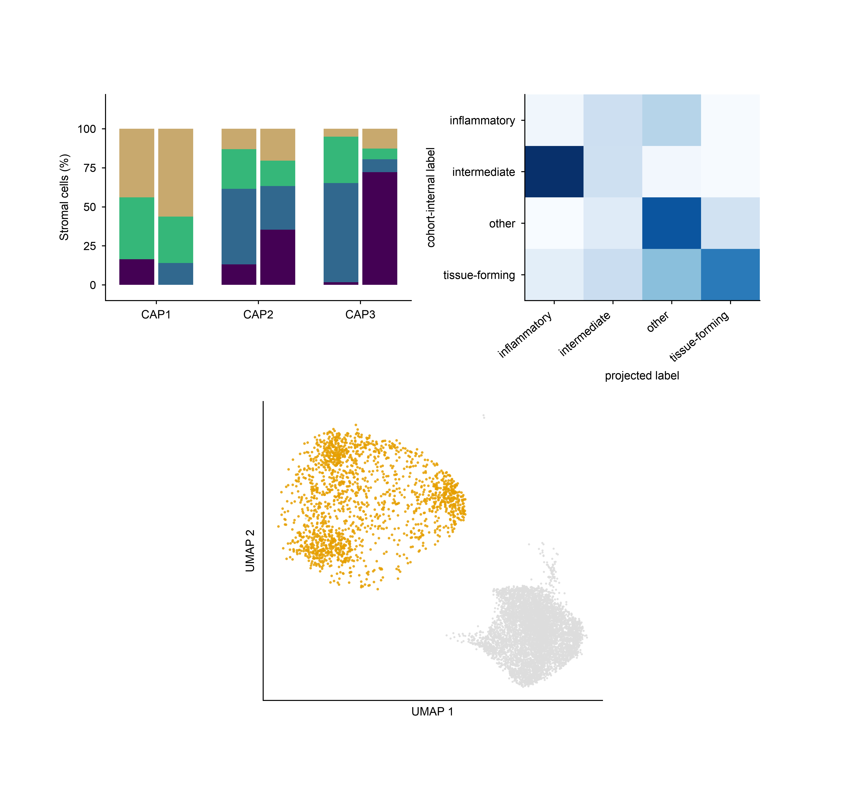
a
projected
projected
projected
b
Cell-level confusion
within
within
within
13
85
120
3
402
83
10
3
0
48
344
78
40
92
171
287
inflammatory
intermediate
tissue-forming
other
c
Validation projected onto the discovery embedding
Discovery (6,215)
Validation (1,779)

