Slide 1
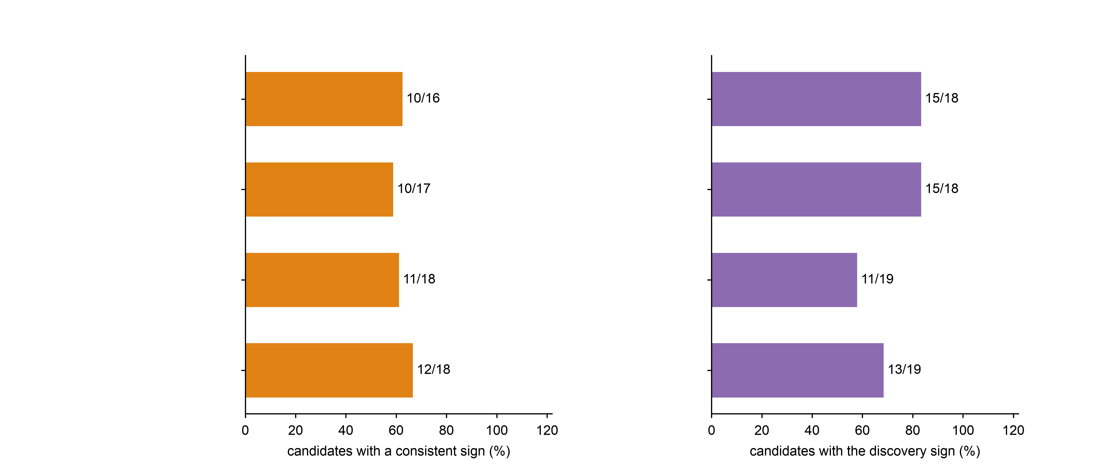
a
Validation cohort (3 lesions)
b
Independent cohort GSE164241
Proliferation + migration programme
Proliferation + migration programme
Migration programme
Migration programme
Proliferation programme
Proliferation programme
Survival / anti-apoptotic programme
Survival / anti-apoptotic programme

