Slide 1

Resource Model

Slide 2
Resource Model
Account
Database
Database
Database
Database
Database
Container
Database
Database
Item
Notes:
A tenant of the Cosmos DB service starts by provisioning a database account. A database account manages one or more databases. A Cosmos DB database manages users, permissions and containers. A Cosmos DB resource container is a schema-agnostic container of arbitrary user-generated JSON items and JavaScript based stored procedures, triggers and user-defined-functions (UDFs). Entities under the tenant’s database account – databases, users, permissions, containers etc. are referred to as resources.
Each resource is uniquely identified by a stable and logical URI and represented as a JSON document. The overall resource model of an application using Cosmos DB is a hierarchical overlay of the resources rooted under the database account, and can be navigated using hyperlinks. Except for the item resource, which is used to represent arbitrary user defined JSON content, all other resources have a system-defined schema.
Container and item resources are further projected as reified resource types for a specific type of API interface. For example, while using document-oriented APIs, container and item resources are projected as collection (container) and document (item) resources, respectively; likewise, for graph-oriented API access, the underlying container and item resources are projected as graph (container), node (item) and edge (item) resources respectively; while accessing using a key-value API table (container) and item/row (item) are projected.

Slide 3
アカウント URI と資格情報
Account
********.azure.com
Database
Database
Database
IGeAvVUp …
Database
Database
Container
Database
Database
Item

Slide 4
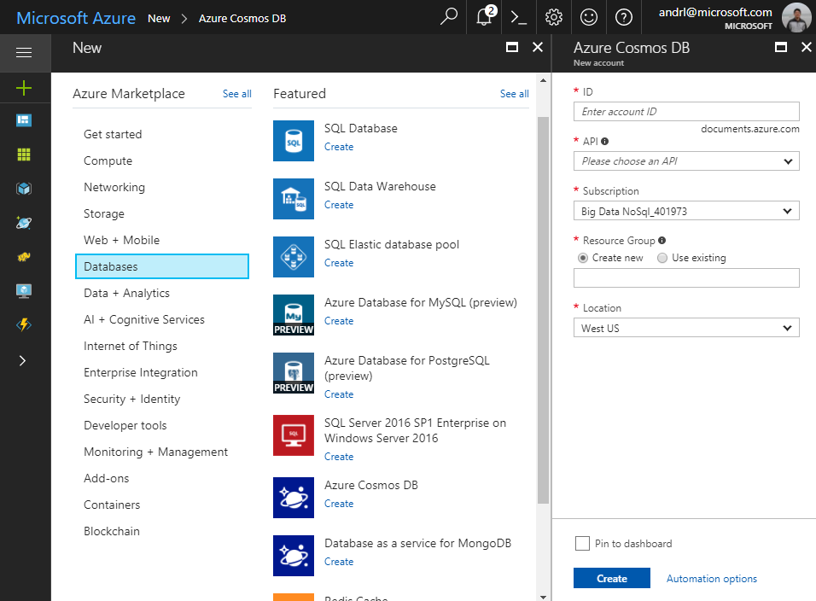
アカウントの作成
Account
Database
Database
Database
Database
Database
Container
Database
Database
Item

Slide 5
データベース
Account
データベースは1つ以上のコンテナーを包含している
Database
Database
Database
Database
Database
Container
Database
Database
Item

Slide 6
コンテナー
Account
コンテナーはコレクション、グラフ、テーブルのどれかで表現される
Database
Database
Database
Database
=
Database
Container
Collection
Graph
Table
Database
Database
Item

Slide 7
コレクションの作成 – SQL API
Account
Items – ドキュメント、グラフノード、行
Database
Database
Database
Database
Database
Container
Collection
Graph
Table
Database
Database
Item
Document Vertices/Edges Row

Slide 8
Containeコンテナーレベルのリソース
Account
ストアドプロシージャ、トリガー、独自関数はコンテナーに紐付く
Database
Database
Database
Database
Database
Container
Database
Database
Sproc
Trigger
UDF
Conflict
Item

Slide 9
System Internals

Slide 10
System design (logical)
Tenants
Follower
Follower
Collections
Graphs
Leader
Forwarder
Tables
Replica set
To a remote resource partition(s)
Container
Container
Container
Resource Partition
A consistent, highly available, and resource governed coordination primitive
Consists of a replica set with each replica hosting an instance of database engine
Uniquely belongs to a tenant
Owns a set of keys
Containers
…
Resource Partitions

Slide 11
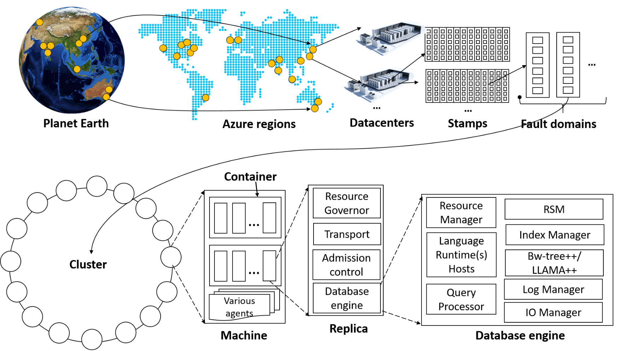
System topology (behind the scenes)
Notes:
The Cosmos DB service is deployed worldwide across all Azure regions including the sovereign and government clouds. We deploy and manage the Cosmos DB service on stamps of machines, each with dedicated local SSDs. The Cosmos DB service is layered on top of Azure Service Fabric, which is a foundational distributed systems infrastructure of Azure. Cosmos DB uses Service Fabric for naming, routing, cluster and container management, coordination of rolling upgrades, failure detection, leader election (within a resource partition) and load balancing capabilities. Cosmos DB is deployed across one or more Service Fabric clusters, each potentially running multiple generations of hardware and of varying number of machines (currently, between 60-800 machines).
Machines within a cluster typically are spread across 10-20 fault domains. The resource partitions is a logical concept. Physically, a resource partition is implemented in terms of a group of replicas, called replica-sets. Each machine hosts replicas corresponding to various resource partitions within a fixed set of processes. Replicas corresponding to the resource partitions are placed and load balanced across these machines. Each replica hosts an instance of Cosmos DB’s schema-agnostic database engine, which manages the resources as well as the associated indexes. The Cosmos DB database engine, in-turn, consists of components including implementation of several coordination primitives, the JavaScript language runtime, the query processor, the storage and indexing subsystems responsible for transactional storage and indexing of data, respectively. To provide durability and high availability, the database engine persists its index on SSDs and replicates it among the database engine instances within the replica-set(s) respectively. While the index is always persisted on local SSDs, the log is persisted either locally, on another machine within the cluster, or remotely across cluster or a datacenter within a region. The proximity of the index and log is configurable based on the price and latency SLA. The ability to dynamically configure the proximity between the database engine (compute) and log (storage) at the granularity of replicas of a resource partition is crucial for allowing tenants to dynamically select various service tiers.

