Slide 1


Introduction to Matplotlib
Joshua Liberman
Intro2Astro 2024

Slide 2
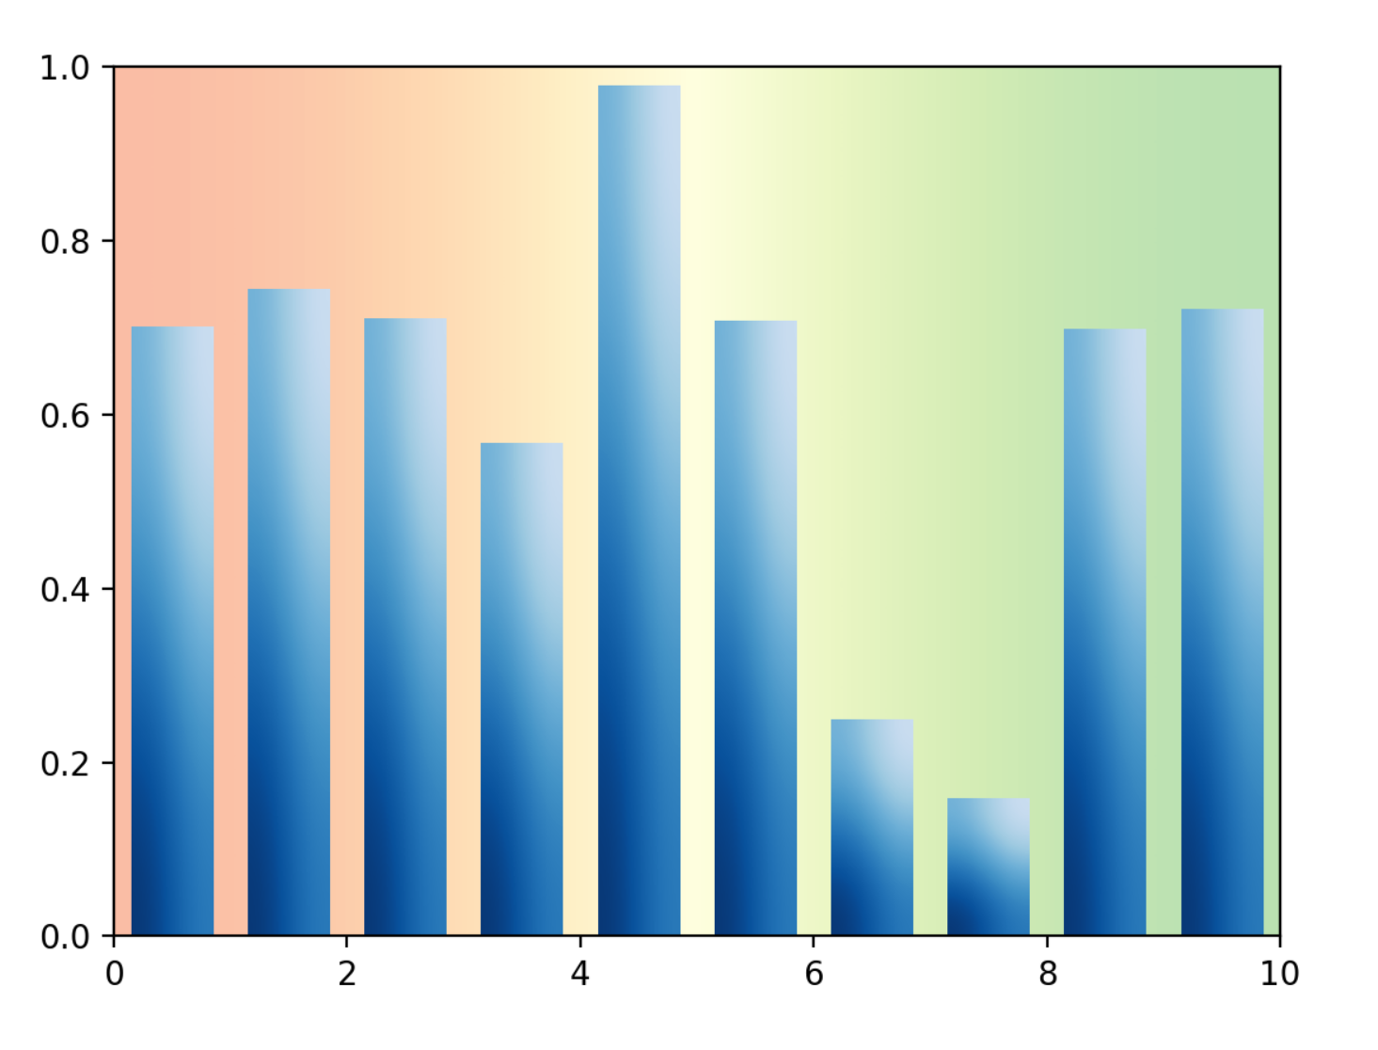
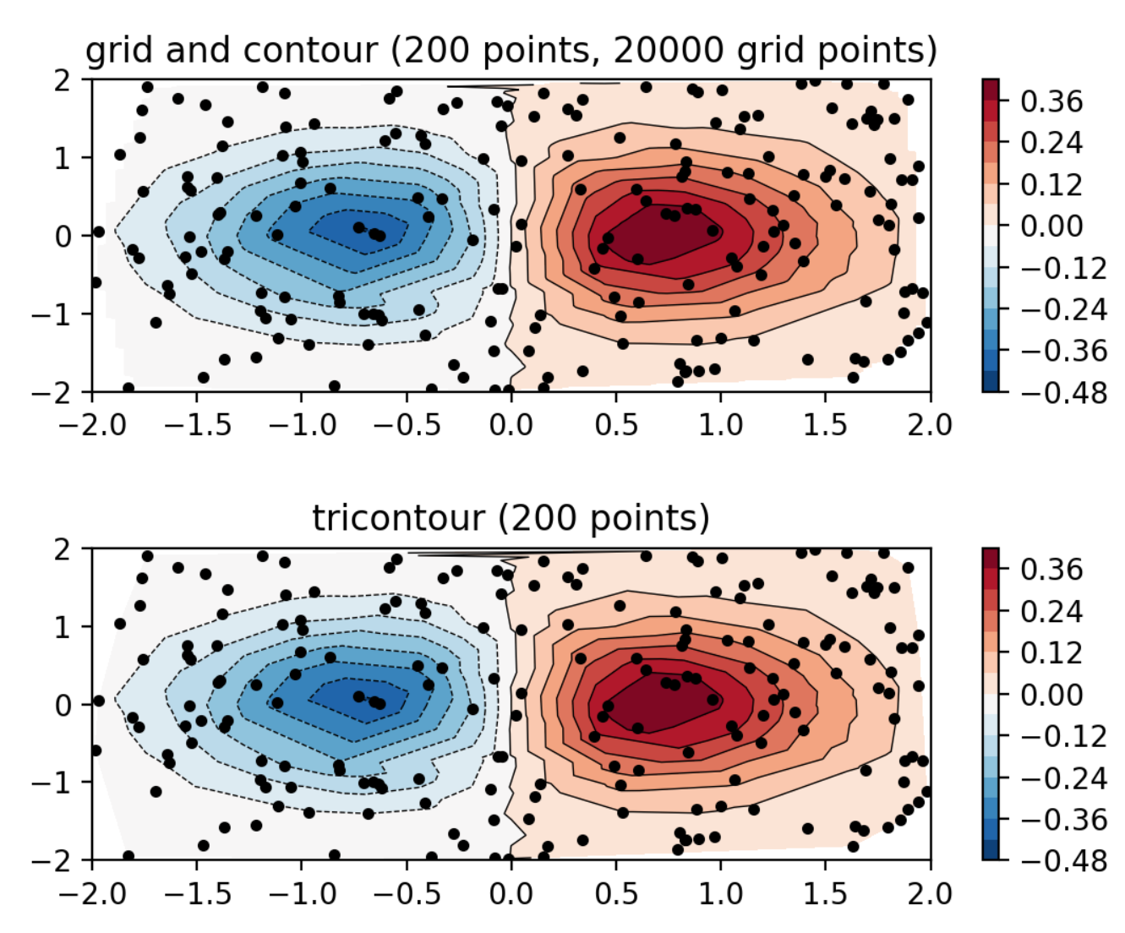
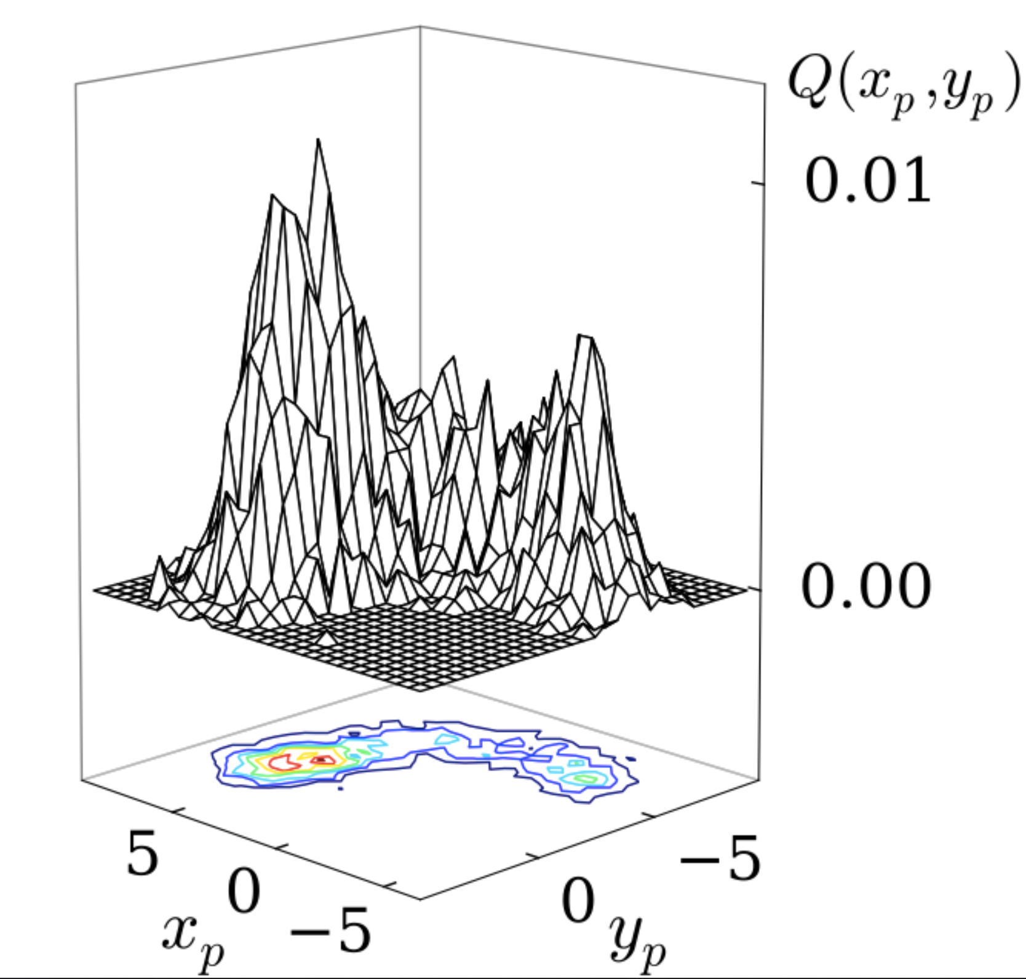
What is Matplotlib?
Plotting library for Python
Allows for powerful visualizations
Notes:
Explain each of these components in prep. for diagram

Slide 3
Installing Matplotlib
pip install matplotlib

Slide 4
Importing Matplotlib Plotting Functionality
Alias
import matplotlib.pyplot as plt
Library
Module
Notes:
You are going to be using this syntax a lot. Note that the alias, or name you assign to the module, can be anything but the standard convention for pyplot is to use ‘plt’.

