Slide 1
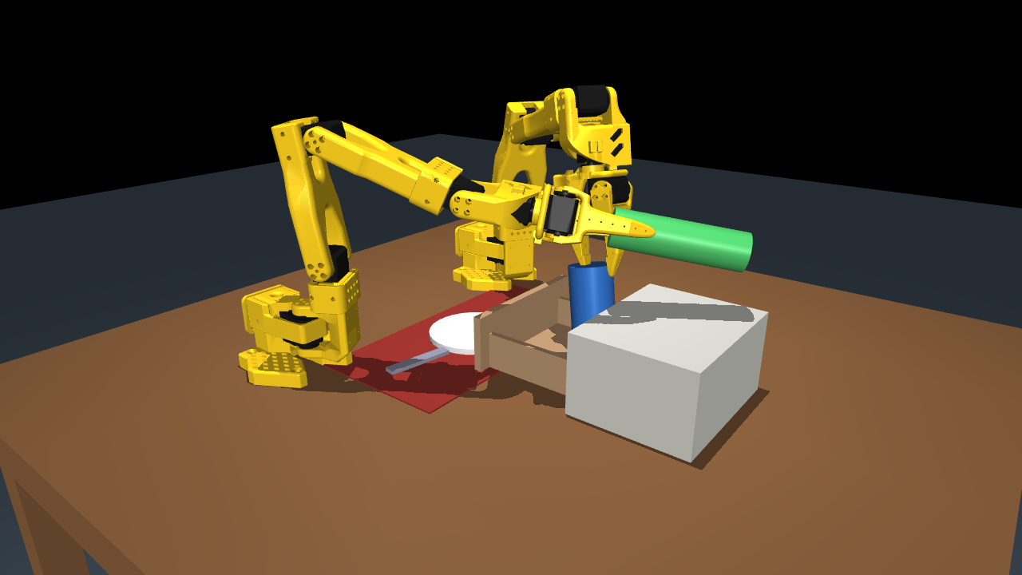
Table for Two
Two SO-101 arms set a dinner table from one sentence — planned and driven on OpenVINO
AI Infra Summit Hackathon · Intel Physical AI Online Challenge · September 2026
Notes:
One spoken sentence in, a fully set dinner table out. Two simulated SO-101 arms, a language planner and a visuomotor policy, all running on OpenVINO.

Slide 2
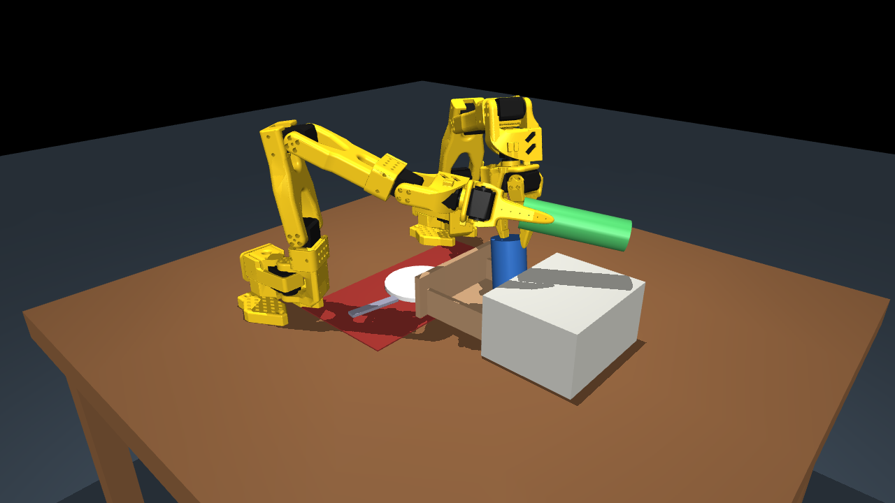
The brief: set a dinner table with two arms
Open the drawer and take out the spoon and fork
Hand the fork from one arm to the other
Put the plate on the placemat
Hold the mug with one arm while the other pours from the bottle
Follow a natural-language instruction; see the scene through cameras
Stay robust across 10 randomised scenes
MuJoCo · 2 × SO-101 · 12 position actuators · 3 cameras · 20 Hz control
Notes:
This is the brief's own scenario. We built the scene from scratch: the official SO-101 model twice, a cabinet with a sliding drawer, and the table-setting props.

Slide 3
How it works
Speech or text
Planner
Stage executor
ACT policy
MuJoCo
Speechmatics transcribes a spoken instruction
Qwen2.5-1.5B INT4 on OpenVINO GenAI writes a checked plan
Subtask token and grasp intent for each stage
2 cameras + 12 joints → 12 joint targets at 10 Hz, OpenVINO INT8
Dual SO-101 arms, drawer, plate, mug, bottle, utensils
Scripted IK skills generate the demonstrations and finish any stage the policy times out on (hybrid mode, reported separately).
Notes:
Hierarchical by design: learning a minute-long bimanual task end to end in a week is not realistic, so language planning and visuomotor control are separate, and every model runs through OpenVINO.

Slide 4
A planner that cannot hand the robot a bad plan
1
Compact plan language
"Hold the cup with the right arm and pour with the left."
pick_hold right mug ; pick_lift left bottle
pour left mug
return left bottle ; place right mug
home left ; home right
One stage per line, ~60 tokens instead of ~400 of JSON a 1.5 B model breaks.
2
Syntax + hand-state check
Known skills and objects; simulate what each hand holds — no pouring without the bottle.
3
Retry, repair, fall back
The model writes the compact plan; the parser turns it into the JSON the executor runs.
Errors go back to the model once; bad steps are dropped; a keyword planner is last resort.
2.12 s per plan on CPU · 2.22 s on Intel iGPU · 16 unit tests
Notes:
Arms are named by the user when they want; the plan is simulated for hand state before anything moves.

Slide 5
ACT policy trained on randomised demonstrations
50
32,285
20k
20
demonstrations
frames at 10 Hz
training steps
future actions per chunk
Inputs: overhead + operator camera (128 × 128), 12 joint positions, one-hot subtask from the planner
Output: the next 20 joint-target vectors; the arm executes 10 and re-plans every second
Demonstrations: scripted IK skills on randomised seeds (50 of 51 seeds kept); held-out seeds 0–9 never seen in training
Grasping is constraint-assisted: a closing gripper attaches the object it was sent for
Notes:
Training seeds start at 100 so the ten evaluation seeds stay unseen. The planner's subtask token is how language reaches the policy.

Slide 6
OpenVINO on Intel: INT8 policy in 5.9 ms
2.7×
faster with NNCF INT8 than FP32 on the same CPU
Action error after INT8: 0.02012 rad mean
Planner: INT4 LLM on OpenVINO GenAI, CPU and iGPU
IRs keep dynamic shapes; runtimes pin batch-1 shapes at load
Measured on Intel Core i9-14900HX + Raptor Lake iGPU; bench/benchmark.py reproduces every number on a Core Ultra in one command.
Notes:
The policy re-plans once per second, so even FP32 uses under two percent of the control budget; INT8 frees the CPU for simulation and the planner.

Slide 7
Results on 10 held-out randomised seeds
Sub-goal | Scripted | Learned policy | Hybrid
Drawer opened | 10/10 | 10/10 | 10/10
Spoon placed | 10/10 | 4/10 | 9/10
Fork handed off + placed | 10/10 | 5/10 | 9/10
Plate on placemat | 10/10 | 10/10 | 10/10
Mug placed | 10/10 | 10/10 | 9/10
Poured | 10/10 | 10/10 | 7/10
Full task | 10/10 | 4/10 | 6/10
Honest limits
Grasps are constraint-assisted, not finger-contact
Hybrid stages finished by a script are counted as assisted, never as policy wins
Benchmarked on Core i9 + iGPU; Core Ultra run is one command
Spoon: grasped in 10/10 seeds, set down 3.3–4.6 cm from target (pass line 3 cm). Pour: failed seeds stop at ~47° tilt.
Notes:
Randomisation per seed: object positions, masses, friction, lighting and table colour.

Slide 8
What's next
Contact-rich grasping
Core Ultra NPU
Real SO-101 arms
Replace the attach constraint with finger contact and train on it
Run the INT8 policy on the NPU and the planner on the iGPU concurrently
Same plan language and policy interface on two physical arms
Table for Two · code, benchmark and every number in this deck are reproducible from the repository
Notes:
Thank you. Everything shown is reproducible with the commands in the README.

