Slide 1
YOUTUBE TREND ANALYSIS
JAMES SPADAFORA , HAYOU LIU , YAXIN WAN , SUZANNE ZHEN , YUTA HAGIWARA

Slide 2
PROJECT DESCRIPTION
Analyze which factors will affect how popular a Youtube video will be
Investigate frequently used words and phrases in certain Youtube videos and correlate the relationship between words and popularity
Model and organize a database through coding to layout a table of most popular videos, from there, perform analysis on what helped certain videos to be popular
Our goal: help advertisers/sponsors decide what kind of video would be best to promote

Slide 3
HYPOTHESIS
Key words such as proper names of famous artists will most result in the most popular videos due to sheer name recognition
The more key words a Youtube video has to its title, the more likely it will be able to garner popularity through searches, views, likes, shares, etc.
Video will gain popularity through traction and time, with a peak that is followed by a gradual decline

Slide 4

OVERVIEW ABOUT YOUTUBE
ONLINE VIDEO-SHARING PLATFORM CREATED IN 2005
YOUTUBE HAS 2 BILLION MONTHLY ACTIVE USERS.
50 MILLION CONTENTS CREATORS ON YOUTUBE
5 BILLION VIDEOS ARE WATCHED PER DAY.
1 BILLION HOURS OF YOUTUBE CONTENT IS WATCHED PER DAY.
73% OF US ADULTS USE YOUTUBE.

Slide 5
Data Set
(Trending Youtube Video Statistics)
The data set we pulled from takes into account several months of data of trending Youtube videos globally
To determine top trending YT videos, the website takes into consideration the amount of activity surrounding the video, this includes: views, shares, comments, likes, buzz on other social platforms, etc.
Source: https://www.kaggle.com/datasnaek/youtube-new#US_category_id.json
Notes:
len(set(vid_data_df['title'])) -> 6455 videos total

Slide 6
Data Sets
(Trending YouTube Video Statistics)
video_id | trending_date | title | channel_title | publish_time | tags | views | likes | dislikes | comment_count | description | category_name
0 | 2kyS6SvSYSE | 2017-11-14 | WE WANT TO TALK ABOUT OUR MARRIAGE | CaseyNeistat | 2017-11-13 17:13:01+00:00 | SHANtell martin | 748374 | 57527 | 2966 | 15954 | SHANTELL'S CHANNEL - https://www.youtube.com/s... | People & Blogs
1 | 1ZAPwfrtAFY | 2017-11-14 | The Trump Presidency: Last Week Tonight with J... | LastWeekTonight | 2017-11-13 07:30:00+00:00 | last week tonight trump presidency|"last week ... | 2418783 | 97185 | 6146 | 12703 | One year after the presidential election, John... | Entertainment

Slide 7
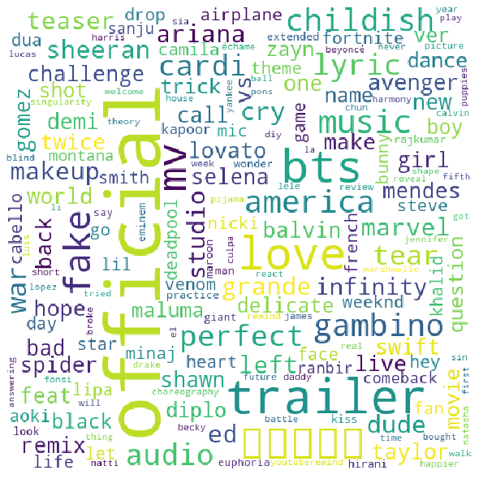
TECHNOLOGY USED
PANDAS: DATA MANIPULATION AND ANALYSIS
WORD CLOUD : DATA VISUALIZATION TECHNIQUE USED FOR REPRESENTING TEXT DATA IN WHICH THE SIZE OF EACH WORD INDICATES ITS FREQUENCY OR IMPORTANCE.
MATPLOTLIB: A PLOTTING LIBRARY FOR THE PYTHON
SQL : Programming and designed for managing data held in a relational database management system

Slide 8
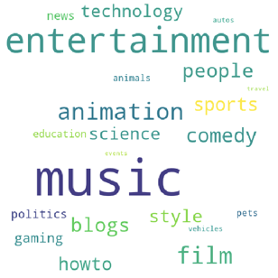
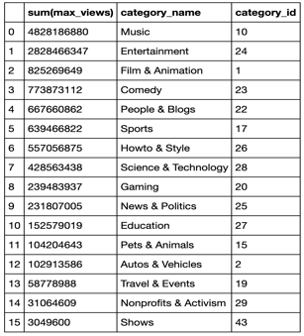
BY CATEGORY
cloud(vid_data_df,"category_name",["views"])

Slide 9
By Category Observations
The videos in the database were established into categories to differentiate genres for the most popular YT videos
Our code sorted through, organized the videos by genre type, and found the most frequented videos, The photo above signifies popularity of the genre by size of the text
Overall: music, entertainment, film, and comedy were the most frequented while travel, nonprofits, and shows generated the least amount of viewer activity
Conclusion drawn: Sponsor/Partnership expenses is probable to be much more expensive for the popular genres due to sheer market advantage, and is something advertisers should take into account

Slide 10
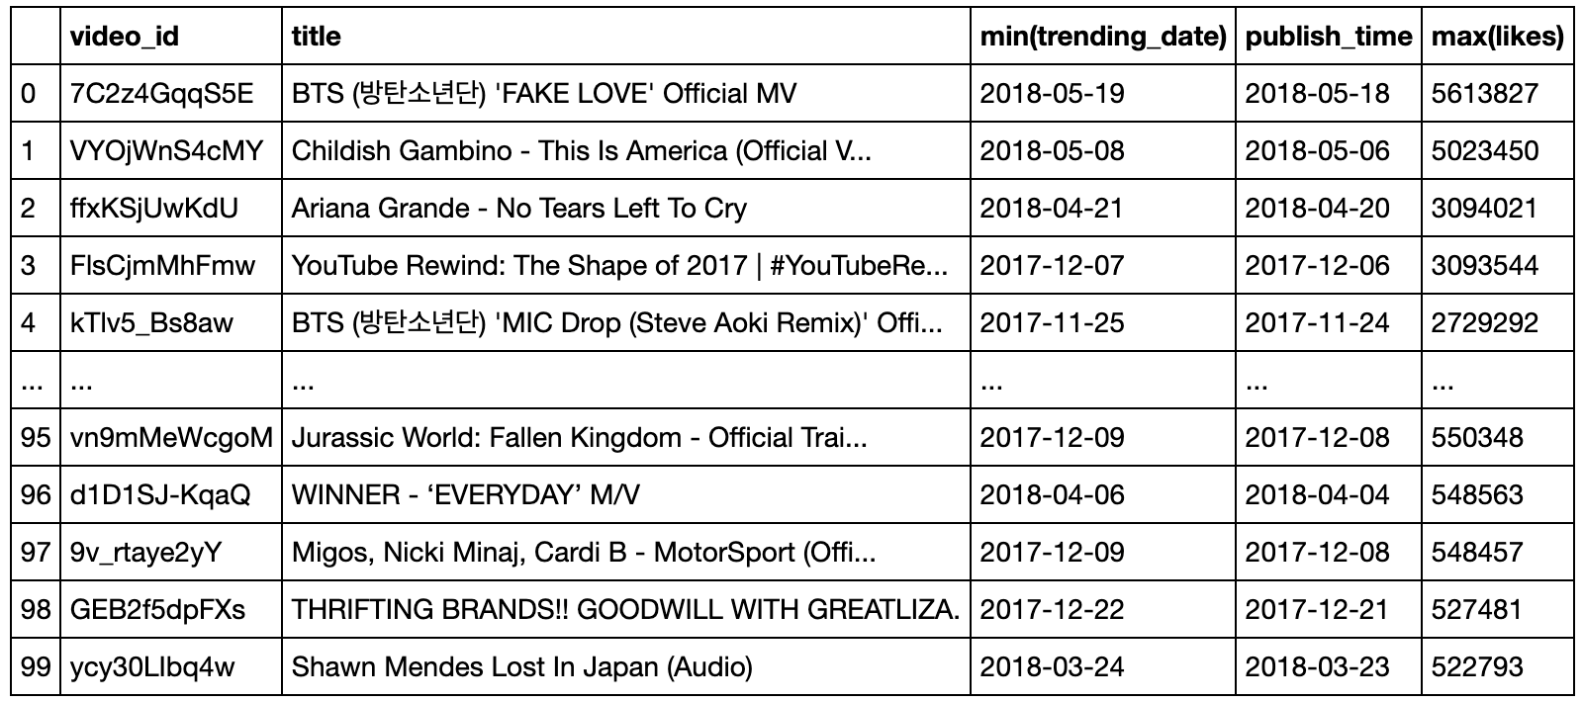
TREND BY LIKES & PUBLISHED DATE

Slide 11
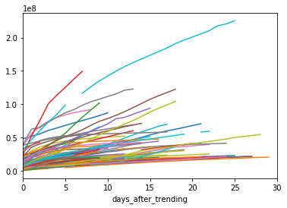
DAYS TRENDING GRAPH

Slide 12
Days Trending Graph Observation
The days trending graph showcases how long a video stays in a “trending” status after its original post date
Due to social marketing, we tend to see consistent growth in videos over a 30 day period, usually the first month is a consistent growth and attraction period, with extreme cases like the outlier showing that sometimes there is a second wave of popularity
Overall conclusion could be made for advertisers that entry into a video sponsorship should be made right away, and they can ride the wave with the video as its “trending” status grows, as it will more than likely die out after the first 30 day period

Slide 13
Overall Conclusion
Shown by both the most frequented words in YT video titles and by the most frequented genres, music videos are definitely the most trended videos on the web
Videos also have a long lifespan to go trending, as most are seen to still be growing within a 30 day period, however, the first month tends to be the best for monetization and ad revenue generation
Advertisers should take this into account when choosing to sponsor or endorse certain videos

