Slide 1
CUSTOMER
SHOPPING
BEHAVIOR
ANALYSIS
3,900
18
Customers
Columns
10
4
Data Analytics Portfolio Project
Python
SQL Server
Power BI
SQL Queries
Categories

Slide 2
Project Overview
2/8
OBJECTIVE
Build an end-to-end analytics pipeline: clean raw retail data, load to SQL Server, write 10 business queries, and visualise all insights in an interactive Power BI dashboard.
01
02
03
04
Data Collection
Data Cleaning
SQL Analysis
Power BI
3,900 records
18 columns
4 categories
Kaggle CSV
Null imputation
Column standardisation
Feature engineering
Duplicate removal
SQL Server Express
10 business queries
CTEs, window fns
Correlated subqueries
Live SQL connection
KPI cards & charts
Donut + slicers
Cross-filter interactivity
Customer Shopping Behavior Analysis · Data Analytics Portfolio

Slide 3
Data Cleaning & Feature Engineering
3/8
DATASET SUMMARY
CLEANING PIPELINE
Records
3,900
1
Missing Value Imputation — category-wise median
Columns (raw)
19
2
Column Standardisation — lowercase + underscores
Columns (clean)
18
3
Column Rename — purchase_amount_(usd) → purchase_amount
Null values in
Review Rating
New features
age_group, freq_days
4
Age Group Binning — quartile segmentation (4 groups)
Final shape
3,900 × 18
5
Frequency Mapping — text labels → integer day values
6
Duplicate Removal — promo_code_used column dropped
Customer Shopping Behavior Analysis · Data Analytics Portfolio

Slide 4
SQL Business Queries
4/8
#
Business Question
SQL Technique
Q1
Revenue by gender
GROUP BY gender + SUM(purchase_amount)
Q2
Discount users above average spend
Correlated subquery: WHERE amount ≥ AVG(...)
Q3
Top 5 products by avg review rating
TOP 5 + AVG(CAST(rating AS FLOAT)) + ROUND
Q4
Avg spend: Standard vs Express shipping
GROUP BY shipping_type + WHERE IN(...)
Q5
Subscribed vs non-subscribed spend
GROUP BY subscription_status + COUNT(*) + SUM
Q6
Top 5 products by discount rate
100 * SUM(CASE WHEN discount) / COUNT(*)
Q7
Customer segmentation (CTE)
CTE + CASE WHEN on previous_purchases
Q8
Top 3 products per category
CTE + ROW_NUMBER() OVER(PARTITION BY category)
Q9
Repeat buyers & subscription correlation
WHERE previous_purchases > 5 + GROUP BY
Q10
Revenue by age group
GROUP BY age_group + SUM ORDER BY DESC
Customer Shopping Behavior Analysis · Data Analytics Portfolio

Slide 5
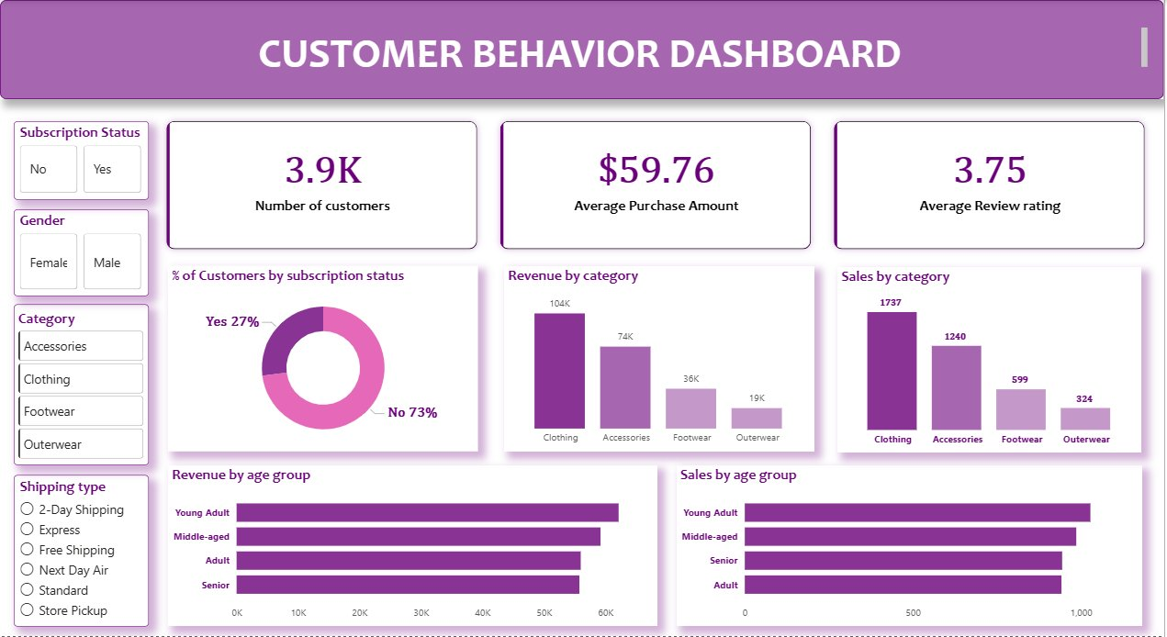
Power BI Dashboard
5/8
Customer Shopping Behavior Analysis · Data Analytics Portfolio

Slide 6
Key Insights & Business Findings
6/8
01
Revenue & Category
02
Customer Demographics
▸ Clothing: $104K — 44% of total revenue
▸ Young Adults & Middle-aged lead revenue + volume
▸ 2.9× higher revenue than Footwear ($36K)
▸ Senior segment ranks 3rd — high-value, often overlooked
▸ Revenue rank: Clothing > Accessories > Footwear > Outerwear
▸ CTE segmentation: majority are Returning (2–10 purchases)
03
Subscriptions & Loyalty
04
Discounts & Promotions
▸ Only 27% subscribed — 73% is an upsell opportunity
▸ Discount users still spend above average (Q2)
▸ Subscribers generate materially higher avg spend (Q5)
▸ Top discount products maintain strong ratings (Q6)
▸ Loyalty drives subscription conversion, not the reverse (Q9)
▸ Strategy raises volume without hurting basket value
Customer Shopping Behavior Analysis · Data Analytics Portfolio

Slide 7
Technology Stack
7/8
Python 3 / pandas
SQL Server Express
Power BI Desktop
VS Code
Data Cleaning & Engineering
Relational Database
Business Intelligence
Development Environment
▸ Null imputation via groupby + transform
▸ SQLAlchemy + pyodbc connection
▸ Live direct SQL Server connection
▸ Python & SQL Server extensions
▸ qcut() quartile binning for age groups
▸ df.to_sql() bulk upload (3,900 rows)
▸ KPI cards, bar charts, donut chart
▸ Script editing and debugging
▸ Text-to-integer dictionary mapping
▸ T-SQL: CTEs, window functions, subqueries
▸ 4 interactive cross-filter slicers
▸ Git source control
▸ Column standardisation & deduplication
▸ 10 structured business queries
▸ Purple theme dashboard
▸ Jupyter-style cell execution
Customer Shopping Behavior Analysis · Data Analytics Portfolio

Slide 8
DELIVERABLES
PROJECT
SUMMARY
✓
customer_shopping_behavior.csv — 3,900 records
✓
CSB.py — exploratory data analysis
✓
Connect_to_Data_Base.py — cleaning + SQL upload
End-to-end production-grade
data analytics portfolio project
built for client presentation.
✓
Data_Base.sql — 10 T-SQL business queries
✓
Power BI Customer Behavior Dashboard
Data Wrangling
SQL Analytics
Professional portfolio documentation (DOCX)
✓
Business Intelligence
Feature Engineering
✓
Client presentation deck (PPTX)
Data Visualisation
Problem Solving
Customer Shopping Behavior Analysis · Data Analytics Portfolio

