Slide 1

sv-weave
Write the class you meant to write.
Factory weaving for SystemVerilog class libraries
Notes:
sv-weave lets engineers write plain SystemVerilog classes and get expert-quality implementations of the library hooks generated for them. The pitch in one line: only the people who build the library learn the generator; everyone else just gets better components.

Slide 2
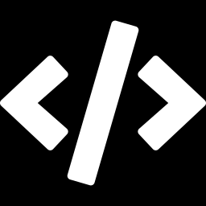
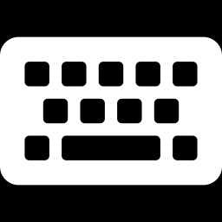
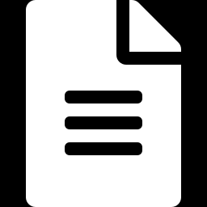
Today's options all leak expertise
Field macros
Hand-written hooks
YAML generators
Slow at run time
Opaque in the debugger
Behaviour hidden in macros
~40 lines per class
Drift when fields change
Silent scoreboard holes
Two sources of truth
A generator to maintain
Generated + hand code to merge
Common failure: every class author has to learn the mechanism.
Notes:
Three ways teams avoid boilerplate today. Macros cost run time and hide behaviour. Hand-written hooks drift: add a field, forget do_compare, and the scoreboard silently stops checking it. YAML generators create a second source of truth and a merge problem. The common failure: the expertise is spread across everyone who writes a class.

Slide 3
Write the class you meant to write
Before: field macros
After: sv-weave
class bus_tx extends uvm_sequence_item;
rand bit [31:0] addr;
rand bit [31:0] data;
rand bit [7:0] payload[];
`uvm_object_utils_begin(bus_tx)
`uvm_field_int(addr, UVM_ALL_ON)
`uvm_field_int(data, UVM_ALL_ON)
`uvm_field_array_int(payload,
UVM_ALL_ON)
`uvm_object_utils_end
endclass
class bus_tx extends uvm_sequence_item;
`uvm_object_utils(bus_tx)
rand bit [31:0] addr;
rand bit [31:0] data;
rand bit [7:0] payload[];
(* weave_nocopy *) int n_retries;
endclass
// copy, compare, print: generated
// add a field -> it's handled
Plain fields. Attributes only where you want something other than the default.
Notes:
Left: the macro version everyone has written. Right: the class you meant to write. No field macros, no hand-written do_copy. An attribute such as weave_nocopy is the only thing a consumer ever adds. Add a field six months from now and it is copied, compared and printed on the next build.

Slide 4

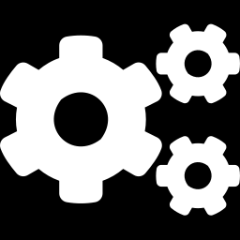

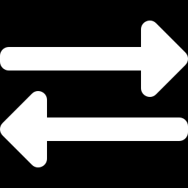
How it works
1. Read
2. Weave
3. Verify
4. Substitute
slang parses your real sources. No second description.
Weavers generate a subclass that implements the library's hooks.
slang elaborates the generated code with your design.
The library's own factory hands out the woven class.
Your source is never edited. Your code never names generated code. Generator errors point at the weaver, not at a 3-hour regression.
Notes:
Four stages. slang reads the real sources. Weavers generate a subclass of each matching class that implements the library hooks for exactly its fields. Before anything is written, slang elaborates the generated code together with the design, and errors are attributed to the weaver that produced the line. Then the library's own factory, the mechanism UVM already has, hands out the woven class wherever the original is created. Overrides still resolve as before.

Slide 5
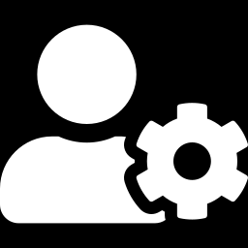
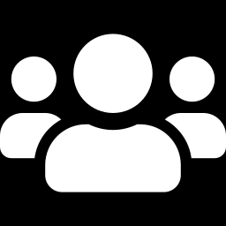
Only producers learn the generator
Producers
Consumers
Methodology team, VIP and protocol-package authors
Testbench and test writers: most of the team
Write weavers (Python) and base classes
Encode how copy, compare, build, ... should work
Fix once; every consumer gets it
Write ordinary SV classes
Add an attribute when the default isn't right
Learn nothing new
expertise, once
Notes:
The key point. Producers, the people who own the library, learn the generator and put their expertise into weavers once. Consumers write ordinary classes and get correct, fast, consistent implementations. A library now ships with its generator: improve a weaver and every testbench that uses the library gets the change on its next build, with no change to consumer code.

Slide 6
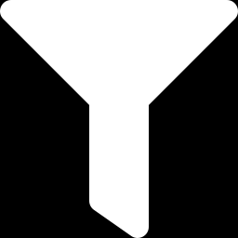
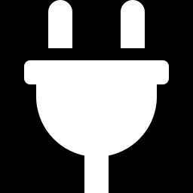
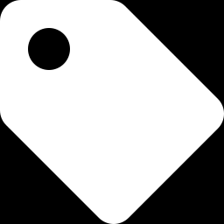
A weaver is a few lines of Python
class PrintFields(plugin.Weaver):
name = "print-fields"
def subscribe(self, bus):
bus.on(extends_root(), self.weave)
def weave(self, w):
p = w.feature("print")
for f in w.fields():
if f.static or not w.sv.accessible(f):
continue
p.body.add(...) # one line per field
Subscribes by pattern
Base class, package, name or attribute.
Targets features, not methods
One copy weaver works with every binding.
Consumers see attributes
weave_nocopy, weave_deep, weave_off
Notes:
This is a complete weaver from the quickstart. It subscribes to every class under the binding's root, and contributes one line per field to the print feature. Weavers contribute to features such as copy or print, never to a library's method by name, so the binding maps them onto do_copy for UVM or onto another library's hook. Consumers never see this code; they see attributes.

Slide 7
Faster, and it stays correct
 | Field macros | Hand-written | sv-weave
Run-time cost | High | Low | Low
Stays in step with fields | Yes | No | Yes
Readable in the debugger | No | Yes | Yes
Lines per class | 1 per field | ~40 | 0
Who must know the mechanism | Everyone | Everyone | Library owners
Woven code is plain field-by-field SV: what an expert writes by hand, generated for every class.
Notes:
Woven code is performance-neutral to hand-written hooks and faster than field macros, because it is the same plain field-by-field code an expert would write. Unlike hand-written hooks, it never drifts from the fields. And only the library owners need to know how it works.

Slide 8

Release and debug from one source
profiles:
release: [core]
debug: [core, "debug.*"]
weavers:
- {name: copy}
- {name: compare}
- {name: xcheck, set: debug.xcheck}
- {name: trace, set: debug.trace}
Debug sets cannot change your stimulus
No rand fields or constraints
No randomize() calls
No threads or delays
Every debug fragment runs inside an RNG fence
Both built side by side; chosen at run time with +weave_profile=debug
Enforced by the tool, not by convention.
Notes:
Weavers belong to extension sets; profiles are lists of sets. Release and debug are generated side by side and selected at run time. Non-core sets are checked: they cannot add rand fields, call randomize, fork or add delays, and each debug fragment is wrapped in an RNG fence that saves and restores the thread's random state, so even library calls that allocate don't shift seeds.

Slide 9
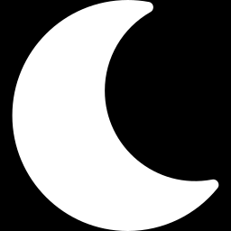
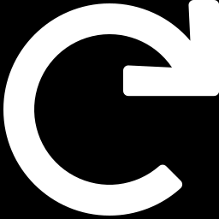
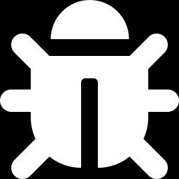
Replay a failing seed with full debug
Overnight
Morning
Same failure
Seed 1234 fails in the release regression.
Rerun seed 1234 with +weave_profile=debug.
Same stimulus, with X-checks, tracing and recording on.
simv +UVM_TESTNAME=smoke +ntb_random_seed=1234 // release
simv +UVM_TESTNAME=smoke +ntb_random_seed=1234 +weave_profile=debug // same stimulus
Notes:
This is the workflow regressions have always wanted. Because the debug profile is guaranteed not to perturb randomization, the exact failing seed can be rerun with every check turned on, and it reproduces the same stimulus. No source change, no rebuild of the testbench code.

Slide 10
Not just UVM
Weavers
Features
Bindings
copy
copy
UVM 1.2
compare
compare
IEEE 1800.2
print
print
In-house library
xcheck
pack
fw-hdl classes
your own
post_build
Written once, against features. A binding maps each feature to one library's hook and factory.
Notes:
Weavers contribute to features, which a binding defines. The binding maps each feature to one library's hook, for example copy to do_copy with a cast in UVM, and says how woven classes register with that library's factory. So a copy weaver works for UVM, for an in-house library, or for synthesizable class code on the fw-hdl path. UVM version differences live in the binding, not in consumer code.

Slide 11
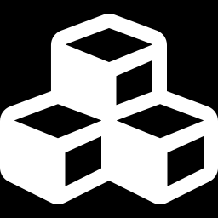
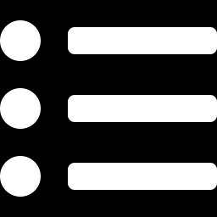
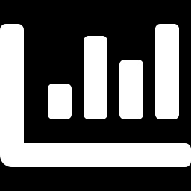
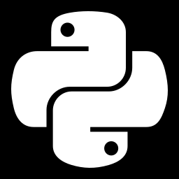
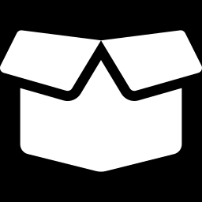
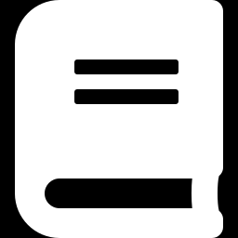
What's next: SV introspection
SystemVerilog has no reflection. Weavers can query the whole design, and the same model can drive outputs beyond SV.
Component construction
Registries
Coverage
build_phase and connections from declared handles
Every sequence and test, found automatically
Bins from what your constraints can reach
Language mirrors
Protocol packages
Docs and schemas
Python and C++ types for cocotb and DPI
Ship base classes with their weavers
Transaction docs, recording schemas
Notes:
Where this goes next. Because weavers can query the whole design, they can generate code about sets of classes, such as registries and selectors. And because the model is an SV-introspection pipeline, the same classes can drive coverage whose bins come from constraint reachability, Python and C++ mirrors, regression lists and documentation. Each is a weaver or emitter a producer writes once.

Slide 12
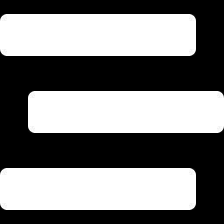
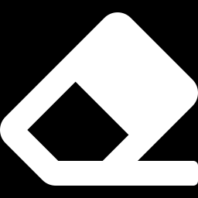

Adopt it one class at a time
1
Add the weave task
One svweave.Weave task in your dv-flow, next to compilation.
2
Drop boilerplate
Remove field macros class by class. Existing hand-written hooks keep working.
3
Move expertise into weavers
Library owners turn conventions into weavers, once.
Notes:
Adoption is incremental. Add the weave task to the flow. Remove field macros one class at a time; woven code runs after super, so classes with hand-written hooks keep working. Then library owners move the team's conventions into weavers.

Slide 13
Write the class you meant to write.
Let the people who know the library make it right: once, for everyone.
Start here
Quickstart: docs/quickstart.rst, examples/quickstart/
Class writers: docs/user/attributes.rst
Library owners: docs/authoring/weavers.rst, bindings.rst
Notes:
Close on the one-liner. Point class writers at the attributes page and library owners at the weaver and binding authoring guides.

