Slide 1

Advanced Neural Network Architecture for Brain Lesion Identification
SRM INSTITUTE OF SCIENCE AND TECHNOLOGY
SCHOOL OF COMPUTING
DEPARTMENT OF COMPUTING TECHNOLOGIES
18CSP107L / 18CSP108L - MAJOR PROJECT / INTERNSHIP
Guided By –
Dr. S. Babu
(Associate Professor) Department of Computing Technologies
Shreya Abraham Varghese
(RA20110030010516)
Vaibhav Parihar
(RA2011003010520)

Slide 2
ABSTRACT
This project aims to conduct a comprehensive comparative analysis of three deep learning algorithms, namely VGG16, InceptionV3, and Xception, for the detection of brain tumors from MRI images. The study evaluates and compares the performance of these algorithms in terms of accuracy, precision, recall, and computational efficiency. Through rigorous testing and analysis, the project seeks to identify the most effective algorithm for accurate and reliable brain tumor detection, contributing to advancements in medical diagnostics and patient care.

Slide 3
INTRODUCTION
The introduction provides an overview of the project, highlighting the significance of automated brain tumor detection in medical imaging. It introduces the three deep learning algorithms - VGG16, InceptionV3, and Xception - and outlines the objectives of the comparative analysis. Additionally, the introduction sets the context for the study, emphasizing the importance of accurate and efficient brain tumor detection for early diagnosis and treatment planning.

Slide 4
MOTIVATION
The motivation behind this project stems from the growing importance of automated medical diagnostics in improving patient outcomes and healthcare efficiency. Manual interpretation of MRI images for brain tumor detection is time-consuming and prone to human error. By leveraging deep learning algorithms, we aim to develop a more efficient and accurate solution for automated brain tumor detection. The comparative analysis is motivated by the need to identify the most suitable algorithm for real-world applications, ultimately benefiting patients and healthcare providers.

Slide 5
LITERATURE REVIEW
Section | Key Points
CNN Model Architecture (Figure 1) | The CNN model is designed from scratch for brain tumor detection, involving rescaling of input images, convolution, batch normalization, and max-pooling layers. The final layers include Flatten and Dense layers for classification into brain tumor or normal categories. The model comprises 21 layers with a total of 15,029,538 parameters. Trainable parameters are 15,028,322, and non-trainable parameters are 1,216.
Dataset Information | The dataset consists of 251 MRI scans of brain images, categorized into those with identified brain tumors (154 images) and normal brain tissue (97 images).
Data Augmentation | Data augmentation techniques are employed to increase the dataset size artificially, addressing limitations due to dataset scarcity or imbalance. Techniques include flipping, rotating, cropping, zooming, adjusting brightness and contrast, adding noise, and changing color for image data. The study employs horizontal and vertical flipping, zooming, and brightness adjustments.
Simulation Parameters | The simulation is run for 100 epochs using the Adam optimizer, a batch size of 32, and a learning rate of 0.001.
Confusion Matrix | A confusion matrix is used to evaluate the model's performance on a test dataset. The binary confusion matrix includes True Positive (TP), False Positive (FP), True Negative (TN), and False Negative (FN). The values in the matrix are 17, 25, 2, and 5, respectively. These values can be utilized to calculate various performance metrics such as accuracy, precision, recall, and F1-score.

Slide 6
CHALLENGES AND LIMITATIONS IN THE EXISTING PROJECT
Existing systems for brain tumor detection from MRI images face several challenges and limitations, including variability in image quality, class imbalance in the dataset, and interpretability of deep learning models. These challenges can affect the performance and reliability of automated detection systems, leading to inaccurate or inconsistent results. Additionally, computational resource requirements and scalability issues pose practical challenges for deploying deep learning algorithms in real-world healthcare settings. Addressing these challenges is crucial for developing robust and effective solutions for automated brain tumor detection.

Slide 7
OBJECTIVES
The primary objective of the project is to conduct a comparative analysis of VGG16, InceptionV3, and Xception algorithms for brain tumor detection from MRI images. Specific objectives include evaluating the performance of each algorithm in terms of accuracy, precision, recall, and computational efficiency.
Additionally, the project aims to identify strengths and weaknesses of each algorithm and determine the most suitable approach for automated brain tumor detection. By achieving these objectives, the project seeks to contribute to advancements in medical imaging and healthcare technology.

Slide 8
INNOVATION
The innovation idea of the project lies in the comparative analysis of deep learning algorithms for brain tumor detection. By systematically comparing the performance of these algorithms, the project aims to provide valuable insights into their effectiveness and suitability for real-world applications. The project also explores innovative approaches to address challenges such as data imbalance, model interpretability, and computational efficiency, thereby contributing to the development of more robust and reliable automated brain tumor detection systems.

Slide 9
SCOPE OF THE PROJECT
The scope of the project encompasses the development of machine learning models based on VGG16, InceptionV3, and Xception algorithms for brain tumor detection from MRI images. The project focuses on comparative analysis and evaluation of these models using standardized performance metrics. The application of the project extends to medical imaging and diagnostics, with potential implications for improving the accuracy and efficiency of brain tumor detection in clinical practice. The project's findings and insights can also inform future research and development efforts in the field of automated medical diagnostics.

Slide 10
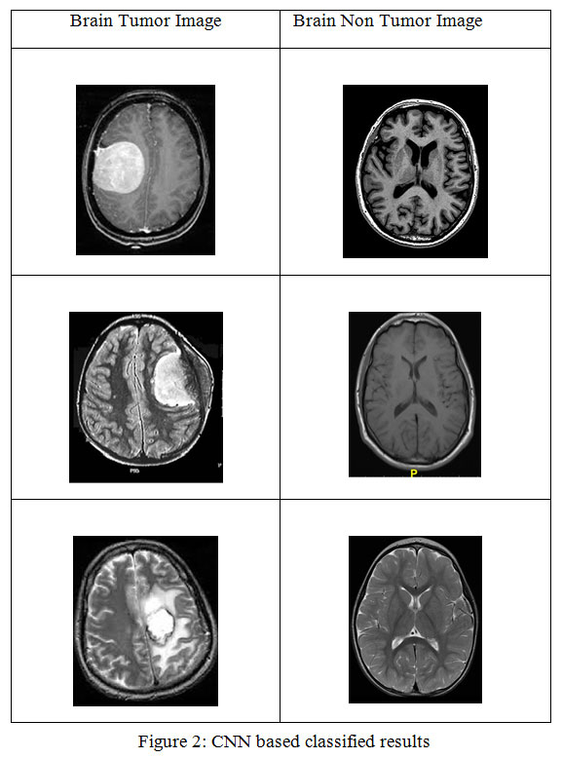
SCOPE OF THE PROJECT

Slide 11
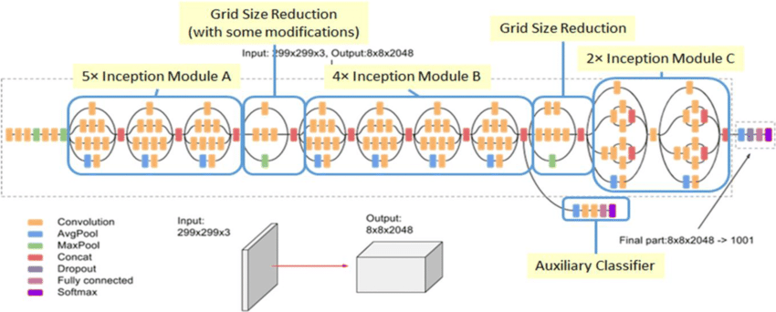
ARCHITECTURE

Slide 12
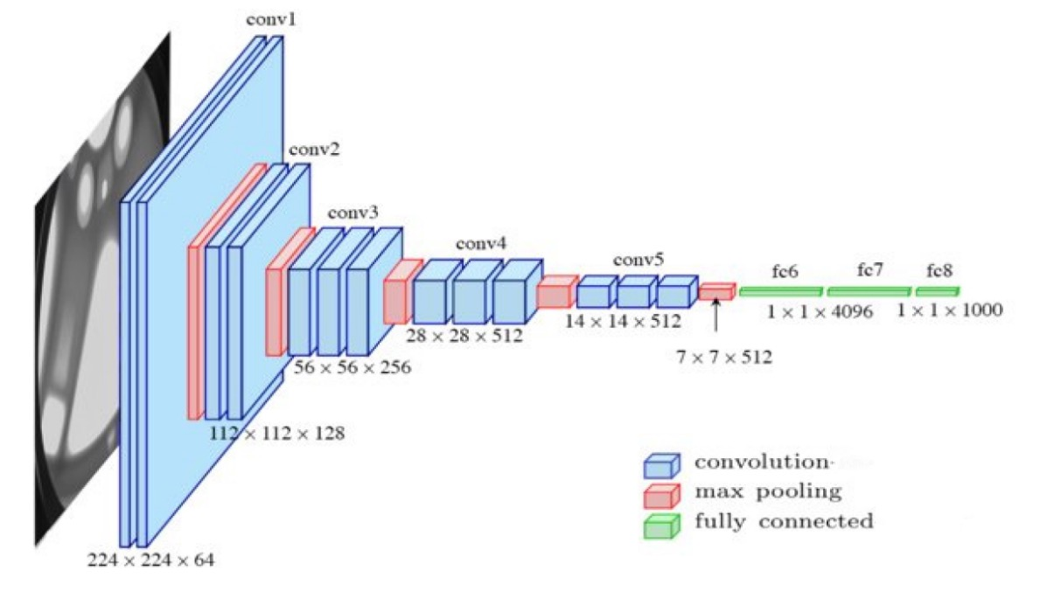
ARCHITECTURE

Slide 13
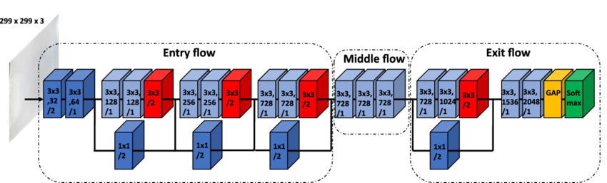
ARCHITECTURE

Slide 14
PROPOSED MODULES
DATASET
DATA PRE-PROCESSING
MODEL TRAINING
MODEL TEST
MODEL EVALUATION
MODEL VISUALISATION

Slide 15
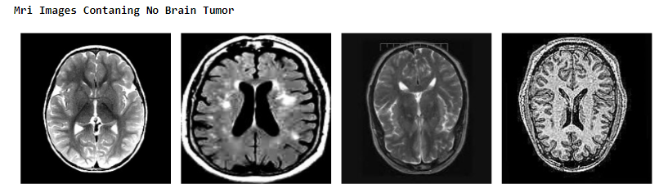
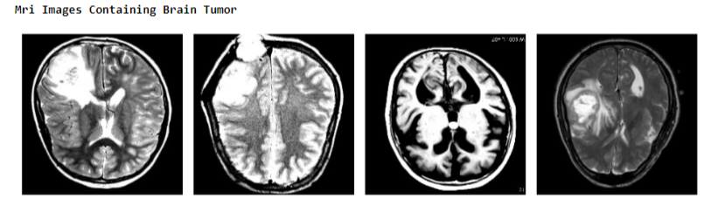
DATASET
Image Acquisition and Formatting: Collect and preprocess MRI images of the brain, ensuring standardized formats and resolutions.

Slide 16
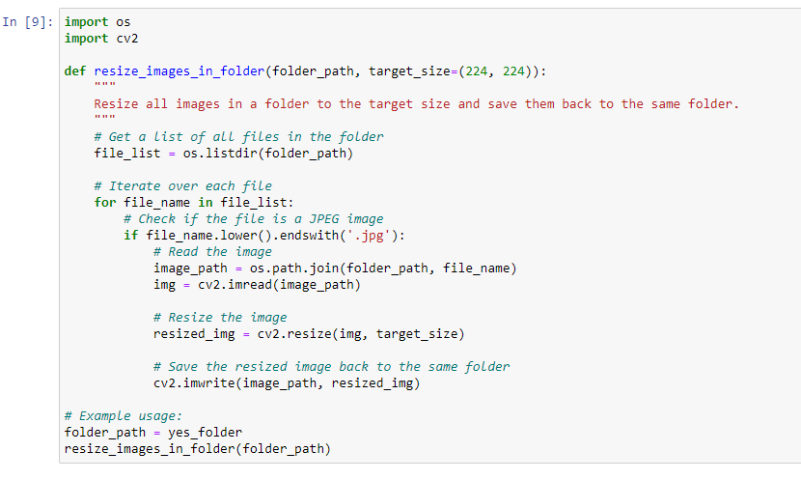
DATA PRE-PROCESSING
Image Acquisition and Formatting: Collect and preprocess MRI images of the brain, ensuring standardized formats and resolutions.

Slide 17
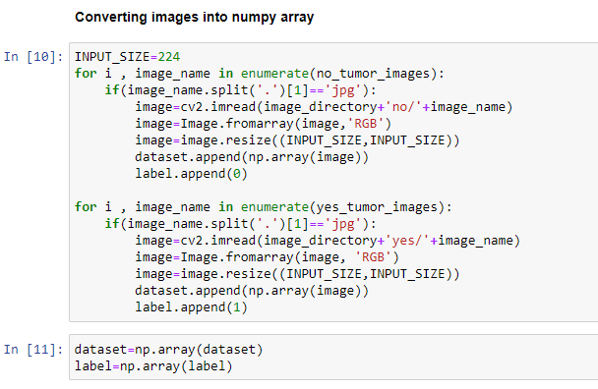
DATA PRE-PROCESSING
Image Acquisition and Formatting: Collect and preprocess MRI images of the brain, ensuring standardized formats and resolutions.

Slide 18
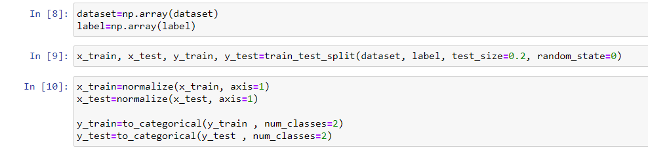
DATA SPLITTING
Training, Validation, and Testing Sets: Split the dataset into training, validation, and testing subsets for model training, validation, and evaluation.

Slide 19
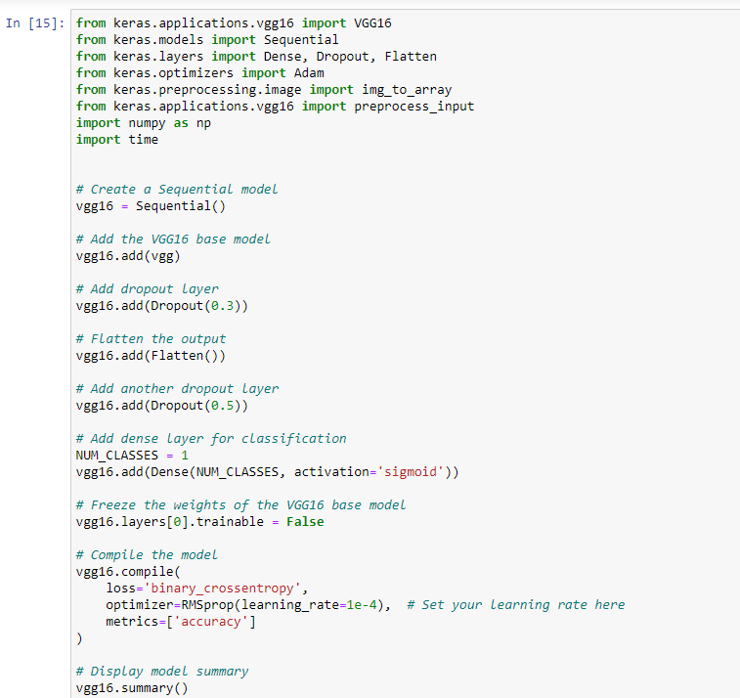
MODEL TRAINING

Slide 20
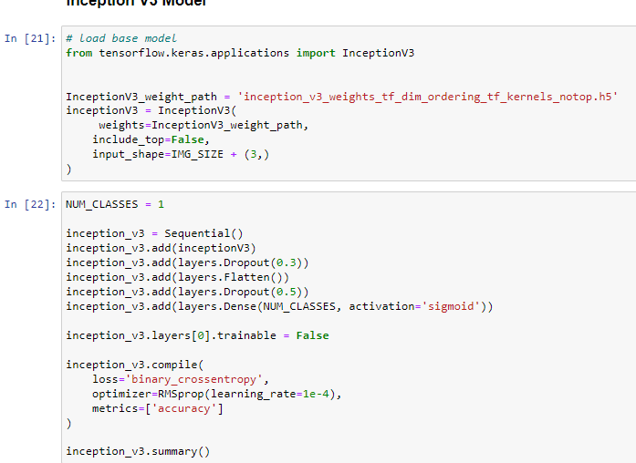
MODEL TRAINING

Slide 21
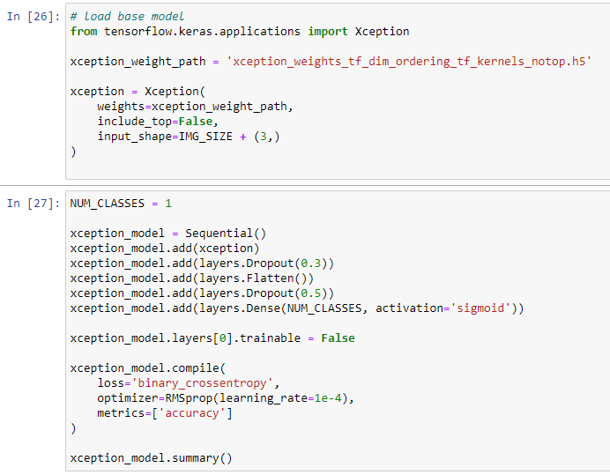
MODEL TRAINING

Slide 22
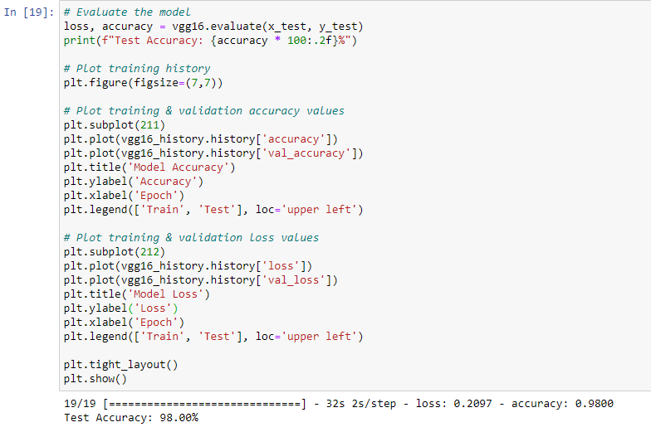
MODEL EVALUATION

Slide 23
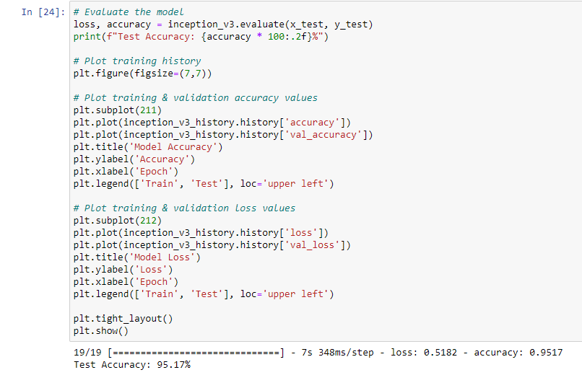
MODEL EVALUATION

Slide 24
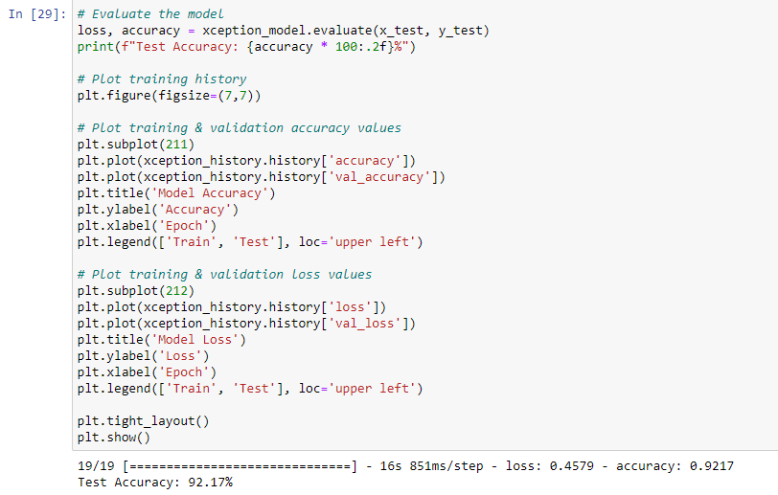
MODEL EVALUATION

Slide 25
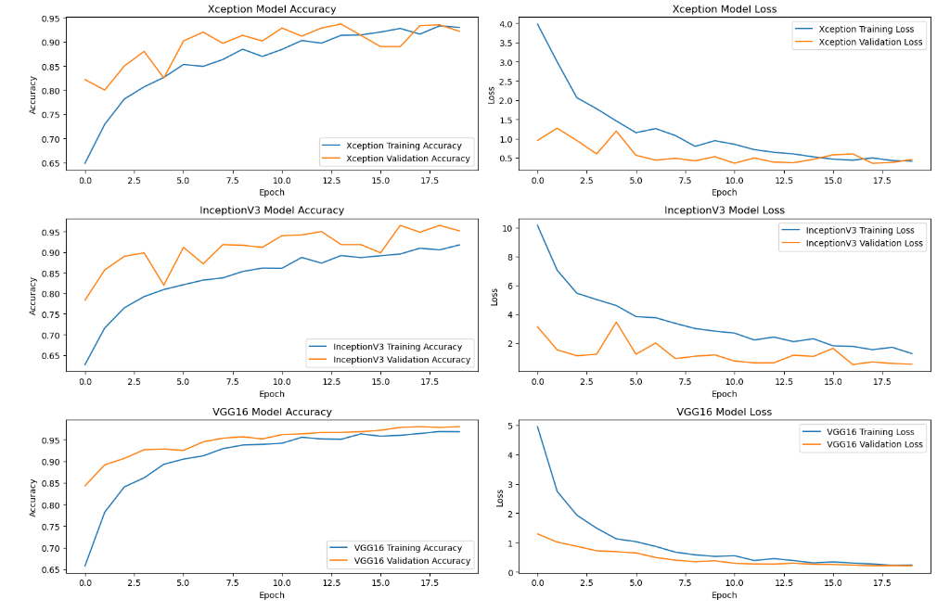
RESULT

Slide 26
FUTURE ENHANCEMENT
The conclusion summarizes the key findings, achievements, and contributions of the project. It reflects on the project's impact on brain tumor detection and discusses future directions for enhancements and extensions. Potential areas for future research may include optimizing model architectures, exploring ensemble methods, integrating additional imaging modalities, and conducting clinical validation studies.

