Slide 1

SRM INSTITUTE OF SCIENCE AND TECHNOLOGY
SCHOOL OF COMPUTING
DEPARTMENT OF COMPUTING TECHNOLOGIES 18CSP107L / 18CSP108L - MAJOR PROJECT / INTERNSHIP
Advanced Neural Network Architecture for Brain Lesion Identification
Guided By –
Dr. S. Babu (Associate Professor)
Department of Computing Technologies
Shreya Abraham Varghese (RA20110030010516)
Vaibhav Parihar
(RA2011003010520)

Slide 2
ABSTRACT
aims analysis of three
to conduct a comprehensive comparative deep learning algorithms, namely VGG16,
This project
InceptionV3, and Xception, for the detection of brain tumors from MRI images. The study evaluates and compares the performance of these algorithms in terms of accuracy, precision, recall, and computational efficiency. Through rigorous testing and analysis, the project seeks to identify the most effective algorithm for accurate and reliable brain tumor detection, contributing to advancements in medical diagnostics and patient care.
2

Slide 3
INTRODUCTION
A Brain tumor is considered as one of the aggressive diseases, among children and adults. Every year, around 11,700 people are diagnosed with a brain tumor. The 5-year survival rate for tumor is approximately 34 percent for men and 36 percent for women. The best technique to detect brain tumors is Magnetic Resonance Imaging (MRI). A huge amount of image data is generated through the scans. A manual examination can be error-prone due to the level of complexities involved in brain tumors and their properties.
3

Slide 4
MOTIVATION
The motivation behind this project stems from the growing importance of automated medical diagnostics in improving patient outcomes and healthcare efficiency. Manual interpretation of MRI images for brain tumor detection is time-consuming and prone to human error. By leveraging deep learning algorithms, we aim to develop a more efficient and accurate solution for automated brain tumor detection. The comparative analysis is motivated by the need to identify the most suitable algorithm for real-world applications, ultimately benefiting patients and healthcare providers.
4

Slide 5
CHALLENGES AND LIMITATIONS IN THE EXISTING PROJECT
Existing systems for brain tumor detection from MRI images face several challenges and limitations, including variability in image quality, class imbalance in the dataset, and interpretability of deep learning models. These challenges can affect the performance and reliability of automated detection systems, leading to inaccurate or inconsistent results. Additionally, computational resource requirements and scalability issues pose practical challenges for deploying deep learning algorithms in real-world healthcare settings. Addressing these challenges is crucial for developing robust and effective solutions for automated brain tumor detection.
5

Slide 6
OBJECTIVES
The primary objective of the project is to conduct a comparative analysis of VGG16, InceptionV3, and Xception algorithms for brain tumor detection from MRI images. Specific objectives include evaluating the performance of each algorithm in terms of accuracy, precision, recall, and computational efficiency.
Additionally, the project aims to identify strengths and weaknesses of each algorithm and determine the most suitable approach for automated brain tumor detection. By achieving these objectives, the project seeks to contribute to advancements in medical imaging and healthcare technology.
6

Slide 7
INNOVATION
The innovation idea of the project lies in the comparative analysis of deep learning algorithms for brain tumor detection. By systematically comparing the performance of these algorithms, the project aims to provide valuable insights into their effectiveness and suitability for real-world applications. The project also explores innovative approaches to address challenges such as data imbalance, model interpretability, and computational efficiency, thereby contributing to the development of more robust and reliable automated brain tumor detection systems.
7

Slide 8
SCOPE OF THE PROJECT
The scope of the project encompasses the development of machine learning models based on VGG16, InceptionV3, and Xception algorithms for brain tumor detection from MRI images. The project focuses on comparative analysis and evaluation of these models using standardized performance metrics. The application of the project extends to medical imaging and diagnostics, with potential implications for improving the accuracy and efficiency of brain tumor detection in clinical practice. The project's findings and insights can also inform future research and development efforts in the field of automated medical diagnostics.
8

Slide 9
PROPOSED MODULES
DATASET
DATA PRE-PROCESSING
MODEL TRAINING
MODEL TEST
MODEL EVALUATION
MODEL VISUALISATION
13-10-2023

Slide 10
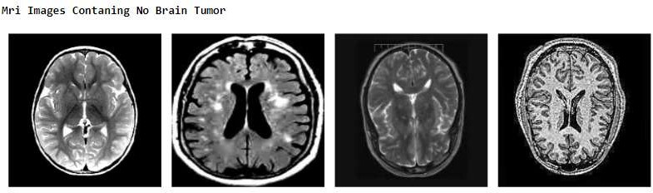
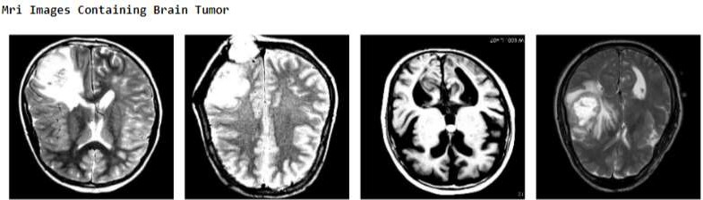
DATASET
Image Acquisition and Formatting: Collect and preprocess MRI
images of the brain, ensuring standardized formats and resolutions.
13-10-2023

Slide 11
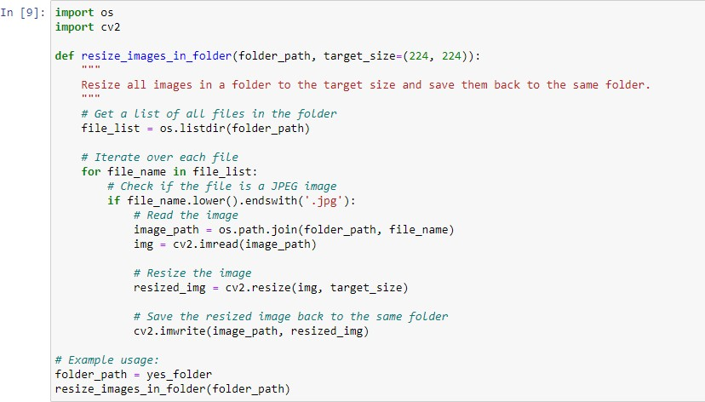
DATA PRE-PROCESSING
Image Acquisition and Formatting: Collect and preprocess MRI
images of the brain, ensuring standardized formats and resolutions.
13-10-2023

Slide 12
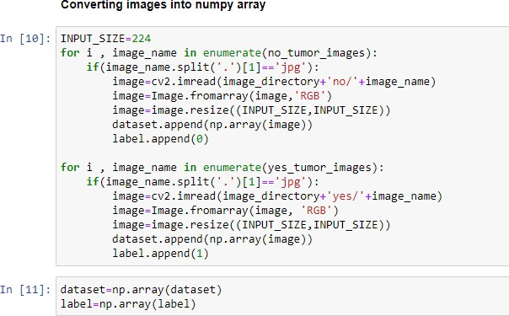
DATA PRE-PROCESSING
Image Acquisition and Formatting: Collect and preprocess MRI
images of the brain, ensuring standardized formats and resolutions.
13-10-2023

Slide 13
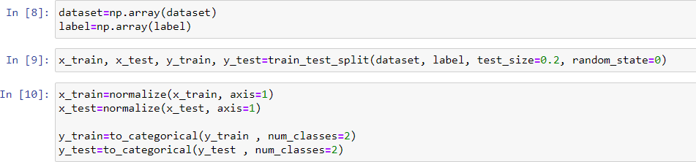
DATA SPLITTING
Training, and Testing Sets: Split the dataset into training, and testing subsets for model training, and evaluation.
13-10-2023

Slide 14
VGG16
VGG16 is a convolutional neural network architecture, with 16 layers, including 13 convolutional and 3 fully connected layers, it utilizes small 3x3 filters with sigmoid activation and max-pooling for downsampling. Boasting 138 million parameters, it excels in learning intricate hierarchical features from input images. Often pre-trained on ImageNet, VGG16 serves as a powerful base model for various computer vision tasks, offering simplicity and robust performance. Widely used in academia and industry, its versatility extends to tasks like object localization, style transfer, and image generation, cementing its status as a pioneering CNN architecture.

Slide 15
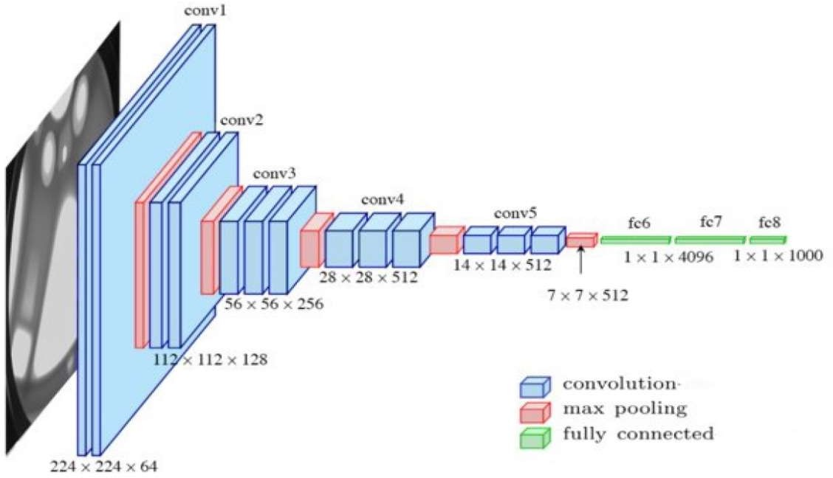
ARCHITECTURE
Architecture diagram for VGG16
13-10-2023

Slide 16
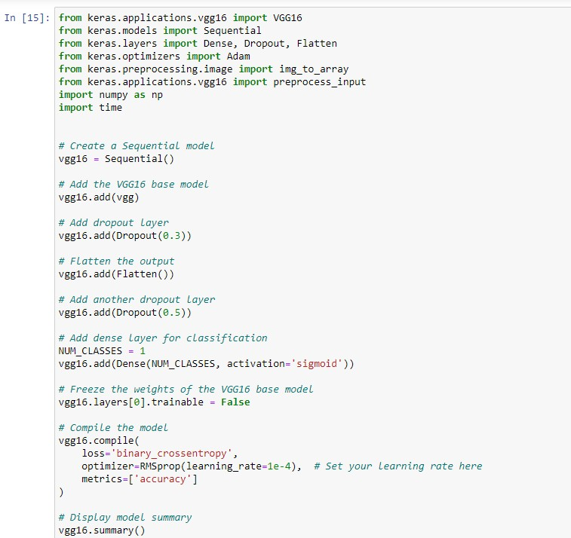
MODEL TRAINING

Slide 17
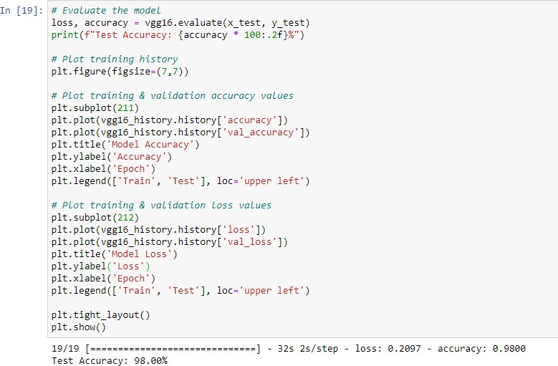
MODEL EVALUATION

Slide 18
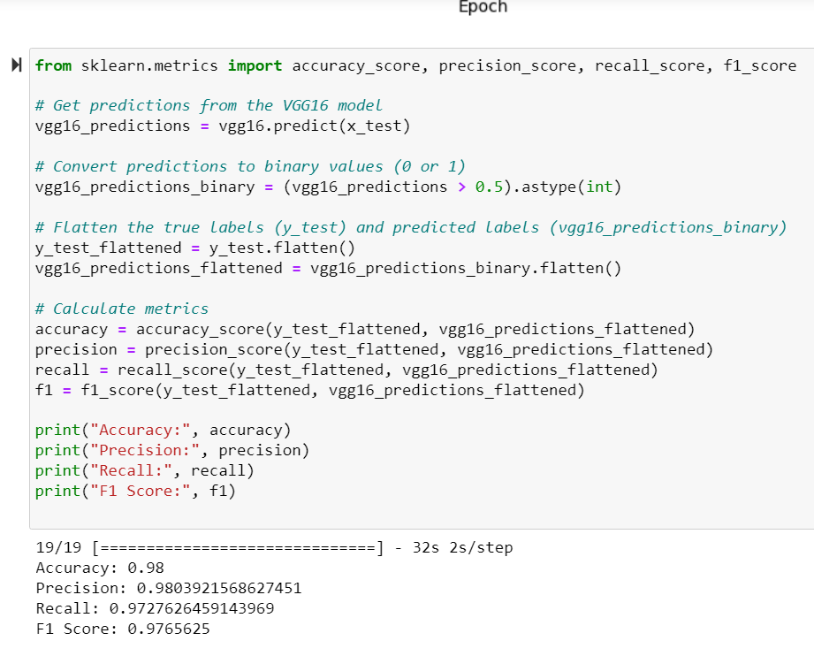
MODEL EVALUATION

Slide 19
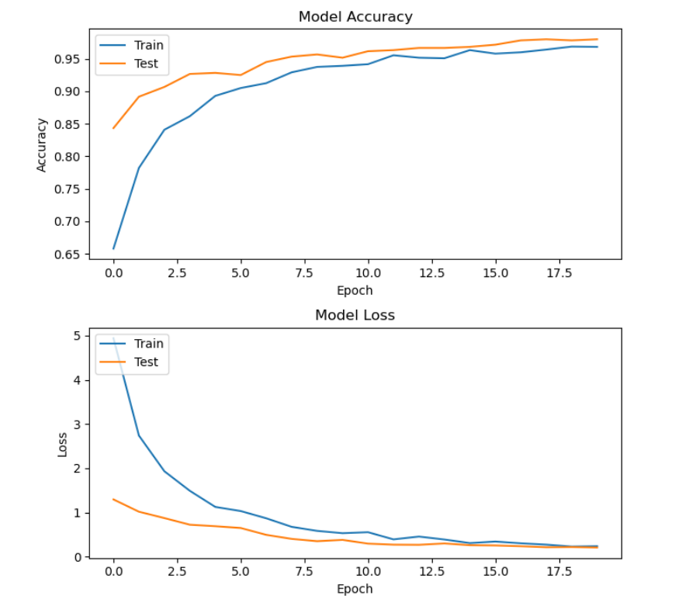
MODEL VISUALISATION

Slide 20
Xception
Xception, an architecture by Google, employs extreme depth-wise separable convolutions, separating spatial and channel-wise operations. With improved computational efficiency and competitive accuracy, it reduces parameters and operations while maintaining performance. Used in diverse computer vision tasks, it offers a unique approach to feature extraction, relying on depth-wise convolutions for intricate pattern recognition.

Slide 21
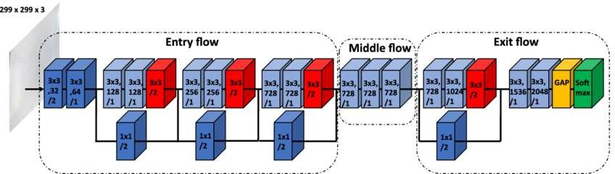
ARCHITECTURE
Architecture diagram for Xception
13-10-2023

Slide 22
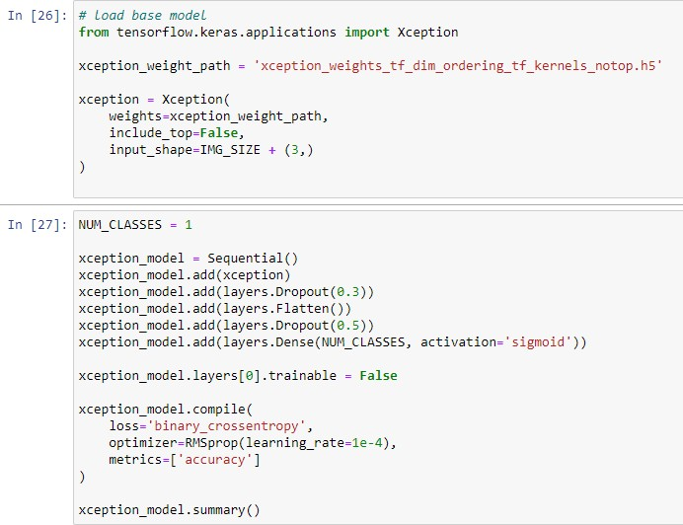
MODEL TRAINING

Slide 23
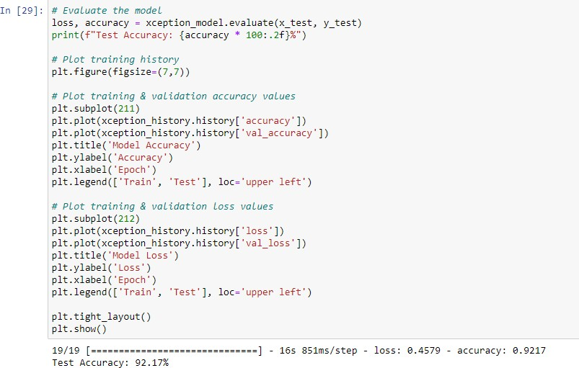
MODEL EVALUATION

Slide 24
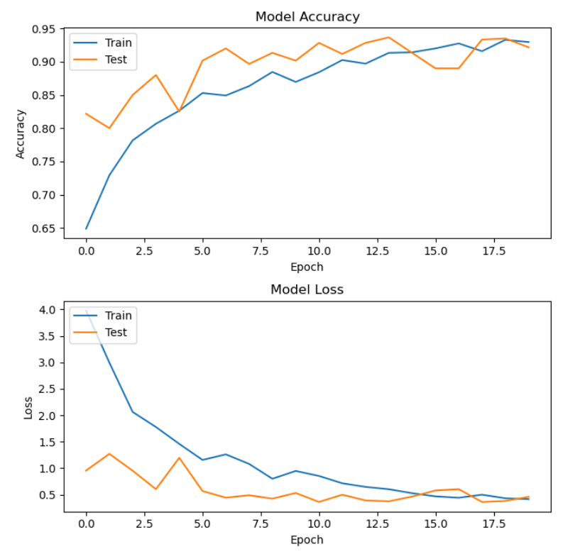
MODEL EVALUATION

Slide 25
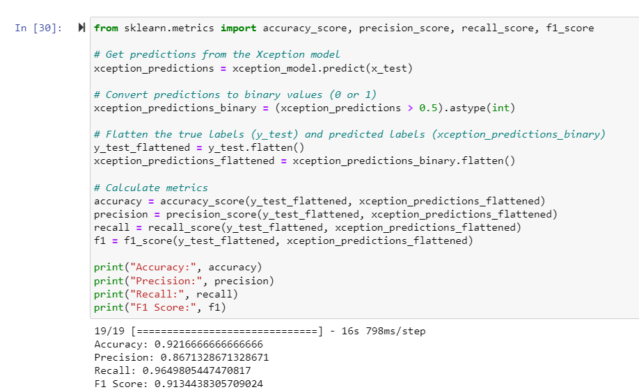
MODEL EVALUATION

Slide 26
Inception V3
InceptionV3, another Google creation, features inception modules, utilizing parallel convolutions with different kernel sizes for multi-scale feature extraction. Its computational efficiency, stemming from fewer parameters, accelerates training and inference. With a focus on capturing features at various levels of abstraction, it excels in recognizing complex patterns, making it a versatile choice for image classification and related tasks.

Slide 27
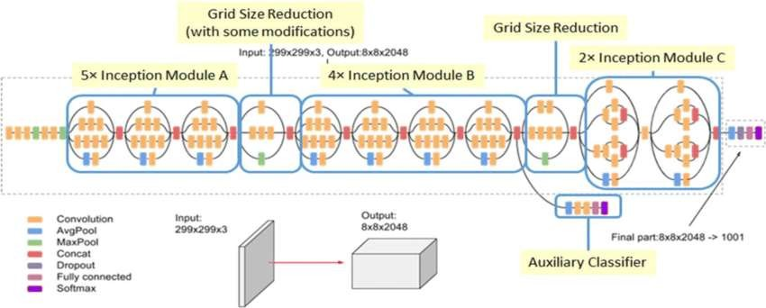
ARCHITECTURE
Architecture diagram for InceptionV3
13-10-2023

Slide 28
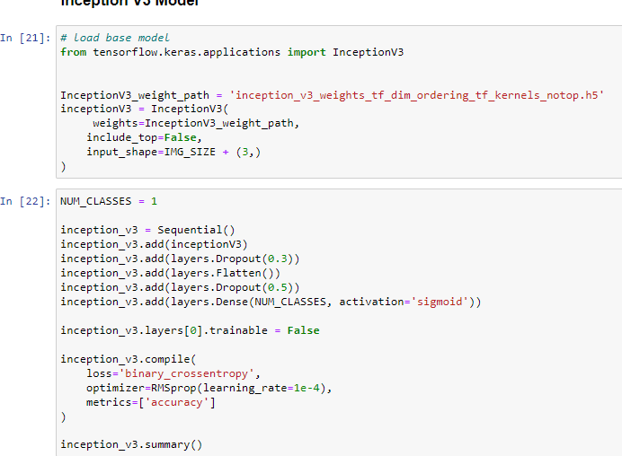
MODEL TRAINING

Slide 29
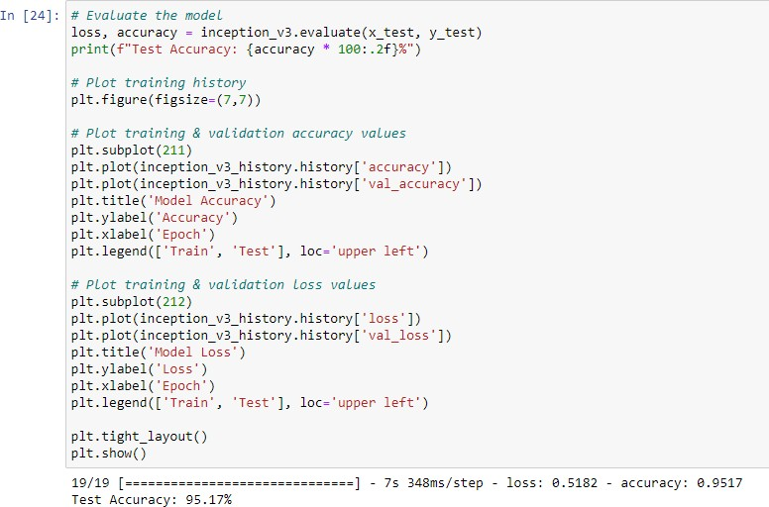
MODEL EVALUATION

Slide 30
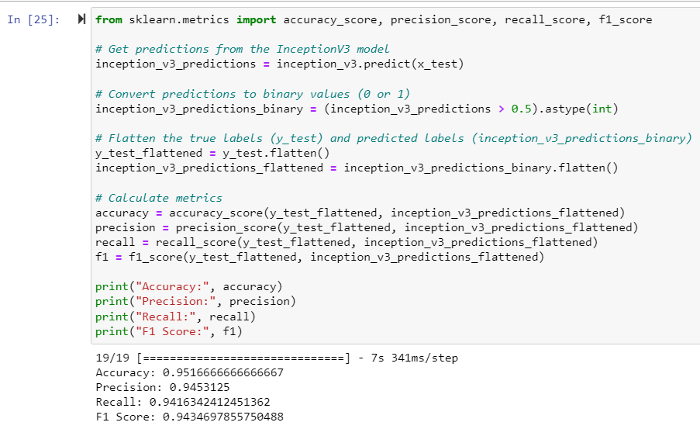
MODEL EVALUATION

Slide 31
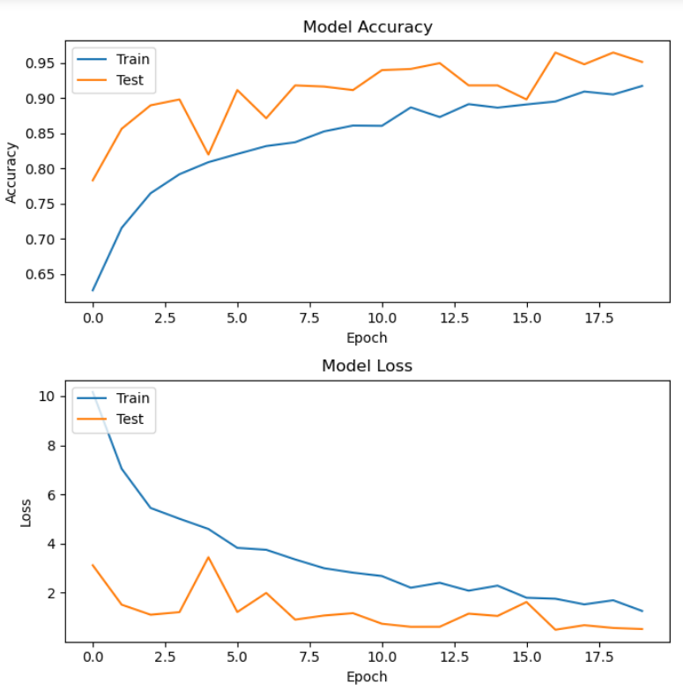
MODEL VISUALIZATION

Slide 32
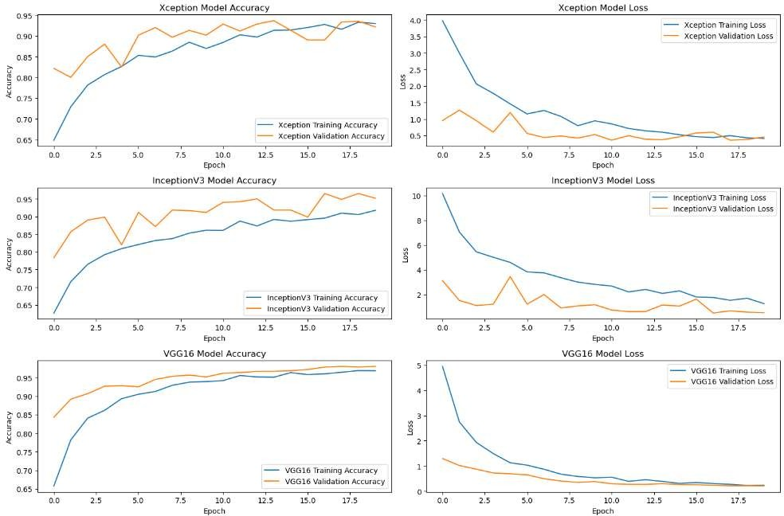
RESULT

Slide 33
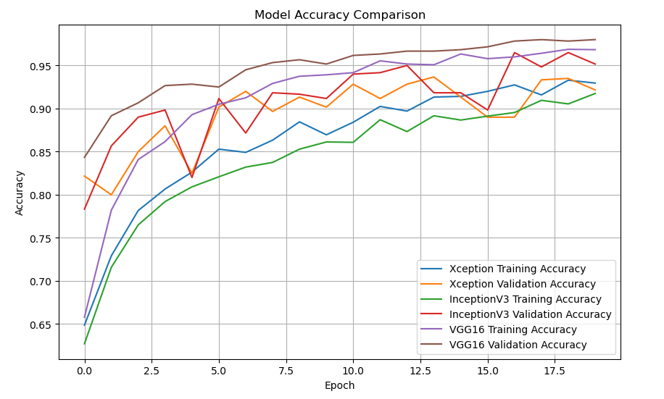
RESULT

Slide 34
FUTURE ENHANCEMENT
The conclusion summarizes the key findings, achievements, and contributions of the project. It reflects on the project's impact on brain tumor detection and discusses future directions for enhancements and extensions. Potential areas for future research may include optimizing model architectures, exploring ensemble methods, integrating additional imaging modalities, and conducting clinical validation studies.

