Slide 1
An Introduction to Git and GitHub for Geomatics Professionals

Slide 2
Presented by:
Scott Hatcher
BW.geospatial@gmail.com

Slide 3
My goal:
Try to answer:
Should I/we use Git/GitHub?
How do I get started?

Slide 4
1.
The Problem
What is Git/Github anyway, and do I/we need to use it?

Slide 5
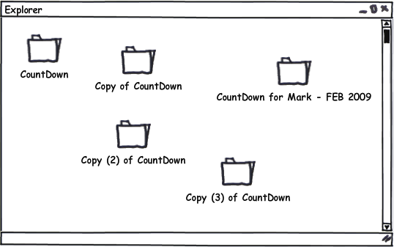
Git is a version control system.
GitHub is a collaborative hosting service for Git repositories.

Slide 6
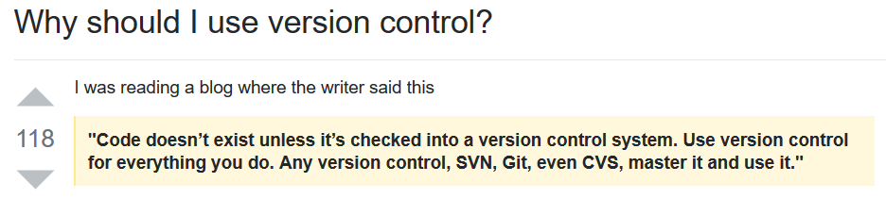
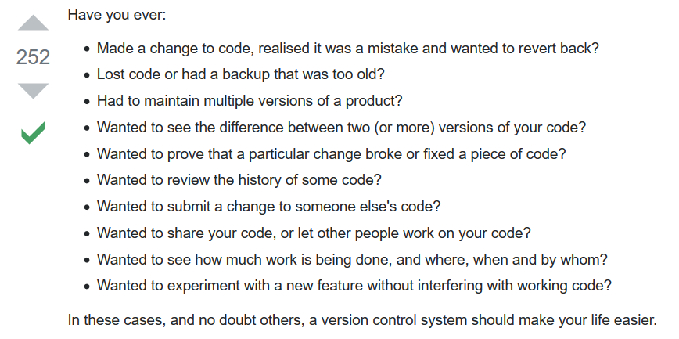

Slide 7

You may be on a software development team as a GIS or geospatial developer.
You may be a computer savvy person looking to formalize documentation versioning and maintenance across your organization.

Slide 8
2.
Version Control System

Slide 9
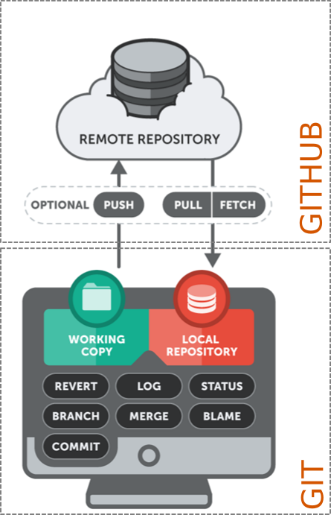
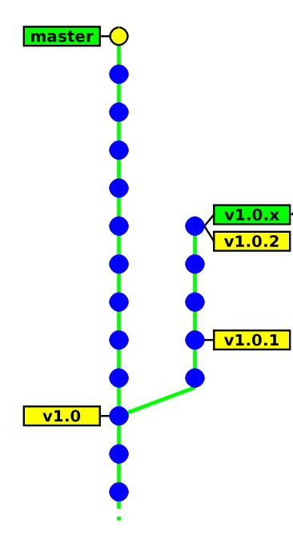
Version Control: What is it?

Slide 10
Version Control: Why?
Individual
Back-ups of the project
Create a “checkpoint” in the project at any stage: Fearlessly modify code
Tagging: Mark certain point in time
Branching: Release versions and continue development

Slide 11
Version Control: Why?
Team
Everything in “Individual”
Allow multiple developer to work on the same codebase
Merge changes across same files: handle conflicts
Check who made which change: blame/praise

Slide 12
No single repository is authoritative
Data can be checked in and out from any repository
Distributed VCS

Slide 13
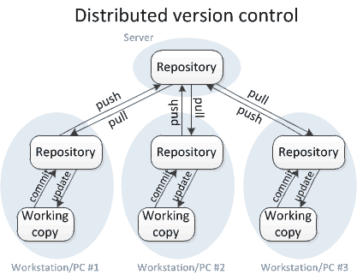
Distributed VCS

Slide 14
3.
Git
--everything-is-local

Slide 15

Free, open source
Fully distributed
Handle small files very effectively
Tracks contents, not files
No network
GUI or CLI
Three stages

Slide 16
Three stages:
Working directory
Staging directory
Git directory (repository)
Git: Stages

Slide 17
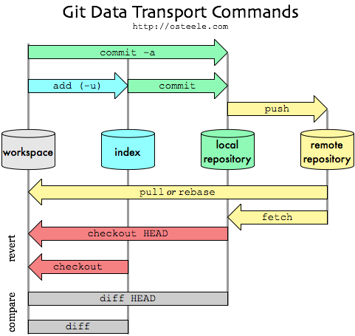
Git: Development

Slide 18
4.
Getting started
The hardest part is choosing.

Slide 19
https://rogerdudler.github.io/git-guide/
https://www.earthdatascience.org/workshops/intro-version-control-git/
Tutorials

Slide 20
THANK YOU!
Scott Hatcher
bw.geospatial@gmail.com
svHatch.github.io

Slide 21
References
https://github.com/RamblingCookieMonster/Git-Presentation
https://stackoverflow.com/questions/1408450/why-should-i-use-version-control
https://www.git-tower.com/learn/git/ebook/en/desktop-gui/basics/why-use-version-control
http://hgbook.red-bean.com/read/how-did-we-get-here.html
http://marklodato.github.io/visual-git-guide/index-en.html
https://www.earthdatascience.org/workshops/intro-version-control-git/
https://rogerdudler.github.io/git-guide/
https://people.irisa.fr/Anthony.Baire/git/git-for-beginners-handout.pdf
https://courses.cs.washington.edu/courses/cse403/13au/lectures/git.ppt.pdf
https://bytesclub.github.io/docs/git.pptx
http://deepcs.njit.edu/git.php

