Slide 1
XML Databases and Searching
Review 2

Slide 2
Review 1
XML Data
XML Databases
Storing XML Data
Converting DB to XML
Converting XML to DB

Slide 3
Review 2
XML Information retrieval
HTML to XML
Text to XML
Searching

Slide 4
Information Retrieval
Information or data of 3 types
Unstructured Data (e.g. html files)
Structured Data (e.g. RDBMS)
Semi-structured Data (e.g. XML files)
Information Retrieval (IR) by Search Engine
(e.g. Google or Altavista) on Unstructured data
- vast quantities of irrelevant data
But 75% of data are in DB
- we need to access them

Slide 5
XML-IR
3 Approaches :
Database-Oriented Approach
IR-based Approach
Hybrid Approach

Slide 6
Database-Oriented Approach
75% of web-data come from DB
Store data in XML format
Advantages
  data relations, constraints and integrity can be modeled and checked
  query languages are similar to SQL
  standard (RDB and OODB) database engines
Disadvantages
  different databases with different entity-relationship structures
  DTDs have very poor data and referential integrity constraints

Slide 7
Modules
Text to XML
HTML to XML
Searching XML Files
Improve Search efficiency (index)

Slide 8
XML to HTML
Tidy Parser
Retains the structure of the HTML
Disadvantage
No Knowledge Discovery

Slide 9
An Example: html to xml
<UL>
<LI>
R. Goldman, J. McHugh, and J. Widom.
<A href="ftp://db.stanford.edu/pub/papers/xml.ps"> From Semistructured Data to XML: Migrating the Lore Data Model and Query Language
</A>
Proceedings of the 2nd International Workshop on the Web and Databases (WebDB '99), pages 25-30, Philadelphia, Pennsylvania, June 1999.
<LI> T. Lahiri, S. Abiteboul, and J. Widom.
<A href="ftp://db.stanford.edu/pub/papers/ozone.ps"> Ozone: Integrating Structured and Semistructured Data
</A>.
Technical Report, Stanford Database Group, October 1998.
</UL>

Slide 10
An example:html to xml(contd..)
<Publication URL="ftp://db.stanford.edu/pub/papers/xml.ps" Authors="RG JM JW">
<Title>From Semistructured Data to XML: Migrating the Lore Data Model and Query Language</Title>
<Published>Proceedings of the 2nd International Workshop on the Web and Databases (WebDB '99)</Published>
<Pages>25- 30</Pages>
<Location>
<City>Philadelphia</City>
<State>Pennsylvania</State>
</Location>
<Date> <Month>June</Month> <Year>1999</Year> </Date>
</Publication>
<Publication URL="ftp://db.stanford.edu/pub/papers/ozone.ps" Authors="TL SA JW">
<Title>Ozone: Integrating Structured and Semistructured Data</Title>
<Published>Technical Report</Published>
<Institution>Stanford University Database Group</Institution>
<Date> <Month>October</Month> <Year>1998</Year> </Date>
</Publication>
<Author ID="SA">S. Abiteboul</Author>

Slide 11
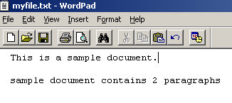
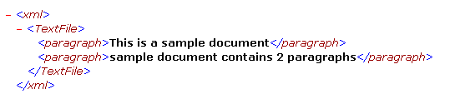
Text to XML
Text Files -> Paragraphs ->Lines -> Words
Separates paragraphs

Slide 12
Few Challenging Queries
IR
AU
XML
Which professors from Anna Univ (AU) are teaching IR and have research projects on XML?
Find the earliest publication with "semi structured data" in its title.

Slide 13
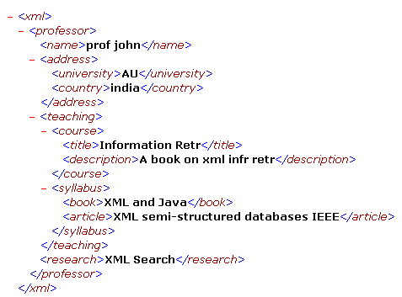
XML

Slide 14
XML IR
Professor
Address
...
Name:
Prof John
Univ: AU
Country:
India
Teaching:
Research:
Course
Title: IR
Project
Syllabus
Title:
Intelligent
Search
of XML
Data
Description:
Information
retrieval ...
...
...
Book
Article
Sponsor:
German
Science
Foundation
...
...

Slide 15
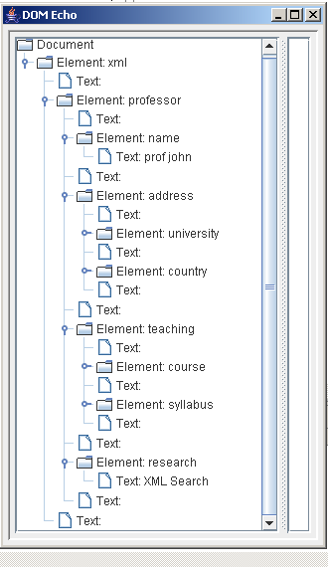
XML DOM

Slide 16

org.w3c.dom.Document
The Document interface represents the entire HTML or XML document.
It is the root of the document tree
Document provides the primary access to the document's data.

Slide 17
Searching algorithms
KMP Search algorithm
Boyer-Moore string search algorithm
Rabin-Karp string search algorithm
Index methods
Faster search algorithms are based on preprocessing of the text.
After building an index, these algorithms can find pattern quickly, using a binary search of the index.

Slide 18
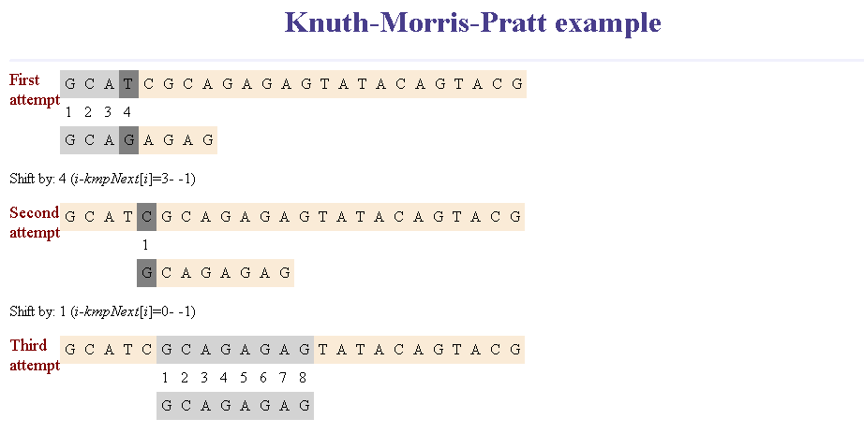
KMP Search
performs the comparisons from left to right

Slide 19
Search Engine Indexing
Search engine indexing entails how data is collected, parsed, and stored
It facilitates fast and accurate retrieval
Alternate name for the process is Web indexing

Slide 20

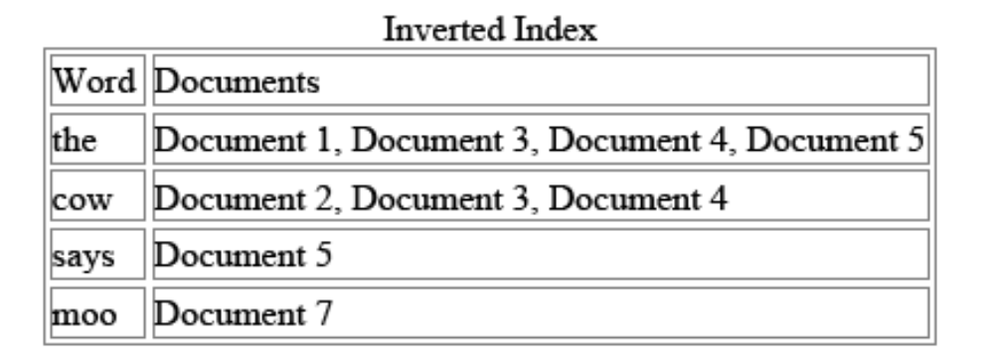
Inverted indices
Many search engines incorporate an inverted index
The search engine can retrieve the matching documents quickly

Slide 21
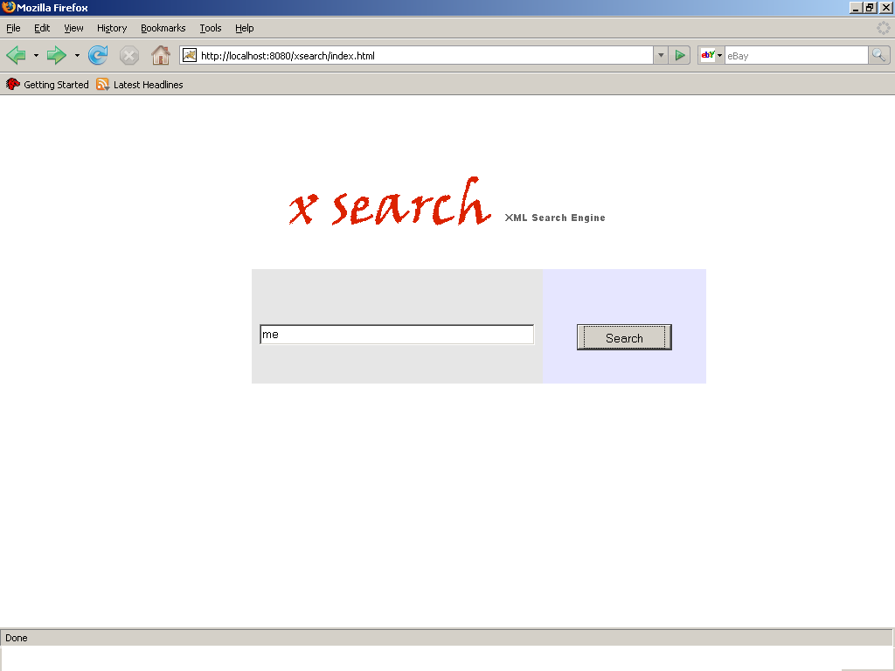

X Search

Slide 22
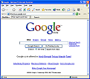
Search Engine working
File System
Web Server
HTML Pages
GIF/JPG Images etc
XML
Web Gateway
Database

Slide 23
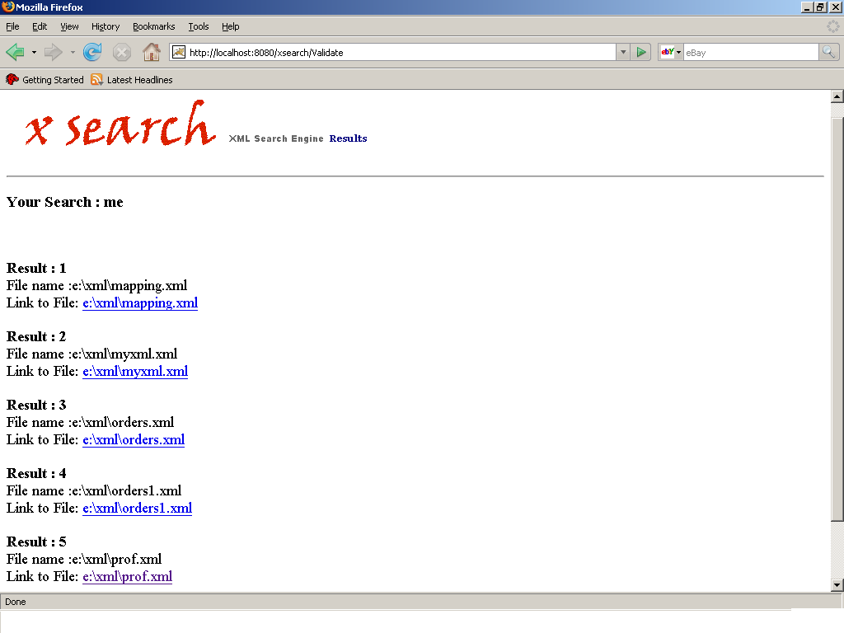
X Search Result page

Slide 24
Search
Ranking Search results
Displaying details of corresponding Database Tables
Searching only the specified tags in XML

Slide 25
Thank You !

