Slide 1
Integration of EPICS to NI platform
Karel Majer, Jan Fara
Date:
31.01.2025

Slide 2
Motivation

Slide 3

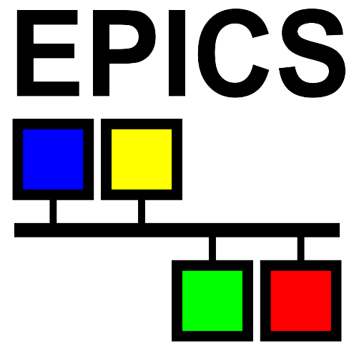
Motivation
(2017) Control system built in LabVIEW
Real-time code running on Pharlap OS
RT <-> GUI communication provided by NI Network Streams
Channel Access used for data archiving
Existing libraries
NI EPICS VIs – missing record fields, problems with archiver
CALab – doesn’t run on Pharlap, NI RT Linux support added only recently

Slide 4
LabIOC
Implementation of Channel Access server and client purely in LabVIEW
Observatory Sciences + ELI
Compliance with Channel Access protocol, compatible with EPICS 3.14 and EPICS 7
Does not use EPICS Base
Runs on any LabVIEW target
Does not use EPICS Base
Does not have full EPICS functionality

Slide 5
LabIOC server
Implemented
Missing
Access to EPICS database from LabVIEW
Basic data types (ai, ao, bi, bo, longin, longout, mbbi, mbbo, stringin, stringout, waveform)
Alarms
Monitor posts
Database links
Soft record types (calc, fanout etc.)
Callbacks (run VI when records processes)
Access control

Slide 6
LabIOC client
Implemented
Missing
caget, caput, camonitor
Batch operations on many PVs
Automatic channel reconnect
All Channel Access data types

Slide 7
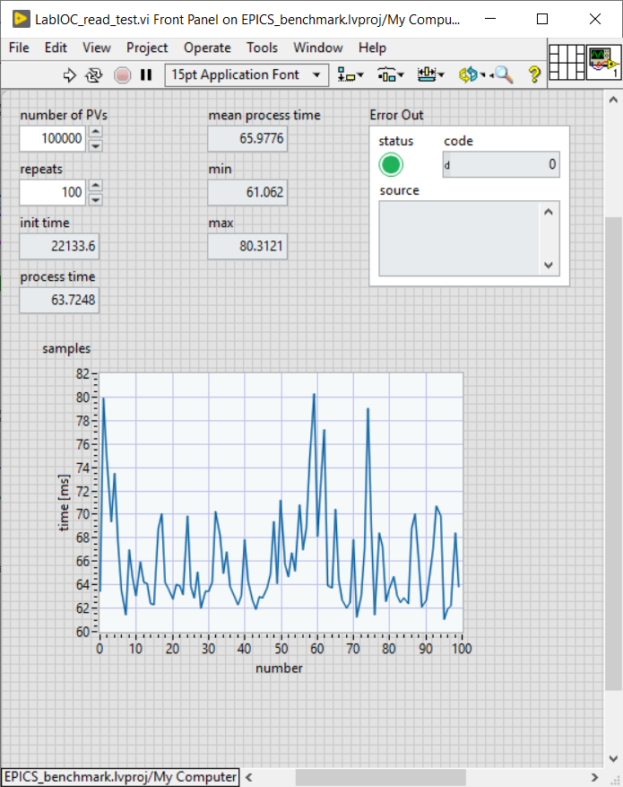
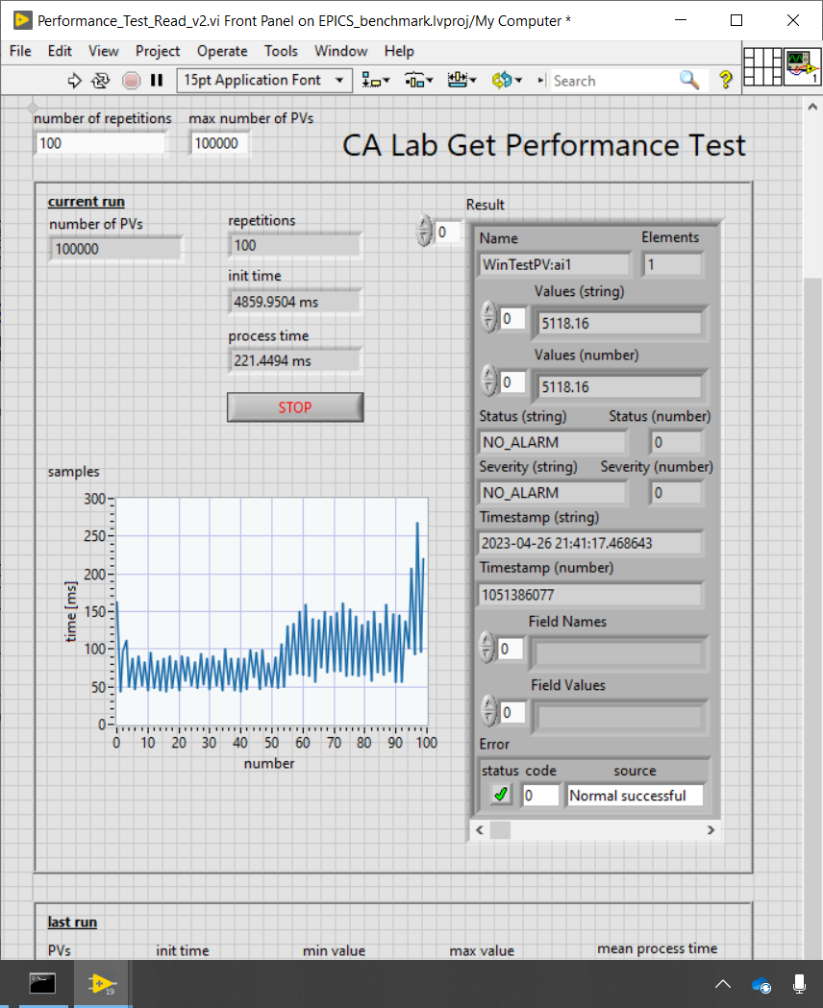
LabIOC client benchmarks
Benchmarks of LabIOC and CALab in cooperation with Helmholtz Zentrum Berlin
Data lost during cyberattack
Read test on 100000 PVs, < 100 ms with both libraries

Slide 8
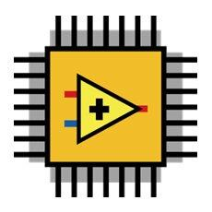
NI FPGA EPICS module
(2023) Shift from LabVIEW to native EPICS
Unclear licensing policy, scaling issues, problems in CS architecture
Adoption of easy-to-use modules (streamdevice, Modbus, OPCUA) and Python interfaces
How to interface NI FPGA devices without LabVIEW?

Slide 9
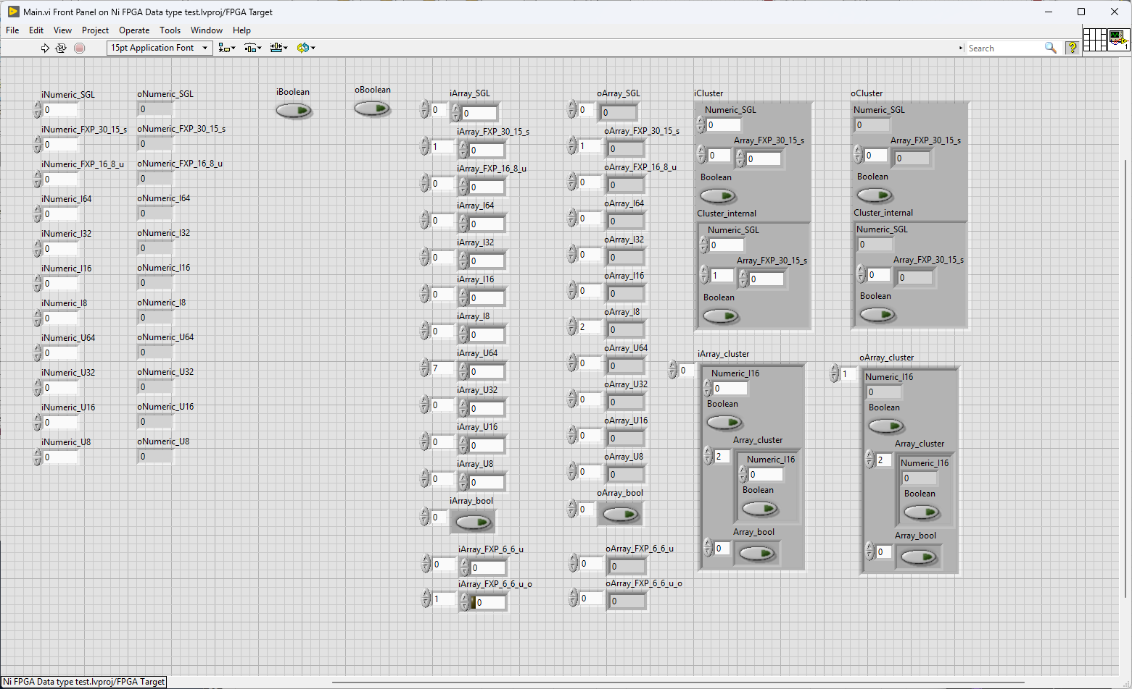
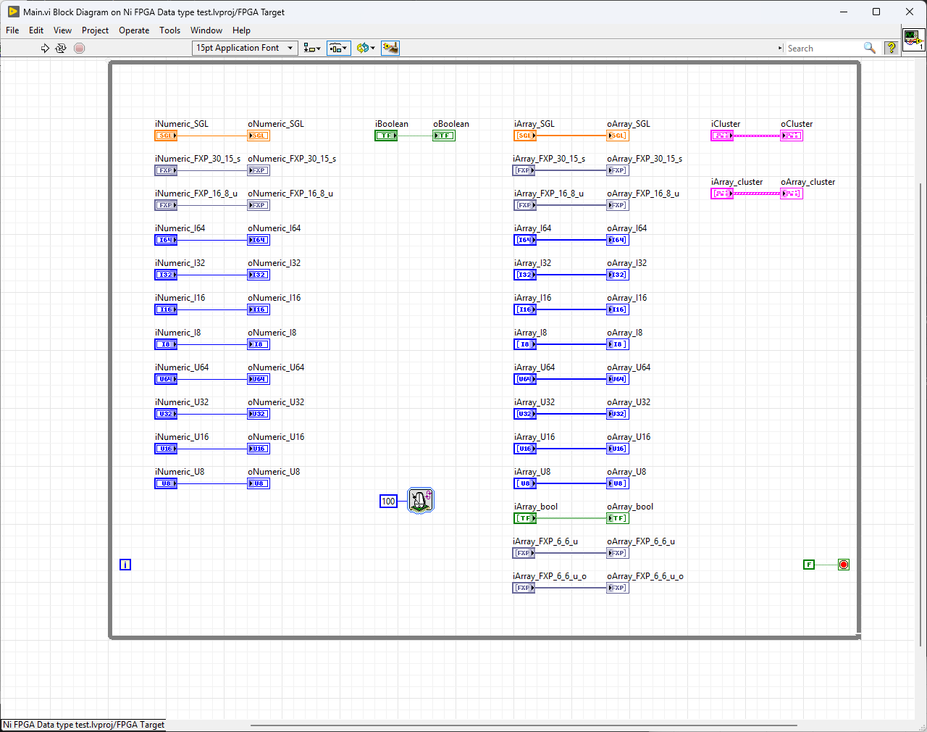
NI FPGA EPICS module

Slide 10
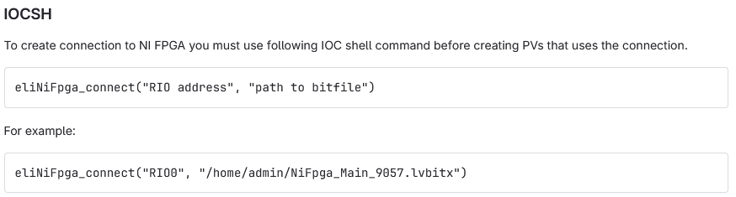
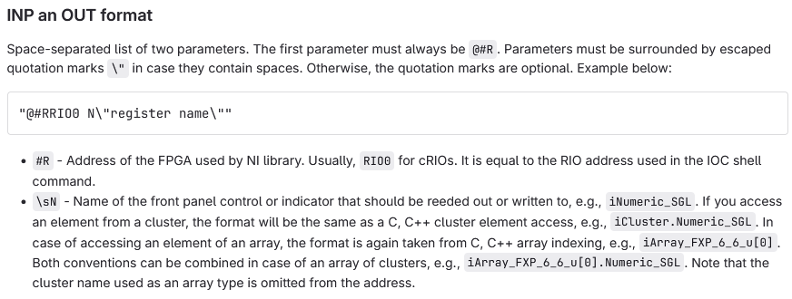
NI FPGA EPICS module

Slide 11
Thank you for your attention!
Karel Majer
karel.majer@eli-beams.eu

