Slide 1
ELI Beamlines
Control System Overview
Author: Radek Horálek
Date:
2/3/2025

Slide 2
Contents
Introduction
Scope of the architecture
Communication protocols
HW needs
RIO utilization
Integration
GUIs
Build & Deploy
Archiving

Slide 3
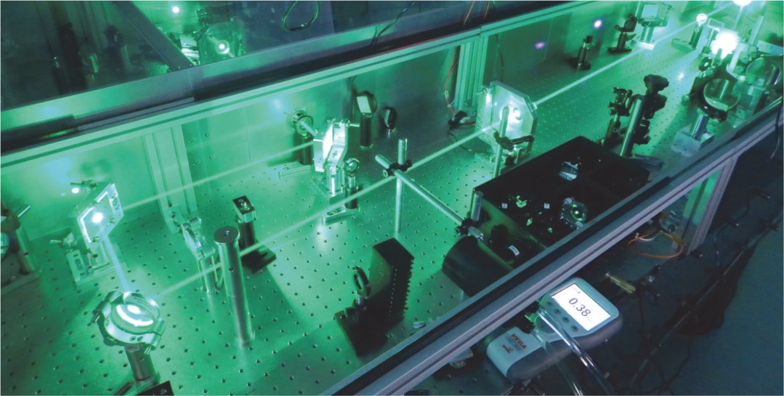
Introduction
Templates and source code versioning ensure fast deployment of new solutions in the lab
MySQL, P4V Helix
ELI Controls and ELI.lib (developed in LabVIEW)
EPICS commands and data are supported

Slide 4
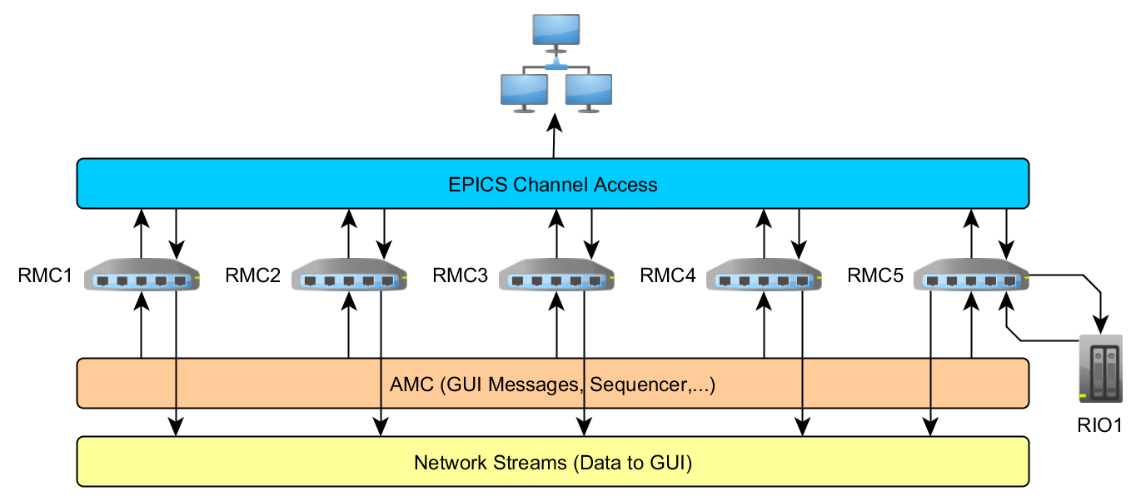
Scope of the Architecture (I)

Slide 5
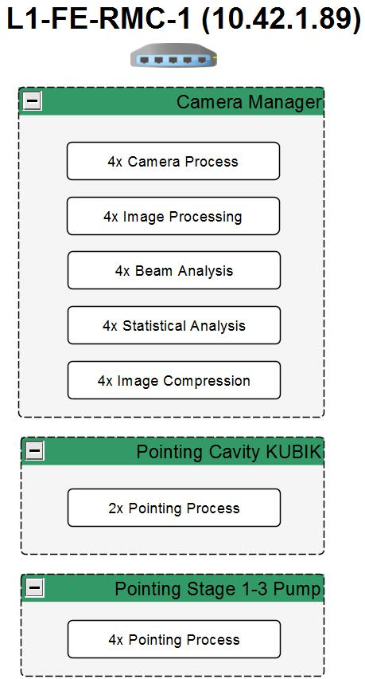
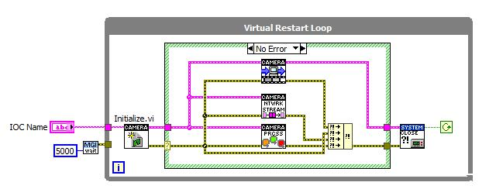
Scope orf the Architecture (II)
Each RMC contains several Input-Output Controllers (IOC)
Each IOC contains processes

Slide 6
Communication Protocols - AMC
AMC (Asynchronous Message Communication)
UDP based
Sending commands from Developer GUIs to IOCs
Network Streams
Handle reliable transfers on top of modified TCP/IP
Used for developer GUIs
Streams are wrapped into the architecture
CA (Channel Access)
Used by EPICS 3.14
Enables transfer of data using TCP/IP with additional features

Slide 7
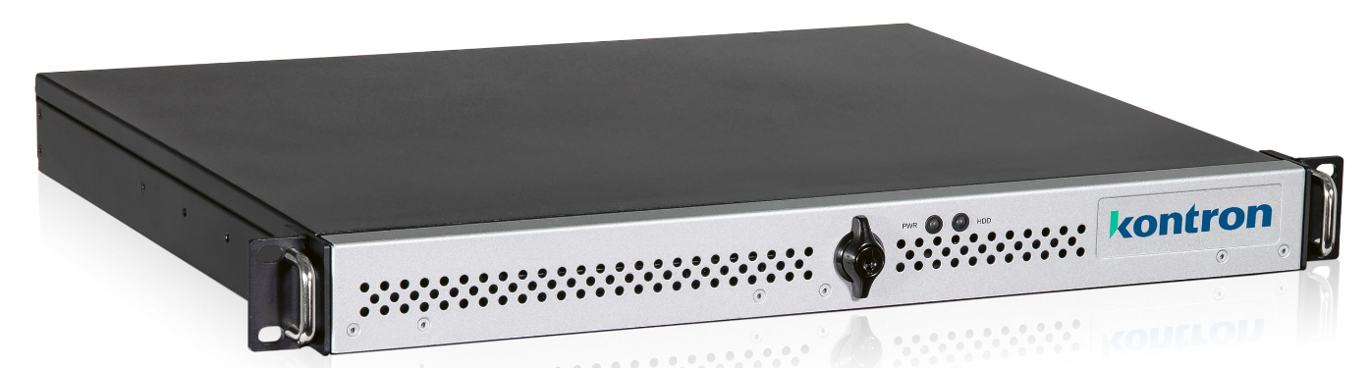
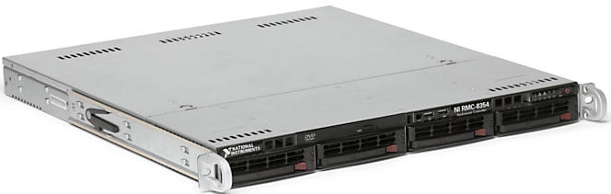
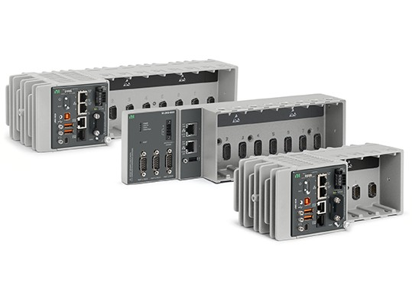
HW Needs
Supported OS: ETS PharLap, NI RT Linux, Win10
RMC 8354 (matured)
KISS 1U Short V3 CFL
Intel i7-9700E (8Core/2,6GHz)
8GB DIMM DDR4 2666
NI cRIO (different types)
Real-time controllers can be virtualized

Slide 8
RIO Utilization
NI 9149 is the most common type (Ethernet RIO)
Programmatic interaction with FPGA front panel for slow data
FIFOs for fast data
Both DAQ and state machine control are applicable on FPGA

Slide 9
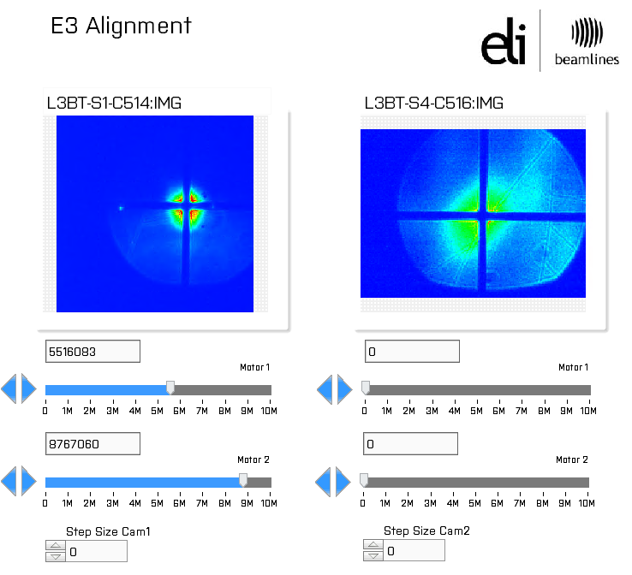
Integration (I)
Process data -> IOC -> EPICS
EPICS GUIs allow access to multiple IOCs through EPICS layer

Slide 10
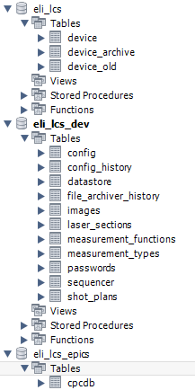

Integration (II)
Database contains information about all the PVs and IOCs
PVs require server information
IOCs require INI and CFG configurations that define their functionality
02.08.2021
10

Slide 11
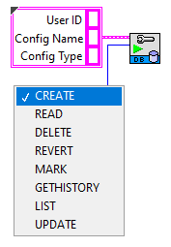
Integration (III)
Database access is provided using DB Config Access.vi
Configuration history can then be used to backtrack in time what changes might have had an effect on the system
02.08.2021
11

Slide 12

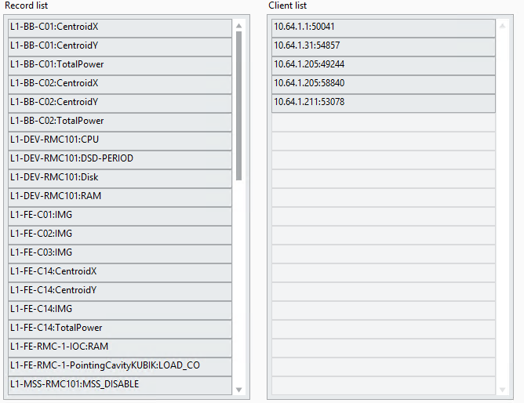
Integration (IV)
Data is published using a LabIOC server which is present on all machines
02.08.2021
12

Slide 13
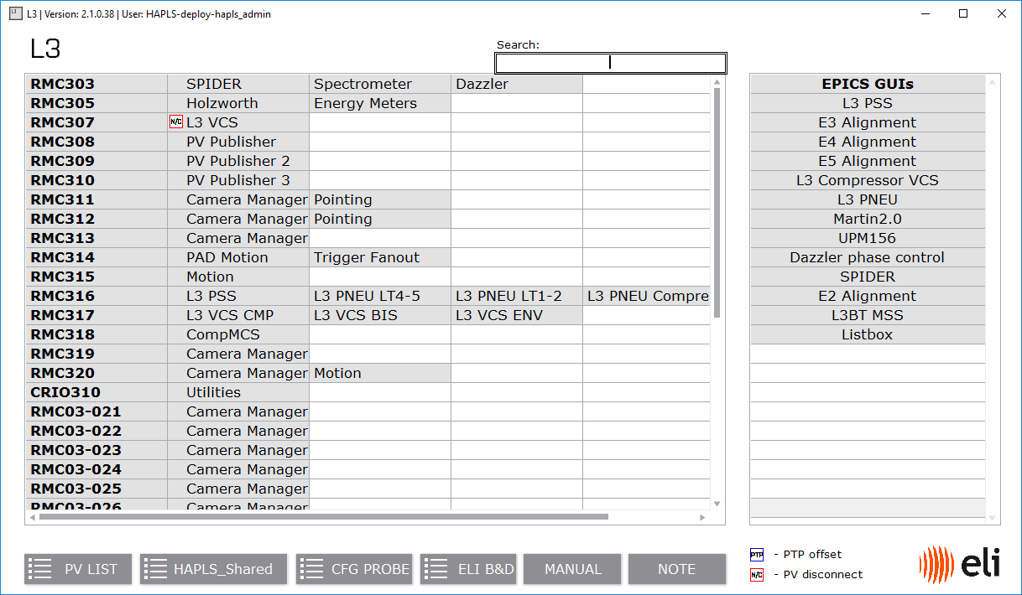
GUIs (I)
A central launcher is used to access developer GUIs
02.08.2021
13

Slide 14
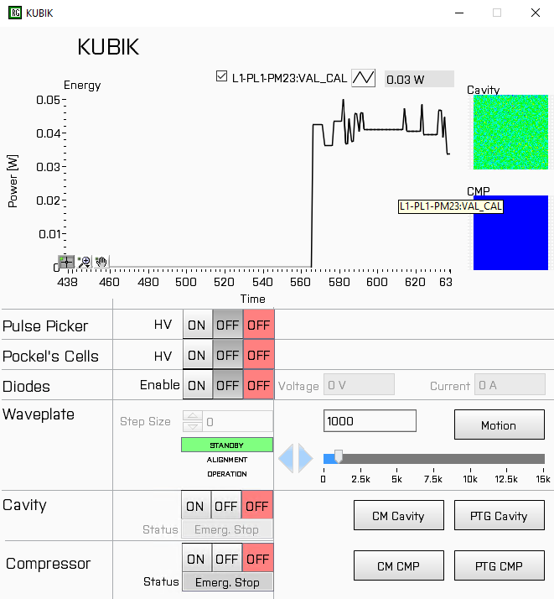
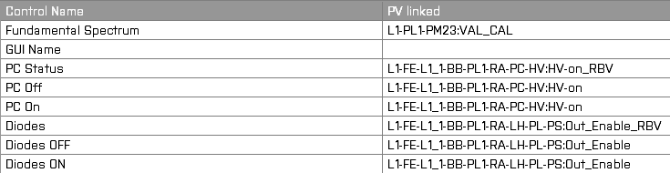
GUIs (II)
EPICS GUIs use a special template that defines their appearance but allows various PVs to be added as data sources
This is stored in the database and it is modifiable using an editor
02.08.2021
14

Slide 15
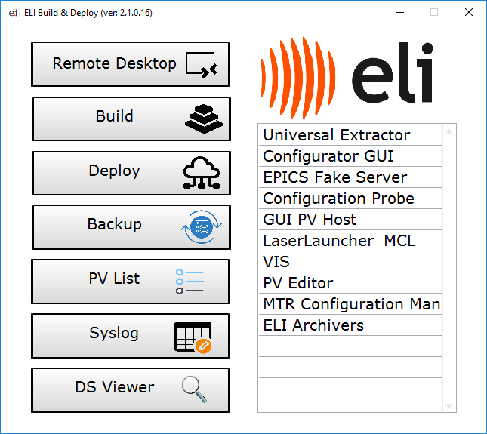
Build & Deploy
Central app allows access to various tasks
02.08.2021
15

Slide 16
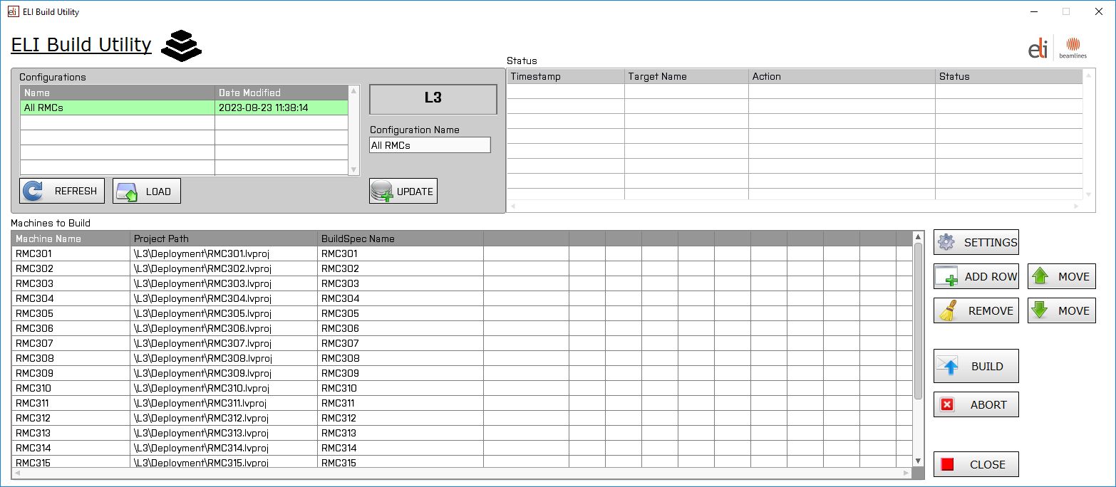
Build & Deploy (Build)
02.08.2021
16

Slide 17
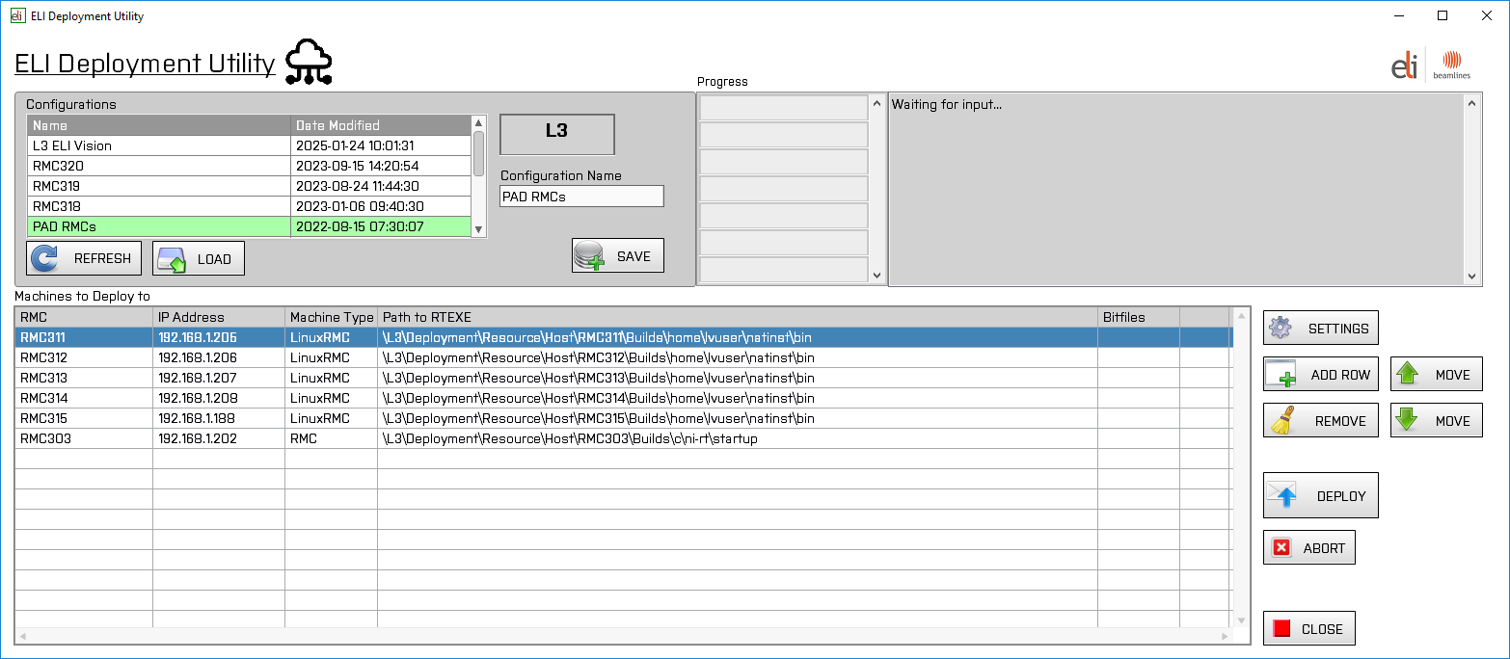
Build & Deploy (Deploy)
02.08.2021
17

Slide 18
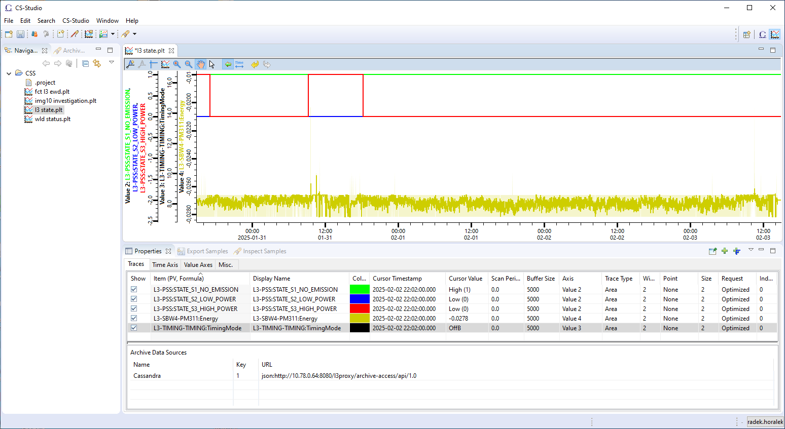
Archiving
Raw archived data are stored centrally for all lasers
02.08.2021
18

Slide 19
Thank you for your attention!
Author: Radek Horalek
(radek.horalek@eli-beams.eu)

