Slide 1

VISUAL ANALYTICS ITCS 5122
Individual Project Presentation by Rohith Vadapalli
Topic: World Test Championship

Slide 2
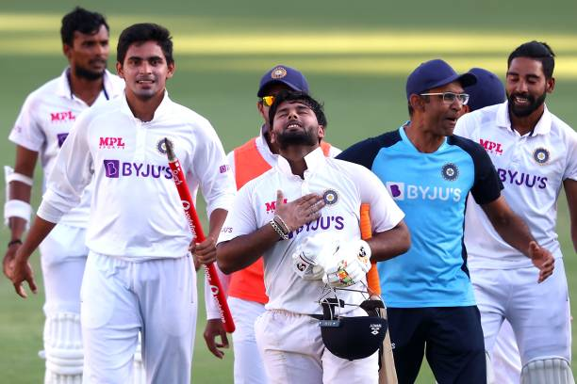
Introduction
The ICC World Test Championship (WTC) is a global competition for Test cricket,introduced to provide context and significance to bilateral Test series. Over a two-year cycle, the top nine Test-playing nations compete by playing a series of matches, with points awarded for wins, draws, or ties. The top two teams at the end of the cycle qualify for a final to determine the world champion. The competition promotes the importance of Test cricket, ensuring that each match carries weight in the race for the championship.
The first WTC cycle took place from 2019 to 2021, with New Zealand winning the inaugural title by defeating India. The ongoing 2023-2025 cycle continues to pit the best Test teams against each other, creating excitement for fans and players alike. By providing a clear championship pathway, the WTC enhances the relevance of Test cricket in the modern game, which is dominated by shorter formats like T20.

Slide 3

About DataSet
The provided datasets focus on three key aspects of cricket:
1. Points Table: This dataset contains team rankings, match outcomes, points, and upcoming fixtures for teams in a competition. It includes information like matches won, lost, tied, drawn, points earned, and team form.
2. Matches: This file provides details of individual matches, including teams, match dates, venues, toss outcomes, player of the match, and match results (winning team, runs/wickets margins).
3. Deliveries: This dataset offers ball-by-ball data for each match, detailing every delivery, including the batting and bowling teams, players involved, runs scored, extras, and wickets taken.
These datasets combined allow for comprehensive analysis of team performance, match outcomes, and player statistics.

Slide 4
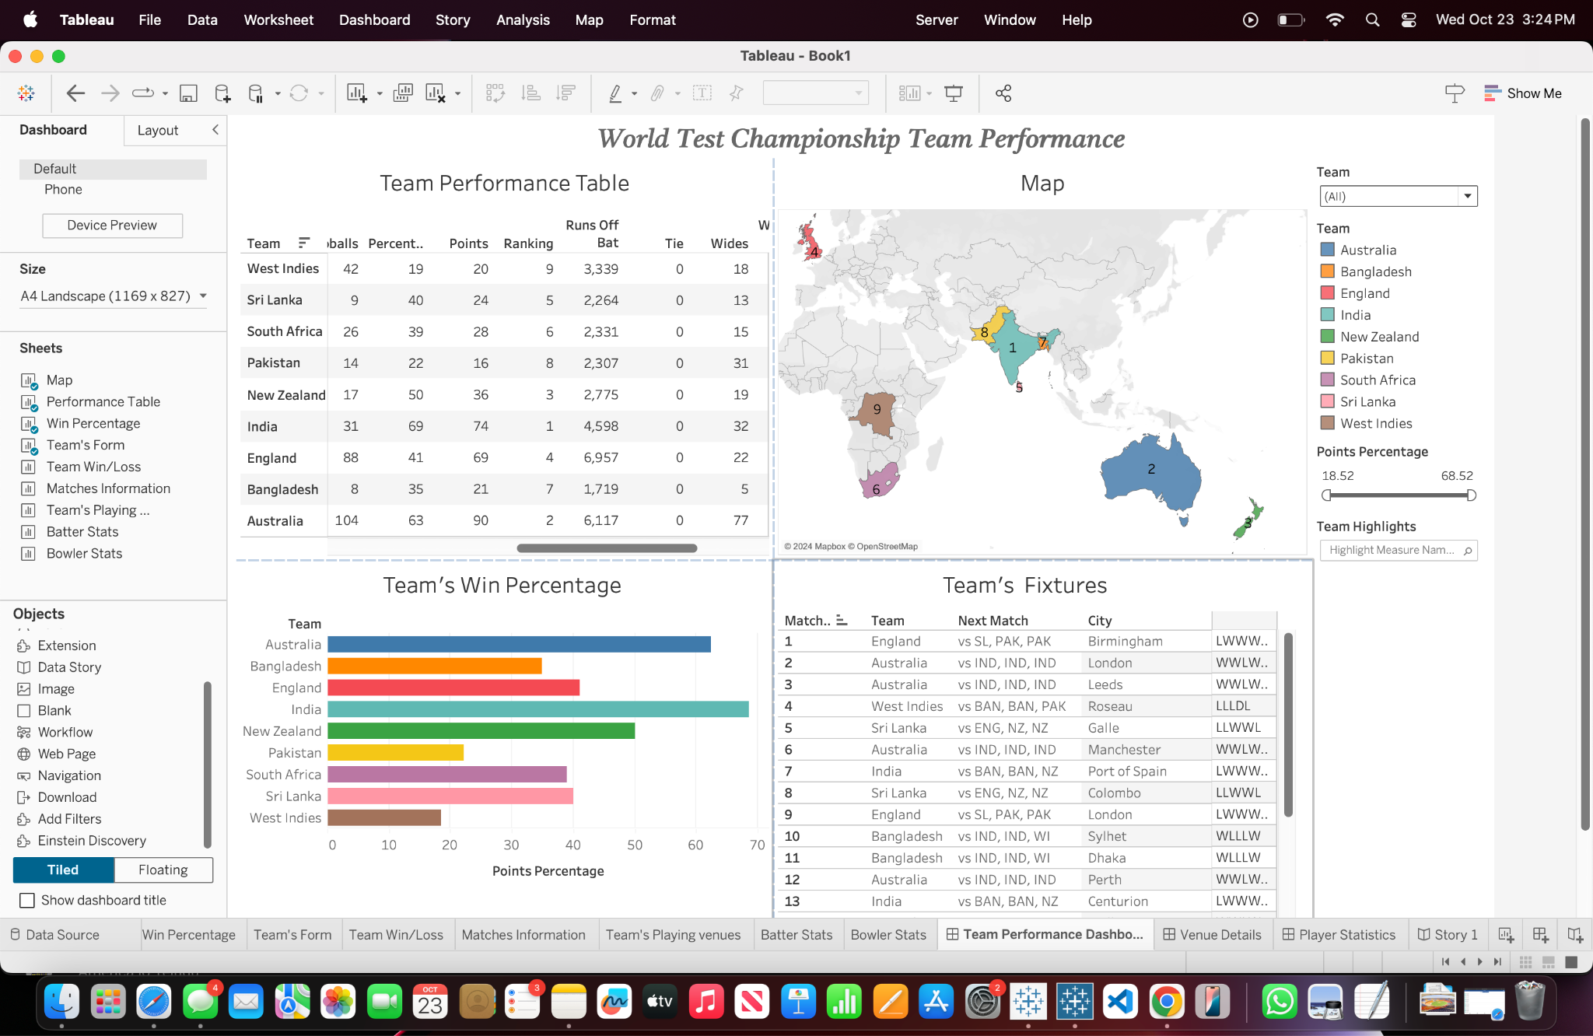
This dashboard provides an insightful overview of the World Test Championship (WTC) Team Performance.
1. Team Performance Table: It highlights key metrics such as the number of matches played, points earned, rankings, runs scored, and other critical stats for each team in the WTC.
2. Geographical Map: Displays the location of each team with a color-coded legend, allowing easy identification of teams based on their points percentage.
3. Win Percentage Bar Chart: Visualizes the win percentage for each team, comparing their overall performance in the WTC.
4. Team’s Fixtures Table: Lists upcoming fixtures for each team, showing the next opponent, venue, and recent form in a compact format.
This dashboard allows for quick comparisons and detailed insights into team performances and schedules within the WTC, providing an all-in-one view for analysts and cricket enthusiasts.

Slide 5
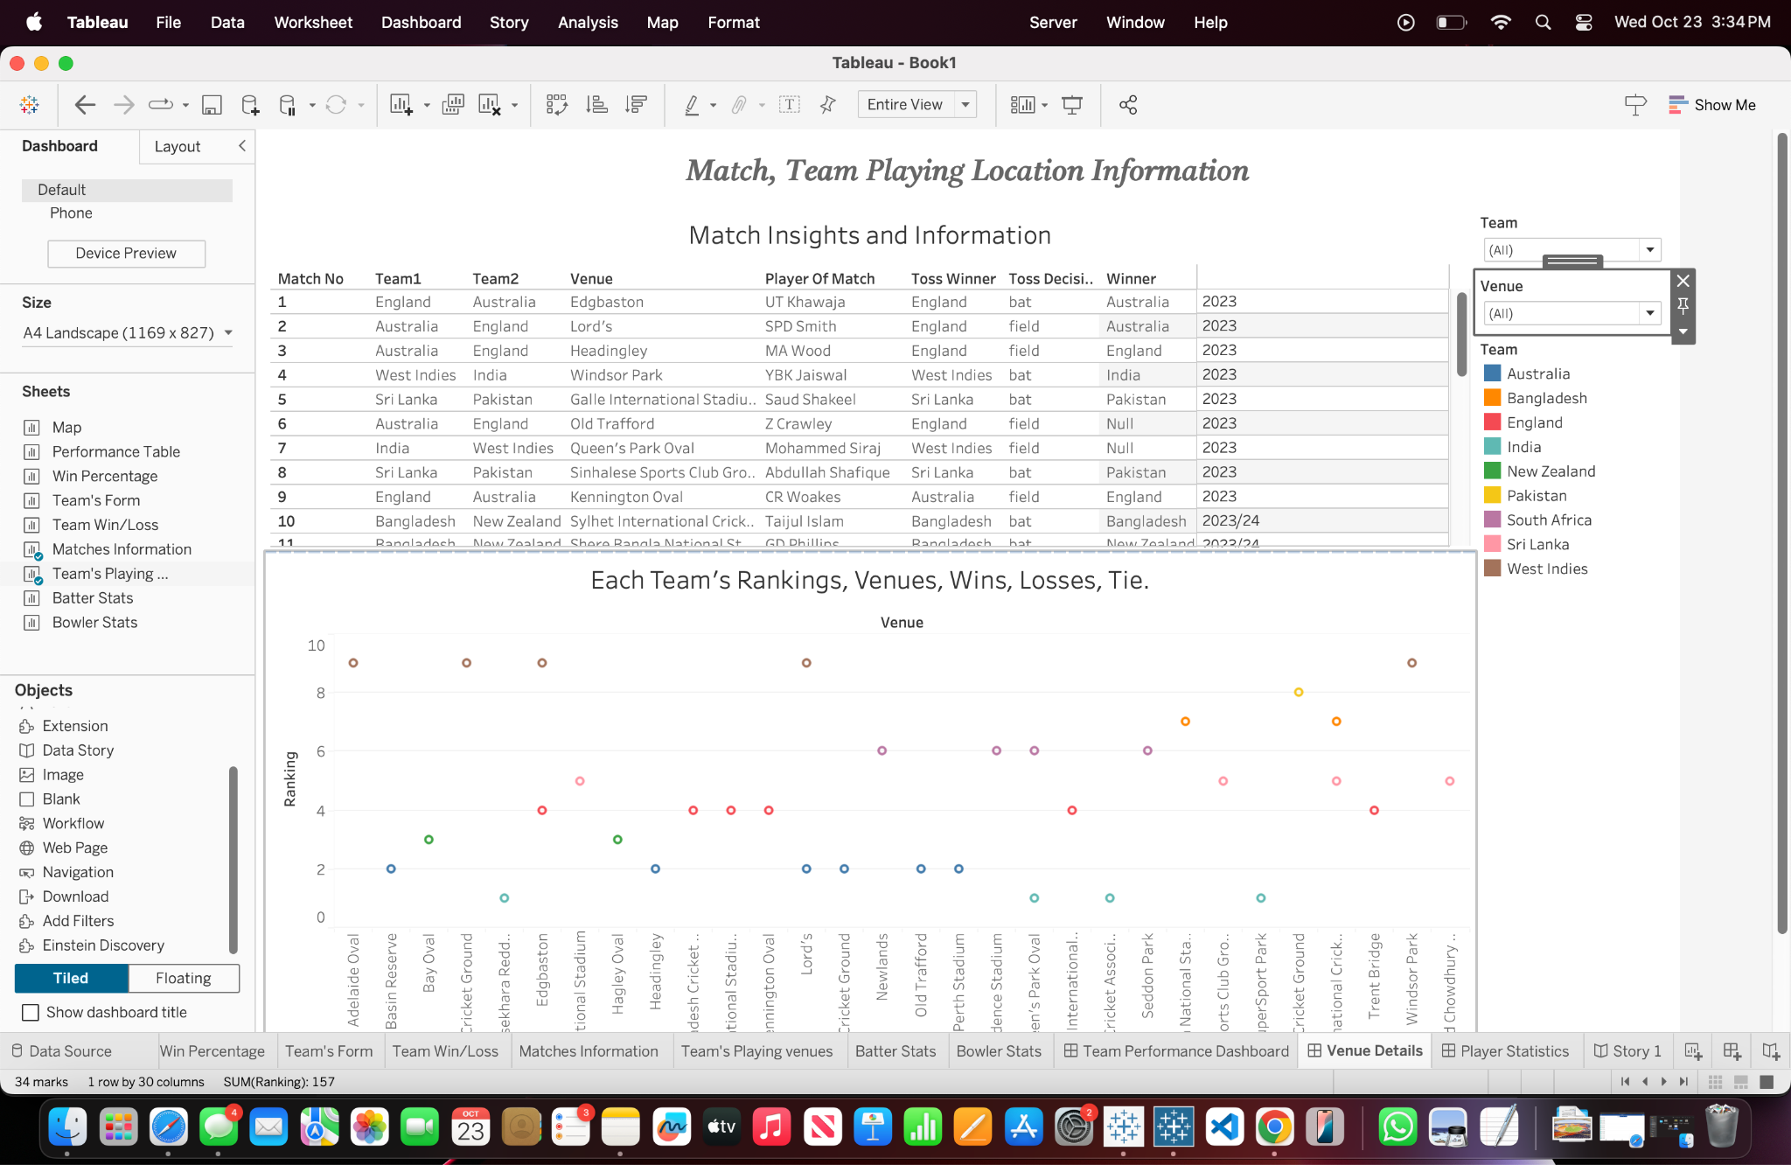
This dashboard provides an in-depth look at Match and Team Playing Location Information for the World Test Championship.
1. Match Insights and Information Table: The table at the top lists detailed information about individual matches, including participating teams, venues, player of the match, toss winner and decision, the match winner, and the year of the match. This allows users to filter and explore specific match results.
2. Scatter Plot Visualization: The lower section displays a scatter plot that illustrates each team's performance (rankings, wins, losses, and ties) across various venues. Different colored dots represent teams, and the x-axis shows the venues while the y-axis tracks rankings, providing a clear view of how teams perform at different locations.
3. Filters: On the right-hand side, filters allow users to narrow down the data by selecting specific teams or venues, making it easier to analyze performances in particular contexts.
Overall, this dashboard enables users to explore match outcomes, venue-specific performance, and team rankings across various venues, offering a comprehensive tool for cricket analysts and fans.

Slide 6
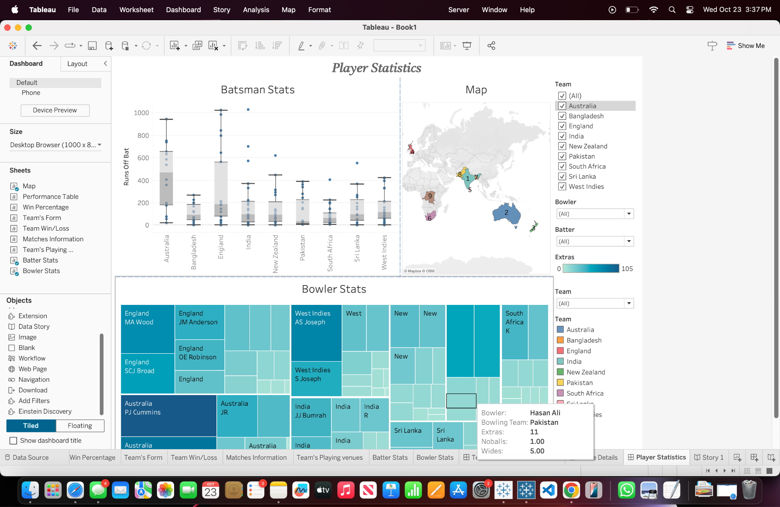
This Player Statistics Dashboard provides an overview of both batting and bowling performances in the World Test Championship.
1. Batsman Stats: The top-left section displays a box plot comparing the runs scored by batsmen from various teams. It highlights the spread of runs, averages, and any outliers, offering insights into batting performance across teams.
2. Map Visualization: The map to the right visually locates the participating teams geographically, with color-coded markers indicating each team's region, providing a quick glance at team distribution.
3.Bowler Stats: The bottom section uses a tree map to represent the performance of individual bowlers. The size and color intensity of the boxes reflect metrics such as the number of wickets taken and extras conceded making it easy to identify top performers and their contributions.
This dashboard offers a clear view of key statistics for batsmen and bowlers, enabling users to analyze individual and team performances throughout the tournament efficiently.

Slide 7
Pros and Cons Of Dashboards
Pros:
Comprehensive Overview: The dashboards provide a detailed and interactive summary of team and player performances, covering key areas like match outcomes, player statistics, and team rankings.
Interactive Filters: Users can easily explore specific teams, players, or venues by applying various filters, enabling personalized insights.
Visual Clarity: The use of different visual elements like scatter plots, bar charts, tree maps, and geographical maps makes the data easy to understand and compare.
Multiple Perspectives: Different aspects like team performance, player statistics, and match information are covered, offering a well-rounded view of the tournament.
Data Granularity: The dashboards allow for both high-level summaries and in-depth analysis, from overall team rankings to ball-by-ball performance metrics.

Slide 8
Cons:
Overcrowded Visuals: Some dashboards may feel crowded with too many elements, making it harder for users to focus on a specific insight without navigating multiple visual components.
Limited Deep Customization: While filters are present, users may not have complete control over every aspect of customization (e.g., advanced drill-downs in player performances).
Data Overload: For casual users, the volume of data visualized might be overwhelming, especially for those unfamiliar with cricket statistics.
Complexity in Interpretation: Some visualizations, like scatter plots and tree maps, may require prior knowledge to fully interpret the results and the significance of the data.

Slide 9
Pros and Cons of the Dataset
Pros:
Rich Detail: The datasets provide detailed, granular information, from team performances to individual ball-by-ball data, enabling in-depth analysis.
Comprehensive Coverage: The datasets cover various aspects of the game, including match outcomes, player stats, and match venues, offering a broad range of analysis opportunities.
Structured Format: The data is structured in a way that is conducive to creating dashboards, making it easier to visualize and analyze the information.
Time-series Capability: With match dates and player performances recorded, time-based trends and comparisons are possible.

Slide 10
Cons:
1. Missing Context: While detailed, the datasets may lack contextual information, such as weather conditions or player injuries, which could affect performance.
2. Data Size: Due to the volume of granular data (especially in the deliveries dataset), processing and visualizing the data may require significant computational resources.
3. Inconsistent Formats: If not carefully cleaned, the datasets could have inconsistencies (e.g., variations in team names or missing values), which may cause issues in analysis or visualization.
4. No Predictive Analytics: The datasets are historical in nature, focusing on past performance, but they do not inherently support predictive or forward-looking analyses without additional modeling.

Slide 11
Future Updations:
Future updates to these dashboards could include incorporating predictive analytics to forecast match outcomes or player performance based on historical data trends. Additionally, integrating external data sources, such as weather conditions or player fitness, could provide deeper context for analysis.
Enhancing real-time data capabilities would allow users to track live match statistics and update dashboards dynamically. Improved customization options for users to create personalized reports or drill deeper into specific aspects of team and player performances would also increase engagement. Lastly, optimizing the visual layout for mobile devices could make the dashboards more accessible on the go.

Slide 12

In conclusion, these dashboards provide a powerful tool for analyzing team and player performances in the World Test Championship, offering detailed insights through interactive visualizations and filters. While they are highly informative and visually appealing, there are opportunities for future enhancements, such as incorporating predictive analytics, real-time updates, and deeper contextual data. By addressing some of the current limitations, these dashboards can evolve into an even more comprehensive and user-friendly platform, empowering both cricket enthusiasts and analysts to make data-driven insights more efficiently.

Slide 13
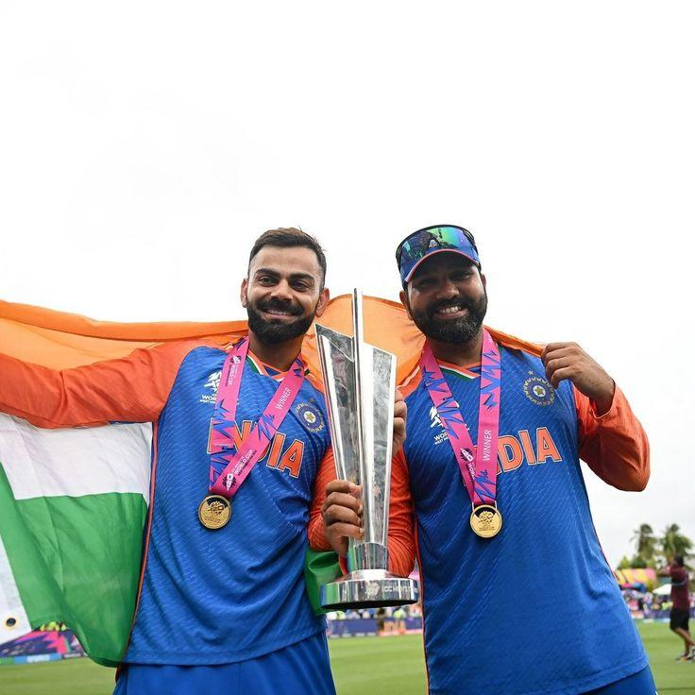
THANK YOU

