Slide 1

AI Agents Architecture

Slide 2
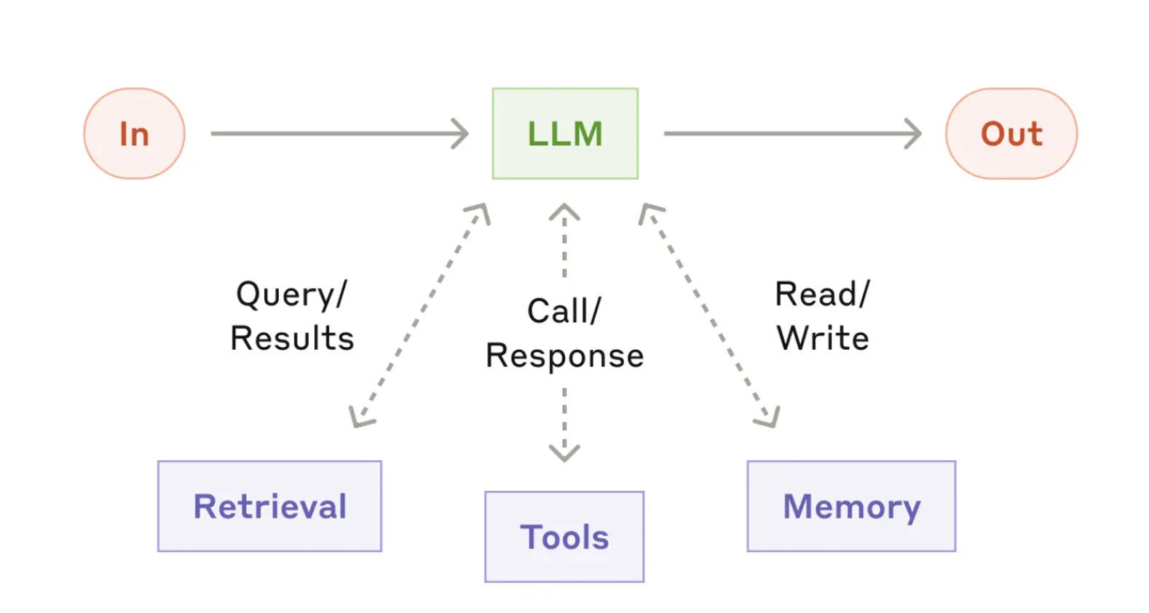
The basic building block of agentic systems shall be LLM’s enhanced with augmentations such as retrieval, tools, and memory
The current models shall actively use capabilities like generating their own search queries, selecting appropriate tools, and determining what information to retain.
Notes:
Flip Data Ecosystem and AI Foundation
Add Operating Model

Slide 3
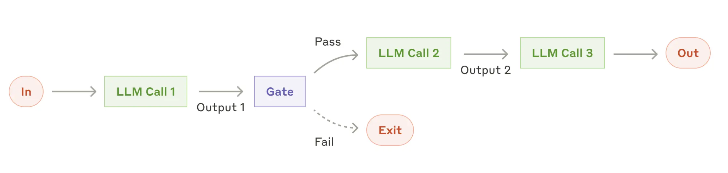

Test
Prompt Chaining Workflow model shall be used in situations where the task can be easily and cleanly decomposed into fixed subtasks.
The main goal is to trade off latency for higher accuracy, by making each LLM call an easier task.
Examples where prompt chaining is useful:
Generating Marketing copy, then translating it into a different language.
Writing an outline of a document, checking that the outline meets certain criteria, then writing the document based on the outline.
Notes:
Flip Data Ecosystem and AI Foundation
Add Operating Model

