Slide 1
Release Notes Automation Framework
Standards-first documentation, built for reliable release publishing intuiract

Slide 2
Problem Statement
Release notes are often manual, inconsistent, and error-prone
Teams lose time reconciling issues, PRs, commits, and QA evidence
Output quality drops when docs are generated without validation
We needed a governed automation path — not ad hoc markdown generation

Slide 3
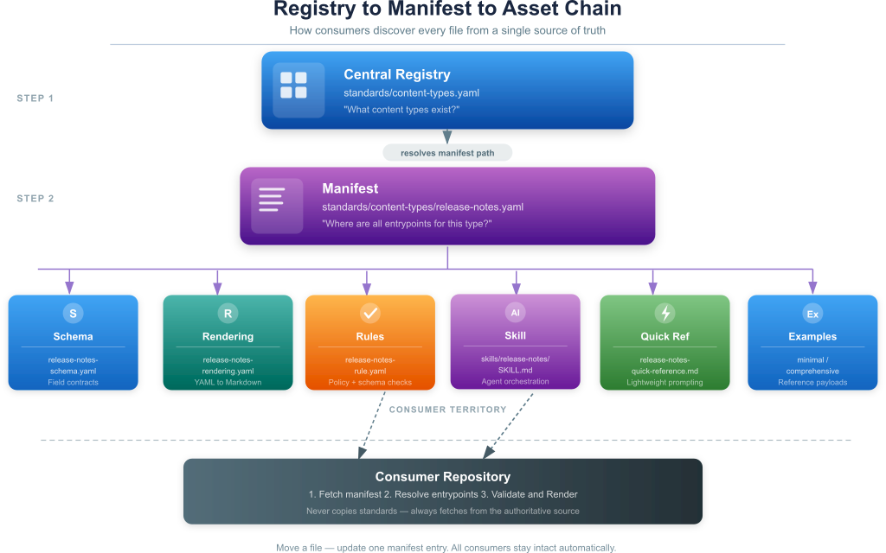
Architecture Diagram
Release Notes Architecture

Slide 4
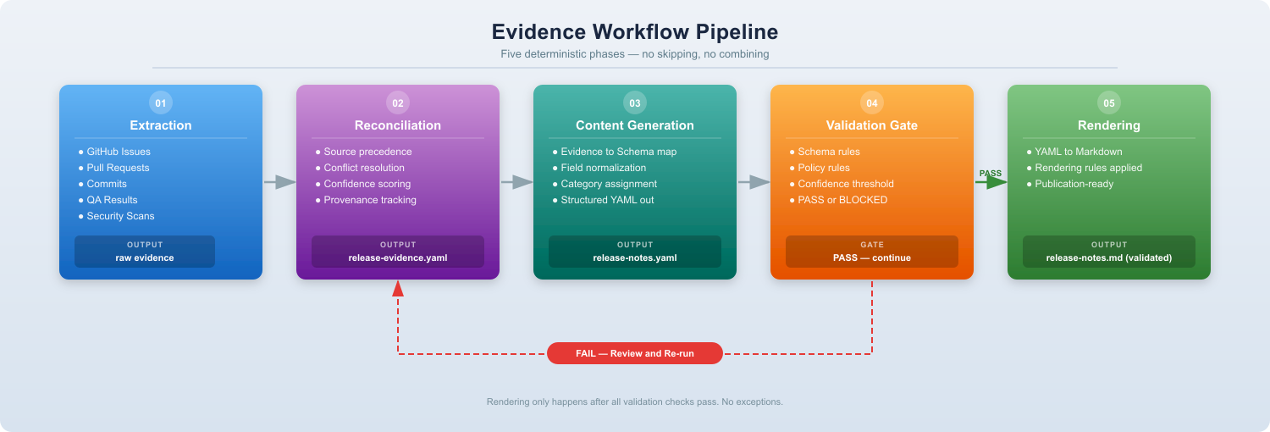
Pipeline
Release Notes Pipeline

Slide 5
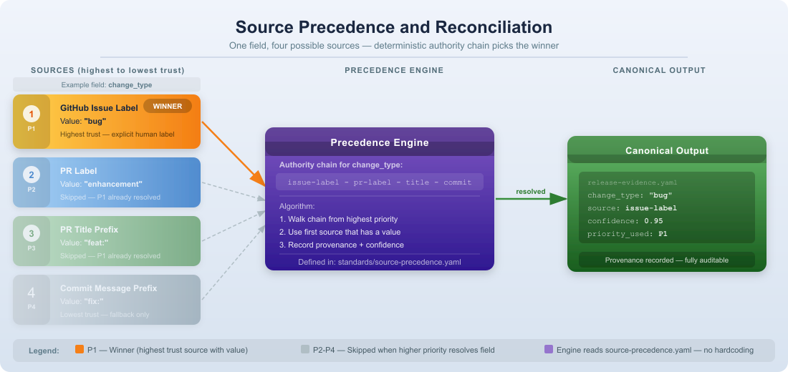
Reconciliation Logic
Release Notes Reconciliation

Slide 6
Our Solution
A standards-driven framework for release documentation.
The release-notes skill:
Extracts evidence from GitHub
Reconciles multiple conflicting sources
Normalizes and scores each item
Validates structured output against a schema
Renders publication-ready Markdown only after passing all checks

Slide 7
What Makes It Different
Not just “git diff → doc.”
Built on:
standards/content-types.yaml — central registry
Content type manifests — stable pointer files
Canonical schema and rendering rules
Validation rules — schema, policy, confidence
Human-readable skill and process documentation
Outcome: deterministic, auditable, reusable

Slide 8
Key Architecture
Registry-first discovery:
Registry: standards/content-types.yaml
Manifest: standards/content-types/release-notes.yaml
Schema: templates/release-notes/release-notes-schema.yaml
Rendering: templates/release-notes/release-notes-rendering.yaml
Rules: rules/release-notes/release-notes-rule.yaml
Skill: skills/release-notes/SKILL.md

Slide 9
Evidence Workflow
Five phases — no skipping, no merging:
Extraction — issues, PRs, commits, QA results, scans
Reconciliation — source precedence, conflict resolution, confidence scoring
Content Generation — map normalized evidence into release-notes schema
Validation — schema + policy + confidence gate
Rendering — Markdown output only after all checks pass

Slide 10
Governance and Safety
Source precedence removes guesswork — every field has a deterministic authority chain
Validation prevents bad releases from being published
Confidence thresholds enable safe automation with minimal manual review
Path conventions protect schema and rule references from breaking across repos

Slide 11
Benefits Delivered
Faster, more reliable release note assembly
Consistent structure across every release
Better audit trail — provenance recorded for each release item
Single authoritative standard for all consumer repositories
Easier onboarding for new products and content types

Slide 12
Why This Matters for Management
Reduces release documentation risk
Scales from one skill to many content types without rework
Supports compliance and traceability requirements
Lowers cost of documentation creation and review
Positions us to offer a reusable, upgrade-safe documentation standard

Slide 13
Next Steps
Demo the release-notes skill with a real release cycle
Onboard one product team to the registry/manifest pattern
Extend the framework to additional content types
Track quality improvements and time saved
Adopt as the standard release documentation process across all products

Slide 14
Course Correction — Closing the Execution Gap
The design is Tier 4. The execution is still Tier 2 — reconciliation logic lives in prose instructions where deterministic code should run. Three focused moves close that gap:
Prompt caching — standards files are large and static; cache them once, cut token cost on every future run permanently
Structured outputs — replace free-form YAML generation with schema-enforced structured output; catch violations at generation time, not after
reconcile.py — move source-precedence application from LLM instruction to actual Python code; this is the single most important gap between design and reliable production behaviour
None of these change the architecture. All three make what is already designed actually trustworthy at scale.

Slide 15
Immediate Roadmap
Stage | Action
Now | Harden execution — prompt caching, structured outputs, reconcile.py
Next | Test reconciliation on a real repo with messy data — inconsistent labels, PRs without linked issues, missing milestones
Then | Package as GitHub Action — triggered on tag push, runs pipeline end-to-end with zero manual work
Later | MCP Server + multi-output pipeline — expose pipeline phases as callable tools; extend evidence model to generate features pages and API changelogs alongside release notes

Slide 16
Roadmap Diagram
Roadmap

