Slide 1


Spendee
Expense Tracker and Budget Manager

Slide 2

Outline
INTRODUCTION
SCOPE
MAJOR FEATURES
FLOWCHART
ADVANTAGES
CONCLUSION
REFERENCE LINKS

Slide 3


Introduction
In today’s era, you have the usual array of rent and utilities to pay.
Can’t handle our cash flow.
Find an easier way to get rid of this problem.
This project is an attempt to manage our daily expenses in a more efficient and manageable way.

Slide 4

Cont…
Our application helps in,
Keep the control on the expenses.
Free the user with as much as possible the burden of manual calculation.
Keep the track of the expenditure.

Slide 5



Scope
For domestic use and for small retailers only.
Does not meet all the requirements of higher-level businesses.
It is usable by anyone who are aiming to save for the future investments and many more.

Slide 6



Development Environment
System software: Android Studio
Programming Language: Java
Database: Firebase Real Time Database

Slide 7



Major Features
Income
We can add our monthly or daily income.
We compare our daily expenses with our income and we try to reduce the expenses which are not needed too much.

Slide 8


Cont…
Expense
Using this feature we enter our daily expenses in this feature.
We can also see that where we expense too much and to compare with our income, where we control our expenses.

Slide 9



Cont…
Search
Using this feature user can search the data of his income and expenses
Calculator
If user wants to use simple calculator this feature will provide the facility to use current device’s default calculator.
Statistical view of expenses per day
If user wants to see graphical representation of their daily expenses, then this feature will fulfil their need.

Slide 10


Cont…
TAX calculator
User can calculate our annual taxes.
Add the amount to the expense manually.
EMI Calculator
If the user wants to know the EMI he can use this feature to calculate.

Slide 11

Cont…
Other features
Alert of low balance
Rate us
Delete account
Change password
Logout

Slide 12

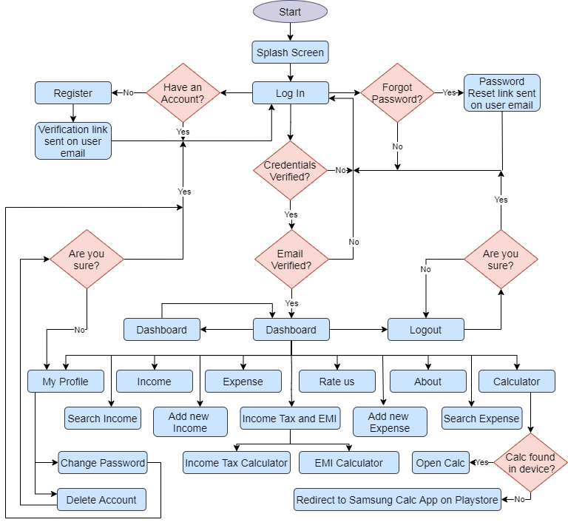

Slide 13


Advantages
Help us to keep track of how much we spend every day and on what.
At the end of the month, we will have a clear picture where our money is going.
Get our expenses under control
Bring some semblance of order to our finances.

Slide 14


Conclusion
Expense Manager is an online app.
Is able to show all the information about how user uses and manages his/her allowance.
As technology emerges, it is possible to upgrade the system.

Slide 15


Reference links
https://developer.android.com/guide/topics/ui
https://developer.android.com/guide/topics/search/search-dialog
https://developer.android.com/training/basics/intents/sending
https://www.youtube.com/watch?v=6YZjwBTrXOs
https://firebase.google.com/docs/auth/android/start
https://firebase.google.com/docs/auth/android/email-link-auth
https://firebase.google.com/docs/auth/android/password-auth
https://firebase.google.com/docs/database/android/read-and-write

Slide 16
THANK YOU..

