Slide 1
Introduction to Functional Programming

Slide 2
What to expect
an overview of Functional Programming and basic concepts
basic Haskell syntax (yes, we'll use Haskell!)
being able to build a program!

Slide 3
Why Haskell?
It's purely functional, so it's easier to identify the concepts being explained.
Paradigm concepts are easily translated to other languages, such as Scala
Because it's awesome
It does not allow you to shoot yourself in the foot
Because it's elegant and clean, it becomes easy to read once you know the minimal syntax

Slide 4
Functional programming
Simply put, it is programming with functions.
A function is:
a description of a computation (a mapping from its input values to an output value);
a value that can be passed over (or be returned from) to another function.
myFunction :: Arg1Type -> Arg2Type -> ... -> ReturnType
myFunction arg1 arg2 ... = body
We can call the function like this:
myFunction arg1 arg2
Functions can also be pure and total.

Slide 5
Pure functions
A function where the return value can only be affected by its input parameters, and it does not produce any observable side-effect is called a pure function - the only effect of the function is the produced return value.
this property is called referential transparency
it allows equational reasoning:
y = f x
g y == g (f x)
Or, if we know that f x is 42, we could simply replace g y with g 42 and be sure that the program still works exactly the same.

Slide 6
Total functions
A function is called total when it has a return value for every combination of its possible input values.
For example, a total function could look like this:
f :: Integer -> Integer
f x = 2*x
Another example, where the function is only defined for just some input values, is not a total function:
f :: Integer -> Integer -> Integer
f x y = x `div` y
Let's try:
> f 4 2
2
> f 4 0
*** Exception: divide by zero

Slide 7
Defining data types
data MyType = MyIntType Int | MyEmptyType | MyStringType String
Defines a new type MyType and provides three alternative data constructors:
MyIntType has one Integer parameter
MyEmptyType has no parameters
MyStringType has one String parameter
> let x = MyIntType 1
> :type x
x :: MyType

Slide 8
List
A data structure that keeps a list of elements of the same type.
data List a = Nil | Cons a (List a)
A list can either be empty list Nil, or Cons, that prepends an element of type a to a list of the same type.
A list of type a in Haskell is denoted as [a]. Nil is represented as [] and Cons - :.
> [1, 2, 3]
[1,2,3]
> 1 : 2: 3 : []
[1,2,3]
Some common functions:
head [1, 2, 3] = 1
tail [1, 2, 3] = [2, 3]
take 2 [1, 2, 3] = [1, 2]

Slide 9
Ranges
A simple way to create lists of number ranges, is to use the .. operator. For example:
> [1..5]
[1,2,3,4,5]
We can specify the increment amount for a range by telling the compiler what the second elment of the sequence will be:
> [1,3..11]
[1,3,5,7,9,11]
Ranges can be used to create lists of characters:
> ['a'..'f']
"abcdef"
> ['a','c'..'z']
"acegikmoqsuwy"

Slide 10
Ranges
We can also create infinite lists of numbers by not specifying the end limit value for the range, as so:
[1..]
Because Haskell is lazy, you can create such lists and the compiler will be able to handle them.

Slide 11
Going further
Let's look as some more advanced features provided by Haskell:
Pattern matching
Strong type system
Curried functions
Lambda functions
Composing two functions
Higher order functions
Lazy evaluation

Slide 12
Pattern matching
powerful alternative for many if statements
functions are written in declarative manner
destructuring matches
maybeDiv :: Int -> Int -> Maybe Int
maybeDiv _ 0 = Nothing
maybeDiv a b = Just (a `div` b)
If the second parameter is 0, the function will match the first case - maybeDiv _ 0 and return Nothing as the result - parameters marked with _ match everything and are ignored. For all other cases, the second line will match as the default case: maybeDiv a b and capture the argument values as a and b.
maybeDiv 10 2 == Just 5 -- True
maybeDiv 10 0 == Nothing -- True

Slide 13
Pattern matching
Let's create a Fibonacci number generator!
fib :: Integer -> Integer
fib 0 = 1
fib 1 = 1
fib n = fib (n-1) + fib (n-2)
First the input argument is matched against the literal 0 - if it matches the function returns 1 (fib 0 = 1).
Otherwise, it is matched against the literal number 1 - if it matches the function returns 1 (fib 1 = 1).
If the above checks don't match, the input argument is matched against a variable n, which will match any value that was passed to the function, and place it in the variable n. At this point, the variable n can be used in the expression on the right side to make recursive calls to fib (fib n = fib (n-1) + fib (n-2)).

Slide 14
Destructuring matching
maybePlus :: Int -> Maybe Int -> Maybe Int
maybePlus a (Just b) = Just (b + a)
maybePlus _ Nothing = Nothing
If the second parameter is a value of Just t - a possible value of Maybe Int type, it matches the first case and labels the integer contained in the value as t. Alternatively, the second case matching maybePlus _ Nothing will capture all inputs where the second argument is Nothing.
maybePlus 10 (Just 5) == Just 15 -- True
maybePlus 10 Nothing == Nothing -- True
or, combined with the function defined earlier:
maybePlus 10 (maybeDiv 10 2) == Just 15 -- True
maybePlus 10 (maybeDiv 10 0) == Nothing -- True

Slide 15
Strong typing
"If it type-checks, it's most likely good"
types not only help to ensure that a program works correctly, but also provide a headline of what a function is doing
for convenience, most compilers implement type inference
maybePlus :: Int -> Maybe Int -> Maybe Int
...
maybePlus (maybeDiv 10 0) 10
<interactive>:58:12: error:
• Couldn't match expected type ‘Int’ with actual type ‘Maybe Int’
• In the first argument of ‘maybePlus’, namely ‘(maybeDiv 10 0)’
In the expression: maybePlus (maybeDiv 10 0) 10
In an equation for ‘it’: it = maybePlus (maybeDiv 10 0) 10

Slide 16
Strong typing
map :: (a -> b) -> [a] -> [b]
Given the above function signature, we can already say what the function is doing:
given a function (a -> b)
and a list [a]
it will map over the list, applying the given function and return a list of its return values
Note: the example here uses variable types, and Haskell will infer the actual types based on the usage of the function - as long as the types marked with the same letter (a or b) are the same, the function will work correctly.

Slide 17
Curried functions
All functions in Haskell either return the end result or a function to get it:
f :: a -> b -> c
f 3 has type (b -> c), which is a function itself. An example of this can be a sum:
addNumbers x y = x + y
addFive = addNumbers 5
addFive 2 -- will return 7
addNumbers 5 returns a function that takes one parameter y and results in 5 + y.
In Haskell, all functions are curried.

Slide 18
Lambda functions
It is frequently convenient to express simple functions anonymously - without assigning a specific label to them, but rather just "embedding" them in the function call directly - as seen in the example below, where 5 is being added to every element of the list.
The syntax to declare a lambda function is: \parameters -> body.
map (\x -> x+5) [1..]
Why "\"? Because (\ resembles a lambda symbol (if you squint hard enough).

Slide 19
Composing two functions
In Haskell, it is possible to compose two functions to one using the . operator:
foo :: Int -> String
foo = show
bar :: String -> [String]
bar x = [x]
foobar = bar . foo
foobar 5 -- ["5"]
> :info foobar
foobar :: Int -> [String]
bar composed with foo will call the function foo first, and pass its results to the argument of bar returning the final results.

Slide 20
Composing two functions
The . operator is not a specific language construct - like many others, it is a simple function, defined in the Prelude:
(.) :: (b -> c) -> (a -> b) -> (a -> c)
(.) f g = \x -> f (g x)
It takes two functions b -> c (f) and a -> b (g), and returns a function of type a -> c, hiding the intermediate type b by passing it directly to the function f. As it does not capture the argument of type a in the argument list, this implementation uses a lambda function to capture it as x.
Alternatively, this could be written as:
(.) :: (b -> c) -> (a -> b) -> (a -> c)
(.) f g x = f (g x)
Note: Prelude is a standard library enabled by default for all Haskell programs.

Slide 21
Higher order functions
Wikipedia:
“In mathematics and computer science, a higher-order function is a function that does at least one of the following:”
For example, map and fold (reduce) are very common higher order functions in functional paradigm.
> :type map
map :: (a -> b) -> [a] -> [b]
> :type foldl
foldl :: Foldable t => (b -> a -> b) -> b -> t a -> b

Slide 22
Lazy evaluation
most programming languages use eager evaluation
but some start to implement lazy generators
Haskell is lazy: it will only compute a value when it is actually used
memory requirements are less explicit and more difficult to reason about
however, it is very convenient - allows "infinite" computation definitions (e.g. an infite list is expressed as [1..]):
> take 5 [1..]
[1,2,3,4,5]

Slide 23
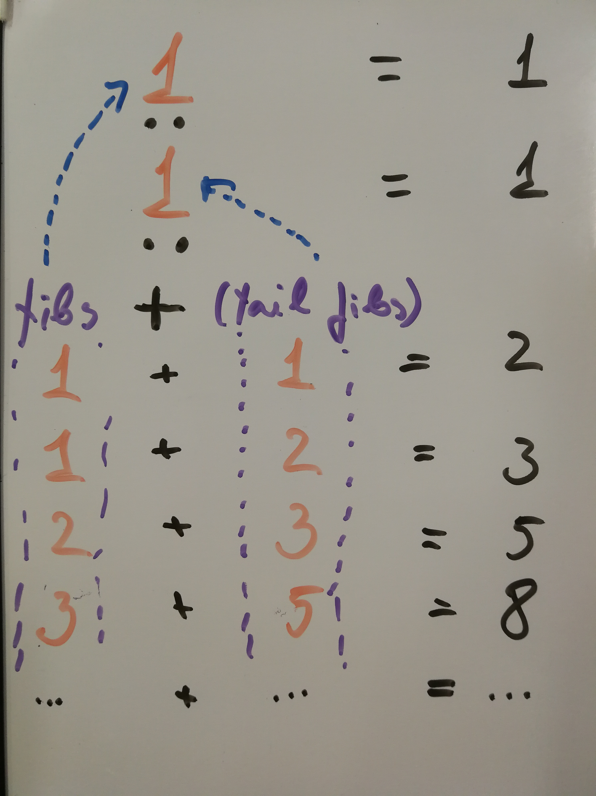
... or even
fibs :: [Integer]
fibs = 1 : 1 : zipWith (+) fibs (tail fibs)
This defines a Fibonacci sequence, as an infinite recursive function.
When calculating, e.g. take 10 fibs, it will return [1,1,2,3,5,8,13,21,34,55], where:
it starts with [1, 1]
2 was generated as 1+1 (sum of first and the second values of fibs)
once we have 2, it generates the next element - this time 1 + 2
and so on, until we get 55 - which is the 10th element.
As we only requested 10 elements, Haskell will stop after calculating the 10th element and will not be stuck calculating the sequence numbers forever, even though there is no exit condition defined in the function fibs.

Slide 24
A practical example

Slide 25
Let's build an application!
We'll start with a simple one - an application that prints sorted numerical arguments.

Slide 26
Defining main
main :: IO ()
main = return ()
A minimal program that does nothing at all. It defines an empty main function that Haskell uses as the entry point.
You'll notice that it hast type of IO a - a context that is allowed to execute I/O functions.

Slide 27
Unit ()
In Haskell () is called Unit. Unit is used to denote a type that carries no information. It is often used when causing side-effects which will have no useful information to give back. For example:
hello :: IO ()
hello = putStrLn "Hello World"
In this case printing a string has no relevant value to return, so it returns (). In this example, () is wrapped in the context of IO because that's the only context where side-effects are allowed in Haskell.

Slide 28
The return function
main :: IO ()
main = return ()
In Haskell, the return value of a function is the result of evaluation the expression inside of that function. As so, there's is no motive to have a return keyword as you find in other languages. There is though, a return function in Haskell, but it does something completely different from what you may be used to.
In Haskell, return is a function that will give you back a value wrapped inside the context of the expression it is at. It sounds more complicated than what it really is. In the example above, it returns () in the context of IO, so IO ()

Slide 29
IO type
Because Haskell is a pure functional programming language, it does not allow printing, or doing any other side-effects in pure logic functions.
But how do we implement a useful program then?!
The answer is - IO monad.

Slide 30
Monad?
A simple description is - it allows to define chained actions in a specific context. A convenient way to express such chained actions is using the do notation:
worldType :: IO String
worldType = return "Haskell"
main :: IO()
main = do
whatWorld <- worldType
let fullText = "hello " ++ whatWorld ++ " world"
putStrLn fullText

Slide 31
Monad
worldType :: IO String
worldType = return "Haskell"
main :: IO()
main = do
whatWorld <- worldType
let fullText = "hello " ++ whatWorld ++ " world"
putStrLn fullText
The "Do" notation allows you to extract a value which is inside of a context (the right side of the <- expression), out of that context. This allows you to use it in a chain of such expressions. The last expression in the do notation, will be returned as the result, and it needs to be in the same context (in the above example IO).

Slide 32
App arguments
import System.Environment (getArgs)
main :: IO()
main = do
args <- getArgs
return ()
To access the program arguments, we will import a standard Haskell function getArgs which, as it needs to interact with the environment, is also defined in the IO context and returns the arguments as a list of strings:
> :info System.Environment.getArgs
System.Environment.getArgs :: IO [String]

Slide 33
Sort!
Let's implement our sorting algorithm:
quicksort [] = []
quicksort (p:xs) = (quicksort lesser) ++ [p] ++ (quicksort greater)
where
lesser = filter (< p) xs
greater = filter (>= p) xs
While not the most efficient, however a quite simple implementation of a popular sorting algorithm.
Notice, that it does not need to interact with I/O and is considered a pure function.
Also, it does not have a function signature! This lets the Haskell compiler to infer the actual types based on both the usage and implementation of the function as we'll see in the further examples.

Slide 34
...sort
But how can we use it?
main :: IO()
main = do
args <- getArgs
putStrLn (quicksort args)
An error!
test.hs:12:15: error:
• Couldn't match type ‘[Char]’ with ‘Char’
Expected type: String
Actual type: [String]
• In the first argument of ‘putStrLn’, namely ‘(quicksort args)’
In a stmt of a 'do' block: putStrLn (quicksort args)
In the expression:
do { args <- getArgs;
putStrLn (quicksort args) }
putStrLn expects a singe string, instead of a list of strings!

Slide 35
Print result
putStrLn expects a singe string, instead of a list of strings! To fix this, we'll use intercalate function imported from the Data.List module.
import Data.List (intercalate)
main :: IO()
main = do
args <- getArgs
putStrLn (intercalate " " (quicksort args))
It's working!
# runghc test.hs 10 100 20
10 100 20
But what's this? 20 should be before 100!

Slide 36
Sorting as integers
20 should be before 100! The reason, as you might have guessed, is that Haskell sorted the arguments as strings. Let's convert the arguemnts to integers:
import Data.Maybe (catMaybes)
main :: IO()
main = do
args <- getArgs
let integerArgs = (catMaybes (map readMaybe args))::[Int]
putStrLn (intercalate " " (map show (quicksort integerArgs)))
That's better:
runghc test.hs 10 100 20 asd
10 20 100
Note: to convert the integers back to strings, we have used the show function.

Slide 37
Combine functions
As we have a working application, let's make it a bit nicer. We'll create small, descriptive functions to be able to read the program easily:
extractIntegers :: [String] -> [Int]
extractIntegers = catMaybes . map readMaybe
formatString = intercalate " " . map show
sortStringsAsIntegers = formatString . quicksort . extractIntegers
main :: IO()
main = do
args <- getArgs
putStrLn (sortStringsAsIntegers args)

Slide 38
Final result
import System.Environment (getArgs)
import Data.List (intercalate)
import Text.Read (readMaybe)
import Data.Maybe (catMaybes)
quicksort [] = []
quicksort (p:xs) = (quicksort lesser) ++ [p] ++ (quicksort greater)
where
lesser = filter (< p) xs
greater = filter (>= p) xs
extractIntegers :: [String] -> [Int]
extractIntegers = catMaybes . map readMaybe
formatString = intercalate " " . map show
sortStringsAsIntegers = formatString . quicksort . extractIntegers
main :: IO()
main = do
args <- getArgs
putStrLn (sortStringsAsIntegers args)

Slide 39

Thanks!

