Slide 1
elections2016
File created on: 6/25/20 12:17:24 AM EDT

Slide 2
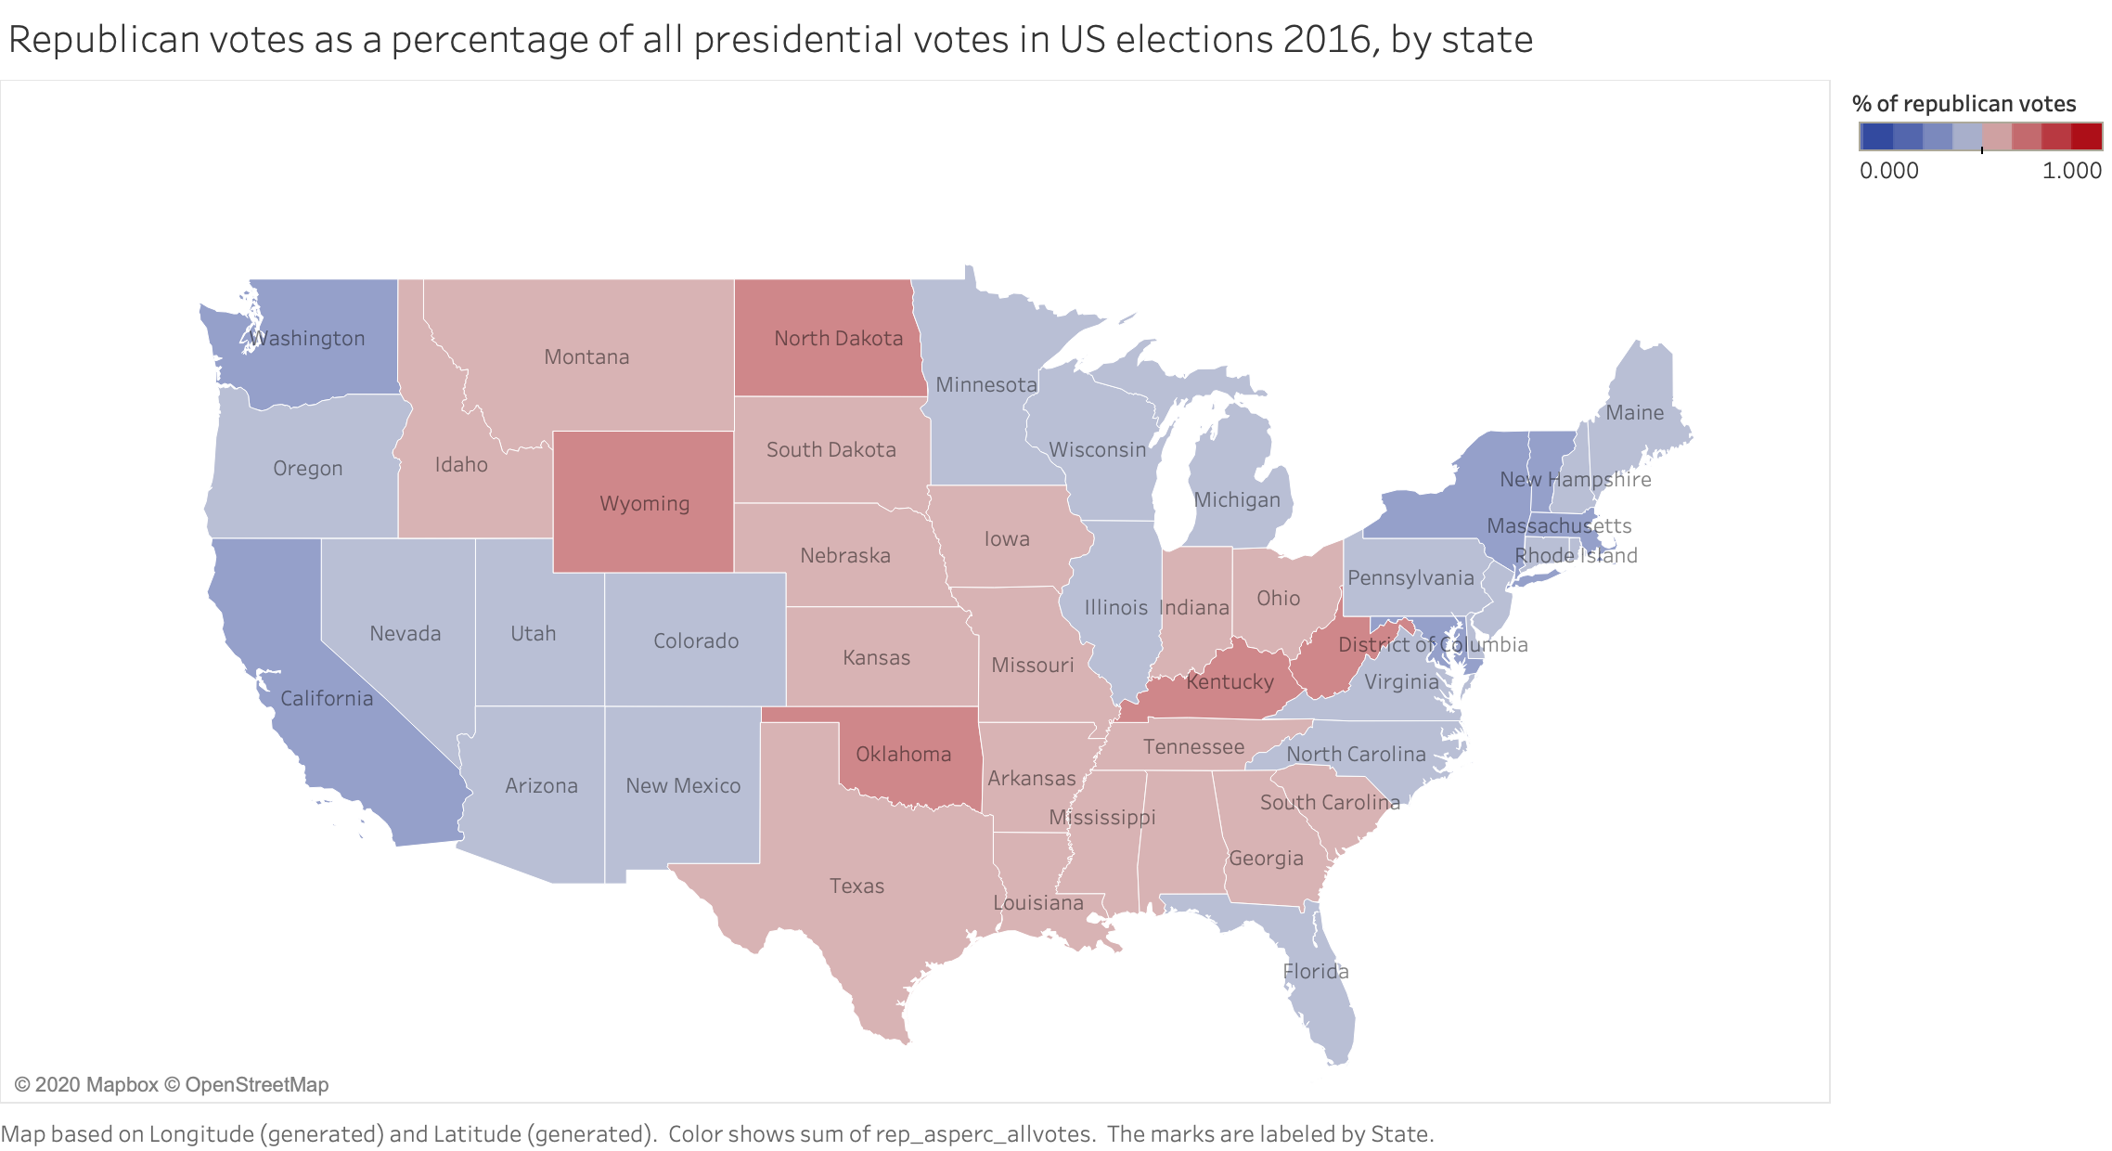

Slide 3
