Slide 1
ANALYSIS OF THE GLOBAL VIDEO GAMES MARKET
GWU - DATS 6103 (Fall 2019)

Slide 2
OUTLINE
ABOUT THE PROJECT
SOURCE OF THE DATA
ANALYSIS OF THE GAMING MARKET
CONCLUSION

Slide 3
I. ABOUT THE PROJECT
In 2017 it was valued at 802 USD million and it is expected to grow for the following years (Zion Market Research).
This project explores the growth of the global gaming industry. It is relevant for publishers and developers of video games to understand the major changes in the gaming industry for the last decades. It is important for them to understand what have been the major changes in the gaming industry over the last decades and can we expect for the upcoming years.
To answer these questions, this projects explores the following topics:
Most popular video games by genre
Most popular video games by region
Most popular consoles
Source: “Cloud Gaming Market by Cloud Type (Public, Private, and Hybrid), by Streaming Type (Video and File), and by Device (Smart Phones, Tablets, Gaming Consoles, and PCs): Global Industry Perspective, Comprehensive Analysis, and Forecast, 2018—2026”

Slide 4
II. SOURCE OF THE DATA
The data of this project was extracted from VGCchartz, a video game sales tracking website. It has information about the consoles, developers, scores, sales, genre, and the year when the video games were released since the 1970s.
The information was scrapped from VGChartz website on November 30th, 2019. “BeutifulSoup” was used for parsing the page.
After the information was successfully extracted, it was stored in a csv file, called "vgames.csv", that was used for reading and manipulating the data.

Slide 5
III. ANALYSIS OF THE GAME MARKET

Slide 6
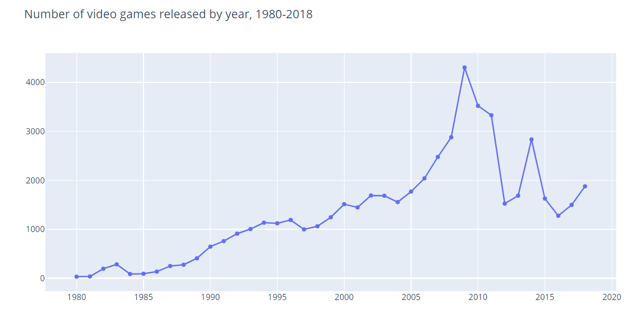
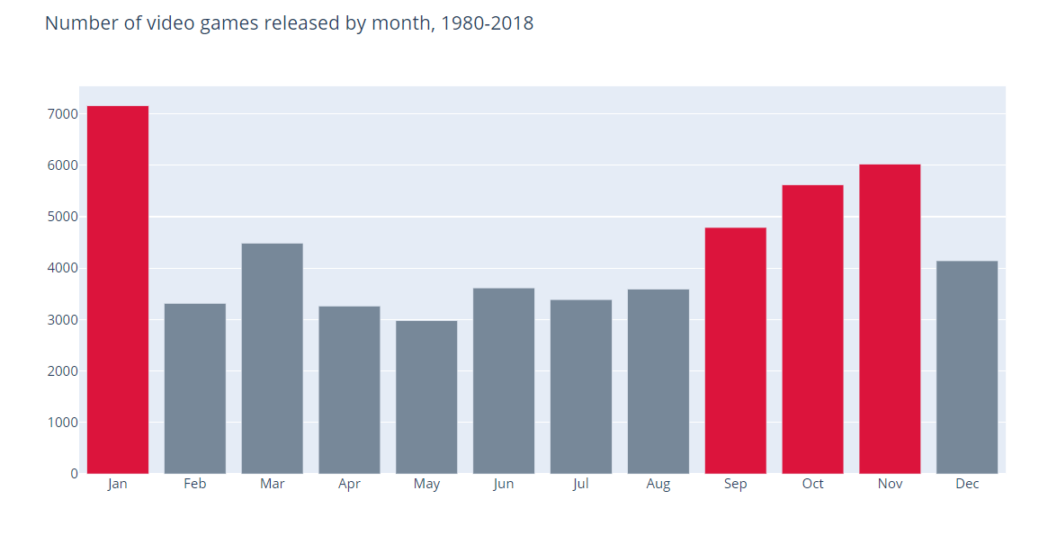
There has been an increasing trend from the 1980s to the end of 2010s. Since then, the trend has not been clear.
For the period 1980 to 2018, January, November, October, and September are the months when most videogames are released.

Slide 7
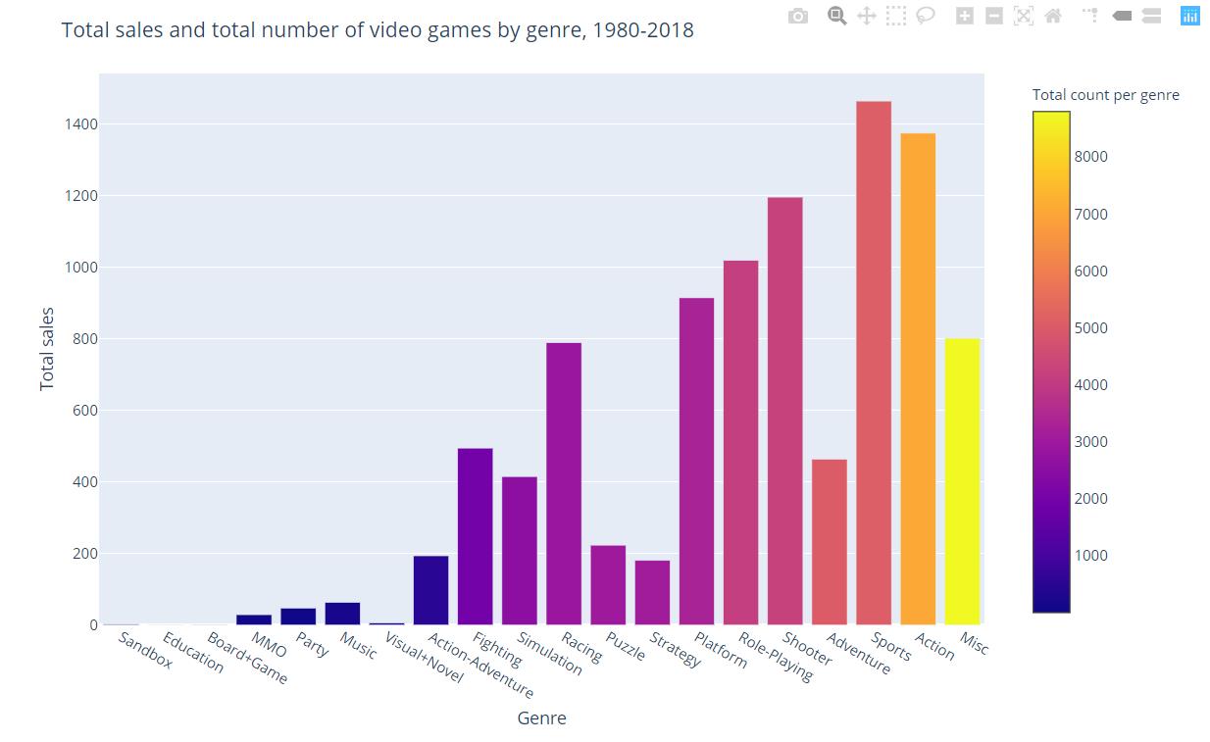
Misc, Action, Sports and Adventure have accumulated over 5,000 video games in the last 40 years.
If we take a closer look, the genres that represent the largest total sales during the same period are: 1) Sports, 2) Action, and 3) Shooter.

Slide 8
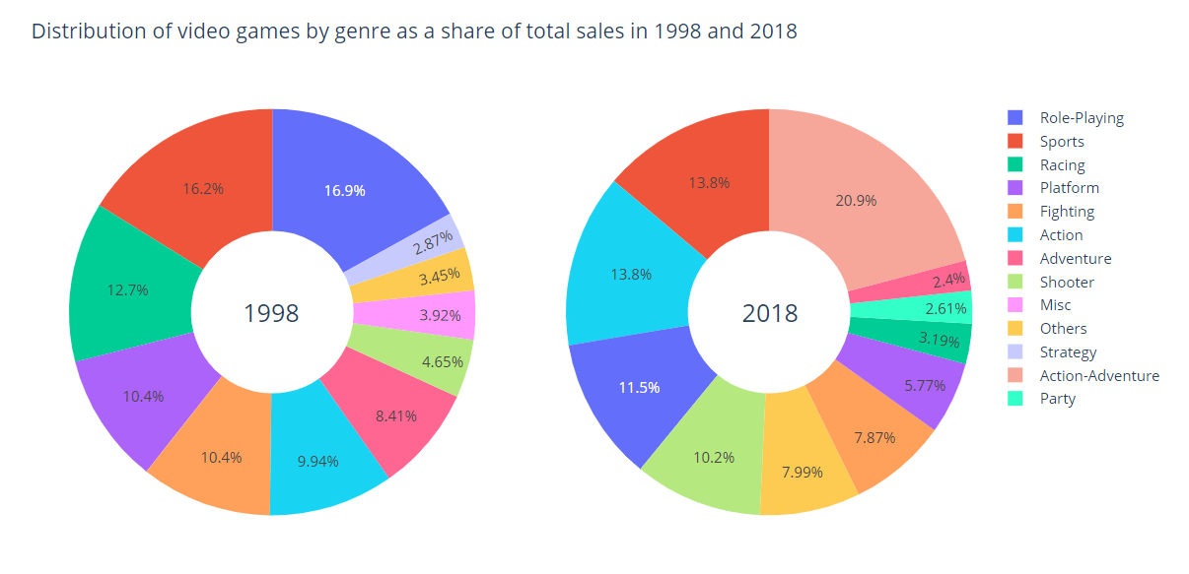
In 1998, Role-Playing, Sports, and Racing represented the most profitable genres. In 2018 Action-Adventure (one of the newest genres) replaced Sports as the most profitable genre.
During this 10-year period, Sports remains in the top 3 of the most profitable genres.

Slide 9
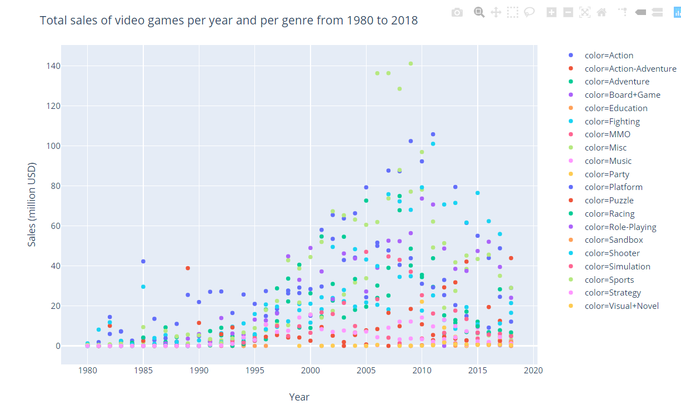
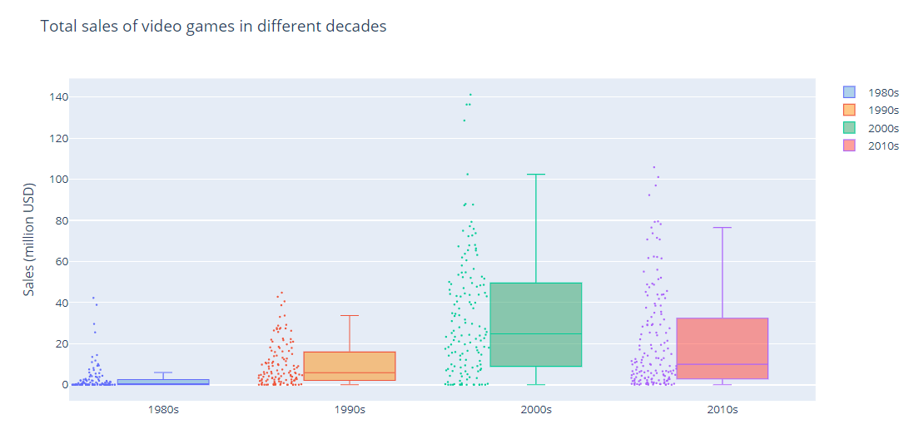
The total value of sales of Sports, Action and Shooter soared in the last 20 years. In the case of Sports, total sales peaked between 2005 and 2010.
The range of sales has also increased. Whereas in the 1980s, the median value of total sales was 0.74 million dollars, in the 2000s it was 24.75 million dollars.

Slide 10
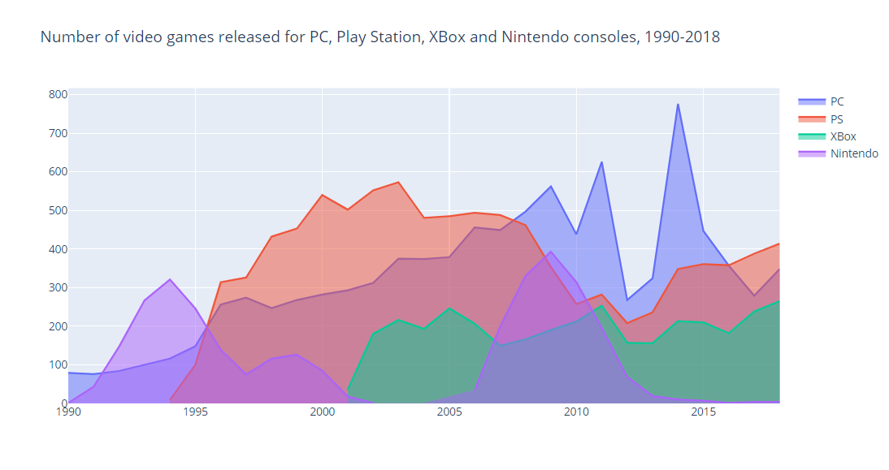
Play Station has been a strong competitor of PC, especially between the period of 1995 to 2010. After 2010, however, PC became the brand with the largest number of video games.

Slide 11
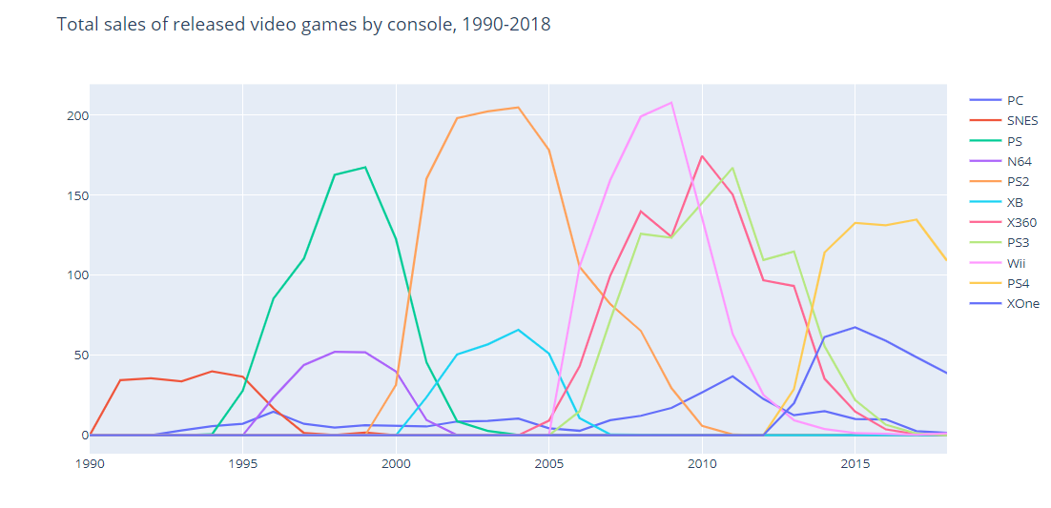
Nintendo was the dominant player between 1990 to 1995, with Super Nintendo
Even though PC might have the largest number of released video games, in terms of sales, it does not represent a strong competitor.
Before 2005, play station was the most profitable console. However, after 2005, the gaming market became more competitive: Wii became the most profitable console, closely followed by Xbox and play station.

Slide 12
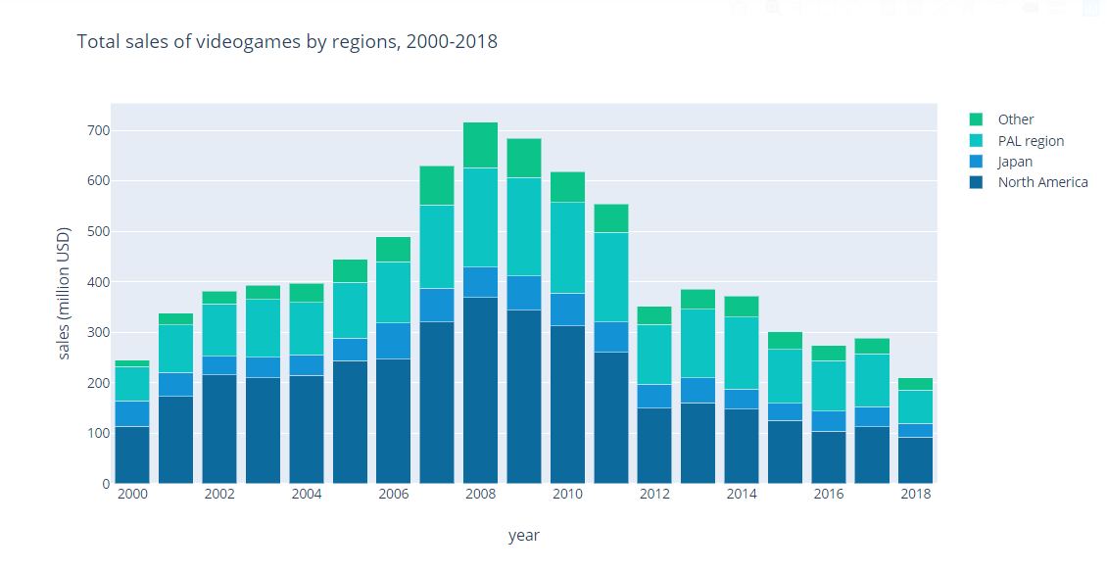
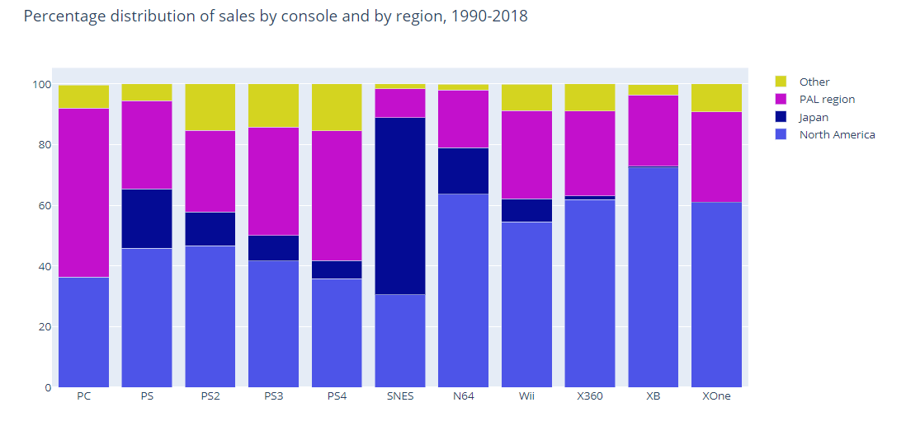
North America represents the region with the largest sales of video games, followed by PAL region (which consists in some regions in Latin America, Middle East and Africa). Also, 2008 represented the most important year in terms of sales.
PC sales have been dominant in PAL region.
Over time, play station has gained strength in PAL region: PS4 has the largest sales in this region.
Super Nintendo was dominant in Japan, but Wii is more popular in North America.
Finally, Xbox remains popular in North America.

Slide 13
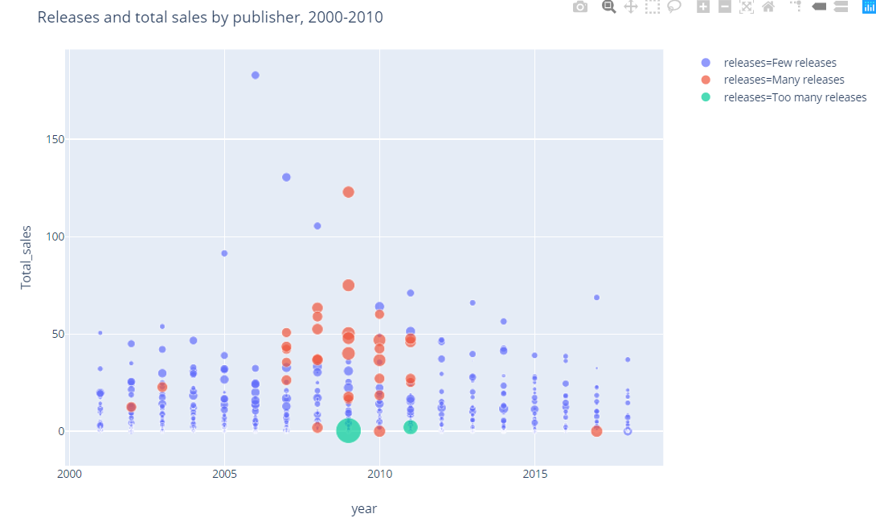
Between 2007 and 2011, many publishers (specially of PC games) tried to gain a position in the market with “many releases”. Nintendo, on the other hand, shows the greatest performance: from 2006, with few releases, Nintendo had one of the largest revenues in the last 19 years.
After 2011, by contrast, publishers tend to release a smaller amount of video games.
Nintendo in 2006
2007-2011
Nintendo
Microsoft is an interesting case: it is associated with “too many releases” of video games, especially between 2007 and 2011(depicted in green color) but with very low revenues.
Microsoft in 2019

Slide 14
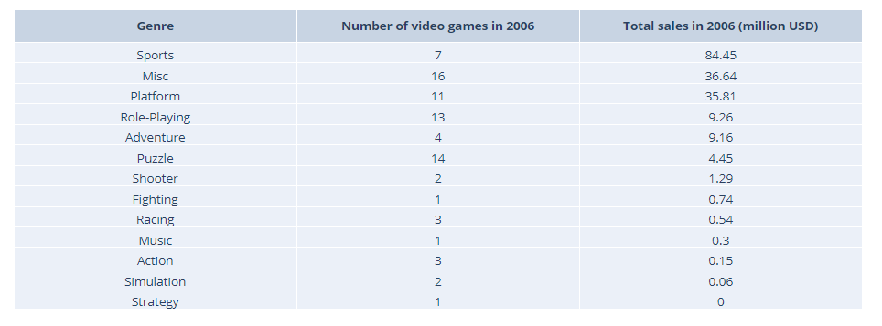
If we take a closer look to Nintendo in 2006, Sports was the most profitable genre for Nintendo in that year, the same year of the World Cup in Germany and the introduction of Wii to the market.

Slide 15
IV. CONCLUSIONS
There is a steady rise of number of video games released between 1980 to 2010. After 2010, the trend has been unclear. This might be a result of the recent development of new online web-based and mobile digital platforms, such as Steam that may become strong competitors for traditional publishers and consoles in the industry.
The gaming industry is extremely dynamic. In the last 10 years the composition of the industry by genres have completely changed with the rise of new genres, such as visual+novel, party, and music. Nonetheless, sports has continuously appeared as one of the top 3 most profitable genres throughout the years.
Indeed, the gaming industry is becoming more profitable. Total sales in 2010s are 33 times larger than total sales in 1980s. PC games might not be as profitable as other brands, but it compensates this gap by releasing vast amounts of video games.

Slide 16
IV. CONCLUSIONS
PC games are more popular in PAL region. Also, in recent years, Play Station has gained terrain in PAL region with its console PS4. On the other hand, Nintendo and Xbox have not been able to expand their market beyond North America (US, Canada, Mexico).
Innovation is what drives the business, and not total releases.
Between 2007 and 2011, publishers flooded the market with vast amounts of video games (specially PC publishers that attempted to gain terrain in the industry). However, this did not translate into higher profits.
In 2006, on the other hand, Nintendo registered the highest profit of the past 2 decades. In this year, sport games became extremely profitable (perhaps due to the World Cup in Germany) and Wii was introduced into the market.

