Slide 1
Health Pal: Phase 4
Blessing Iyofor, Clayton Barklage, Ollie Peel, Steven Valet

Slide 2
Introduction
HealthPal is a health monitoring tool designed to assist users in tracking their essential health metrics, setting wellness goals, and receiving AI-driven health recommendations tailored to their unique data.
HealthPal will cater to individuals seeking to monitor their health metrics and achieve their wellness goals.

Slide 3
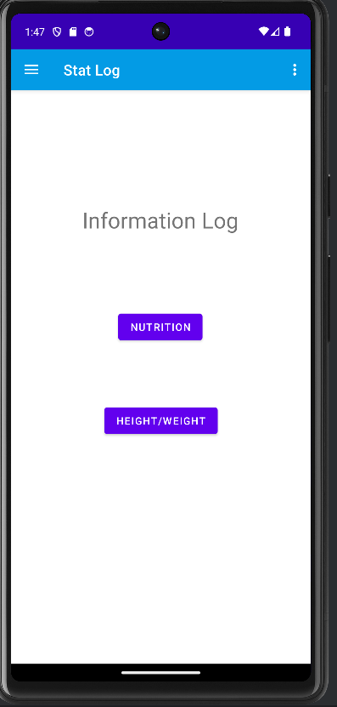
Information Login

Slide 4
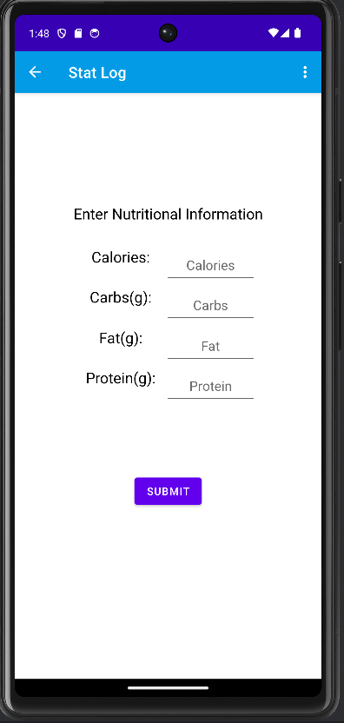
Nutrition Log

Slide 5
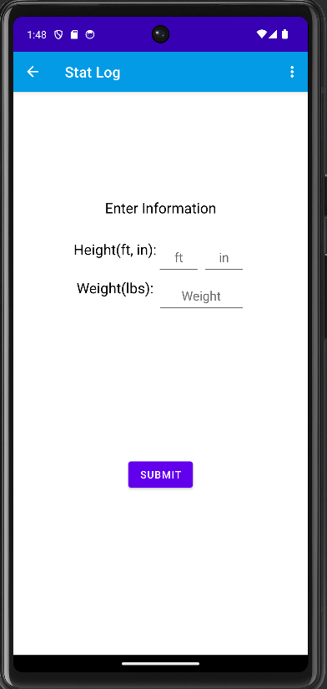
Stat Log

Slide 6
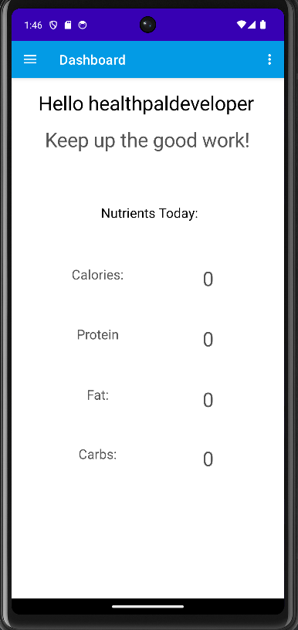
Dashboard

Slide 7
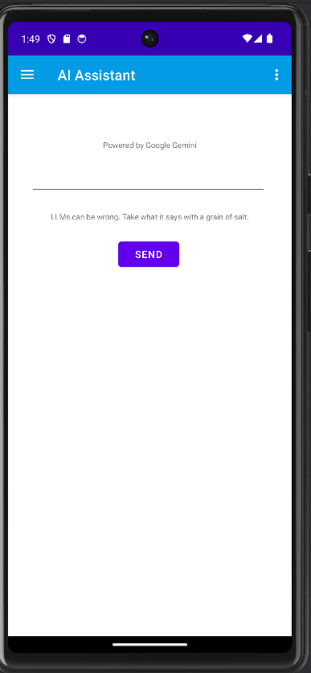
AI Assistant

Slide 8
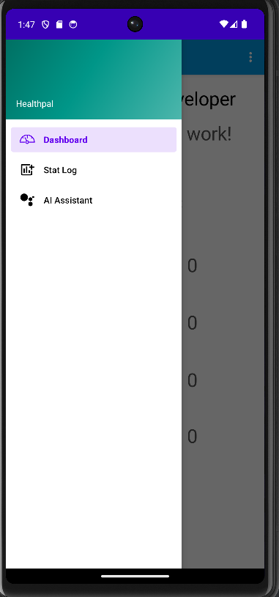
Navigation

Slide 9
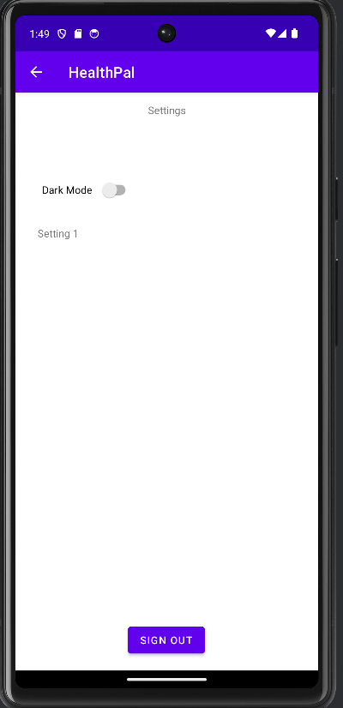
Settings

Slide 10
HealthPal Demonstration…

