Slide 1
HealthPal: Phase 2
Blessing Iyofor, Clayton Barklage, Ollie Peel, Steven Valet, Tyler Blackmore

Slide 2
Introduction
Maintaining a healthy lifestyle has become increasingly challenging in today's fast-paced society. HealthPal aims to bridge this gap by leveraging technology to promote health awareness and proactive informed decision making.
With this mindset, we’ve begun to create an app that will provide a comprehensive yet straightforward tool for users to log, track, and visualize their health data at a glance.

Slide 3
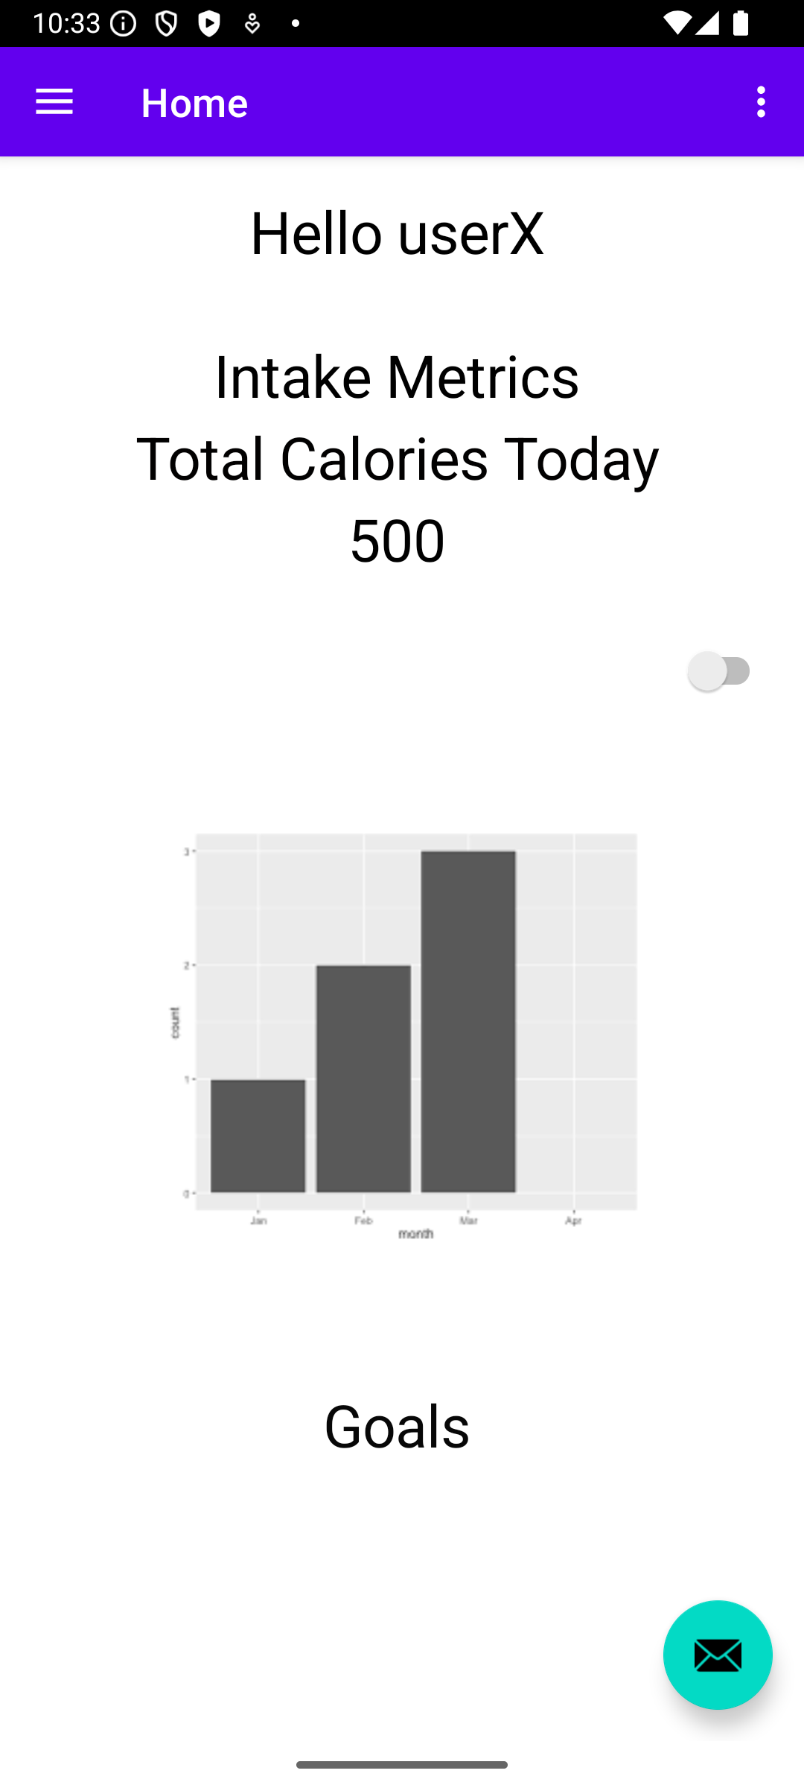
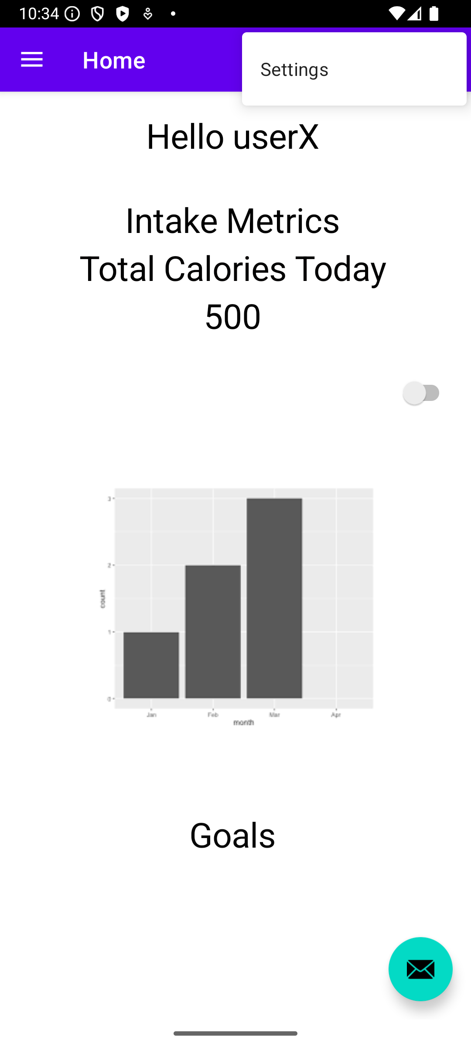
User Interface
Home Page:
Displays daily user metrics and goals
Settings:
Can be accessed through any page
Notes:
* Settings page not yet added as of 3/9/2025

Slide 4
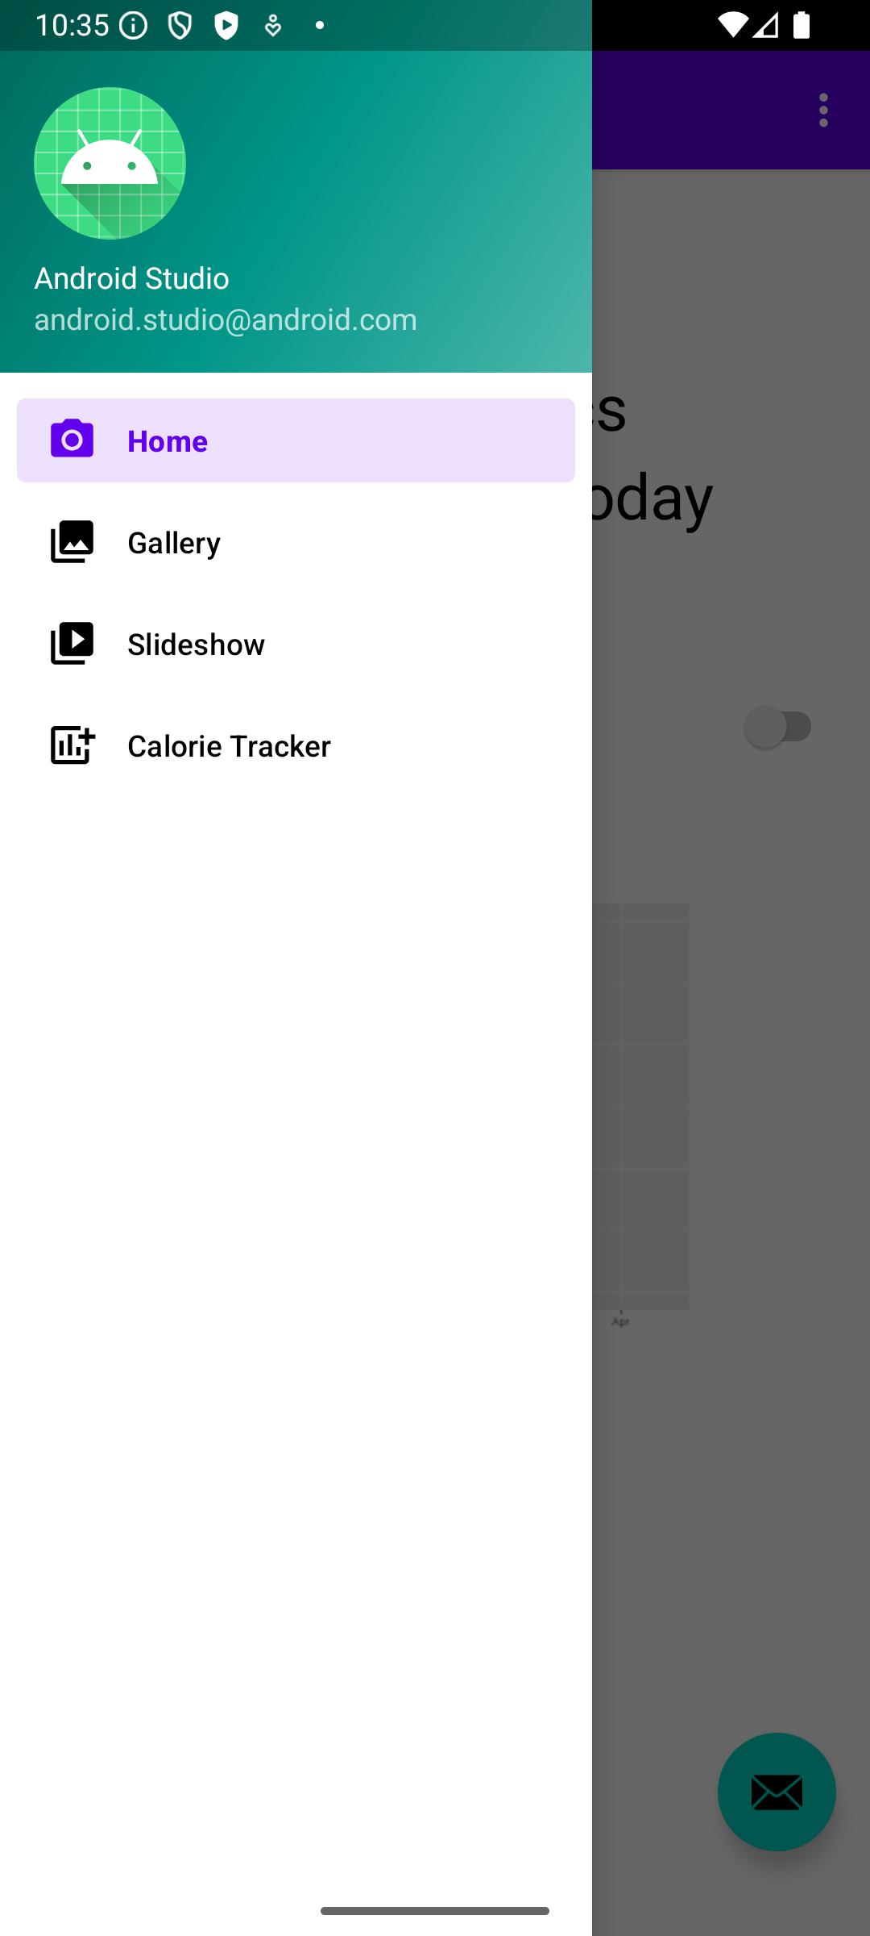
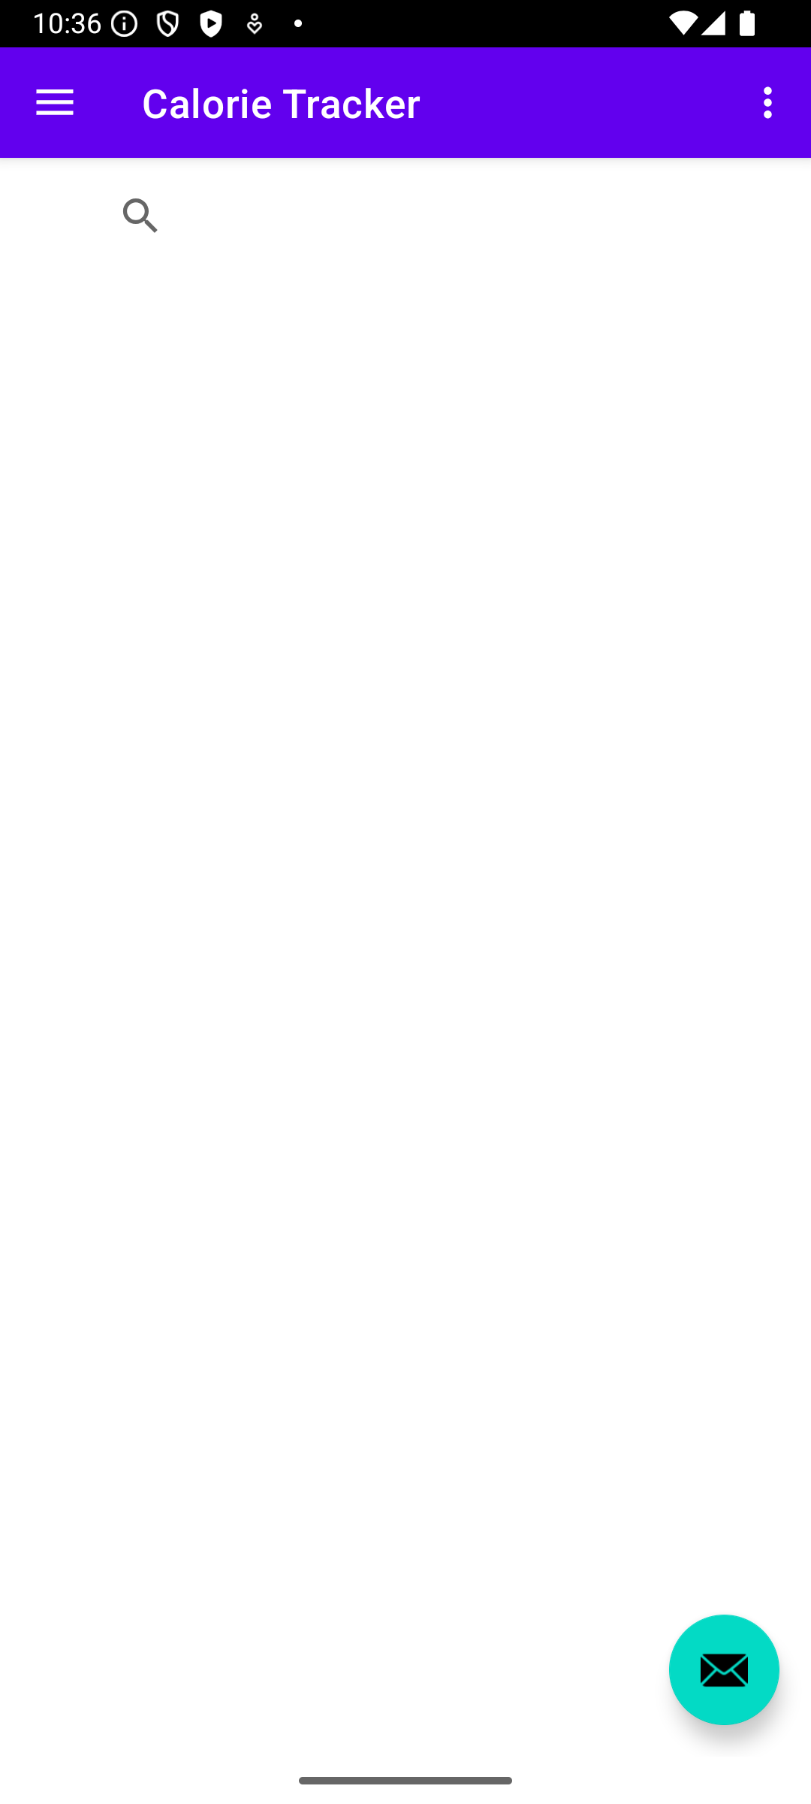
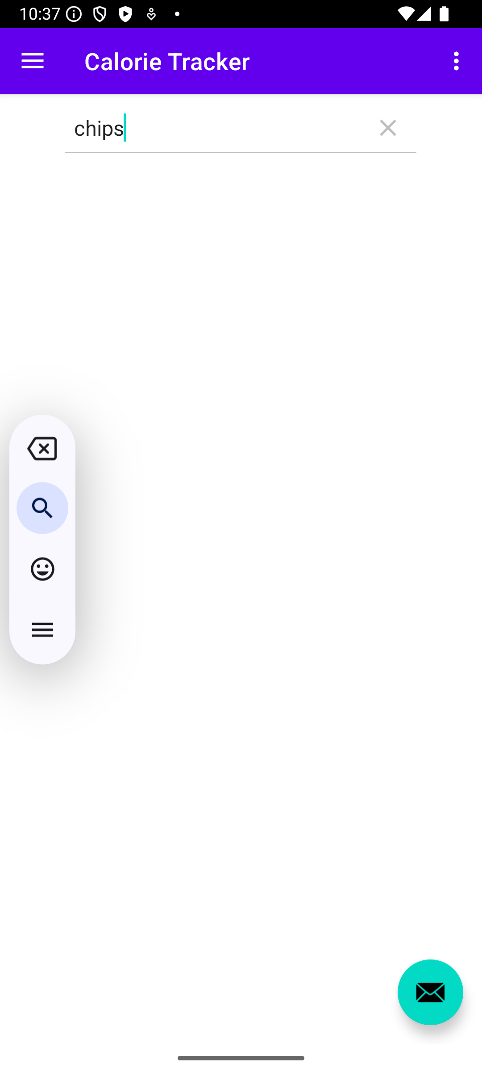
Activity Drawer:
Displays basic user profile info
Lets users navigate to different pages in the app
Calorie Tracker:
Search function allows users to look up food they’ve eaten
Notes:
* Gallery and Slideshow are temporary – can be used as templates for different pages

Slide 5
APIs/Other Technology Used In Front-End
Google Login API: User authentication
Open Food Facts API: Calorie tracker
Built-in tools in Android Studio: App design and functionality

Slide 6
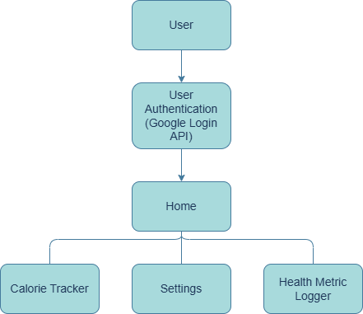
High-Level System Architecture
Notes:
User uses app: authentication first, takes them to home page which connects to all other pages, data request/data return between calorie tracker and API

Slide 7
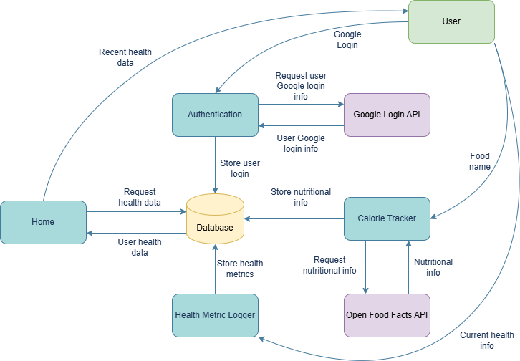
Data Flow Diagram

Slide 8
The Database
SQL Server used to store:
User profiles
Unique user ID, user’s name, email
Health metrics
Weight, hours slept, temperature, etc.
Calorie logs
Food type, carbohydrates, proteins, vitamins, etc.

Slide 9
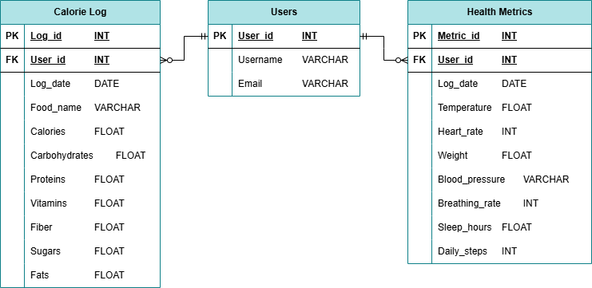
Database Design

Slide 10
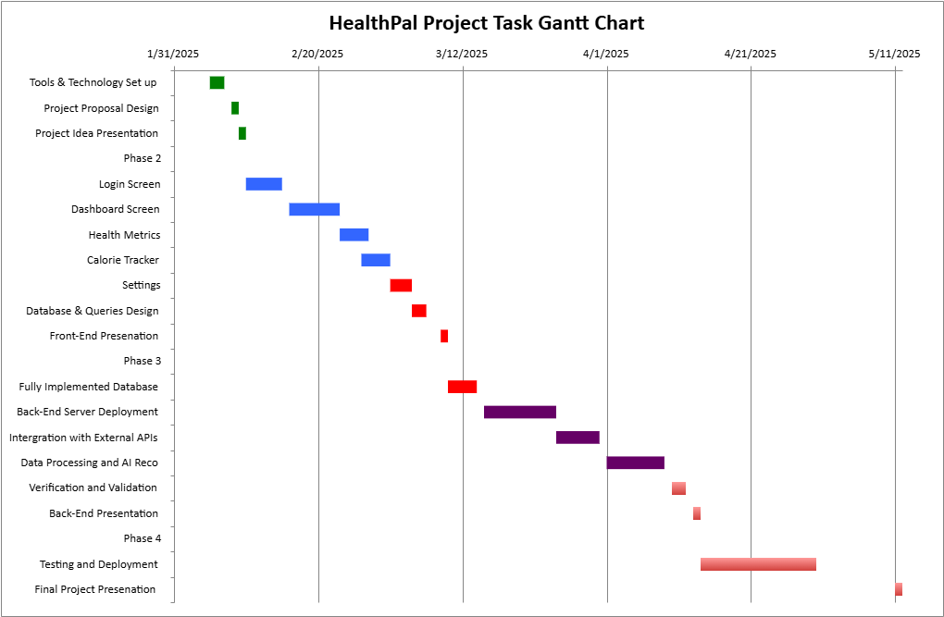
Duration Estimate
Task Name | Start | End | Duration (days)
Phase 1
Team Formation | 1/31/2025 | 2/2/2025 | 2
Project Ideal Finalized | 2/3/2025 | 2/4/2025 | 1
Tools & Technology Set up | 2/5/2025 | 2/7/2025 | 2
Project Proposal Design | 2/8/2025 | 2/9/2025 | 1
Project Idea Presentation | 2/9/2025 | 2/10/2025 | 1
Phase 2
Login Screen | 2/10/2025 | 2/15/2025 | 5
Dashboard Screen | 2/16/2025 | 2/23/2025 | 7
Health Metrics | 2/23/2025 | 2/27/2025 | 4
Calorie Tracker | 2/26/2025 | 3/2/2025 | 4
Settings | 3/2/2025 | 3/5/2025 | 3
Database & Queries Design | 3/5/2025 | 3/7/2025 | 2
Front-End Presenation | 3/9/2025 | 3/10/2025 | 1
Phase 3
Fully Implemented Database | 3/10/2025 | 3/14/2025 | 4
Back-End Server Deployment | 3/15/2025 | 3/25/2025 | 10
Intergration with External APIs | 3/25/2025 | 3/31/2025 | 6
Data Processing and AI Reco | 4/1/2025 | 4/9/2025 | 8
Verification and Validation | 4/10/2025 | 4/12/2025 | 2
Back-End Presentation | 4/13/2025 | 4/14/2025 | 1
Phase 4
Testing and Deployment | 4/14/2025 | 4/30/2025 | 16
Final Project Presenation | 5/11/2025 | 5/12/2025 | 1

