Slide 1
Health Pal: Phase 3
Blessing Iyofor, Clayton Barklage, Ollie Peel, Steven Valet, Tyler Blackmore

Slide 2
Introduction
HealthPal is a health monitoring tool designed to assist users in tracking their essential health metrics, setting wellness goals, and receiving AI-driven health recommendations tailored to their unique data.
HealthPal will cater to individuals seeking to monitor their health metrics and achieve their wellness goals.

Slide 3
What We’ve Been Working On
Improved upon features introduced in our last phase
Settings
Calorie tracker
Implemented more of our planned features
Login screen
AI assistant
Set up our database

Slide 4
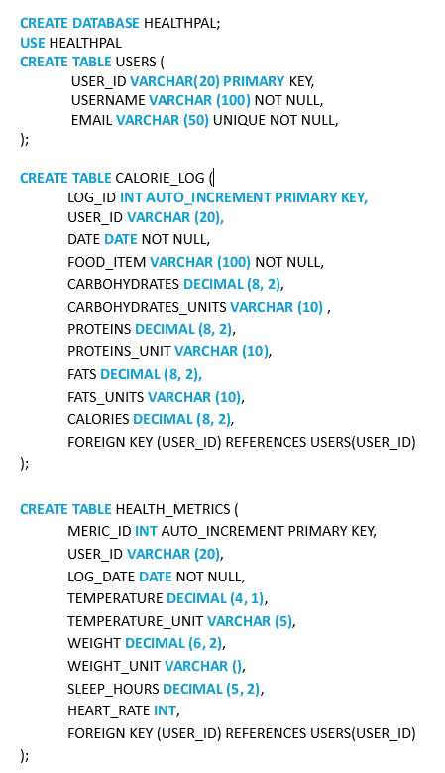
Database Queries
Notes:
User uses app: authentication first, takes them to home page which connects to all other pages, data request/data return between calorie tracker and API

Slide 5
Data Flow Diagram
Database
Store
Calorie Tracker
Request Info
Open Food Facts API
Store
Health Metrics
Return Info
Retrieve
Data
AI Assistant
HealthPal™
App
Return
Answer
Send
Prompt
Request User
Information
Login
Google Login API
Google Gemini API
User Login
Token
Login
User

Slide 6
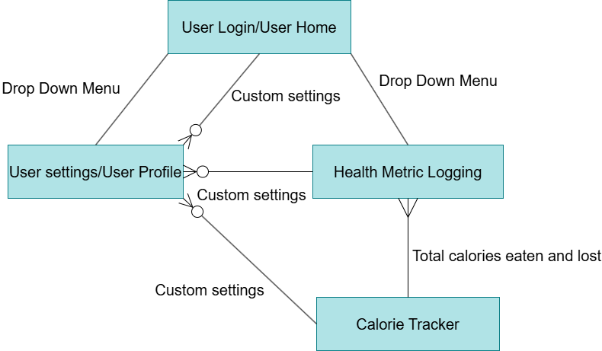
Entity Relationship Diagram
Notes:
User uses app: authentication first, takes them to home page which connects to all other pages, data request/data return between calorie tracker and API

Slide 7
Use Case
Actors:
Primary Actor: HealthPal user
Google Sign-in API: Validates user credentials
Open Food Facts API: Provides nutritional breakdown for food items
OpenAI: Generates personalized health recommendations
Database Server: Stores user data and logs

Slide 8
Preconditions:
User must have HealthPal app installed
A stable internet connection must be had to be fully functional
User is authenticated through Google sign-in
Post-conditions:
Users’ health metrics and food logs are successfully stored in the backend database
Personalized recommendations are generated and displayed
Users can view and update their data
Exceptions:
If Open Food Facts is unavailable, food items cannot be analyzed for nutritional breakdown
If OpenAI is unavailable, recommendations cannot be provided

Slide 9
HealthPal Demonstration…

