Slide 1
HealthPal
Andrew Taylor, Blessing Iyofor, Clayton Barklage, Ollie Peel, Steven Valet, Tyler Blackmore

Slide 2

Project Proposal
Maintaining a healthy lifestyle has become increasingly challenging in today's fast-paced society. By tracking essential health metrics such as heart rate, blood pressure, calorie intake, and sleep patterns, individuals can make informed decisions that positively impact their overall health and quality of life.
HealthPal is a comprehensive health monitoring app designed to address the growing need for accessible, efficient, and personalized health management.

Slide 3
HealthPal will cater to individual users seeking to monitor their basic health metrics and achieve their wellness goals. The app will let users log daily/weekly health metrics as well as set and track personal health goals. Users can receive AI-driven recommendations based on their health data and reports using the data can be exported for medical consultations or personal tracking.

Slide 4
Project Idea
A couple different ideas to start…
Disaster readiness app
Personalized health monitoring app
Calorie tracker
Combined health monitoring and calorie tracking
Temperature
Weight
Blood pressure
Heart rate
Calorie intake
AI suggestions based on health data

Slide 5
Scope of Work
Features
Log and track metrics such as temperature, weight, blood pressure, heart rate, calorie intake, sleep hours, and daily steps
Set and monitor health-related goals with progress visualization using charts and graphs
Receive AI-driven health recommendations based on logged data
Generate health reports and export data for sharing with health professionals
Use secure login functionality through Google Authentication API
Integrate APIs for calorie tracking, text generation, and meal logging

Slide 6
System Components
Frontend
Mobile interface with Python
framework
Backend
Python
SQL Database

Slide 7
API Integration
Google authentication API for easy login
Food data fetched from Open Food Facts API
OpenAI API for tips and suggestions
Data Visualization
Scikit-learn for basic health predictions or rule-based insights
Matplitlib or Plotly for trend charts and progress tracking

Slide 8
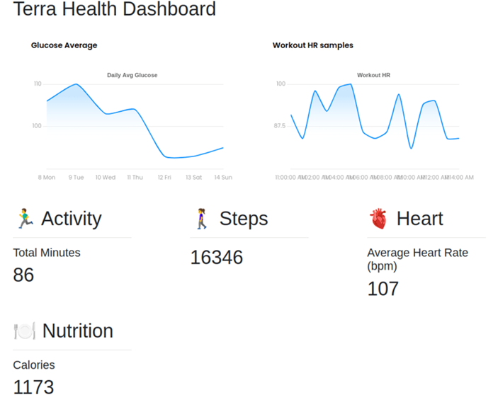
Cutting-Edge Technology
Open AI
Offer personalized recommendations to improve health
Diet, exercise, etc.
Matplotlib or Plotly for Data Visualization
Create dashboards to show user progress and highlight areas of improvement

Slide 9
Acceptance Criteria
The project will be considered complete when the following criteria are met:
All outlined features are fully implemented and functional
The app is tested and free of major bugs
User authentication is secure and functional
Health metrics are logged, stored, and displayed accurately
AI recommendations provide relevant and actionable insights
The app is deployed and accessible to users

Slide 10
Period of Performance:
February 10, 2025 – April 30, 2025
Place of Performance:
At an individual’s remote workplace on secured network
Using Visual Studio Code or Android Studio
Version control and source code storage on GitHub
14 Week Timeline
Weeks 1-2: Gather requirements, design, and plan project
Weeks 3-6: Backend and database development
Weeks 7-10: Frontend development and API integration
Weeks 11-13: Comprehensive testing and user acceptance testing
Week 14: Deployment and project handoff

