Slide 1
Employee Information Portal
By, Sai Dinesh Vallamsetti
Spring-2016, T01161297

Slide 2
Project and Sponsor Description:
“Employee Information Portal” serves as a web portal to save, modify and retrieve the employee information of an organization.
Earlier they used excel sheet to maintain their employee information.
Excel sheet is being replaced with web-application.

Slide 3
Proposal and Plan:
Develop a web portal using Java J2EE as a core technology
HTML, xhtml, xml and JSP for the front end
Oracle/ MySQL as a back end and Apache tomcat Server as application Server
Project is implemented in agile methodology

Slide 4
Technologies and Frameworks Used:
Java 7, J2EE, JSF and Spring MVC
HTML5, XML, CSS3, XHTML and JSP
SQL, HQL

Slide 5
Tools Used and third party support
Eclipse Mars.2
Oracle SQL Developer, MySQL Workbench, MySQL Server 5.5.40
CSS generator.
Third party-support:
Primefaces.

Slide 6
Maven Plugin Installation

Slide 7
MVC- Model-View-Controller
Response..
Html, Xhtml, JSP, JSON, Xml
view
System
requests
controller
Model
Database..

Slide 8
JSF
Java Server Faces
Flexible for developing web-based user interfaces.
Advantages:
Reusability
Data transfer is easy
Standard HTML inputs.

Slide 9
JSF
View
controller
DB Util
Database

Slide 10
JSF
View- XHTML, JSP , [tags]
MODEL- Annotation @Managed Bean
Controller Java Classes

Slide 11
Project Users and Responsibilities
Admin
Users
Employee
Create Users and manages Application
CRUD operations on Employees personal and professional info
Access their profiles[personal, leaves, pay information] Request leaves, forms etc.

Slide 12
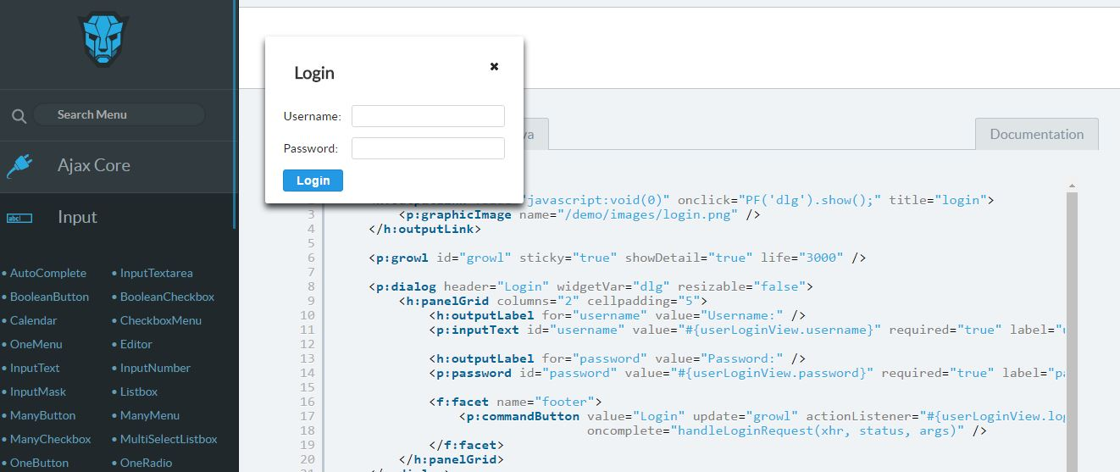
Primefaces, Richfaces
Third-party support.
Pre-built templates.
Open Source UI component Library.

Slide 13
Sample Demo

Slide 14
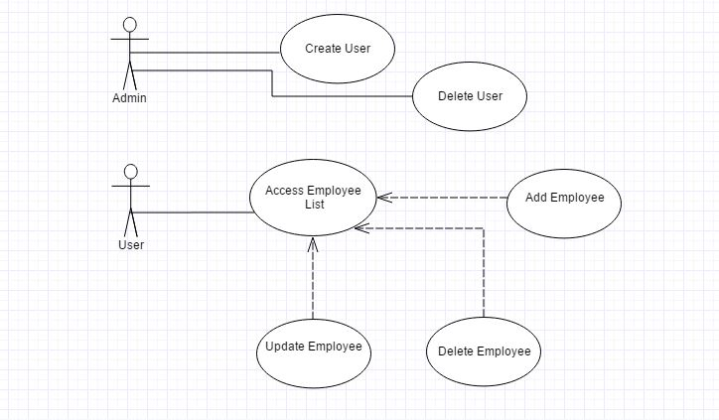
UML Diagrams: Use-Case

Slide 15
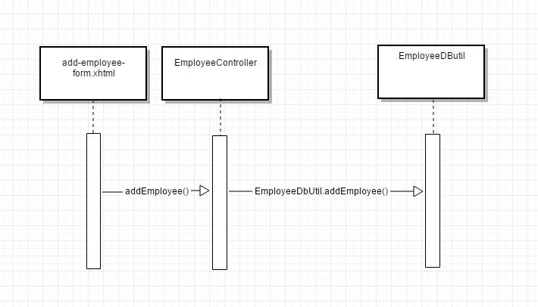
Sequence Diagram:

Slide 16
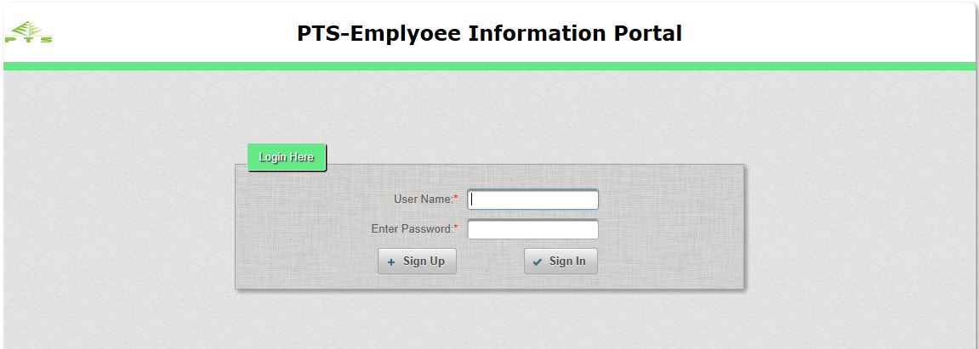
Home

Slide 17
Code Snippets and Screen Shots:
Validations:

Slide 18
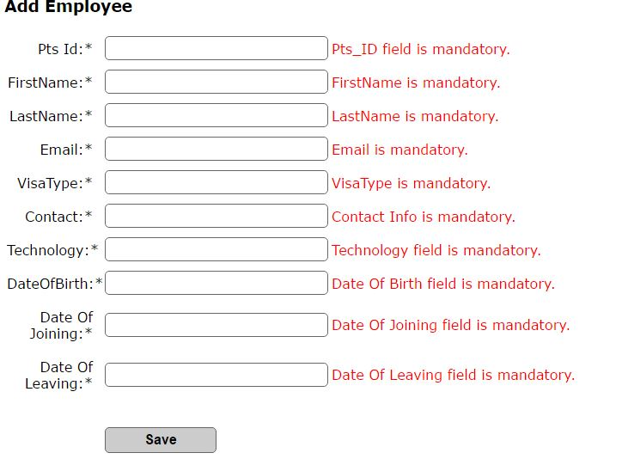
Validations:

Slide 19
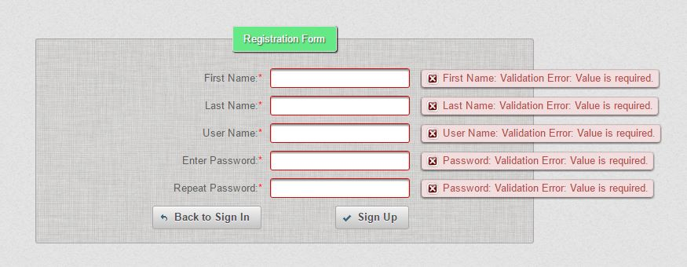
Validations:

Slide 20
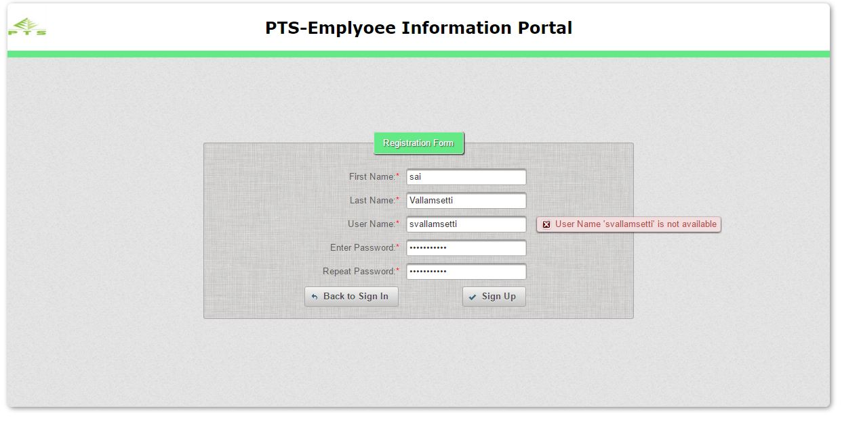
Validations:[user check]

Slide 21
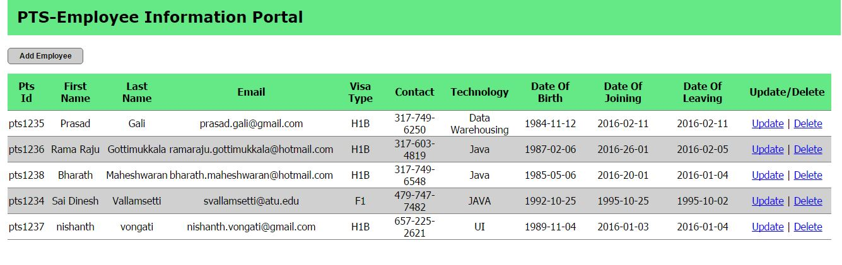
CRUD Operations:

Slide 22
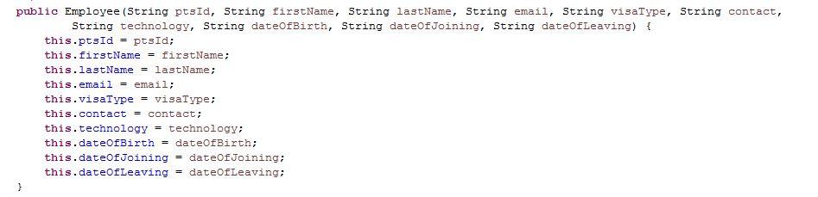
CRUD Operations[java model]:

Slide 23
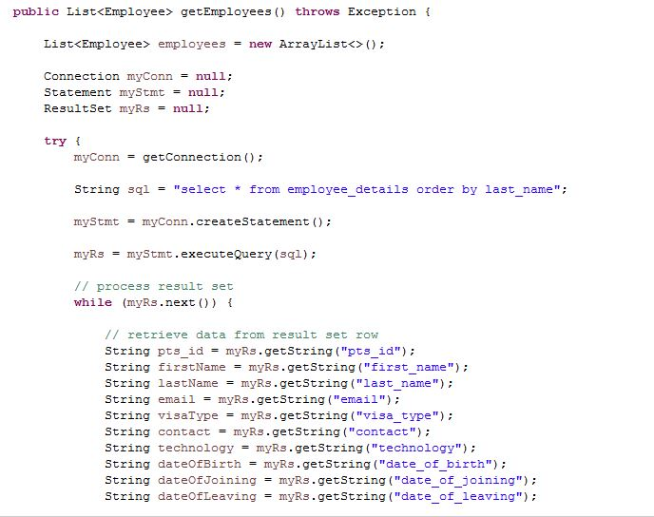
CRUD Operations[load employees]

Slide 24
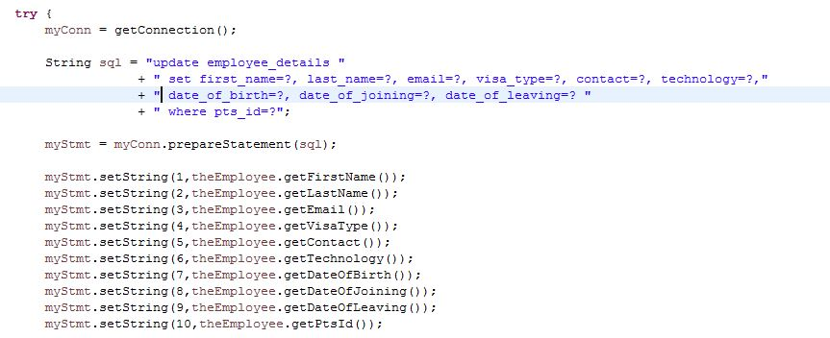
CRUD Operations[update method]:

Slide 25
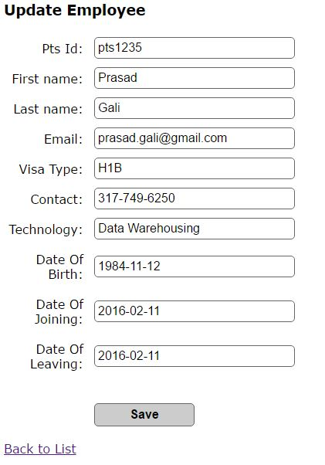
CRUD Operations[update-screen]:

Slide 26
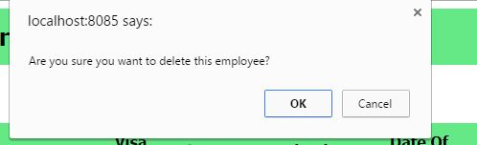
CRUD Operations[delete alert]:

Slide 27
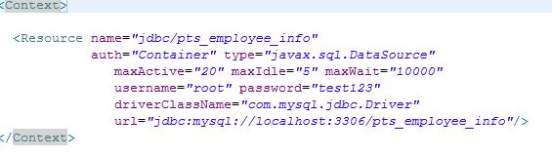
DB Calls[db-config]:

Slide 28

DB Calls[users]:

Slide 29
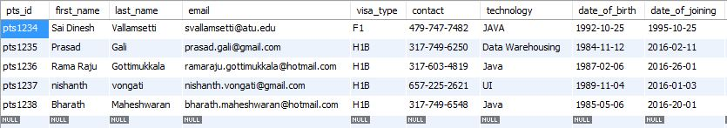
DB Calls[Details]:

Slide 30
Status and Future Works
Development and Integration Phase
Impressive CSS can be added
Some PL/SQL [View, triggers and stored procedures]
JavaScript frameworks can be added
SPA
Forgot Password Functionality

Slide 31
Conclusion
Gained practical experience on new Java, J2EE technologies and frameworks.
Had some good interactions with experienced-people.
Improved coding and debugging skills.

Slide 32
Thanks for my parents and all my professors and well wishers ☺

