Slide 1
The Multiple Regression Model II
Prof. Sebastián Vallejo Vera

Slide 2
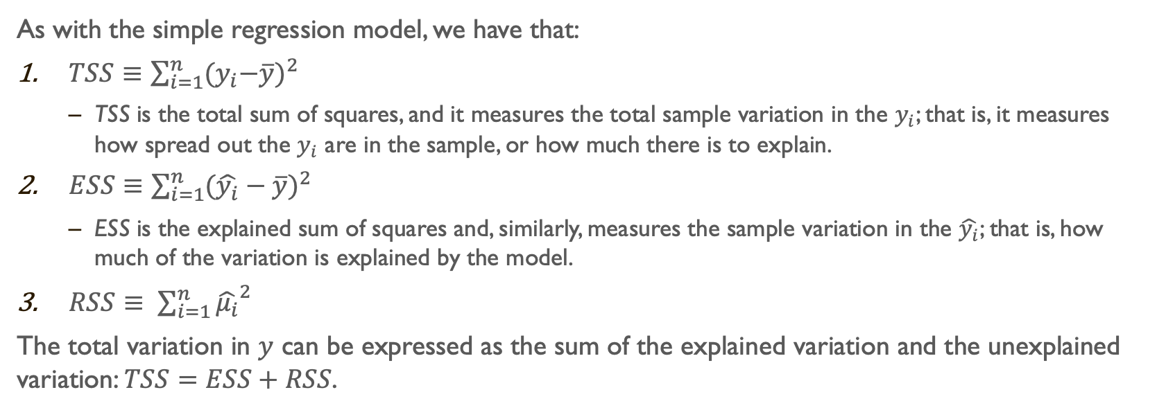
Goodness-of-Fit
As with the simple regression model, we have that:
$TSS≡\sum_{i=1}^{n}{{{(y}_{i}−\overline{y})}^{2}}$
TSS is the total sum of squares, and it measures the total sample variation in the $y_{i}$; that is, it measures how spread out the $y_{i}$ are in the sample, or how much there is to explain.
$ESS≡\sum_{i=1}^{n}{{(\hat{y_{i}}−\overline{y})}^{2}}$
ESS is the explained sum of squares and, similarly, measures the sample variation in the $\hat{y_{i}}$; that is, how much of the variation is explained by the model.
$RSS≡ \sum_{i=1}^{n}{{\hat{μ_{i}}}^{2}}$
The total variation in $y$ can be expressed as the sum of the explained variation and the unexplained variation: $TSS=ESS+RSS$.

Slide 3
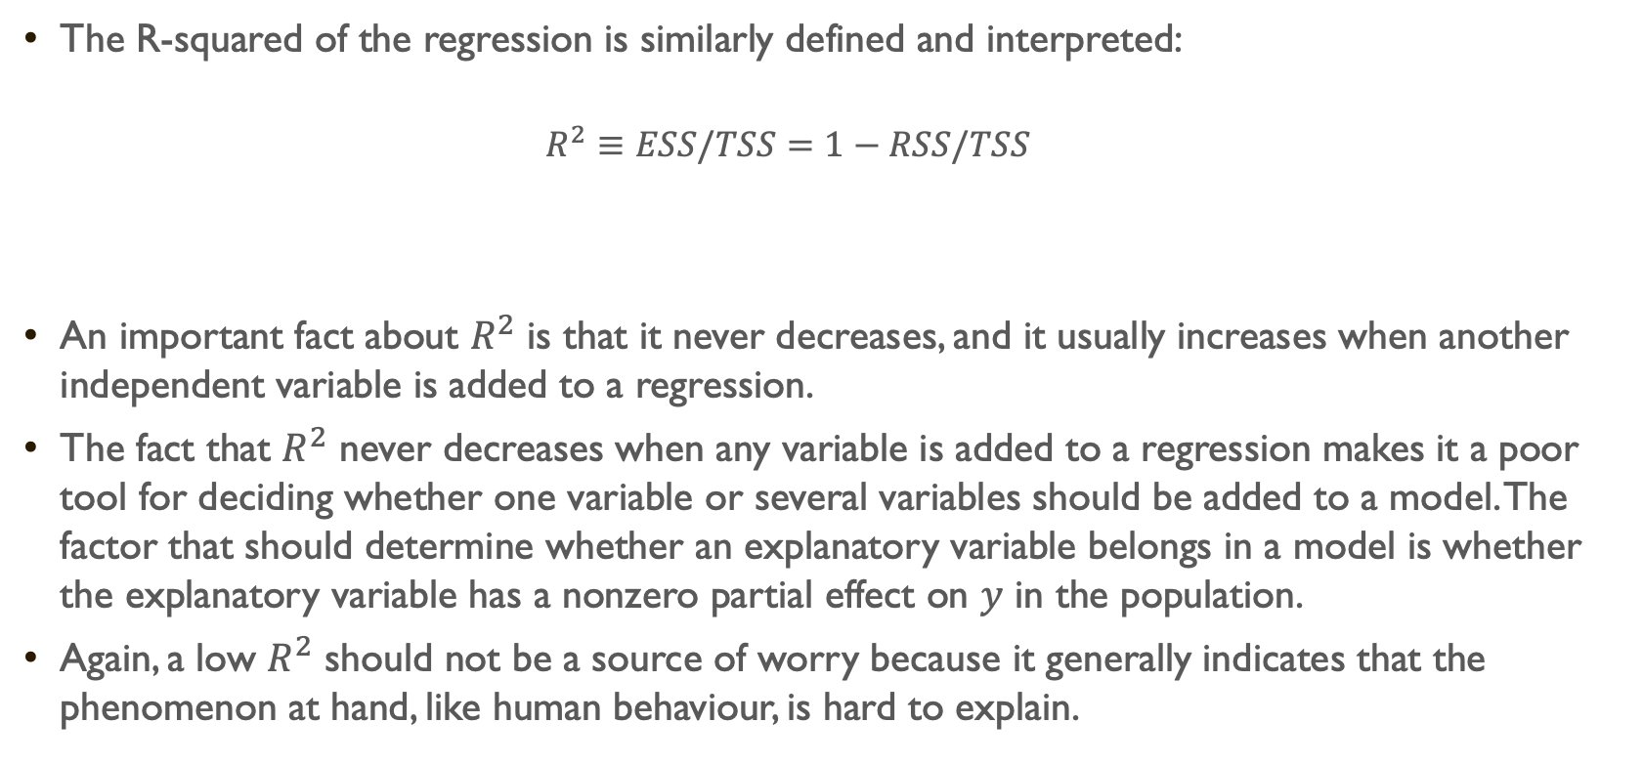
The R-squared of the regression is similarly defined and interpreted:
$$R^{2}≡ESS/TSS=1−RSS/TSS$$
An important fact about $R^{2}$ is that it never decreases, and it usually increases when another independent variable is added to a regression.
The fact that $R^{2}$ never decreases when any variable is added to a regression makes it a poor tool for deciding whether one variable or several variables should be added to a model. The factor that should determine whether an explanatory variable belongs in a model is whether the explanatory variable has a nonzero partial effect on $y$ in the population.
Again, a low $R^{2}$ should not be a source of worry because it generally indicates that the phenomenon at hand, like human behaviour, is hard to explain.

Slide 4

As with the simple regression model, we can study the properties of the distributions of $\hat{β_{0} }$, $\hat{β_{1} }$, ..., $\hat{β_{k} }$over repeated random samples from the population.
Let’s use “MLR” to refer to Multiple Linear Regression.

Slide 5
The Assumptions
That lead to the Gauss-Markov Theoreom

Slide 6
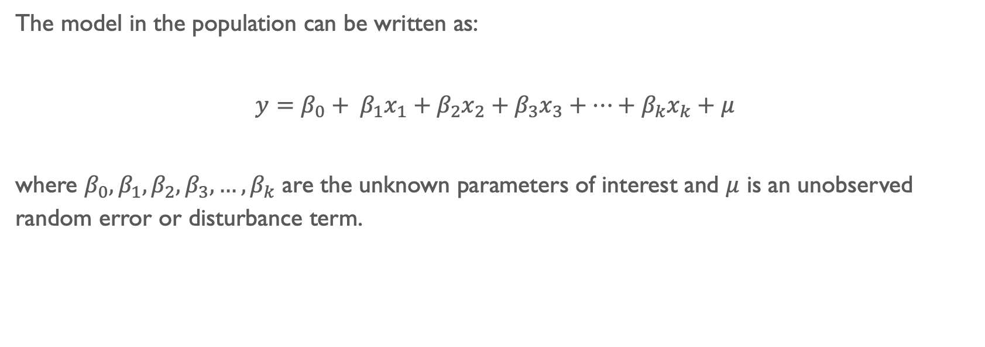
Assumption MLR.1: Linear in Parameters
The model in the population can be written as:
$y=β_{0}+ β_{1}x_{1}+β_{2}x_{2}+β_{3}x_{3}+…+β_{k}x_{k}+μ$
where $β_{0}, β_{1},β_{2},β_{3},…,β_{k}$ are the unknown parameters of interest and $μ$ is an unobserved random error or disturbance term.

Slide 7

Assumption MLR.2: Random Sampling
We have a random sample of size $n$, $\{\left(x_{i1},x_{i2},x_{i3},…,x_{ik},y_{i}\right):i=1, …, n\}$, following the population model:
$y=β_{0}+ β_{1}x_{1}+β_{2}x_{2}+β_{3}x_{3}+…+β_{k}x_{k}+μ$

Slide 8
Assumption MLR.3: No perfect Collinearity
In the sample (and therefore in the population), none of the independent variables are constant, and there is no exact linear relationships among the independent variables.
If an independent variable is an exact linear combination of the other independent variables, then we say the model suffers from perfect collinearity, and it cannot be estimated by OLS.
It is important to note that Assumption MLR.3 does allow the independent variables to be correlated; they just cannot be perfectly correlated.

Slide 9
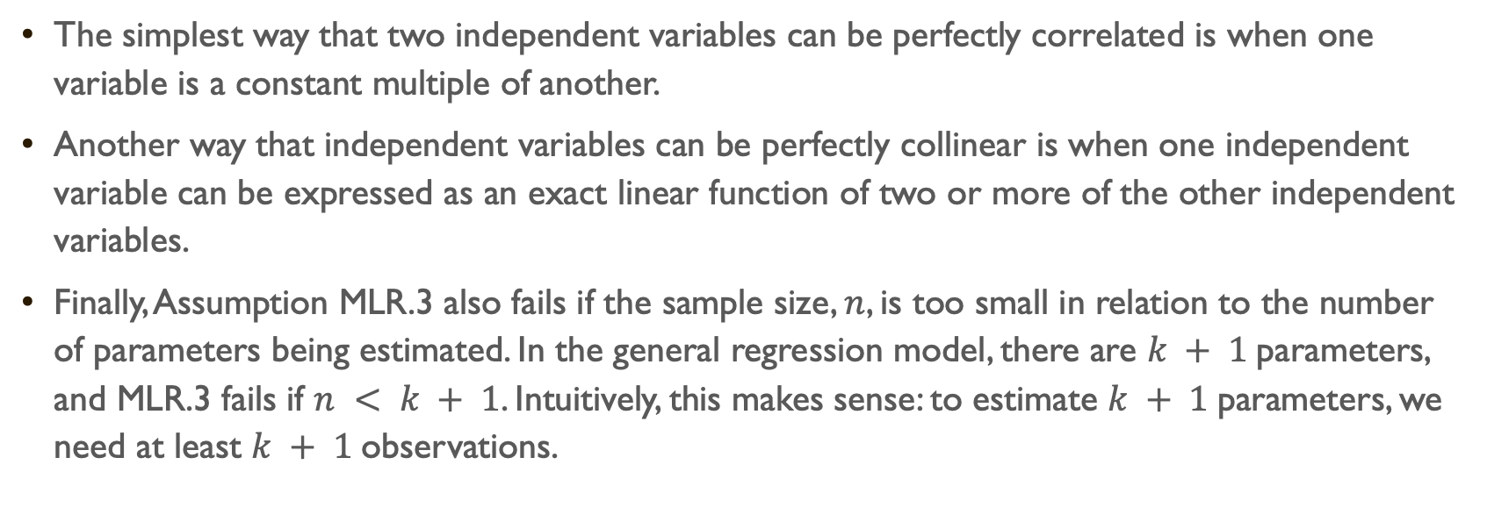
The simplest way that two independent variables can be perfectly correlated is when one variable is a constant multiple of another.
Another way that independent variables can be perfectly collinear is when one independent variable can be expressed as an exact linear function of two or more of the other independent variables.
Finally, Assumption MLR.3 also fails if the sample size, $n$, is too small in relation to the number of parameters being estimated. In the general regression model, there are $k + 1$parameters, and MLR.3 fails if $n < k + 1$. Intuitively, this makes sense: to estimate $k + 1$parameters, we need at least $k + 1$observations.

Slide 10
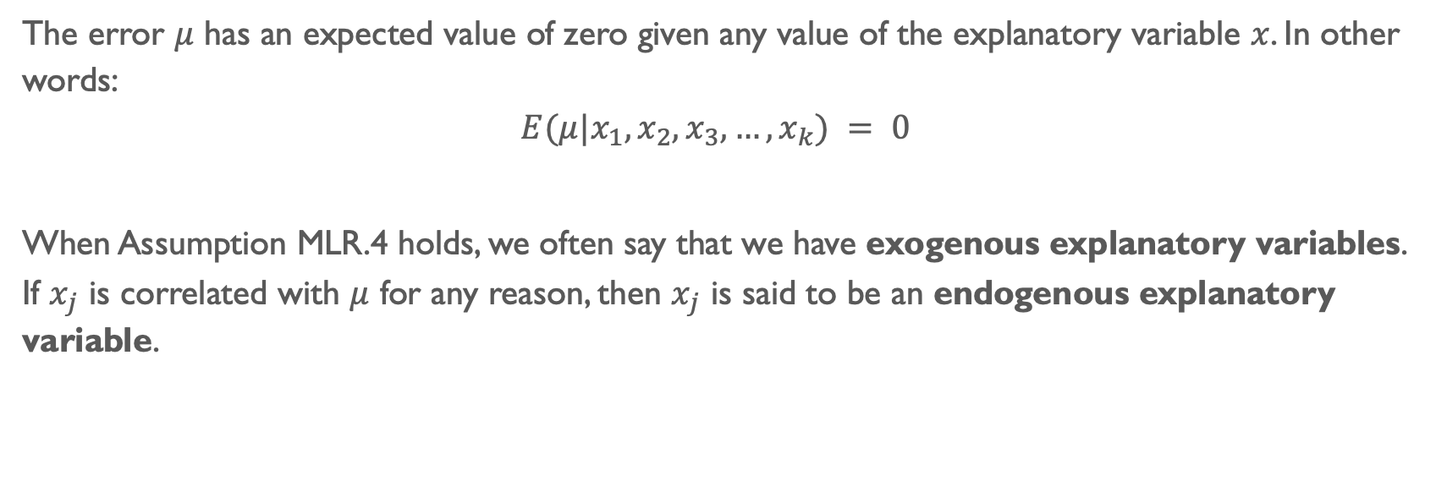
Assumption MLR.4: Zero Conditional Mean
The error $μ$ has an expected value of zero given any value of the explanatory variable $x$. In other words:
$$E(μ|x_{1},x_{2},x_{3},…,x_{k}) = 0$$
When Assumption MLR.4 holds, we often say that we have exogenous explanatory variables. If $x_{j}$ is correlated with $μ$ for any reason, then $x_{j}$ is said to be an endogenous explanatory variable.

Slide 11
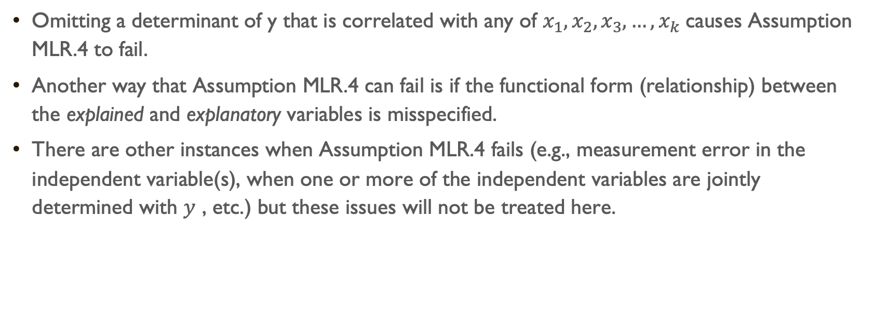
Omitting a determinant of y that is correlated with any of $x_{1},x_{2},x_{3},…,x_{k}$causes Assumption MLR.4 to fail.
Another way that Assumption MLR.4 can fail is if the functional form (relationship) between the explained and explanatory variables is misspecified.
There are other instances when Assumption MLR.4 fails (e.g., measurement error in the independent variable(s), when one or more of the independent variables are jointly determined with $y$ , etc.) but these issues will not be treated here.

Slide 12
THE Gauss-Markov Theorem

Slide 13
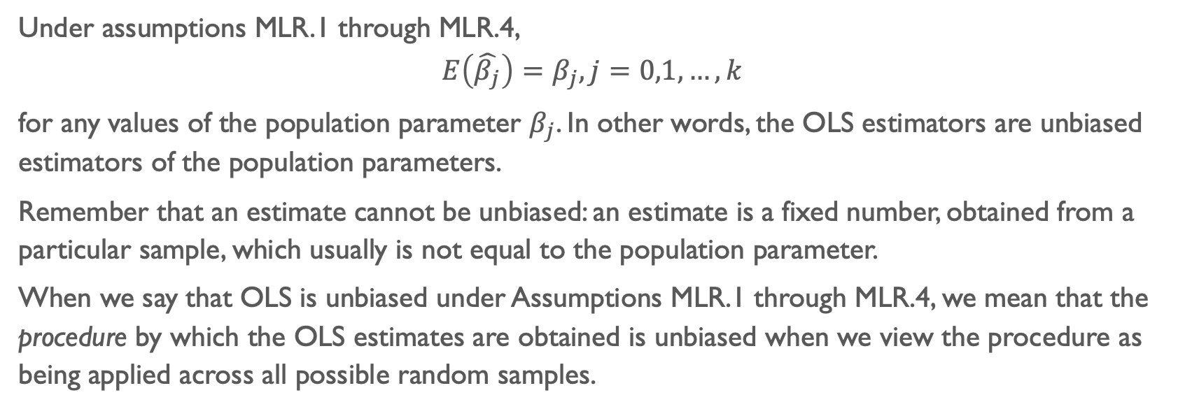
Theorem MLR.1: Unbiasedness of OLS
Under assumptions MLR.1 through MLR.4,
$$E\left(\hat{β_{j}}\right)=β_{j}, j=0,1,…,k$$
for any values of the population parameter $β_{j}$. In other words, the OLS estimators are unbiased estimators of the population parameters.
Remember that an estimate cannot be unbiased: an estimate is a fixed number, obtained from a particular sample, which usually is not equal to the population parameter.
When we say that OLS is unbiased under Assumptions MLR.1 through MLR.4, we mean that the procedure by which the OLS estimates are obtained is unbiased when we view the procedure as being applied across all possible random samples.

Slide 14
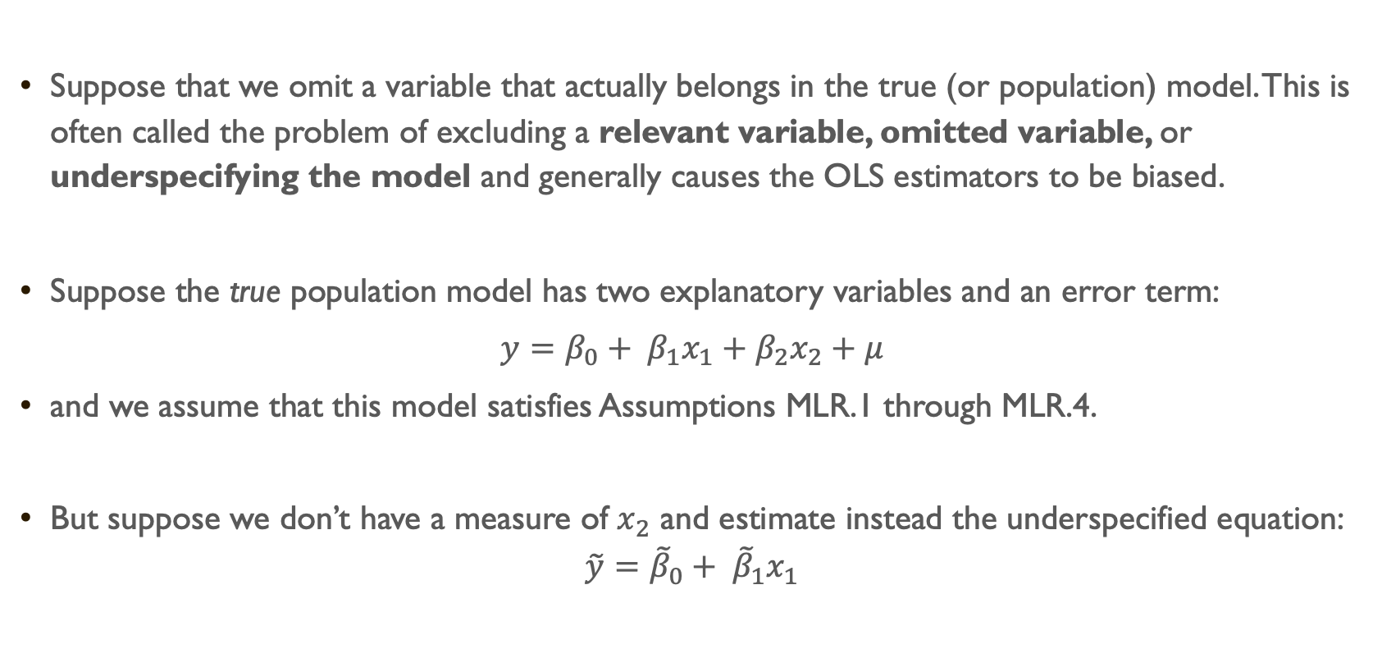
Suppose that we omit a variable that actually belongs in the true (or population) model. This is often called the problem of excluding a relevant variable, omitted variable, or underspecifying the model and generally causes the OLS estimators to be biased.
Suppose the true population model has two explanatory variables and an error term:
$y=β_{0}+ β_{1}x_{1}+β_{2}x_{2}+μ$
and we assume that this model satisfies Assumptions MLR.1 through MLR.4.
But suppose we don’t have a measure of $x_{2}$ and estimate instead the underspecified equation:
$$\tilde{y}={\tilde{β}}_{0}+ {\tilde{β}}_{1}x_{1}$$

Slide 15
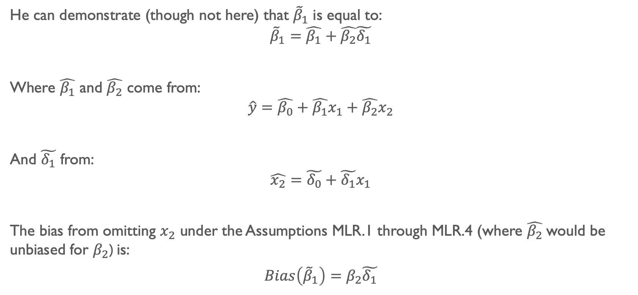
He can demonstrate (though not here) that ${\tilde{β}}_{1}$ is equal to:
$${\tilde{β}}_{1}=\hat{β_{1}}+\hat{β_{2}}\tilde{δ_{1}}$$
Where $\hat{β_{1}}$ and $\hat{β_{2}}$ come from:
$$\hat{y}=\hat{β_{0}}+\hat{β_{1}}x_{1}+\hat{β_{2}}x_{2}$$
And $\tilde{δ_{1}}$ from:
$$\hat{x_{2}}=\tilde{δ_{0}}+\tilde{δ_{1}}x_{1}$$
The bias from omitting $x_{2}$ under the Assumptions MLR.1 through MLR.4 (where $\hat{β_{2}}$would be unbiased for $β_{2}$) is:
$Bias\left({\tilde{β}}_{1}\right)=$ $β_{2}\tilde{δ_{1}}$

Slide 16
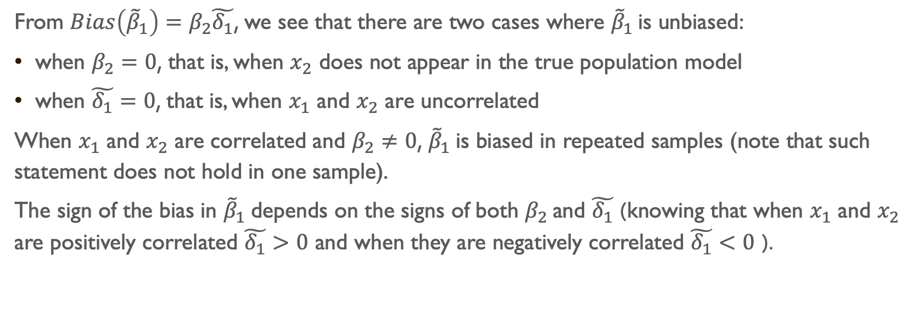
From $Bias\left({\tilde{β}}_{1}\right)=$ $β_{2}\tilde{δ_{1}}$, we see that there are two cases where ${\tilde{β}}_{1}$ is unbiased:
when $β_{2}=0$, that is, when $x_{2}$ does not appear in the true population model
when $\tilde{δ_{1}}=0$, that is, when $x_{1}$ and $x_{2}$ are uncorrelated
When $x_{1}$ and $x_{2}$ are correlated and $β_{2}≠0$, ${\tilde{β}}_{1}$is biased in repeated samples (note that such statement does not hold in one sample).
The sign of the bias in ${\tilde{β}}_{1}$depends on the signs of both $β_{2}$ and $\tilde{δ_{1}}$ (knowing that when $x_{1}$ and $x_{2}$ are positively correlated $\tilde{δ_{1}}>0$ and when they are negatively correlated $\tilde{δ_{1}}<0$ ).

Slide 17
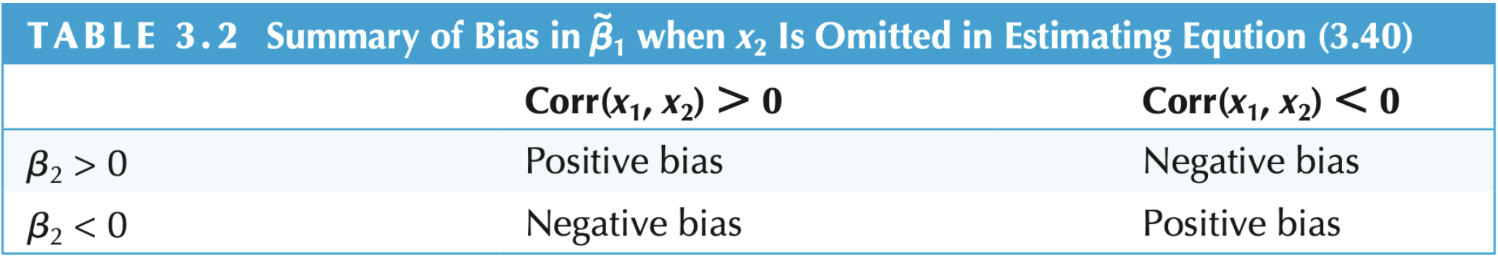
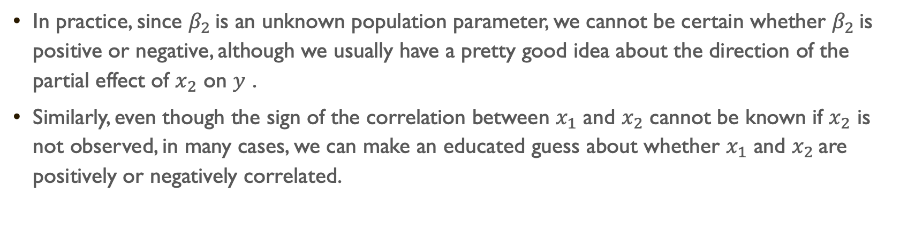
In practice, since $β_{2}$ is an unknown population parameter, we cannot be certain whether $β_{2}$ is positive or negative, although we usually have a pretty good idea about the direction of the partial effect of $x_{2}$ on $y$ .
Similarly, even though the sign of the correlation between $x_{1}$ and $x_{2}$ cannot be known if $x_{2}$ is not observed, in many cases, we can make an educated guess about whether $x_{1}$ and $x_{2}$are positively or negatively correlated.

Slide 18
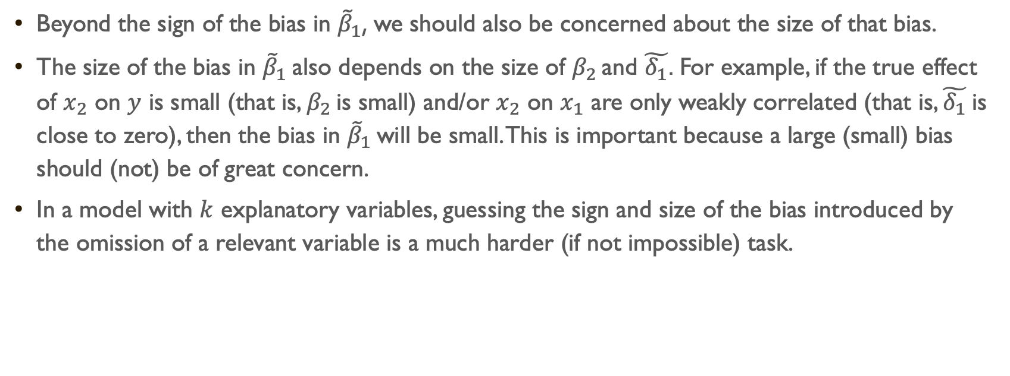
Beyond the sign of the bias in ${\tilde{β}}_{1}$, we should also be concerned about the size of that bias.
The size of the bias in ${\tilde{β}}_{1}$also depends on the size of $β_{2}$ and $\tilde{δ_{1}}$. For example, if the true effect of $x_{2}$ on $y$ is small (that is, $β_{2}$ is small) and/or $x_{2}$ on $x_{1}$ are only weakly correlated (that is, $\tilde{δ_{1}}$is close to zero), then the bias in ${\tilde{β}}_{1}$ will be small. This is important because a large (small) bias should (not) be of great concern.
In a model with $k$ explanatory variables, guessing the sign and size of the bias introduced by the omission of a relevant variable is a much harder (if not impossible) task.

Slide 19
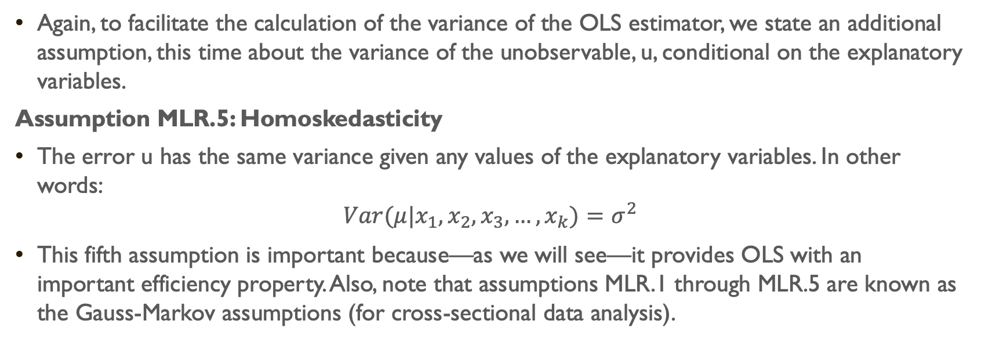
Theorem MLR.2: Sampling variances of the OLS slope estimators
Again, to facilitate the calculation of the variance of the OLS estimator, we state an additional assumption, this time about the variance of the unobservable, u, conditional on the explanatory variables.
Assumption MLR.5: Homoskedasticity
The error u has the same variance given any values of the explanatory variables. In other words:
$$Var(μ|x_{1},x_{2},x_{3},…,x_{k})=σ^{2}$$
This fifth assumption is important because—as we will see—it provides OLS with an important efficiency property. Also, note that assumptions MLR.1 through MLR.5 are known as the Gauss-Markov assumptions (for cross-sectional data analysis).

Slide 20
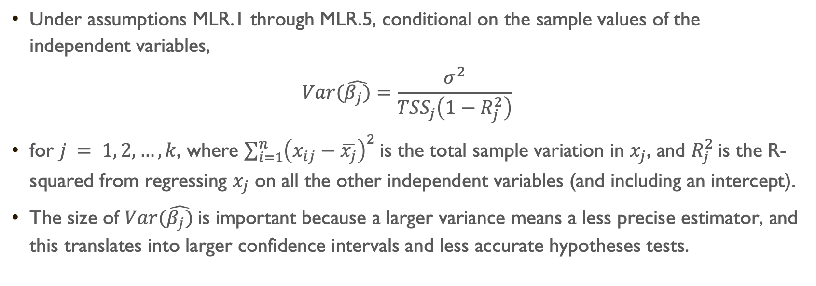
Under assumptions MLR.1 through MLR.5, conditional on the sample values of the independent variables,
$$Var(\hat{β_{j})}=\frac{σ^{2}}{{TSS}_{j}\left(1−R_{j}^{2}\right)}$$
for $j = 1, 2, …, k$, where $\sum_{i=1}^{n}{{\left(x_{ij}−\overline{x_{j}}\right)}^{2}}$is the total sample variation in $x_{j}$, and $R_{j}^{2}$is the R-squared from regressing $x_{j}$ on all the other independent variables (and including an intercept).
The size of $Var(\hat{β_{j})}$is important because a larger variance means a less precise estimator, and this translates into larger confidence intervals and less accurate hypotheses tests.

Slide 21

The formula presented in Theorem MLR.2 tells us that the variance of $\hat{β_{j}}$ depends on three factors: $σ^{2}$, ${TSS}_{j}$, and $R_{j}^{2}$.

Slide 22
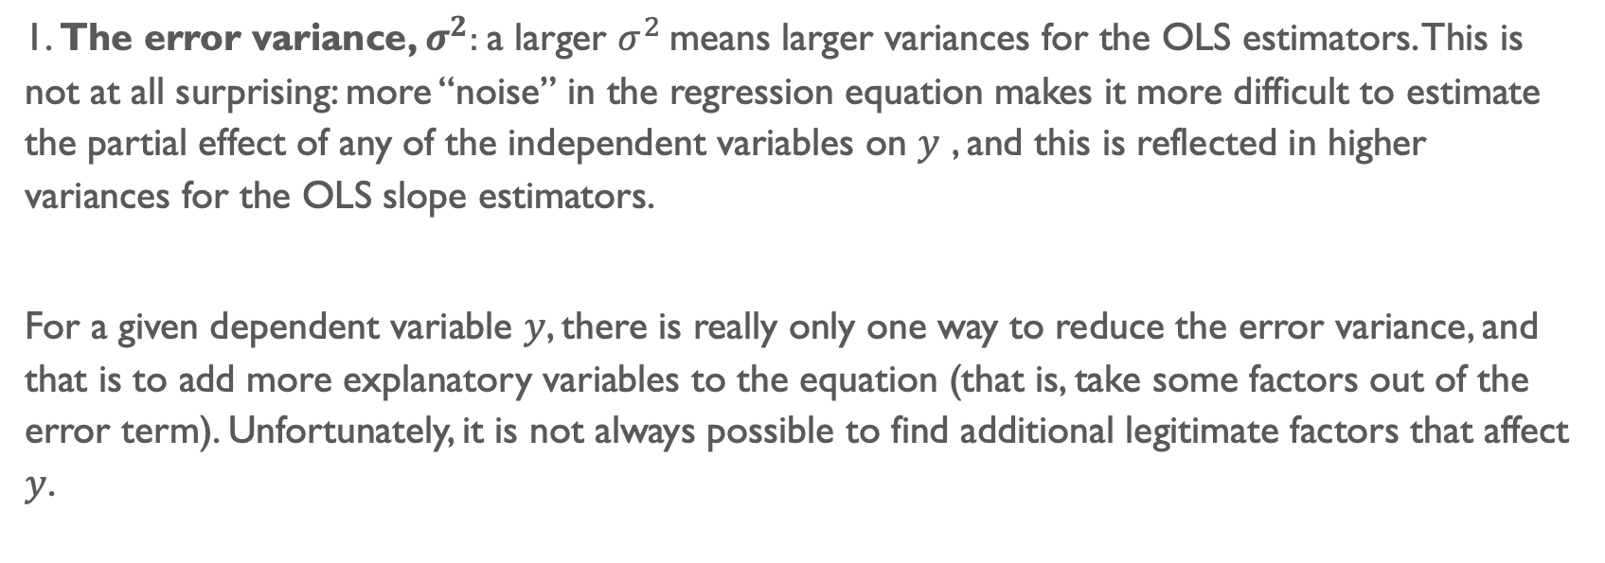
1. The error variance, $σ^{2}$: a larger $σ^{2}$ means larger variances for the OLS estimators. This is not at all surprising: more “noise” in the regression equation makes it more difficult to estimate the partial effect of any of the independent variables on $y$ , and this is reflected in higher variances for the OLS slope estimators.
For a given dependent variable $y$, there is really only one way to reduce the error variance, and that is to add more explanatory variables to the equation (that is, take some factors out of the error term). Unfortunately, it is not always possible to find additional legitimate factors that affect $y$.

Slide 23
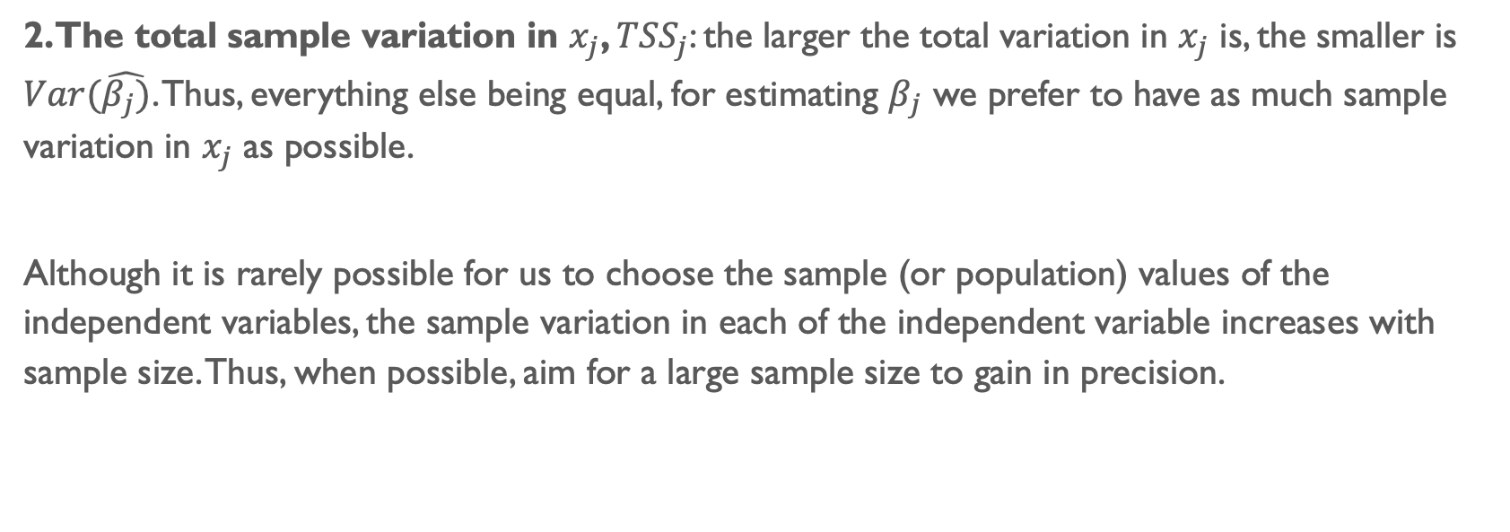
2. The total sample variation in $x_{j}$, ${TSS}_{j}$: the larger the total variation in $x_{j}$ is, the smaller is $Var(\hat{β_{j})}$. Thus, everything else being equal, for estimating $β_{j}$ we prefer to have as much sample variation in $x_{j}$ as possible.
Although it is rarely possible for us to choose the sample (or population) values of the independent variables, the sample variation in each of the independent variable increases with sample size. Thus, when possible, aim for a large sample size to gain in precision.

Slide 24
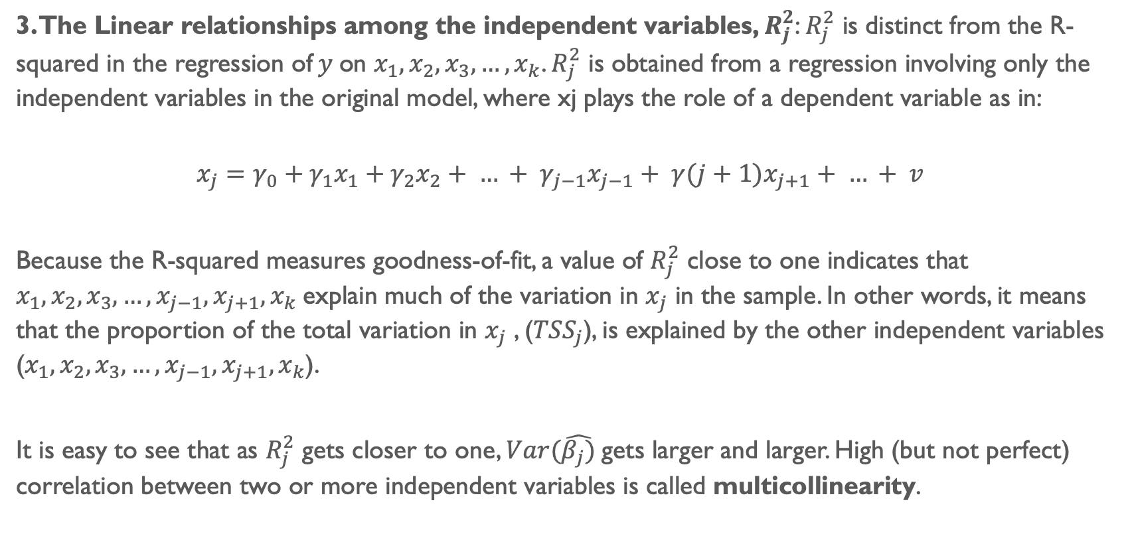
3. The Linear relationships among the independent variables, $R_{j}^{2}$: $R_{j}^{2}$ is distinct from the R-squared in the regression of$y$on $x_{1},x_{2},x_{3},…,x_{k}$. $R_{j}^{2}$ is obtained from a regression involving only the independent variables in the original model, where xj plays the role of a dependent variable as in:
$$x_{j}=γ_{0}+γ_{1}x_{1}+γ_{2}x_{2}+ … + γ_{j−1}x_{j−1}+ γ(j+1)x_{j+1}+ … + v$$
Because the R-squared measures goodness-of-fit, a value of $R_{j}^{2}$ close to one indicates that $x_{1},x_{2},x_{3},…,x_{j−1},x_{j+1},x_{k}$explain much of the variation in $x_{j}$ in the sample. In other words, it means that the proportion of the total variation in $x_{j}$ , (${TSS}_{j}$), is explained by the other independent variables ($x_{1},x_{2},x_{3},…,x_{j−1},x_{j+1},x_{k}$).
It is easy to see that as $R_{j}^{2}$ gets closer to one, $Var(\hat{β_{j})}$gets larger and larger. High (but not perfect) correlation between two or more independent variables is called multicollinearity.

Slide 25
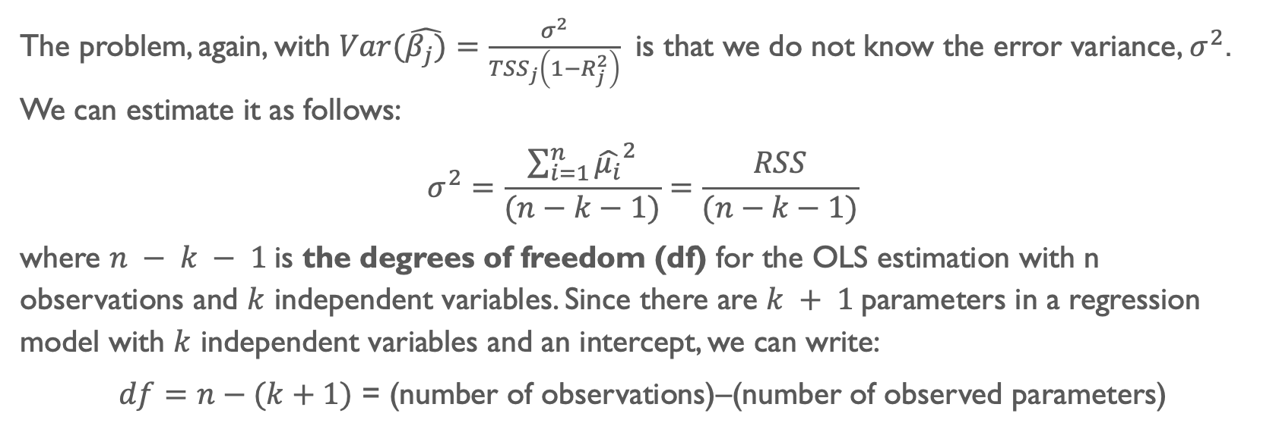
The problem, again, with $Var(\hat{β_{j})}=\frac{σ^{2}}{{TSS}_{j}\left(1−R_{j}^{2}\right)}$ is that we do not know the error variance, $σ^{2}$. We can estimate it as follows:
$$σ^{2}=\frac{\sum_{i=1}^{n}{{\hat{μ_{i}}}^{2}}}{(n−k−1)}=\frac{RSS}{(n−k−1)}$$
where $n − k − 1$is the degrees of freedom (df) for the OLS estimation with n observations and $k$ independent variables. Since there are $k + 1$parameters in a regression model with $k$ independent variables and an intercept, we can write:
$df=n−(k+1)$ = (number of observations)–(number of observed parameters)

Slide 26
This takes us to the following theorem…

Slide 27

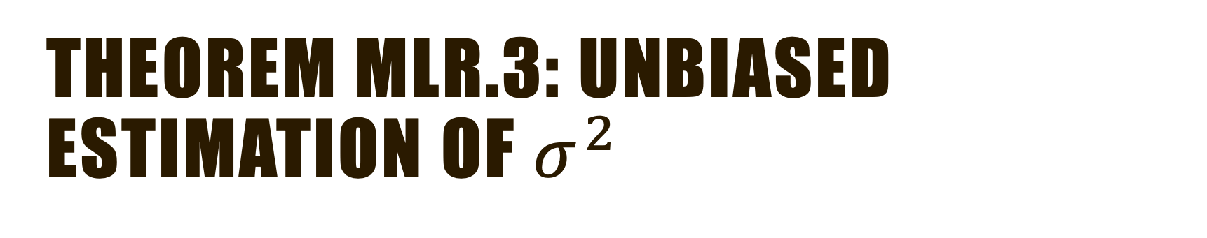
Theorem MLR.3: Unbiased estimation of $σ^{2}$
Under the Gauss-Markov assumptions MLR.1 through MLR.5,
$$E\left(\hat{σ^{2}}\right)=σ^{2}$$

Slide 28
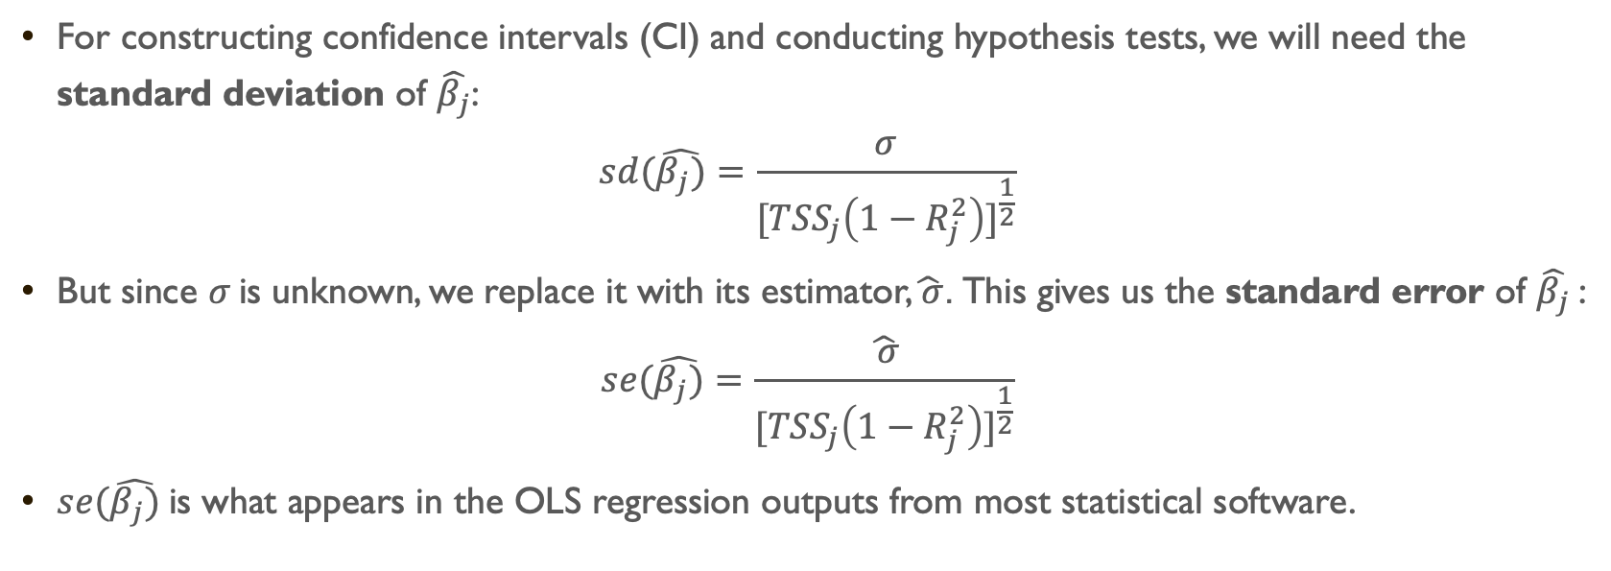
For constructing confidence intervals (CI) and conducting hypothesis tests, we will need the standard deviation of $\hat{β_{j}}$:
$$sd(\hat{β_{j})}=\frac{σ}{{[{TSS}_{j}\left(1−R_{j}^{2}\right)]}^{\frac{1}{2}}}$$
But since $σ$ is unknown, we replace it with its estimator,$\hat{ σ}$. This gives us the standard error of $\hat{β_{j}}$:
$$se(\hat{β_{j})}=\frac{\hat{ σ}}{{[{TSS}_{j}\left(1−R_{j}^{2}\right)]}^{\frac{1}{2}}}$$
$se(\hat{β_{j})}$is what appears in the OLS regression outputs from most statistical software.

Slide 29
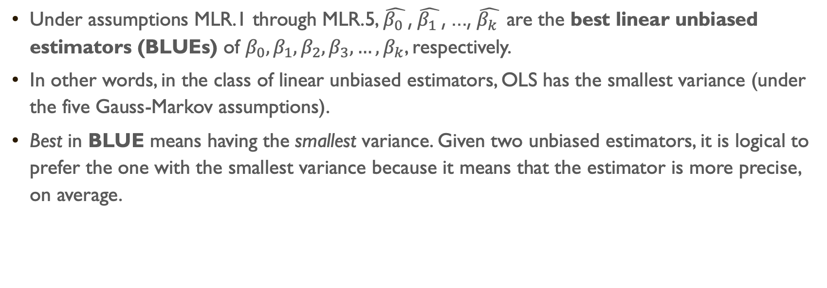
Theorem MLR.4: Gauss-Markov Theorem
Under assumptions MLR.1 through MLR.5, $\hat{β_{0} }$, $\hat{β_{1} }$, ..., $\hat{β_{k} }$are the best linear unbiased estimators (BLUEs) of $β_{0}, β_{1},β_{2},β_{3},…,β_{k}$, respectively.
In other words, in the class of linear unbiased estimators, OLS has the smallest variance (under the five Gauss-Markov assumptions).
Best in BLUE means having the smallest variance. Given two unbiased estimators, it is logical to prefer the one with the smallest variance because it means that the estimator is more precise, on average.

Slide 30
Ok, that was… something… but how does it help me with life?

