Slide 1


Stochastic Search
Sergi Valverde

Slide 2



Monte Carlo Search : discrete optimization
Pure random search (Brooks,1958) is the most simple stochastic search algorithm. It consists in sampling each search point independently in the search domain and keeping the best solution found.
Example: Counting Ones
Search Space:
Objective Function:
Goal: maximization
http://en.wikipedia.org/wiki/Monte_Carlo_method
Notes:
Find x that maximizes the objective function f(x). The pure random search, ﬁrst proposed by Brooks in 1958 [1] is the most simple stochastic search algorithm that consists in sampling each search point independently in the search domain and keeping the best solution found. (S. H. Brooks. A discussion of random methods for seeking maxima. Operations Research,251 (1958))
In many applications, the shear number of possible combinations and states is so astronomical that it is impossible to carry out evaluations over all possible combinations systematically. In this case, the Monte Carlo method is the best alternative. Monte Carlo is in fact a class of methods now widely used in computer simulations. Since the pioneer studies in 1940s and 1950s, especially the work by Ulam, von Newmann, and Metropolis, it has been applied in almost all area of simulations, from Ising model to financial market, from molecular dynamics to engineering, and from the routing of the Internet to climate simulations.

Slide 3
Fitness Landscape: “Counting Ones”
Search Space
0 | 0 | 1 | 0 | 1 | 1 | 0 | 1
Objective Function
~/counting_ones.m
function f = counting_ones(a)
  % counting_ones(a); a: vector{0,1}
  f = sum ( a > 0);
end
Notes:
fitness= #ones in the chromosome
function f = counting_ones(a)
% counting_ones(a); a: vector, {0,1}
f = sum(a > 0);

Slide 4

Monte Carlo Search Space: Counting Ones
Ex: n=3
0 | 1 | 0
1 | 1 | 0
0 | 1 | 1
1 | 1 | 1
0 | 0 | 0
1 | 0 | 0
0 | 0 | 1
1 | 0 | 1
Notes:
http://en.wikipedia.org/wiki/Random_search
We can think of monte carlo search as conducting (random) trials at the points of a grid in the search space.

Slide 5

Monte Carlo Search Space: Counting Ones
Ex: n=3
Best
0 | 1 | 0
1 | 1 | 0
1 1 0
0 | 1 | 1
1 | 1 | 1
0 | 0 | 0
1 | 0 | 0
0 | 0 | 1
1 | 0 | 1
1 1 0
Notes:
http://en.wikipedia.org/wiki/Random_search
We can think of monte carlo search as conducting (random) trials at the points of a grid in the search space.

Slide 6
Monte Carlo Search Space: Counting Ones
Ex: n=3
Best
0 | 1 | 0
1 | 1 | 0
1 1 0
0 | 1 | 1
1 | 1 | 1
0 | 0 | 0
1 | 0 | 0
0 | 0 | 1
1 | 0 | 1
1 1 0
0 0 0

Slide 7
Monte Carlo Search Space: Counting Ones
Ex: n=3
Best
0 | 1 | 0
1 | 1 | 0
1 1 0
0 | 1 | 1
1 | 1 | 1
0 | 0 | 0
1 | 0 | 0
0 | 0 | 1
1 | 0 | 1
1 1 0
0 0 0
1 0 1

Slide 8
Monte Carlo Search Space: Counting Ones
Ex: n=3
Best
0 | 1 | 0
1 | 1 | 0
1 1 0
0 | 1 | 1
1 | 1 | 1
0 | 0 | 0
1 | 0 | 0
0 | 0 | 1
1 | 0 | 1
1 1 0
0 0 0
1 0 1
0 0 1

Slide 9
Monte Carlo Search Space: Counting Ones
Ex: n=3
Best
0 | 1 | 0
1 | 1 | 0
1 1 1
0 | 1 | 1
1 | 1 | 1
0 | 0 | 0
1 | 0 | 0
0 | 0 | 1
1 | 0 | 1
1 1 0
0 0 0
1 0 1
0 0 1
1 1 1
Notes:
1 1 0 -> 0 0 0 -> 1 0 1 -> 0 0 1 -> 1 1 1
1 0 1 -> 1 0 0 -> 0 0 1 -> 1 1 0

Slide 10




Monte Carlo Search: discrete optimization
Input:
Output:
a* := generate random vector of length n;
for i = 2 to niter do
x := generate random vector of length n;
if f(x) > f(a*) then
a* := x;
end
end
~/binary_montecarlo.m
function [astar, f_best] = binary_montecarlo(func, n, niter)
end
Notes:
Implement a Monte-Carlo Search algorithm (see slide 14 of lecture 1) for maximization problems in MATLAB, in order to solve the Counting Ones problem. Let the function take the following arguments:
% f: objective function
% n:bitstring length
% niter: maximum number of evaluations
Let the function produce as outputs:
• the best individual found by the algorithm; • the fitness of the best individual.
Use n = 100 and for a run of 100 iterations, plot the fitness against the elapsed number of iterations.

Slide 11
Monte Carlo Search: implementation
~/binary_montecarlo.m
function [astar, f_best] = binary_montecarlo(func, n, niter)
  astar = rand(n,1) > 0.5;
  for (i=2:niter)
x = rand(n,1) > 0.5;
if (func(x) >= func(astar))
astar = x;
end
end
f_best = func(astar)
end
Random Sampling
Notes:
Store the current best solution found so far, and compare fitness value of new solutions with this current best solution. Furthermore, you can pass a function as argument by putting the @-symbol before the function name (i.e., it is passed as function handle).

Slide 12
Optimization: initialize vectors beforehand
It can save tremendous amounts of time
function [astar, hist_f] = binary_montecarlo(func, n, niter)
  % [best,hist_f] = binary_montecarlo(func,n,iters)
  % Performs a binary Monte Carlo search. Given objective func,
  % bitstring length n, and number of iterations, this algorithm
  % will try to find the bitstring that maximizes func.
  hist_f = zeros(1,niter);
  astar = rand(n,1) > 0.5;
  f_best = func(astar);
  hist_f(1) = f_best;
  for (i=2:niter)
    x = rand(n,1) > 0.5;
    f_x = func(x);
    if (f_x >= f_best)
      astar = x;
      f_best = f_x;
    end
    hist_f(i) = f_best;
    plot(hist_f)
    drawnow()
  end
end
Notes:
Otherwise, Matlab will reallocate space every time you increase their size.

Slide 13
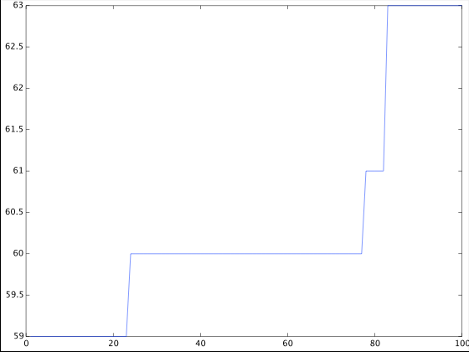
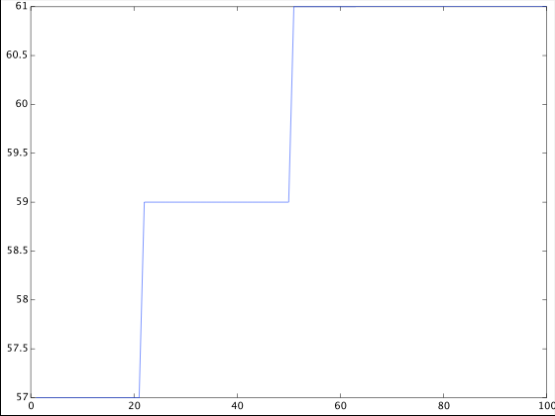
Binary Monte Carlo Search: Counting Ones
Use n=100 and a run of 100 iterations
octave> [b f] = binary_montecarlo (@counting_ones, 100, 100);
Notes:
octave-3.4.0:1> cd "/Users/sergi/Desktop/octave"
octave-3.4.0:2> pwd
ans = /Users/sergi/Desktop/octave
octave-3.4.0:3> source ("binary_montecarlo.M")
octave-3.4.0:4> source ("counting_ones.M")

Slide 14

Evolution is not Monte Carlo Search
Identical strings might be tested repeatedly
Monte Carlo performs worse than full enumeration in many cases
Exponential running time:
Notes:
see analysis (1-introduction.pdf, page 15)
expected number of iterations to find the optimal bitstring with n bits is exponential with the number of bits, i.e., E_{iter} (n) \sim 2^n

Slide 15
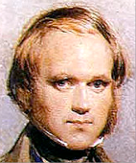
Evolutionary Search: discrete optimization
Imitate evolution to find the maximum value of the objective function. Mutate the current individual (parent) and keep the fittest (parent or offspring).
Example: Counting Ones
Search Space:
Objective Function:
Goal: maximization
Notes:
Let the function take the following arguments:
• the objective function;
• the length n of the vector ⃗x;
• a vector of length n containing the lower bounds of the search domain; • a vector of length n containing the upper bounds of the search domain; • the maximum number of fitness function evaluations.
Let the function produce as outputs:
• the best individual found by the algorithm; • the fitness of the best individual.
Run the algorithm on the Ackley function for 100 iterations with n = 2, xi ∈ [−5, 5], and c1 = 20, c2 = 0.2, c3 = 2π. Plot the fitness versus the number of iterations.
Note: we are now optimizing a minimization problem.

Slide 16

Evolutionary Search: discrete optimization
Input:
Output:
a* := generate random vector of length n;
for i = 2 to niter do
x := invert every bit of vector a* with probability p
x := generate random vector of length n;
if f(x) > f(a*) then
a* := x;
end
end
~/binary_evolution.m
function [parent, f_parent] = binary_evolution(func, n, niter)
  end
Notes:
% f: objective function
% n: bitstring length
% niter: number of evaluations
% p = ?

Slide 17
Evolutionary Search: implementation
~/binary_evolution.m
function [parent, f_parent] = binary_evolution(func, n, niter)
  p = 1/n; % Mutation rate < error threshold
  parent = rand(n,1) > 0.5;
  for (i=2:niter)
    bits = (rand(n,1) < p);
    x = mod (parent + bits, 2);
    if (func(x) >= func(parent))
parent = x;
    end
end
f_parent = func(parent);
end
Mutation
Notes:
bits = rand(n,1) <p; % choose bits to mutate
x = mod(parent + bits, 2) % generate offspring from parent

Slide 18
Optimization
Function evaluations are costly; do not waste them:
~/binary_evolution.m
function [parent, f_parent] = binary_evolution(func, n, niter)
  p = 1/n;
  parent = rand(n,1) > 0.5;
  f_parent = func(parent);
  for i = 2:niter
    bits = (rand(n,1) < p);
    x = mod (parent + bits, 2);
    f_x = func (x);
    if (f_x >= f_parent)
parent = x;
      f_parent = f_x;
    end
end
end
Notes:
bits = rand(n,1) <p; % choose bits to mutate
x = mod(parent + bits, 2) % generate offspring from parent

Slide 19
Statistics
You may want to see more than just the optimal bitstring:
~/binary_evolution.m
function [parent, hist_f] = binary_evolution(func, n, niter)
  p = 1/n;
  hist_f = zeros(1,niter);
  parent = rand(n,1) > 0.5;
  f_parent = func(parent);
  hist_f(1) = f_parent;
  for i = 2:niter
    bits = (rand(n,1) < p);
    x = mod (parent + bits, 2);
    f_x = func (x);
    if (f_x >= f_parent)
parent = x;
      f_parent = f_x;
    end
    hist_f(i) = f_parent;
end
end
Notes:
bits = rand(n,1) <p; % choose bits to mutate
x = mod(parent + bits, 2) % generate offspring from parent

Slide 20
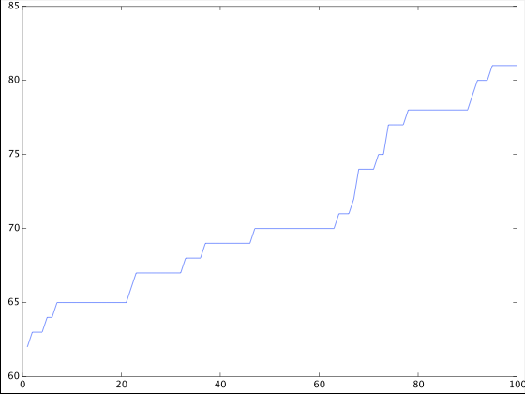
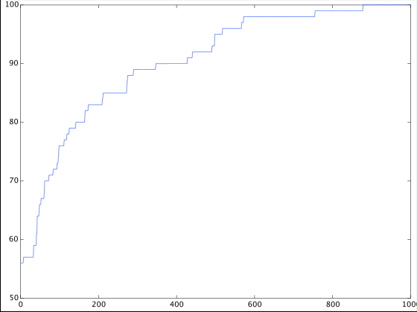
Evolutionary Search: Counting Ones
Use n=100, mutation rate p = 1/n, and a run of 1000 iterations
octave> [parent hist_f] = binary_evolution (@counting_ones, 100, 1000);
octave> plot (hist_f)
Notes:
octave-3.4.0:1> cd "/Users/sergi/Desktop/octave"
octave-3.4.0:2> pwd
ans = /Users/sergi/Desktop/octave
octave-3.4.0:3> source ("simple_ga.M")
octave-3.4.0:4> source ("counting_ones.M")

Slide 21

Evolutionary Search is much faster than Random Search
Logarithmic running time:
This is a so-called (1+1)-EA (see next time)
Notes:
See: (1-introduction.pdf, page 19) and
Droste et al, “On the analysis of the (1+1) evolutionary algorithm”, Theor. Comp. Sci. 276 (2002) 51-81.

Slide 22

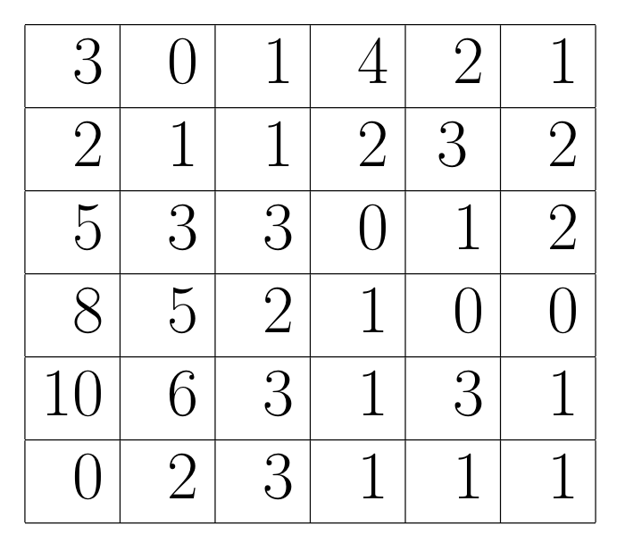
  Exercise: Locating Emergency Stations
Map showing the number of emergency calls per year in each one square mile area of the city. Find the best location for the new facility.
Notes:
http://www.cherryhill-nj.com/index.aspx?NID=223

