Slide 1
Microservices

Slide 2
Agenda
Understanding Monolithic Application & its challenges
Microservices
Building blocks of microservices
How to microservices solve monolithic application challenges
Example – Microservice development
Common Design Patterns
REST and JSON
Key benefits
Key Challenges
Monitoring and Alerts

Slide 3
Monolithic Architecture - Challenges
Scalability
Agility
Hybrid Technologies
Fault Tolerance
Tightly coupled components
Large team and considerable team management effort
Startup time

Slide 4
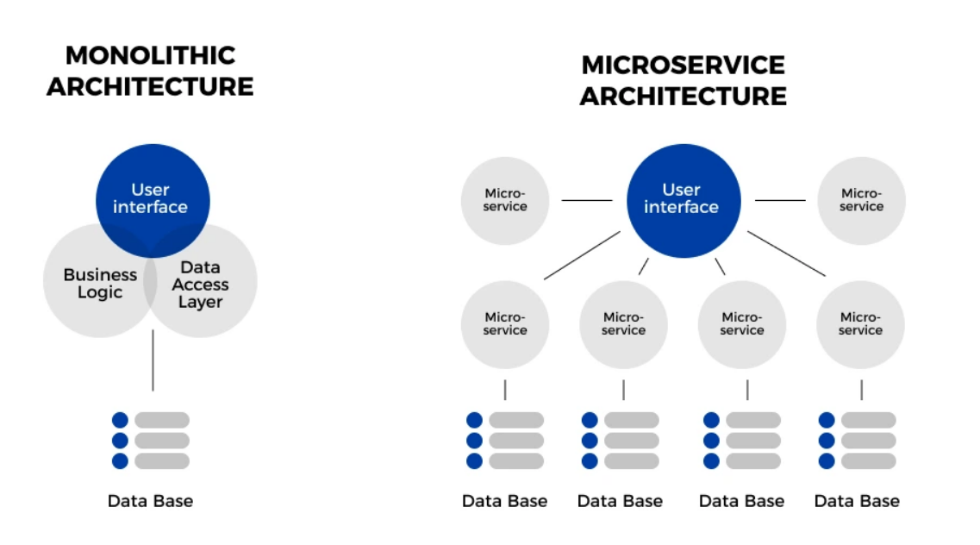

Slide 5
Microservices
Microservices is an architecture wherein all the components of the system are put into individual components, which can be built, deployed, and scaled individually
Components are loosely coupled
Service Discovery
Small focused teams
Less startup time
Communication with other microservices through Application Programming Interface (API)

Slide 6
Microservices Architecture(MSA) - Design Patterns
Decomposition Design Patterns
Decompose into smaller microservices – provides insight on how to do it logically
Integration Design Patterns
How to get one result from multiple services in a single call
Database Design Patterns
Helps to design database whether we need independent/shared database
Observability Design Patterns
Logging, monitoring, performance and so
Cross Cutting Concern Design Patterns
Deals with service discovery, external configuration, deployment scenarios

Slide 7
Decomposing Design patterns
Business Capability
Develop the microservices based on the business capability
Inventory Management
Order Management
Subdomain
Develop the microservices based on the subdomains of a main domain – this is also known as DDD – Domain Driven Design
Strangler
Develop the microservice using the “New” or “Existing” behaviours

Slide 8
Integration Design Patterns
API Gateway
One entry point for all API calls from external clients
Aggregator
Aggregating the responses that we receive from multiple service calls into a single response
Proxy
Using proxy model instead of aggregator model
Client Side UI Composition
Based on the UI functionality define the microservices
Chain Of Responsibilities
Branch
Extended version of aggregator and chain patterns

Slide 9
Database Design Patterns
Database per service
Only one database per one microservice
Shared database per service
Shared database for multiple microservices
Command Query Responsibility Segregator
Segregating the operations and create one service per operation
Saga
Sequence of local transactions
Asynchronous Messaging
Asynchronous communication of request and response
Event Sourcing
Inter service communication

Slide 10
Observability Design Patterns
Log Aggregation
Performance Metrics
Distributed Tracing
Health Check

Slide 11
Cross Cutting Concern Design Patterns
External Configuration
Service Discovery
Circuit Breaker
Blue Green deployment

