Slide 1
TOULOUSE MICROSERVICES
26/03/2019
Stéphane Vanacker
Manager Agile

Slide 2
Introduction à « Toulouse Microservices »

Slide 3
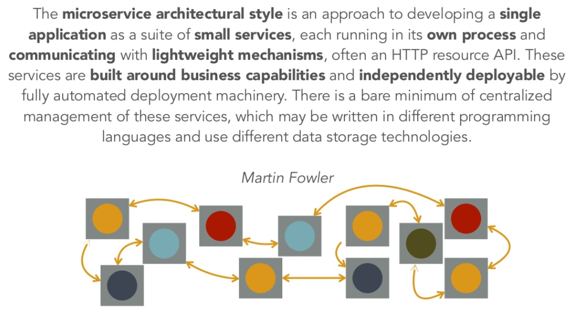
Architectures micro-services

Slide 4
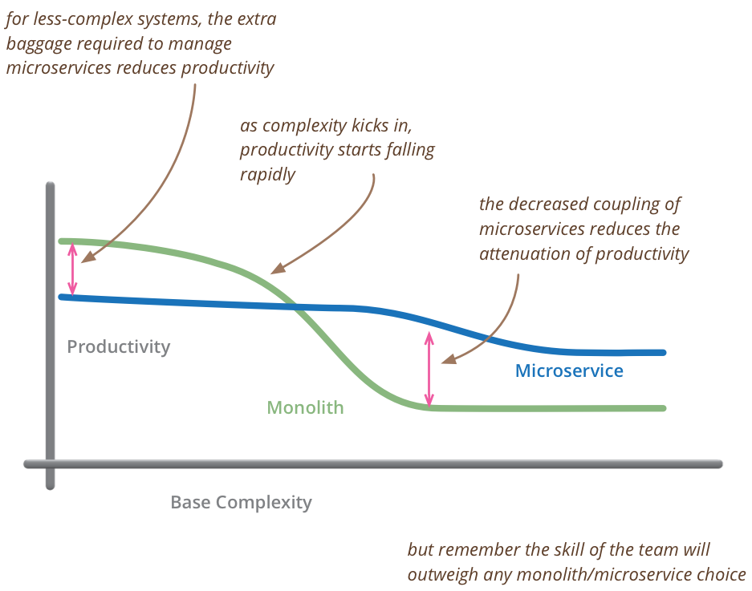
Motivations pour les microservices sur des grandes applications

Slide 5
Jeff Bezos Mandate - 1
All teams will henceforth expose their data and functionality through service interfaces.
Teams must communicate with each other through these interfaces
There will be no other form of interprocess communication allowed: no direct linking, no direct reads of another team's data store, no shared-memory model, no back-doors whatsoever. The only communication allowed is via service interface calls over the network
It doesn't matter what technology they use. HTTP, Corba, Pubsub, custom protocols -- doesn't matter. Bezos doesn't care

Slide 6
Jeff Bezos Mandate - 2
All service interfaces, without exception, must be designed from the ground up to be externalizable. That is to say, the team must plan and design to be able to expose the interface to developers in the outside world. No exceptions.
Anyone who doesn't do this will be fired.
Thank you; have a nice day!

Slide 7
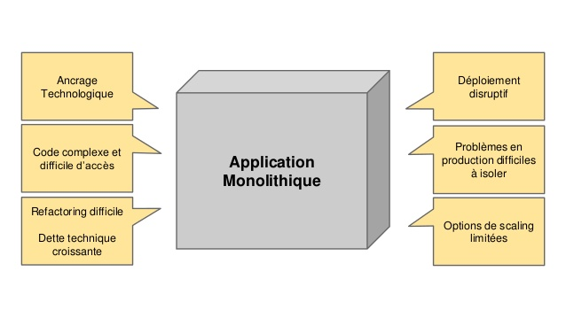
Architectures monolithiques
De l’application simple à l’application à tout faire

Slide 8
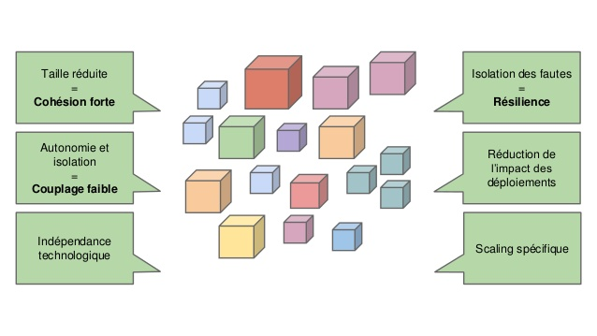
Architectures micro-services
Est-ce la solution pour créer et conserver une application simple à faire évoluer, à cout constant, et technologiquement à jour ?

Slide 9
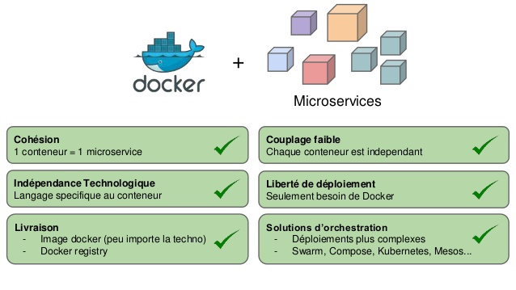
Les conteneurs applicatifs
Une réponse qui tombe au bon moment !

Slide 10
Prochaines sessions

Slide 11

A vos CFP !

Slide 12
Questions ?

