Slide 1
Titanic

Slide 2
Titanic
source:
https://www.kaggle.com/c/titanic
"The sinking of the RMS Titanic is one of the most infamous shipwrecks in history. On April 15, 1912, during her maiden voyage, the Titanic sank after colliding with an iceberg, killing 1502 out of 2224 passengers and crew. This sensational tragedy shocked the international community and led to better safety regulations for ships.”

Slide 3
Titanic
Aim of this project is simply predicting who would've survived in the titanic sinking based on:
Traveling Class (called pclass in the data)
Sex
Age
Fare Price First let’s plot a bar graph of those who Survived Vs. Those who did not.

Slide 4
Attribute details
There are multiple attributes like:
survival Survival (0 = No; 1 = Yes)
pclass Passenger Class (1 = 1st; 2 = 2nd; 3 = 3rd)
name Name
sex Sex
age Age
sibsp Number of Siblings/Spouses Aboard
parch Number of Parents/Children Aboard
ticket Ticket Number
fare Passenger Fare
cabin Cabin
embarked Port of Embarkation (C = Cherbourg; Q = Queenstown; S = Southampton)

Slide 5
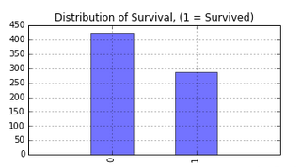
Data Visualization
Distribution of survival:

Slide 6
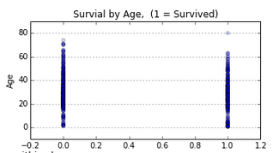
Data Visualization
Distribution of survival by age:

Slide 7
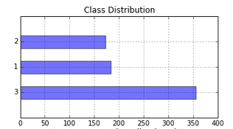
Data Visualization
Class distribution:

Slide 8
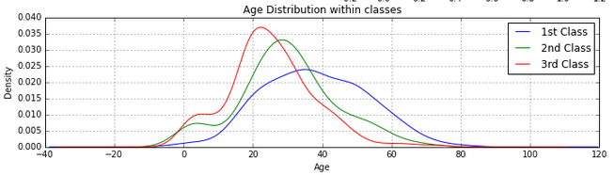
Data Visualization
Age distribution within classes:

Slide 9
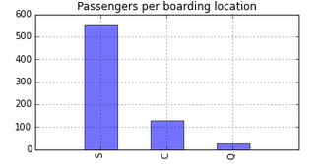
Data Visualization
Passengers per boarding location:

Slide 10
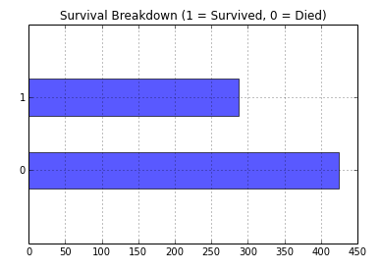
Exploratory Visualization
Survival breakdown:

Slide 11
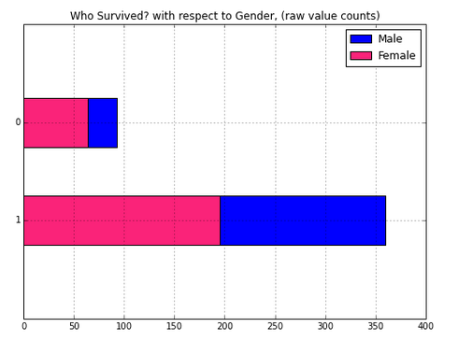
Exploratory Visualization
Survival? With respect to gender:

Slide 12
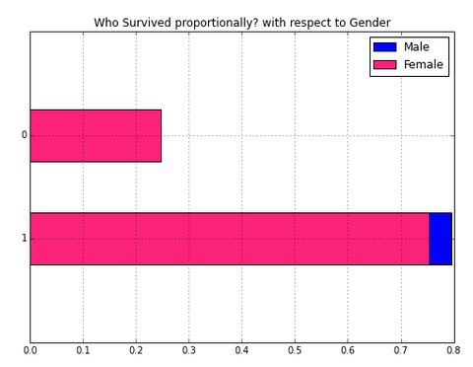
Exploratory Visualization
Who survived proportionality? With respect to gender:

Slide 13
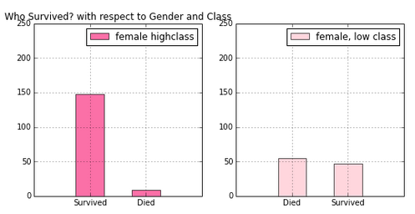
Exploratory Visualization
Who survived? With respect to gender and class:

Slide 14
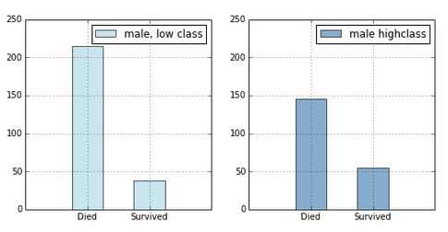
Exploratory Visualization
Who survived? With respect to gender and class:

Slide 15
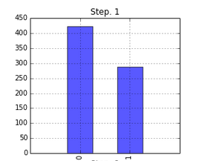
Interactive data analysis
Survival compared

Slide 16
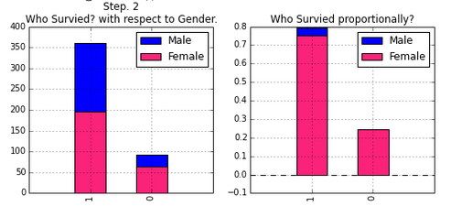
Interactive data analysis
Survival compared

Slide 17
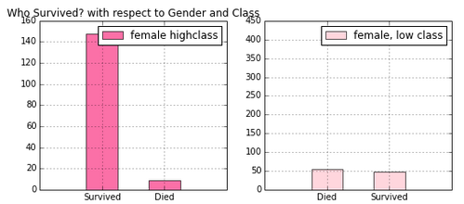
Interactive data analysis
Survival compared

Slide 18
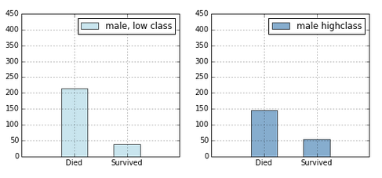
Interactive data analysis
Survival compared

Slide 19
Prediction: Survival
We want to predict a binary outcome. That is, we want to know whether some will die, (represented as a 0), or survive, (represented as 1). So firstly, to calculate the probability that an individual observation, or person, is likely to be a 0 or 1.
Prediction formula :
formula = 'Survived ~ C(Pclass) + C(Sex) + Age + SibSp + C(Embarked)'

Slide 20
Prediction: Logistic Regression
“In statistics, logistic regression, or logit regression, or logit model is a regression model where the dependent variable (DV) is categorical. This article covers the case of binary dependent variables—that is, where it can take only two values, such as pass/fail, win/lose, alive/dead or healthy/diseased.”
Source: http://scikit-learn.org/stable/modules/tree.html

Slide 21
Prediction: Logistic Regression
Main code for prediction and storing results:
  # create a regression friendly dataframe using patsy's dmatrices function
  y,x = dmatrices(formula, data=df, return_type='dataframe')
  # instantiate our model
  model = sm.Logit(y,x)
  # fit our model to the training data
  res = model.fit()
  # save the result for outputing predictions later
  results['Logit'] = [res, formula]
  res.summary()

Slide 22
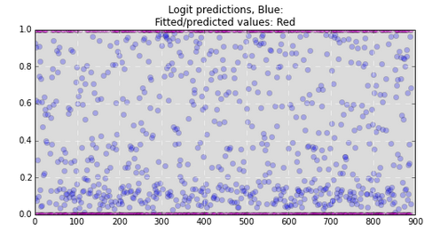
Plotting Model
Plot predictions vs actual

Slide 23
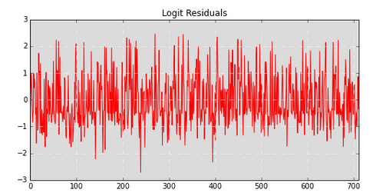
Plotting Model
Logit residuals

Slide 24
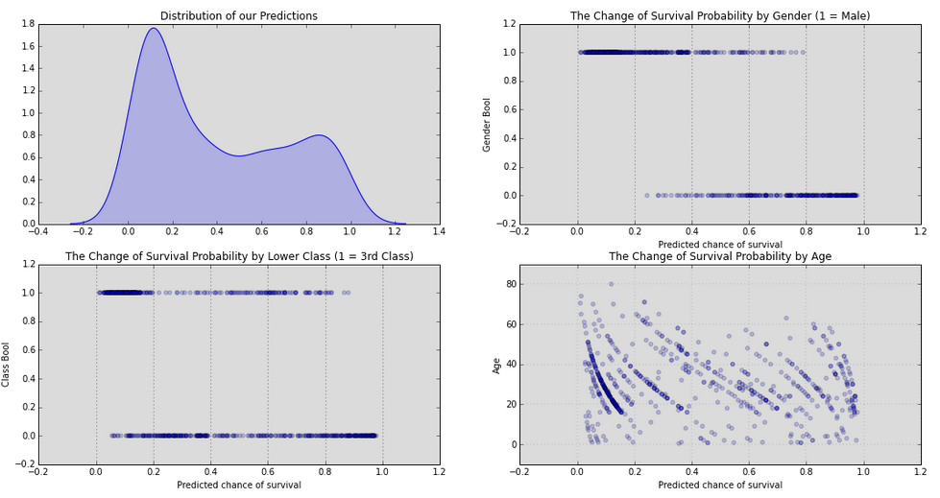
Visualization: Final

Slide 25
Prediction: Conclusion
The chance of survival for men is so low and by age it depends on various factors. The chance of survival of upper class is way more compared to lower class.

