Slide 1
Convexity Adjustments for VaR
Peter Caspers
Eurobanking 2011

Slide 2
Generic VaR Computation
Input Parameters x
Probabilities of Default
Loss given Defaults
Correlation of Risk Factors
Volatilities of Risk Factors
Model f ( ⋅ )
VaR ( γ , T ) = f ( x )
γ confidence level
T risk horizon

Slide 3
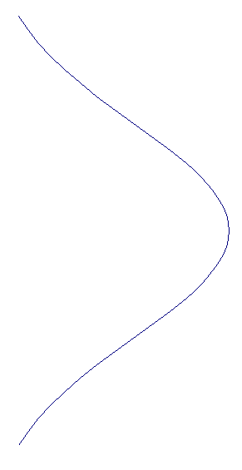
Deterministic input parameters
Input Parameters x are in general estimates of their true values.
In VaR calculation this is usually ignored:
Estimation
VaR Calculation
Y
f ( T ( y ) )
T
T( y ) = x
f

Slide 4
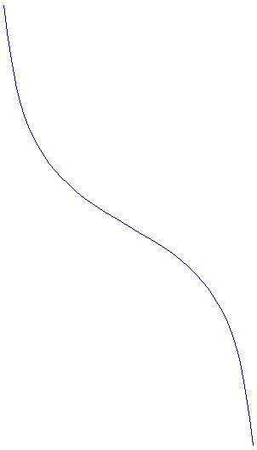
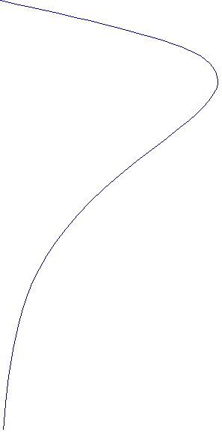
Random input parameters
Usual calculation: VaR = f ( x )
But: Expected VaR = E ( f(T(Y)) ) ≠ f ( E(T(Y)) )
due to non-linearity of f
E( f(T(Y)) )
Estimation
VaR Calculation
Y
f ( T ( Y ) )
T
f
f ( E(T(Y)) )
T( Y )
E( T ( Y ) ) = True value
If T is unbiased

Slide 5
Estimation risk
Let‘s call
f ( E ( T(Y) ) ) - E ( f ( T(Y) ) )
the estimation risk. Then
True VaR = Usual VaR + Estimation Risk (in Expectation)
The estimation risk is a convexity adjustment to the usual risk computation, accounting for the uncertainty of parameter estimates.
The estimation risk is not zero as soon as
- f is non-linear and / or
estimators of input parameters have non-zero variance
Both is usually the case.

Slide 6

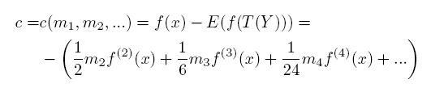
Computing the convexity adjustment
The idea is to approximate f by a taylor expansion around the true value x and then write
where m₂ is the Variance of T(Y).
The convexity adjustment or estimation risk is then expressed by
Note that in the actual computation of m₂ and f⁽²⁾(x) in practice the true value x has to
be replaced by its estimate.

Slide 7
Specific example: ASFR model
The ASFR model computes a credit VaR taking an asset correlation R and
a single probability of default PD as an input.
The latter parameter x = PD is the one of interest, i.e. we want to consider the estimation risk
of this parameter. R is fixed in our setup.
The model for the PD distribution is as follows: Fixing the number of obligors and R from
above, we generate correlated defaults using a 1 factor gauss model. The number of
defaults is then divided by the number of obligors resulting in a sample PD of our model
distribution.
f, its second derivative and the moments of the PD estimator can be computed
semi-analytically using a gauss hermite integration.

Slide 8

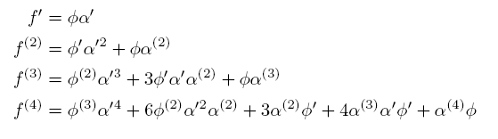
Computations in the ASFR
The VaR in the ASFR model is given by
with x = PD and
The derivatives of f are given by

Slide 9
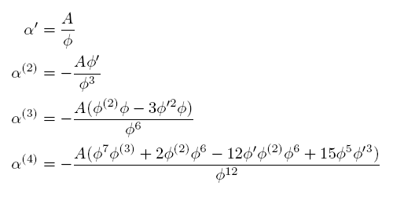
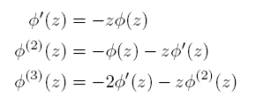
Computations in the ASFR
where
and

Slide 10



Computations in the ASFR
The second moment of T is computed using the law of total variance
where Z ~ N(0,1) is the systematic risk factor. The first term can be written as
with p(Z) = PD | Z = conditional PD given Z. Using E(T|Z) = p(Z) the second term equals
Both integrals can be computed using a Gauss Hermite schema.

Slide 11
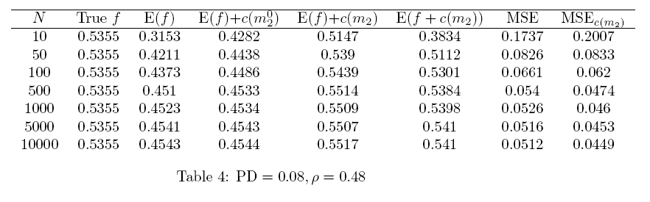
Specific example: Results
The estimation risk is the higher the
higher the PD
higher the correlation
smaller the number of obligors N
The correction – in terms of the bias – is quite
effective, if N is not too small. For small N
(e.g. N=10 above) the correction is too small.

Slide 12
Specific example: Results
In terms of the MSE, the corrected estimator is not as convincing as when looking
at the bias alone.
I.e. The improvement of getting closer to the true VaR in expectation is bought by
a higher variance of the estimator.

Slide 13
Summary
A method for taking into account estimation risk defined as the difference between
- the expected VaR based on estimates of true input parameters and
- the VaR computed on basis of the true parameters themselves
is suggested.
The effect of the correction is demonstrated within the ASFR framework.
The bias can be reduced quite effectively in this example.
The variance however is increased by the correction, such that the MSE ist comparable
to the uncorrected case.

