Slide 1
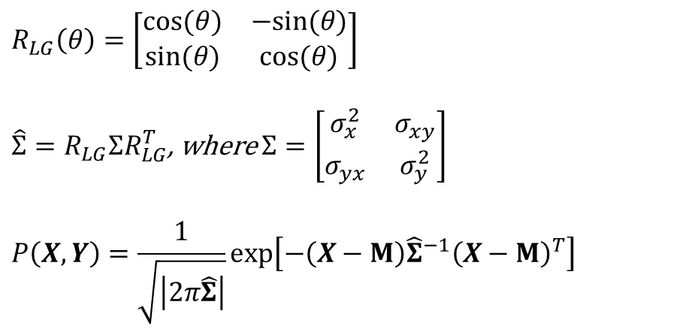
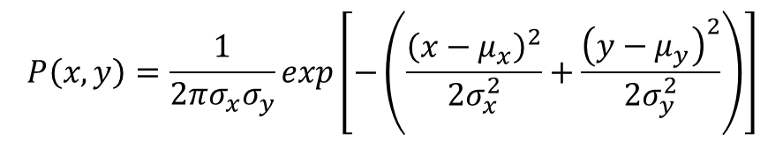
Generalized Implementation of Multi-Variate Gaussian Probability Estimation
Simplified Implementation of Multi-Variate Gaussian Probability Estimation
$$P\left(x,y\right)=\frac{1}{2πσ_{x}σ_{y}}exp\left[−\left(\frac{{\left(x−μ_{x}\right)}^{2}}{2σ_{x}^{2}}+\frac{{\left(y−μ_{y}\right)}^{2}}{2σ_{y}^{2}}\right)\right]$$
$$R_{LG}\left(θ\right)=\left[\begin{matrix}cos⁡(θ) & −sin⁡(θ) \\ sin⁡(θ) & cos⁡(θ)\end{matrix}\right]$$
$\hat{Σ}=R_{LG}ΣR_{LG}^{T}$, where $Σ=\left[\begin{matrix}σ_{x}^{2} & σ_{xy} \\ σ_{yx} & σ_{y}^{2}\end{matrix}\right]$
$$P\left(X,Y\right)=\frac{1}{\sqrt{\left|2π\hat{Σ}\right|}}exp⁡\left[−\left(X−Μ\right){\hat{Σ}}^{−1}{\left(X−Μ\right)}^{T}\right]$$
Notes:
The above implementation will not be accurate in global frame if variance of sensor measurement is different in vehicle frame. Transformation of covariance matrix (resulting in non-zero off-diagonal terms) may be necessary.
Since the variance of the sensor for this project is same in x & y direction, its ok to use the above implementation in the global frame. (same variance means that spread is circular, and a circle will remain the same shape irrespective of coordinate transformation).

