Slide 1
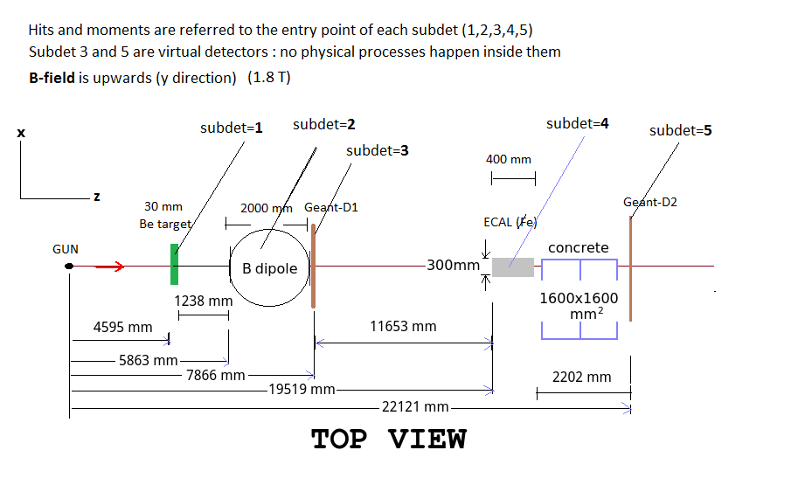
31/1/2017
Tracking studies
Bertolin (INFN-Padova)
L. Sestini (INFN and University of Padova)
MCMC_Be_30mm_v4conc_small.root

Slide 2
Tracking with hits in (CMS) muon chamber
using as staring point the muon position at subdetector 5 entrance:
8 hits are generated in the x-z view with a 150 mum Gaussian spread
(x-z: bending plane)
4 hits are generated in the y-z view with a 200 mum Gaussian spread
match the CMS muon chamber structure
one C++ function

Slide 3
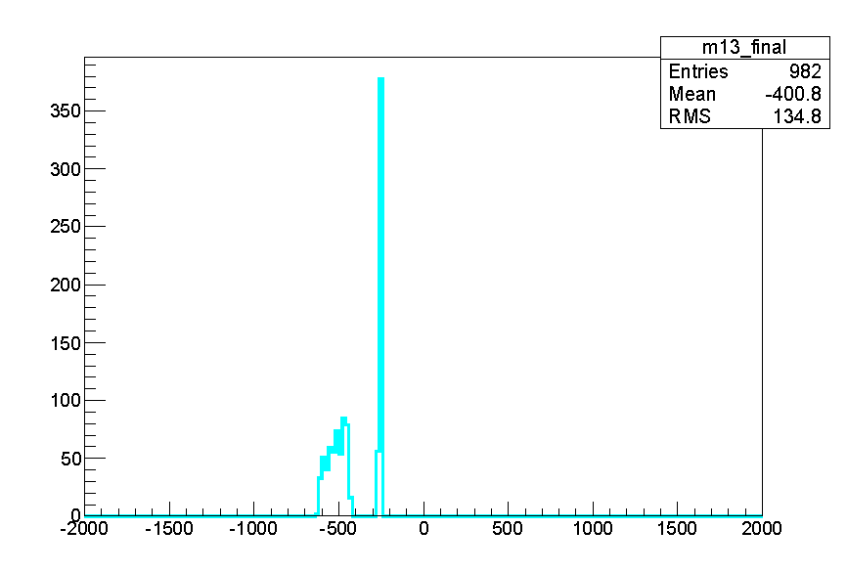
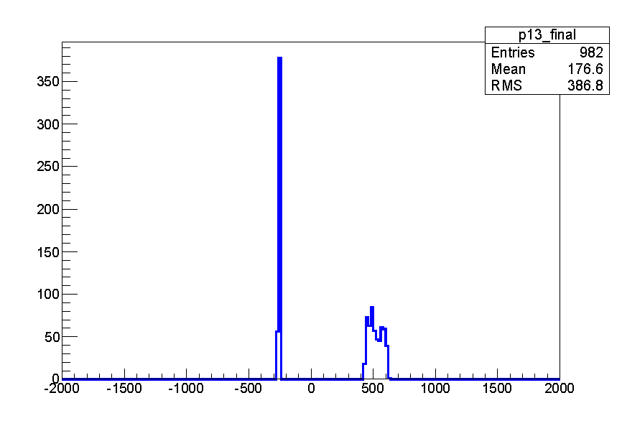
Position at subdetector 5 entrance
mu+
< -350 mm
mu-
broad distribution: pairs produced in the Be target
very sharp distribution: pairs produced in the concrete
> 300 mm

Slide 4
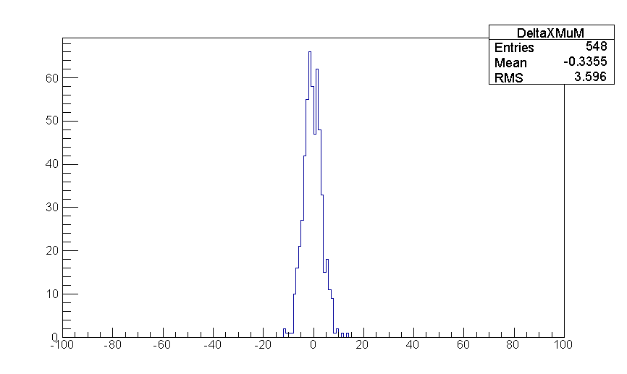
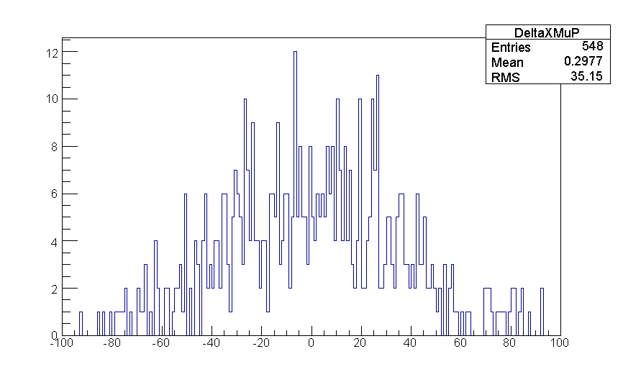
Backward propagation and comparison to the position at subdetector 3 entrance
x z plane
x z plane
RMS = 3.6 millimeters
RMS = 35 millimeters
DeltaX [mm]
DeltaX [mm]
mu- case: straight line propagation in vacuum
one C++ function
x(muon) > 300 mm
mu+ case: straight line propagation in vacuum + concrete
one C++ function
x(muon) < -350 mm
keep the mu- line as “clean” as possible

Slide 5
Backward propagation and comparison to the position at subdetector 2 entrance
but subdetector 3 is hopefully not a big concern since the only hit we will eventually find there is going to be the mu- one
in subdetector 2, at the magnetic field entrance, we however expect e+/e-/mu+/mu- hits mostly overlapped and indistinguishable … can we define a search window for the mu- hit ? How large can it be ?
projection:
x z
inputs:
8 muon chamber hits with a 150 mum Gaussian spread
1 hit with a 5 mum Gaussian spread (subdetector 3)
B = 0.7 * 1.8 T, 2 m length
TRUE TMath::Sqrt(pxh*pxh+pzh*pzh) used for the propagation in the magnetic field
unrealistic but useful to setup the algorithm
method: analytical propagation performed by a single C++ function
y z
inputs:
4 muon chamber hits with a 200 mum Gaussian spread
1 hit with a 15 mum Gaussian spread (subdetector 3)
method: straight line propagation performed by a single C++ function

Slide 6
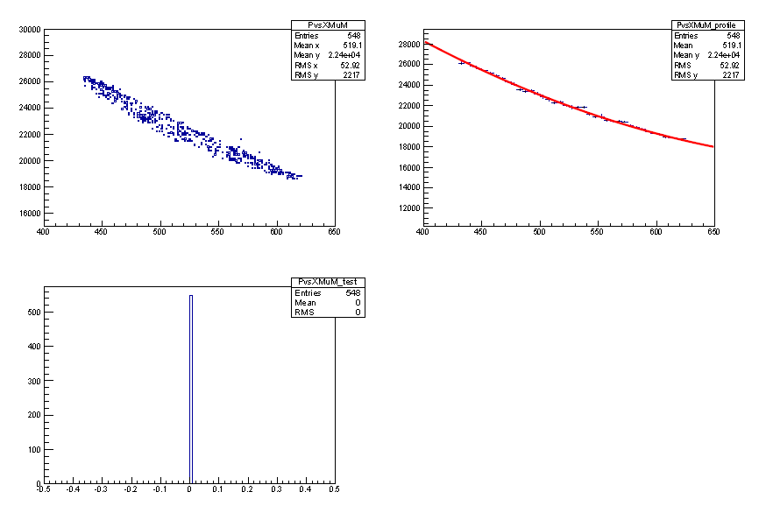
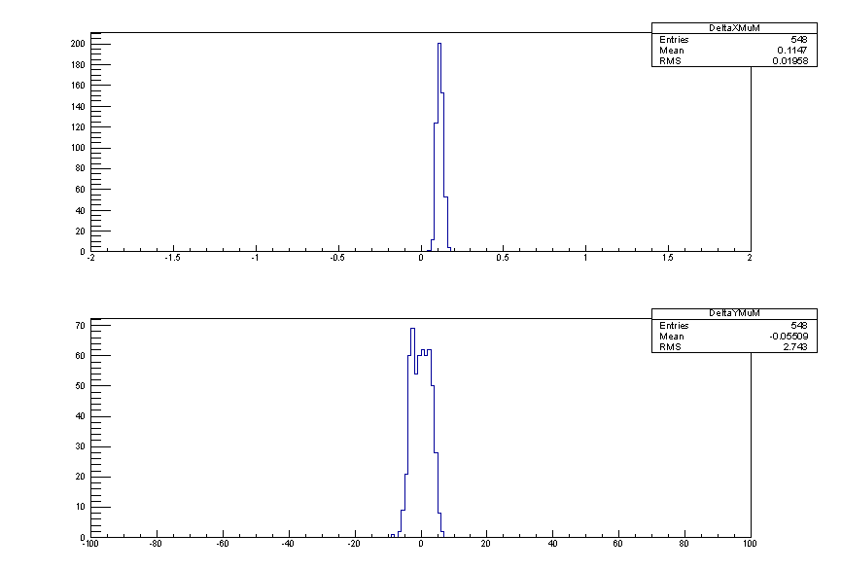
DeltaX, DeltaY at subdetector 2 entrance
TMath::Sqrt(pxh*pxh+pzh*pzh)
x z
RMS = 0.020 mm
/!\ 0.11 mm mean being investigated
DeltaX [mm]
y z
RMS = 2.7 mm
DeltaY [mm]

Slide 7
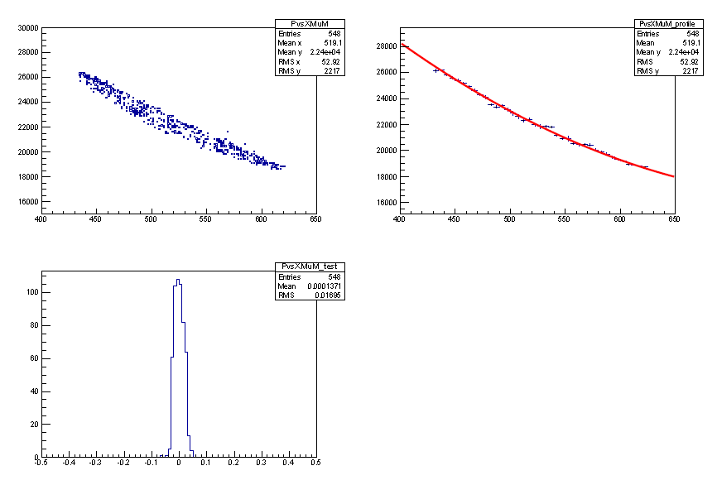
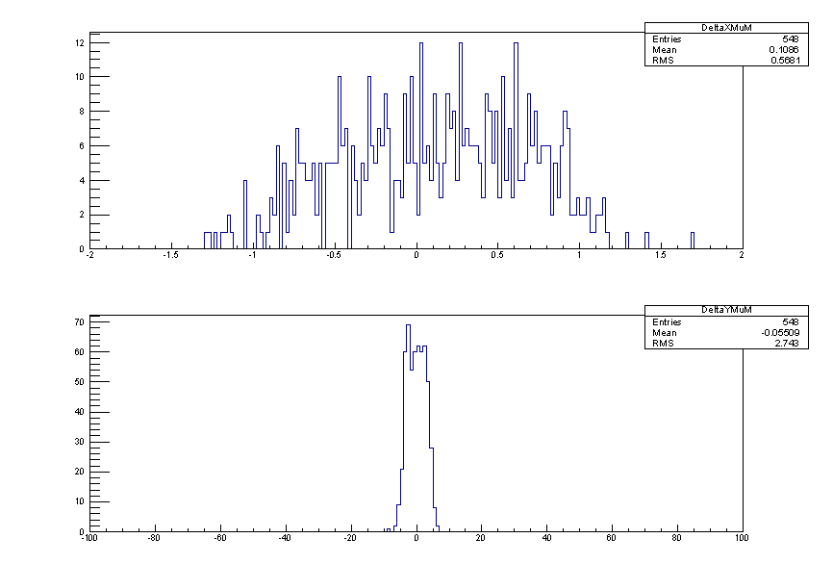
DeltaX, DeltaY at subdetector 2 entrance
p @ sd==2 vs xh @ sd==5
empiric quadratic dependence
p=f(xh @ sd==5)
from correlation between
p @ sd==2 vs xh @ sd==5
RMS=0.017
DeltaX [mm]
Delta_p/p
search window “size”:
RMS(X) = 0.57 mm
RMS(Y) = 2.74 mm
(0.57*2.74)/(20*20) = 3.9e-3
(20*20)/(0.57*2.74) = 256
DeltaY [mm]

Slide 8
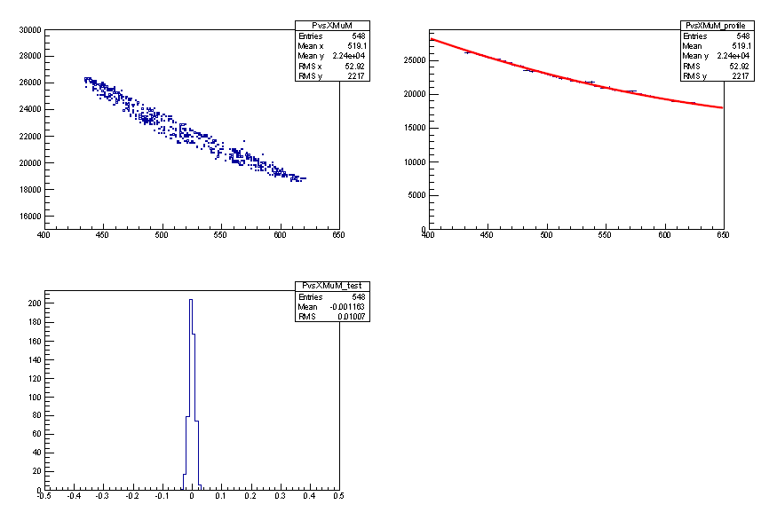
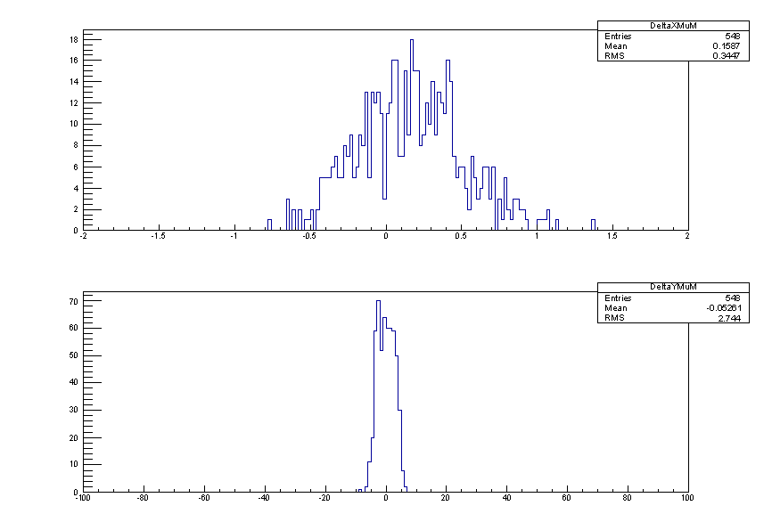
DeltaX, DeltaY at subdetector 2 entrance
r->Gaus(1.,0.01)*TMath::Sqrt(pxh*pxh+pzh*pzh)
DeltaX [mm]
DeltaY [mm]

Slide 9
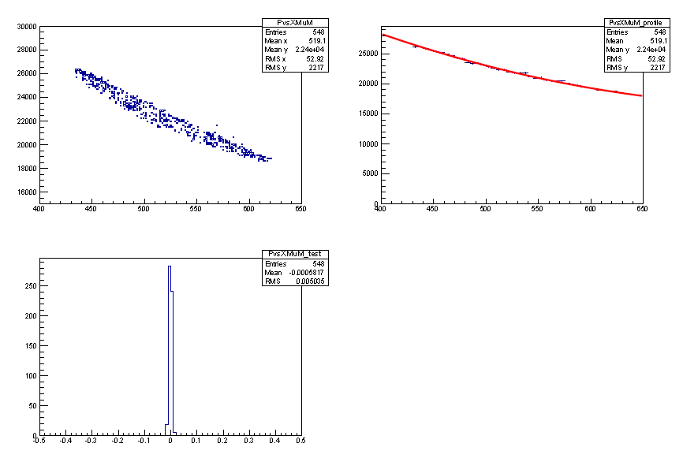
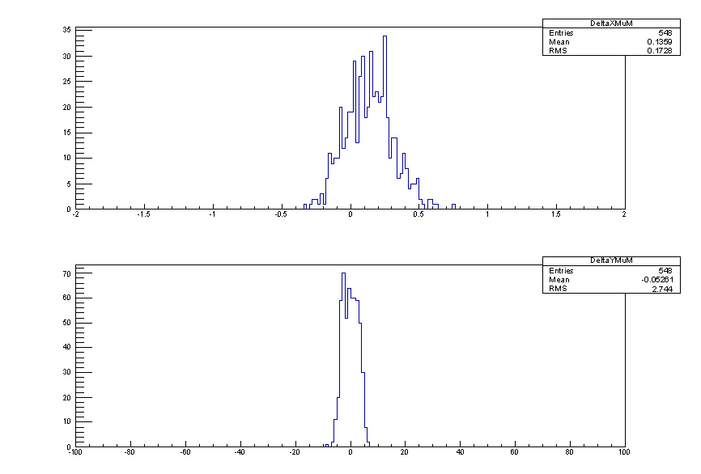
DeltaX, DeltaY at subdetector 2 entrance
r->Gaus(1.,0.005)*TMath::Sqrt(pxh*pxh+pzh*pzh)
DeltaX [mm]
DeltaY [mm]

Slide 10

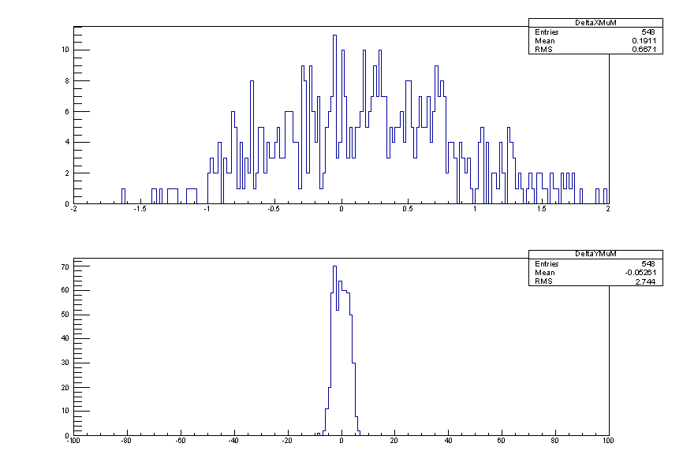
DeltaX, DeltaY at subdetector 2 entrance
r->Gaus(1.,0.02)*TMath::Sqrt(pxh*pxh+pzh*pzh)
DeltaX [mm]
DeltaY [mm]

Slide 11
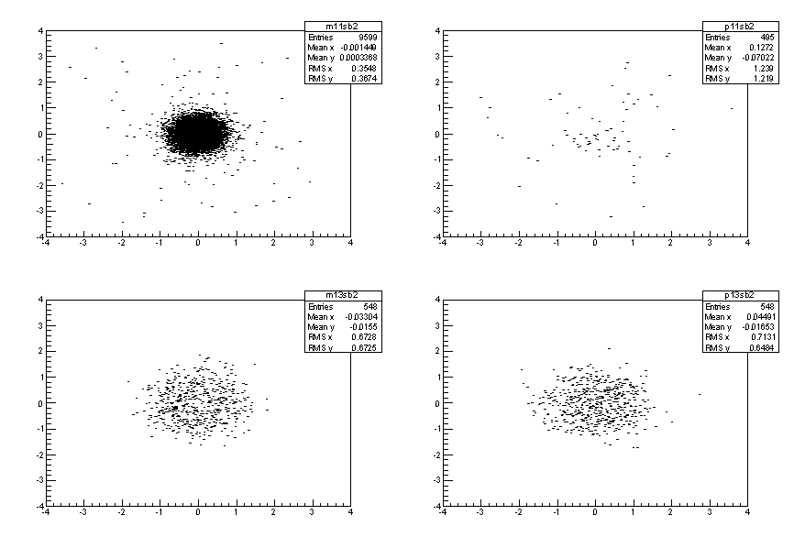
yh vs xh @ sb==2
e+
e-
mm
search window “size”:
RMS(X) = 0.57 mm
RMS(Y) = 2.74 mm
mu+
mu-
mm
mm
mm

Slide 12
Summary and next steps
with the v4 detector setup
investigate the shape of the DeltaY distribution
investigate the 0.11 mm bias in x
RMS(X) = 0.57 mm driven by the Delta_p/p accuracy
RMS(Y) = 2.74 mm, likely just less points with lower resolution
in v4 along the mu- line only vacuum
any additional passive material will only degrade results
are using extremely simple software setup: C++ functions, root
will move to any updated detector simulation when defined

