Slide 1
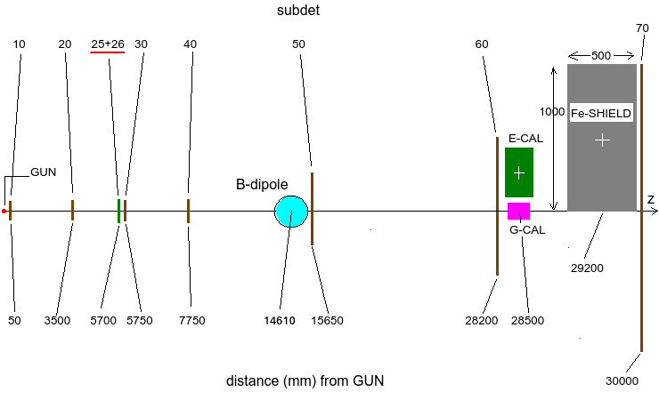
LEMMA meeting
1/3/2017
First look
A. Bertolin (INFN-Padova)

Slide 2
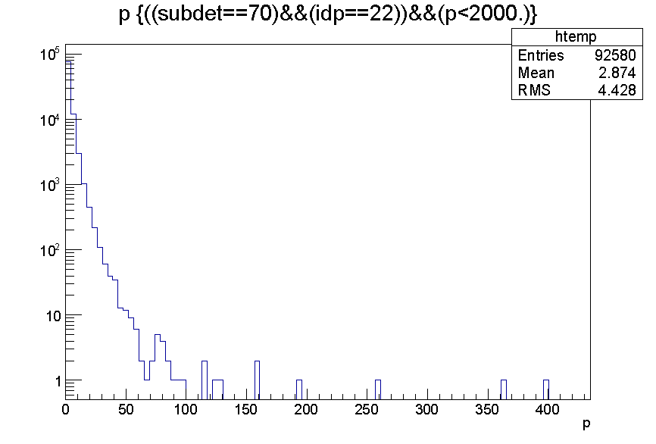
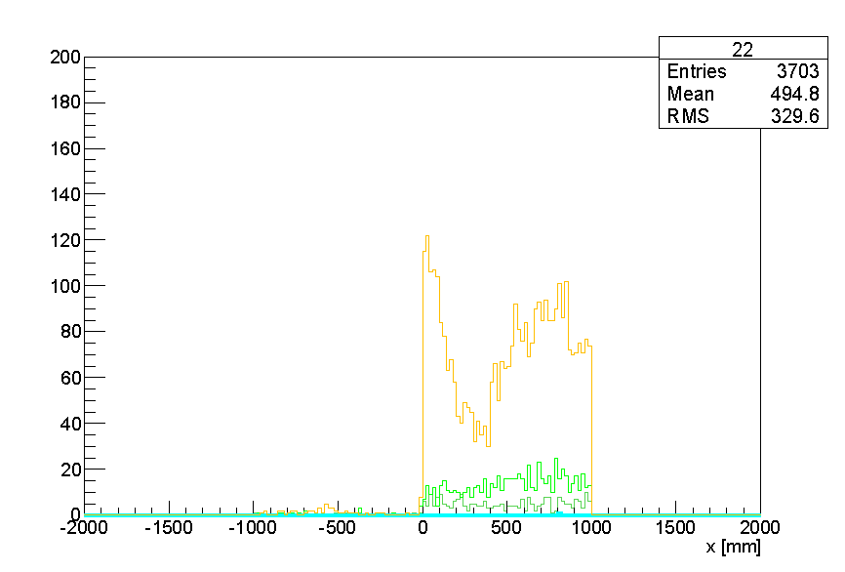
subdet == 70 (camere a mu)
nessuna amplificazione del segnale
10 k
p(gamma) > 10 MeV
lato mu+
lato mu-
[MeV]
color legend:
photons: yellow
e+: olive green
e-: light green
mu+: cyan
mu-: blue

Slide 3
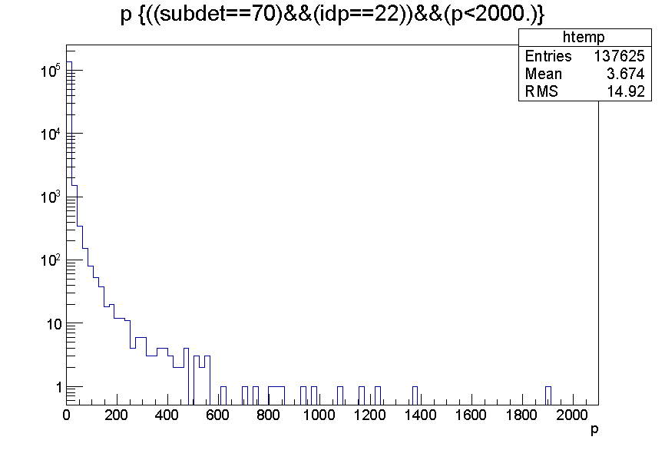
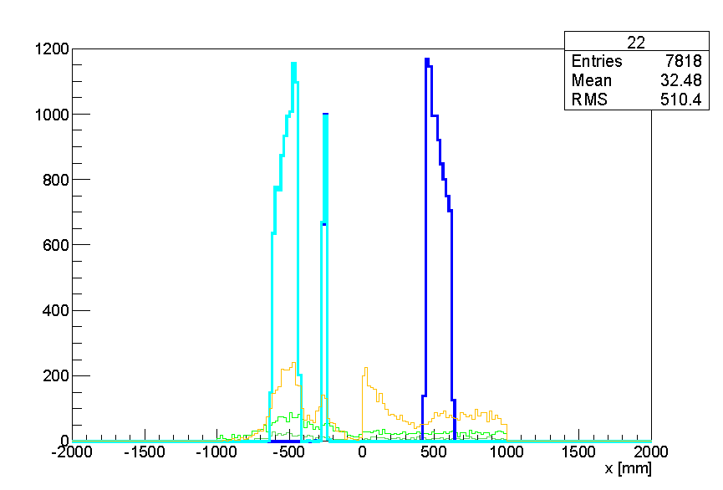
subdet == 70 (camere a mu)
segnale x 1e+6
20 k
p(gamma) > 10 MeV
[MeV]
color legend:
photons: yellow
e+: olive green
e-: light green
mu+: cyan
mu-: blue

Slide 4
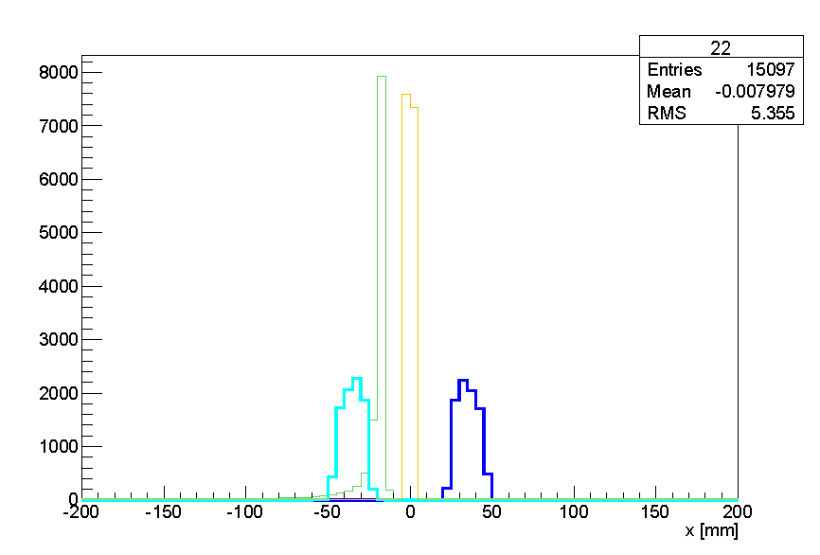
subdet == 50 (magnet exit)
segnale x 1e+6
20 k
color legend:
photons: yellow
e+: olive green
e-: light green
mu+: cyan
mu-: blue
6 bins = 30 mm

Slide 5
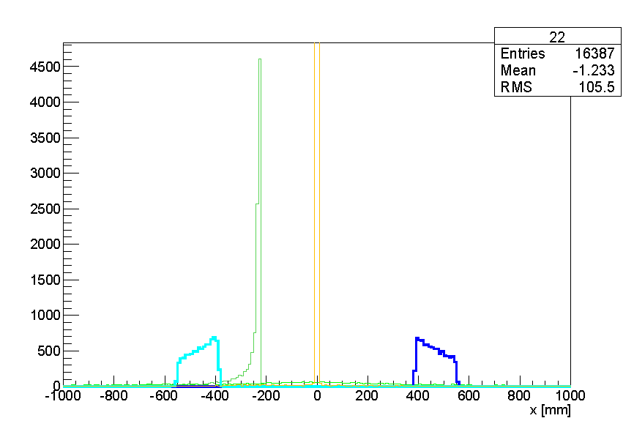
subdet == 60 (CAL entry point)
segnale x 1e+6
20 k
color legend:
photons: yellow
e+: olive green
e-: light green
mu+: cyan
mu-: blue
~ 200 mm

Slide 6
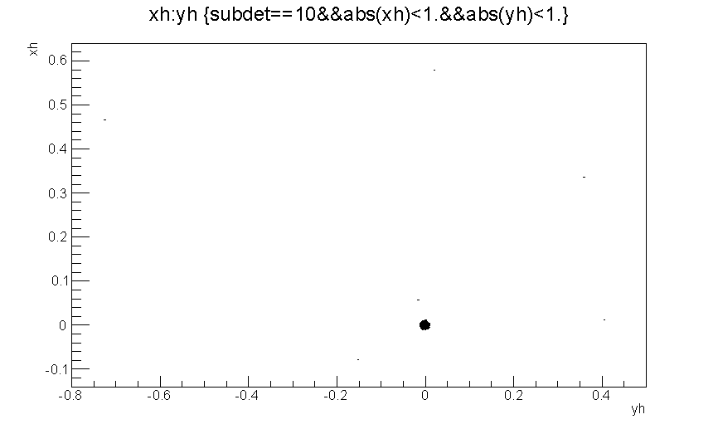
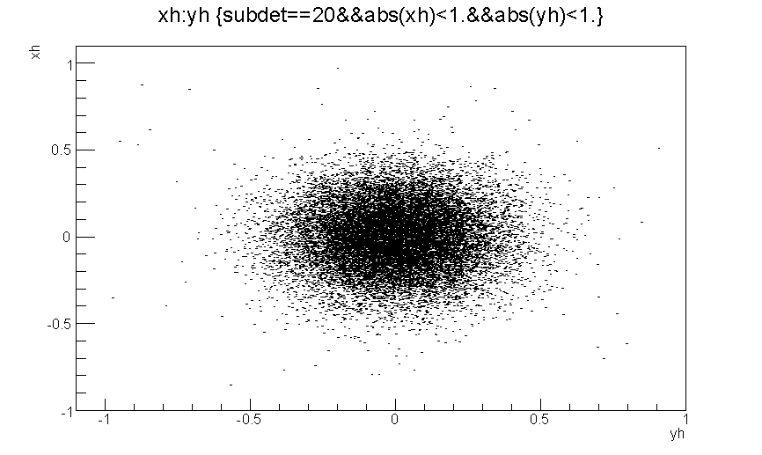
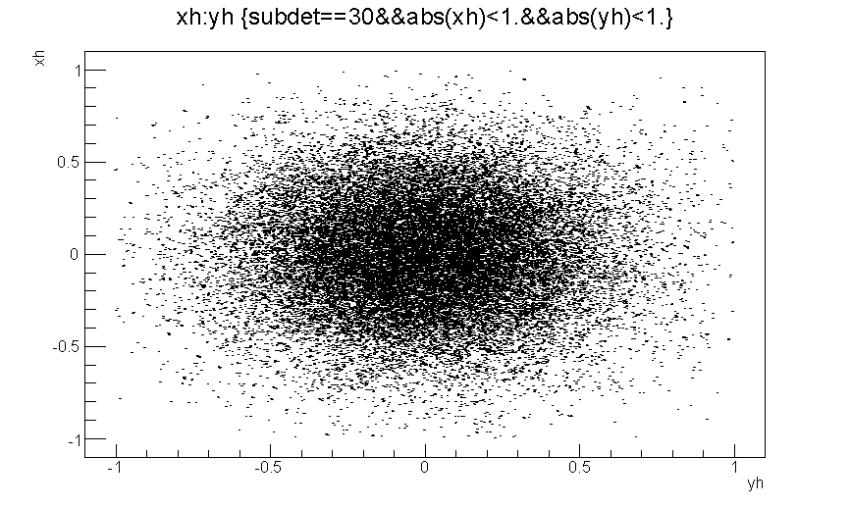
segnale x 1e+6
20 k
unità di misura: mm
subdet = 10
subdet = 20
subdet = 30

