Slide 1
21/3/2017
Pattern recognition studies: first look to the improved setup
Bertolin (INFN-Padova)
L. Sestini (INFN and University of Padova)

Slide 2
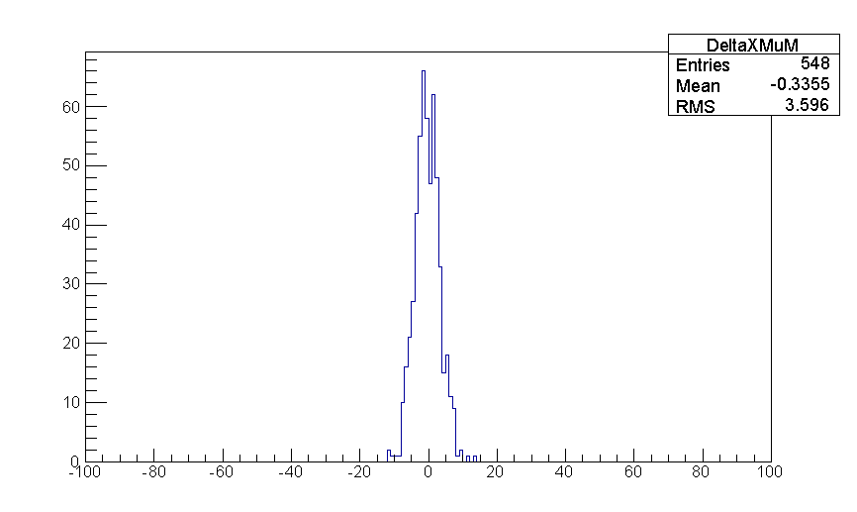
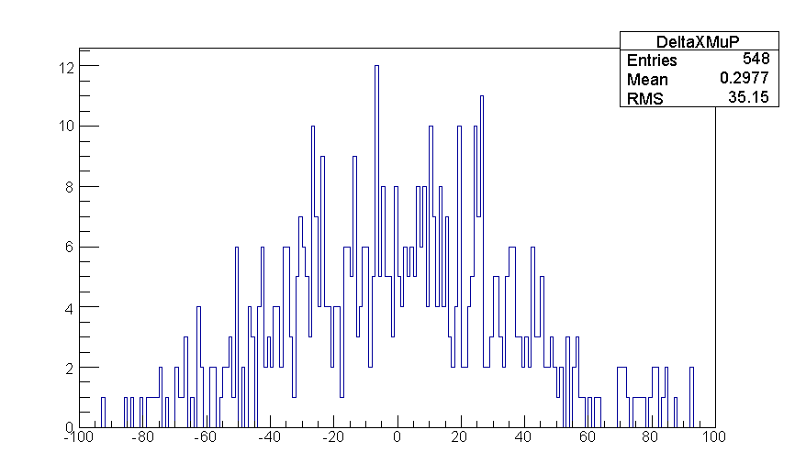
Backward propagation and comparison to the position at subdetector 3 entrance
31/1/2017 meeting
muon chamber only extrapolation to the plane after the magnetic filed (50)
x z plane
x z plane
RMS = 3.6 millimeters
RMS = 35 millimeters
DeltaX [mm]
DeltaX [mm]
mu- case: straight line propagation in vacuum
one C++ function
x(muon) > 300 mm
mu+ case: straight line propagation in vacuum + concrete
one C++ function
x(muon) < -350 mm
keep the mu- line as “clean” as possible

Slide 3
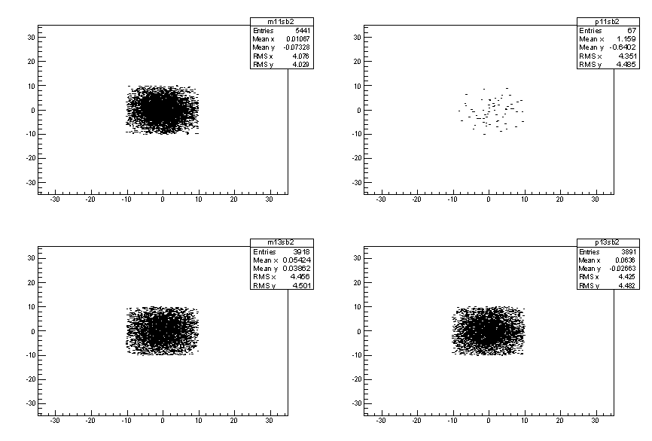
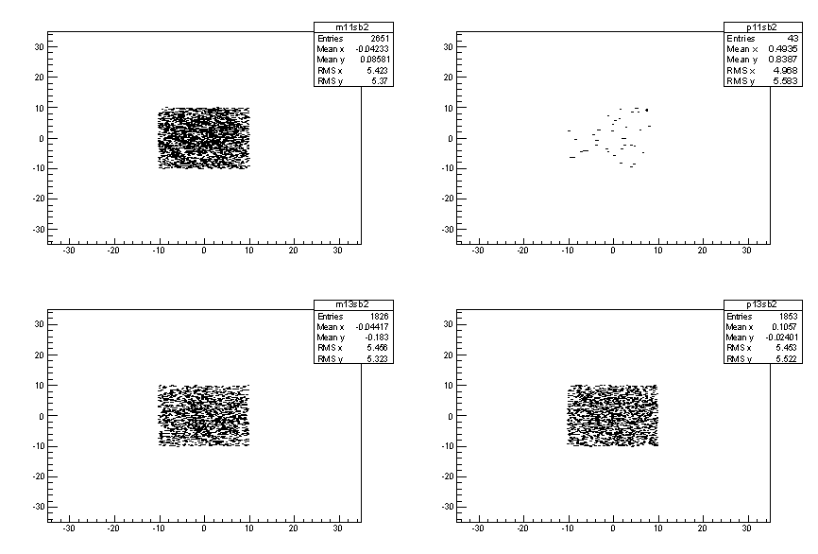
subdetector 40 (before the magnet): y vx x
MCMC_v3_10k_mu_vacuum
MCMC_v4_10k_mu_vacuum
e+
e-
e+
e-
mu+
mu-
mu+
mu-
spot size is 20 x 20 mm² i.e. 1 small detector size

Slide 4
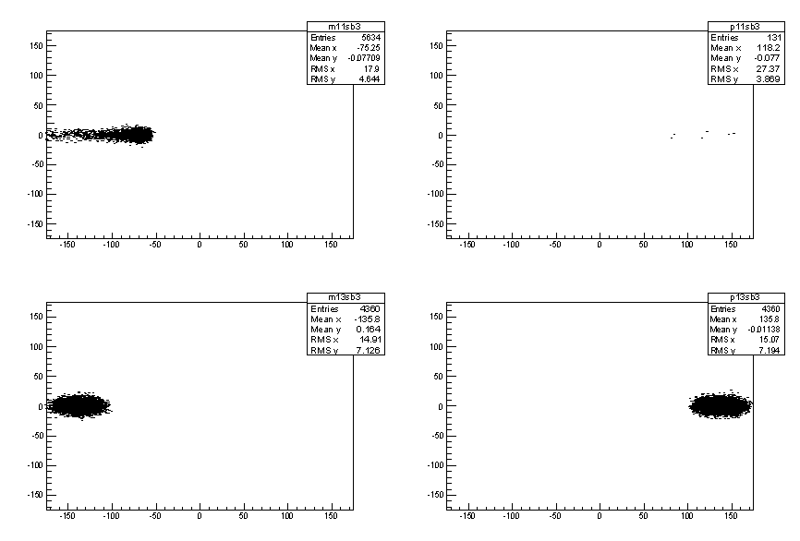
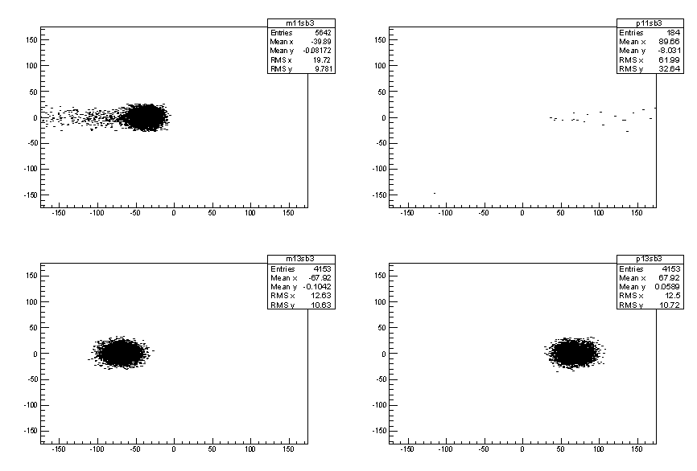
subdetector 50 (after the magnet): y vx x
MCMC_v3_10k_mu_vacuum
MCMC_v4_10k_mu_vacuum
e+
e-
e+
e-
mu+
mu-
mu+
mu-
closer to x=0 because subdetector 50 is more backward in v4 w.r.t. v3
larger RMS_y in v4 w.r.t. v3
spot size fits well 100 x 100 mm² but we need 2 detectors

Slide 5
Backward propagation and comparison to the position at subdetector 40 (before the magnet)
when a mu+ mu- pair is recorded
there is no need of pattern recognition at subdetector 50, after the magnet, because the only hit we will eventually find there is going to be the mu- one (do not expect more than 1 e+ annihilation “per event”)
at subdetector 40, magnetic field entrance, we however expect e+/e-/mu+/mu- hits mostly overlapped and indistinguishable … can we define a search window for the mu- hit ? How large can it be ?
projection:
x z
  inputs:
    8 muon chamber hits with a 150 mum Gaussian spread
    1 hit with a 5 mum Gaussian spread (subdetector 50)
    B = 0.7 * 1.8 T, 2 m length
    TRUE TMath::Sqrt(pxh*pxh+pzh*pzh) used for the propagation in the magnetic field
unrealistic but useful to setup the algorithm
method: analytical propagation performed by a single C++ function
y z
  inputs:
    4 muon chamber hits with a 200 mum Gaussian spread
    1 hit with a 15 mum Gaussian spread (subdetector 50)
method: straight line propagation performed by a single C++ function

Slide 6
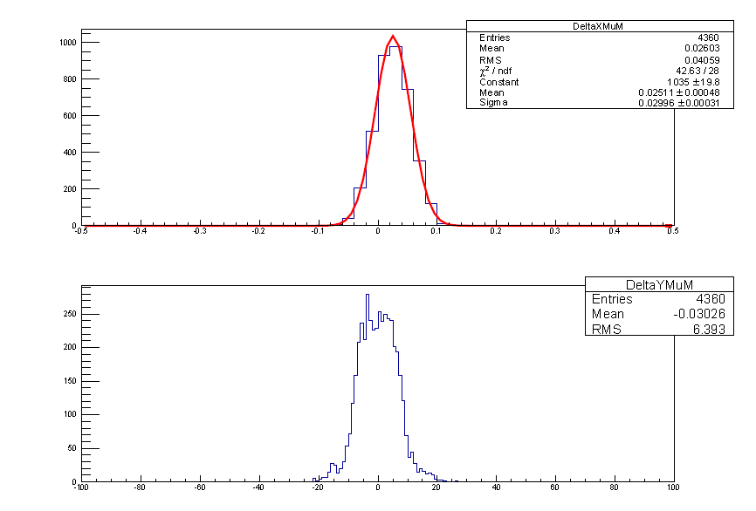
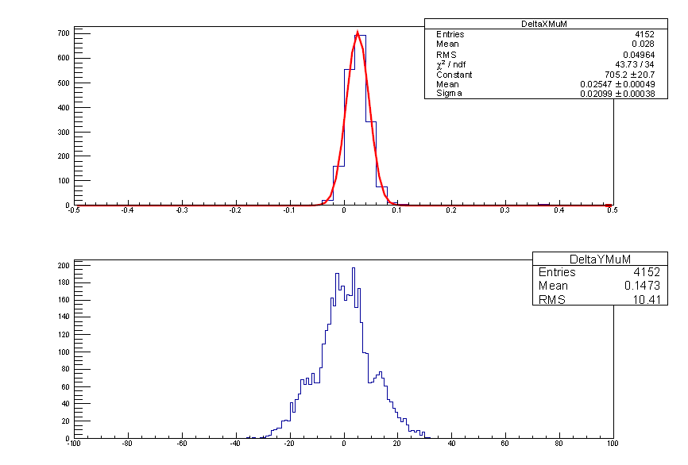
subdetector 40: difference between the extrapolated and the actual mu- hit position
MCMC_v3_10k_mu_vacuum
MCMC_v4_10k_mu_vacuum
sigma_x = 0.030 mm
sigma_x = 0.021 mm
?
next logical step: replace the true momentum with the momentum estimate obtained from the position recorded in the muon chamber
  reminder for the 31/1/2017 presentation:
  RMS(X) = 0.57 mm driven by the Delta_p/p accuracy
  RMS(Y) = 2.74 mm, likely just less points with lower resolution

Slide 7
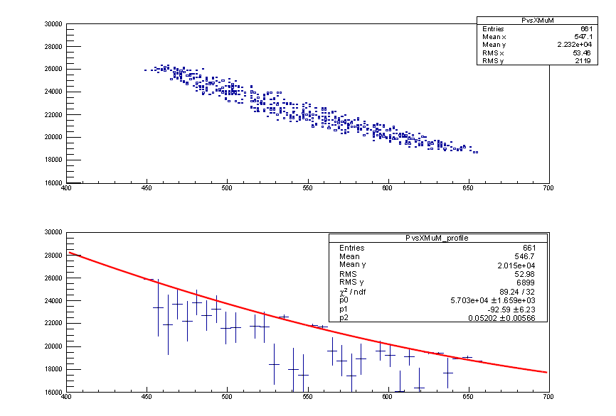
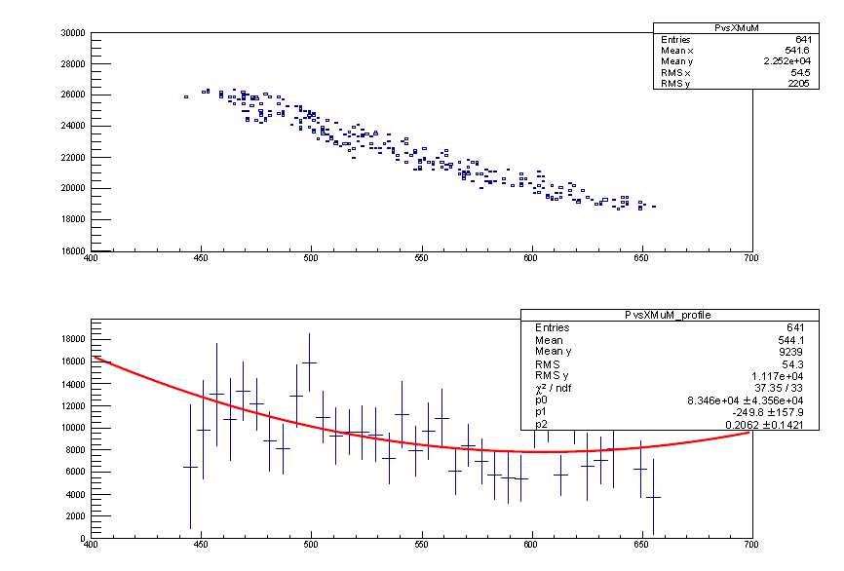
MCMC_v3_10k_mu_vacuum
MCMC_v4_10k_mu_vacuum
y range: from 0 to 18000 MeV
makes no sense given the plot above …
using the same code to analyze both files …

Slide 8
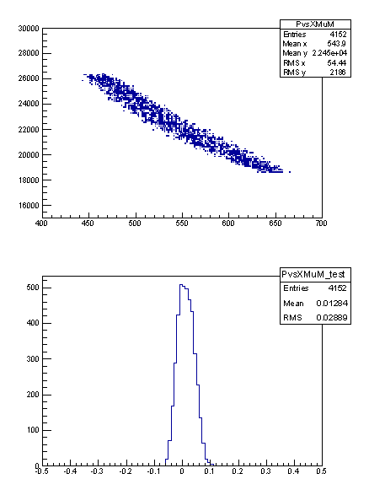
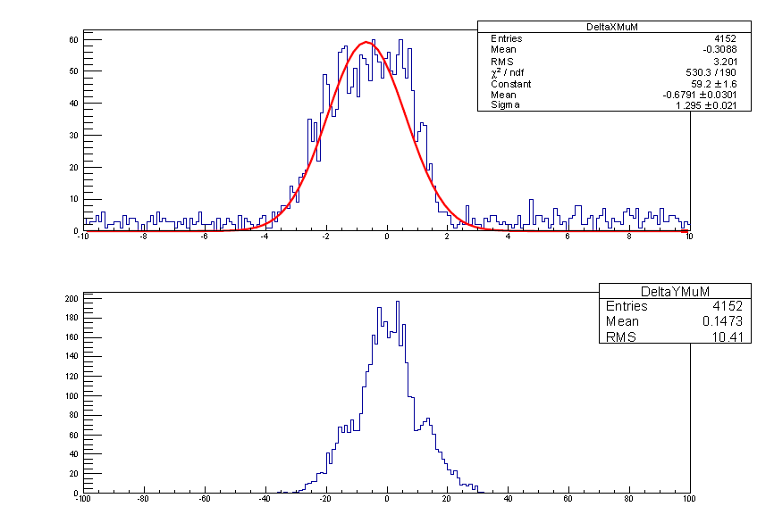
straight line trough (450,26000)
and
(650,19000)
sigma_x = 1.3 mm
deltap/p
RMS = 3 %
?
0.57 mm from a fit to the TProfile object w.r.t. 1.3 mm fitting by hand …

Slide 9
Summary and next steps
tracking / patter recognition power of muon chambers is maximized if the amount of dead material in front of them is minimized
arrangement of subdetectors more helpful for patter recognition in v4 w.r.t. v3
planning to insert subdetector 55 as soon as possible
still have a few things to understand in v4 Tuples

