Slide 1
18/5/2017
Pattern recognition studies
A. Bertolin (INFN-Padova)
(geometrical) efficiency as a function of the positron impact point on the first subdetector
expected occupancy in subdetectors 40 (and 30)

Slide 2
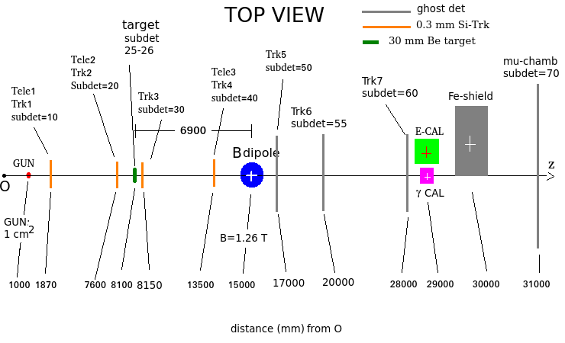
input file: MCMC_v5_10k_mumu_air_gun4cmq_shield50cm.root
Fe-shield: from +325 mm to -1675 mm
(geometrical) efficiency =
(e+ in 10 && 20) && (mu+ in 25 || 26) && (mu+ in 30 && 40 && 50 && 55 && 70) && (mu- in 70)
/
(e+ in 10 && 20) && (mu+ in 25 || 26)
in (x,y) bin of e+ position at subdet 10

Slide 3
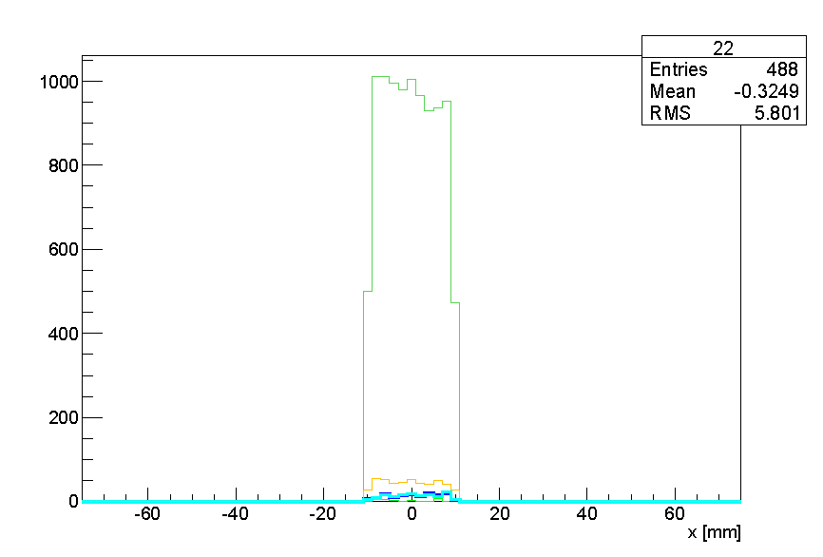
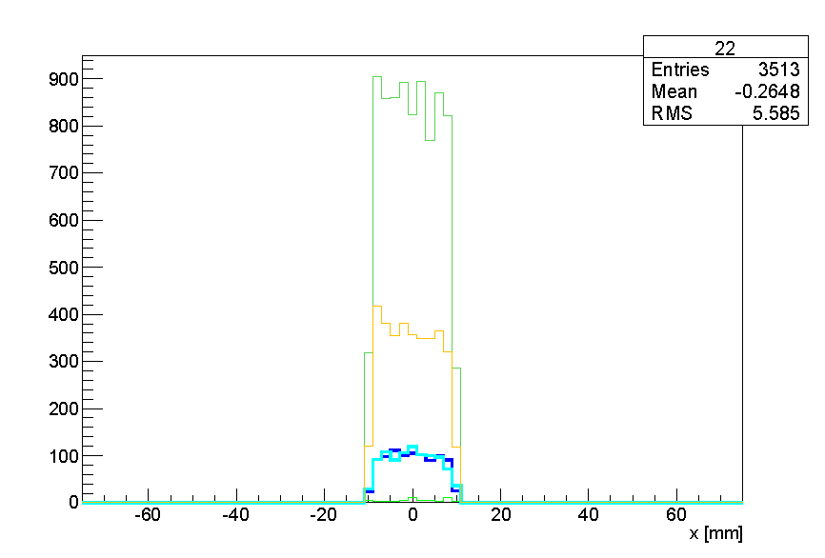
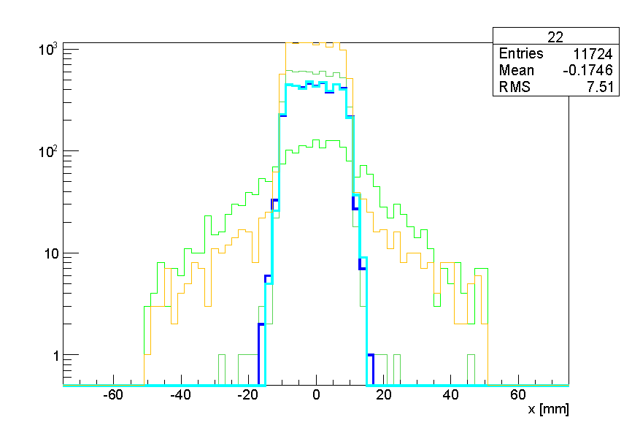
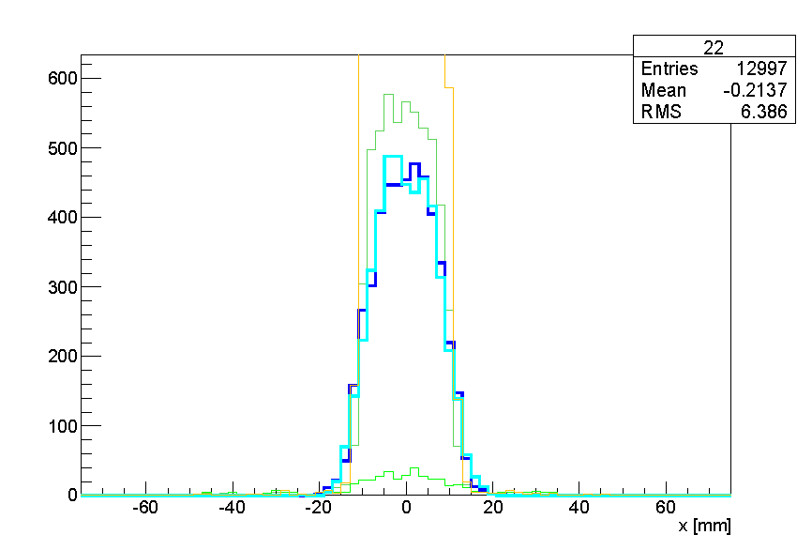
subdet 10:
already 2x2
subdet 20:
already 2x2
log scale
subdet 30:
cut as 2x2
subdet 40:
cut as 2x2

Slide 4
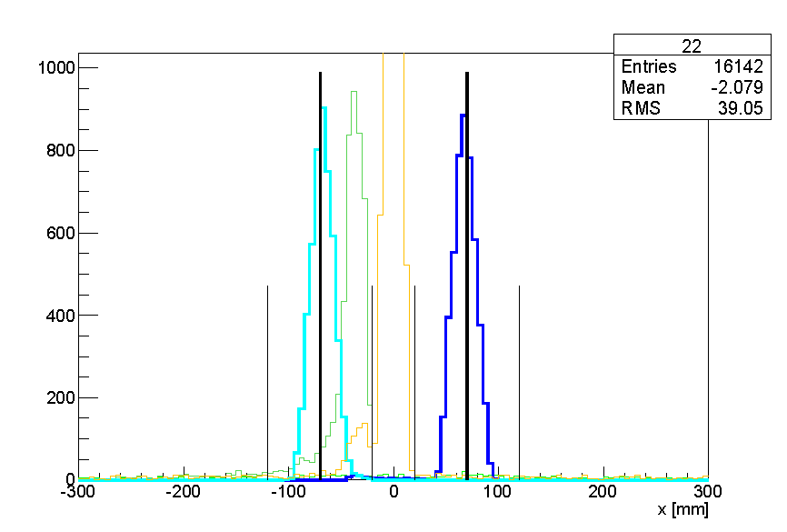
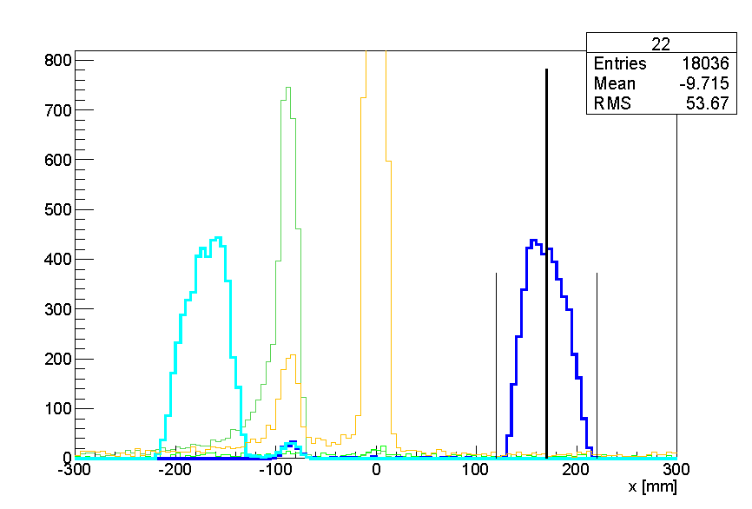
subdet 50
subdet 55
subdet 50:
x = + 75 mm ± 50 mm
subdet 55:
x = + 175 mm ± 50 mm
we decided to identify the one at “the same z” but x < 0 as 56
we decided to identify the one at “the same z” but x < 0 as 51

Slide 5
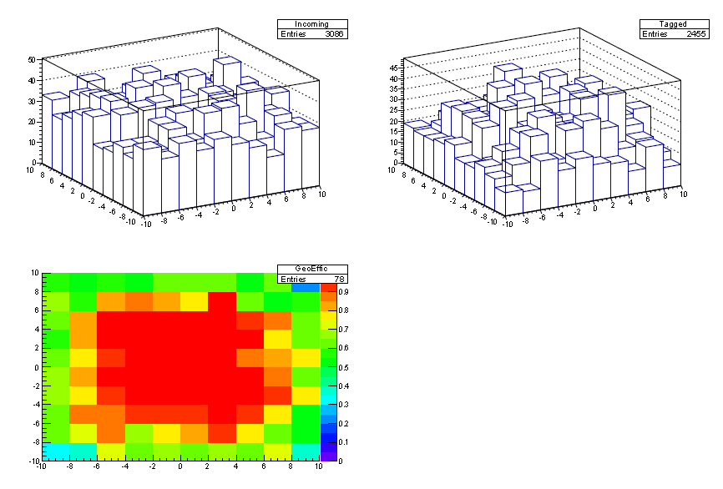
(geometrical) efficiency =
(e+ in 10 && 20) && (mu+ in 25 || 26) && (mu+ in 30 && 40 && 50 && 55 && 70) && (mu- in 70) /
(e+ in 10 && 20) && (mu+ in 25 || 26)
denominator
numerator
efficiency
in the white box, ± 5 mm, the efficiency is ~ 100 %
on average, WITH THE INPUT FLAT DISTRIBUTION, the efficiency is ~ 75 %

Slide 6
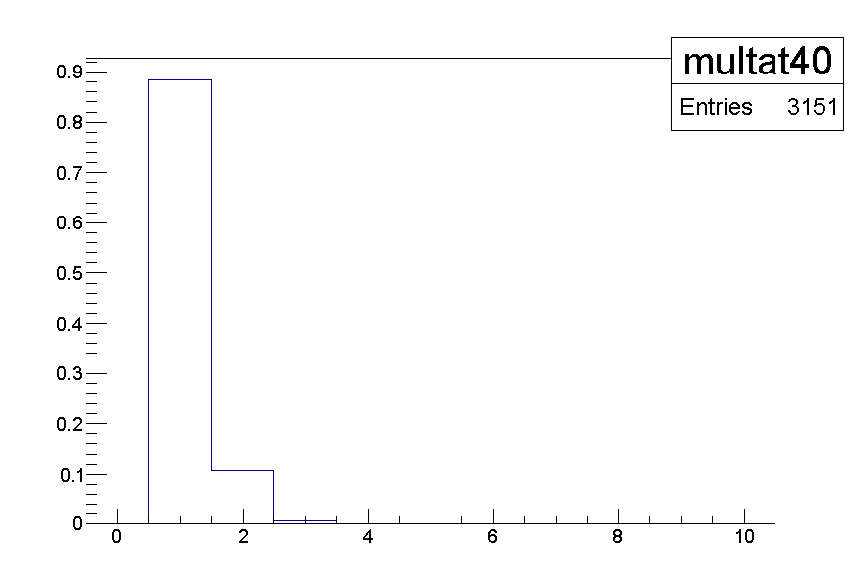
assuming:
a number of additional particles crossing subdet 40 given by Poisson(5.2) (mu- and additional e+ from the beam)
a distribution form them given by Uniform(-10.,+10.)
sigma_x_40, sigma_y_40 as given by Lorenzo
how often do we find n particles in a 3*sigma_x_40 && 3*sigma_y_40 window centered on the prediction ?
events with > 1 are not straightforward to analyze
the “topologies” at 40 and 30 are hopefully correlated so the overall number of events not straightforward to analyze is again 10 %

Slide 7
Backup

Slide 8
