Slide 1
LEMMA Test Beam Meeting
28/6/2017
Report on recent software activities
A. Bertolin, L. Sestini

Slide 2
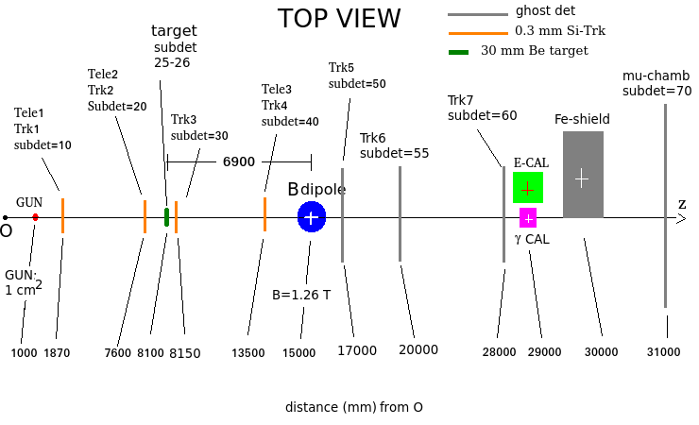
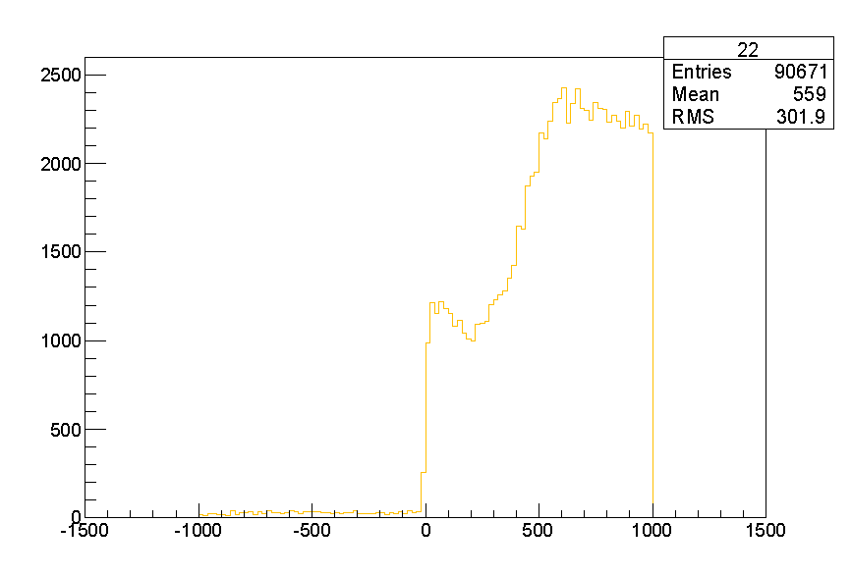
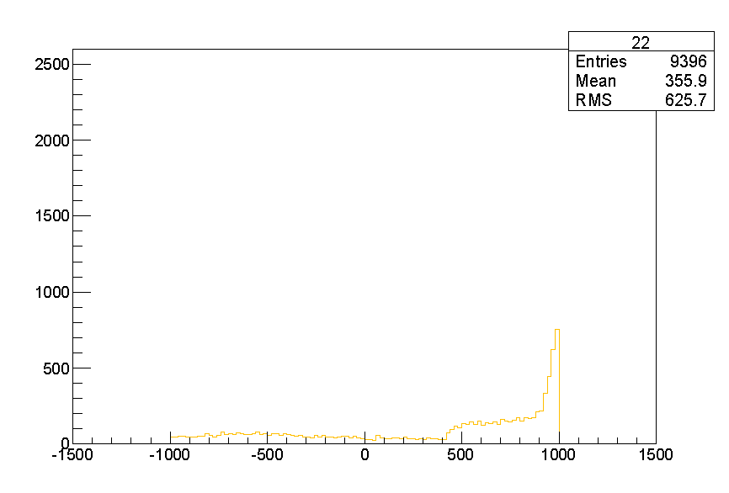
Tuning of Fe-shield position
rule for tuning: shielding should not intercept any of the mu- from annihilation
if the muon chamber length exceed 2000 mm the x upper “corner” should not exceed + 1000 mm
MCMC_v5_20k_FTFP_air_gun4cmq_shield50cm+390mm.root
MCMC_v4_10k_FTFP_air.root
x axis: from 0 mm to -1000 m
y axis: 1 m
z axis: 1 m
cross checked with Marco D.
x axis: from +390 mm to -1610 mm
y axis: 1 m
z axis: 0.5 m

Slide 3
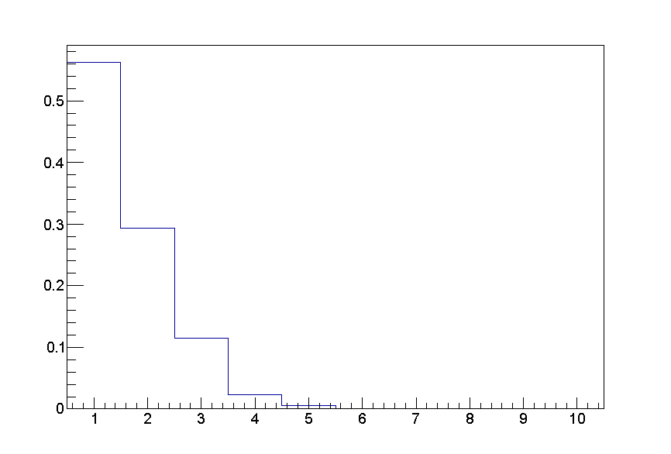
Position pile-up per event
Double_t positrons_x_spill=5.e+6;
Double_t spill_delta_t=4.8; // sec
Double_t time_integration=1.e-6; // sec i.e. 5 musec
Double_t Poisson_mean=(positrons_x_spill*(time_integration/spill_delta_t));
cout << "positrons per spill = " << Poisson_mean << endl;
positrons per spill = 1.04167
root [0] .x Poisson.C(1.04167)
entries at 0 vetoed by the muon trigger
outcome:
30 % of 2 positions
10 % of 3 positrons

Slide 4
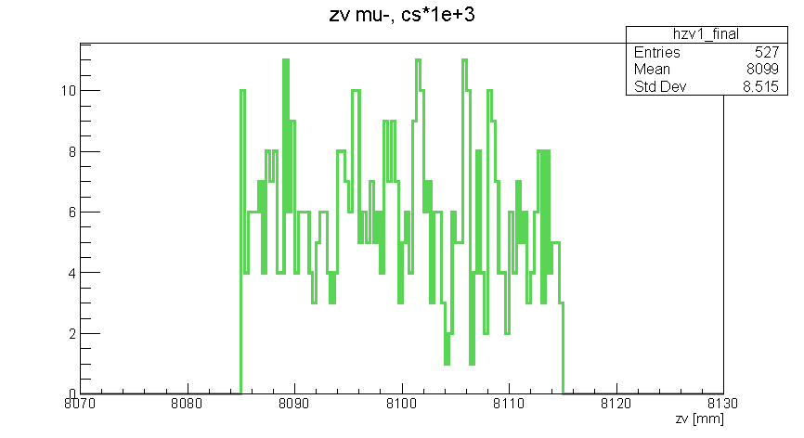
Mu pairs per spill
Run Summary:
Number of events processed: 1M
Time: 234632s = 2d 17h 10min 32s
Dim: 5.1GB
generated: 1M
cross section enhancement: 1e+3
402 (reco) / 516 (in acceptance)
[integrated efficiency: 0.703869]
5 x 402 / 1e+3 = 2.00 reco pairs per spill
2 spill per minute -> 4 pairs per minute
1 hour (60 minutes) -> 240 pairs per hour
1 hour of data should be enough to get sufficiently filled “monitoring histograms”
A. Lorenzon

Slide 5
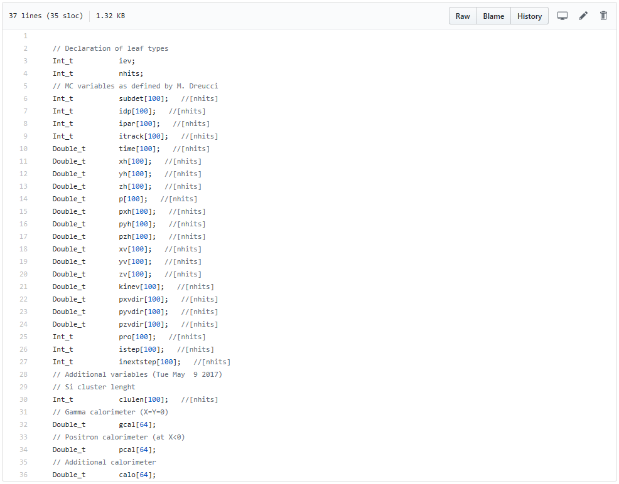
Recent software work
tupleTransformer.C
applied to: MC tuple with one entry per HIT
output: MC tuple with one entry per EVENT, content defined in tupla.h
in addition subdetectors 50,51 and 55,56 are “defined” at:
x = +70 (-70) mm for 50 (51) +- 50 mm with
Z=17000 mm
x = +170 (-170) mm for 55 (56) +- 50 mm with z=20000 mm
https://github.com/svaninigit/LEMMA/blob/master/sw/Common/tupla.h
/!\
“undefined” quantities should be set to -9999.
for illustration purposes:
yh[i] of an “X sensitive layer” = -9999.
2. xh[i] – zh[i] and yh[i] – zh[i] series belonging to the same muon track are identified by the same value of itrack[i]
always assumes one incoming e+ per event

Slide 6
Recent software work (cont.)
work has started in Padova to properly reconstruct and put the muon chamber data in the format defined by tuple.h (S. Vanini, A. Lorenzon)
for the Si detectors we expect to have an ASCII file, with an AXIAL like format so to say, like the one circulated by Laura B., which can be “merged” in the muon data tuple at the offline level with a suitable script (some sort of event builder process)

Slide 7
Recent software work: alignment and monitoring tool
tbanalysis.C, based on the format defined by tuple.h
root 5.34.21
a few overall activity plots
requires activity in 10 20 30 40 50 55 70, both x and y
mu-:
>= 8 x-hits && >= 4 y-hits
backward propagation to 50/55 40 30 -> alignment
mu+:
>= 8 x-hits && >= 4 y-hits
backward propagation to 51/56 -> alignment
to be added:
hits plotting tool: x-z, y-z views (event display)
output root file with computed information:
n_x_hits_mum
x_pos_mum[11] z_x_pos_mum[11] x_pos_mum_err[11]
n_y_hits_mum
y_pos_mum[11] y_x_pos_mum[11] y_pos_mum_err[11]
n_x_hits_mup
x_pos_mup[11] z_x_pos_mup[11] x_pos_mup_err[11]
n_x_hits_mum
y_pos_mup[11] y_x_pos_mup[11] y_pos_mup_err[11]
limited to subdet 51, 56 and 70
hits can be translated in a subdetector dependent way before any use
copy of whatever is recorded in 10 and 20

Slide 8
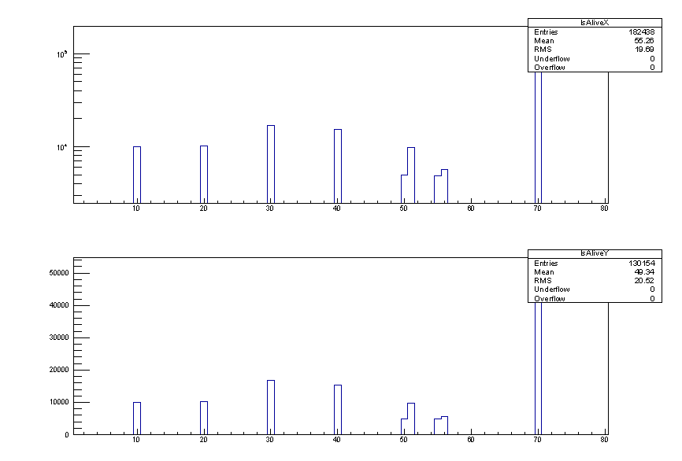
is alive plot

Slide 9
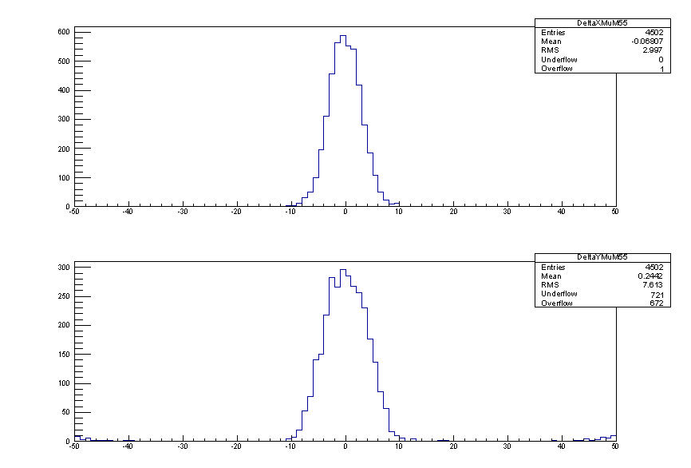
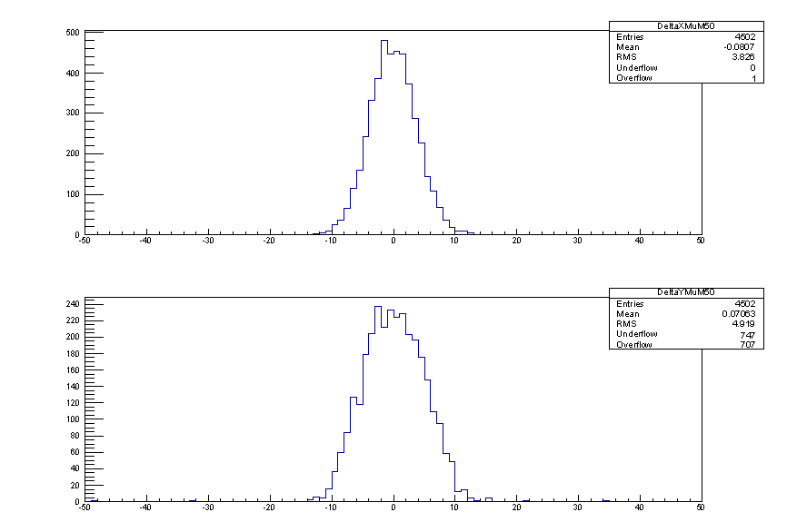
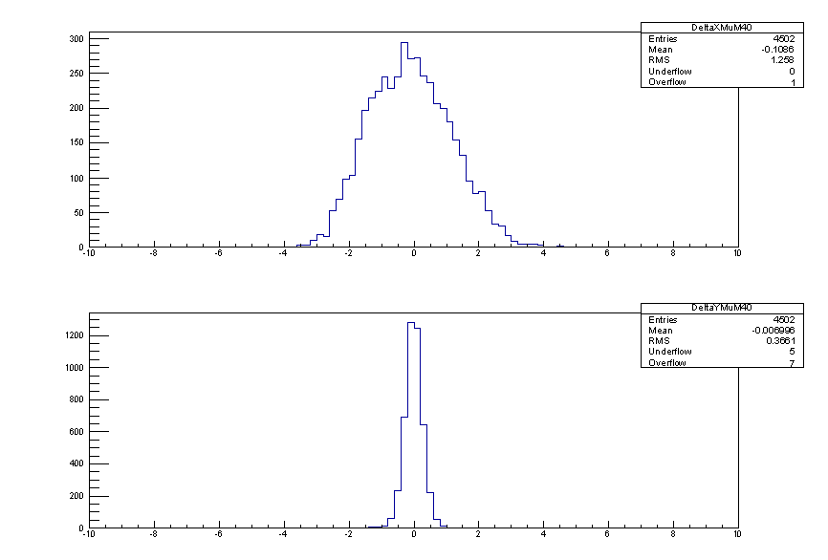
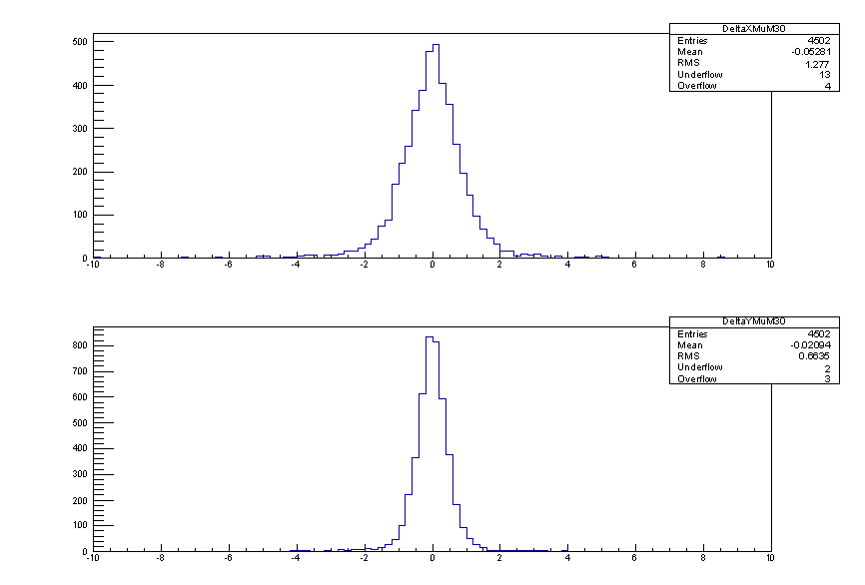
mu- line, difference between the extrapolated and the MEASURED position
55
50
X
Y
40
30
estimated p effect

Slide 10
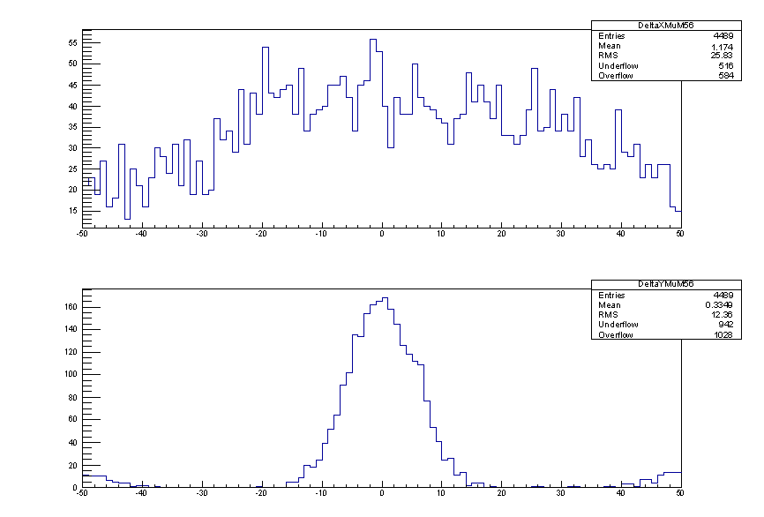
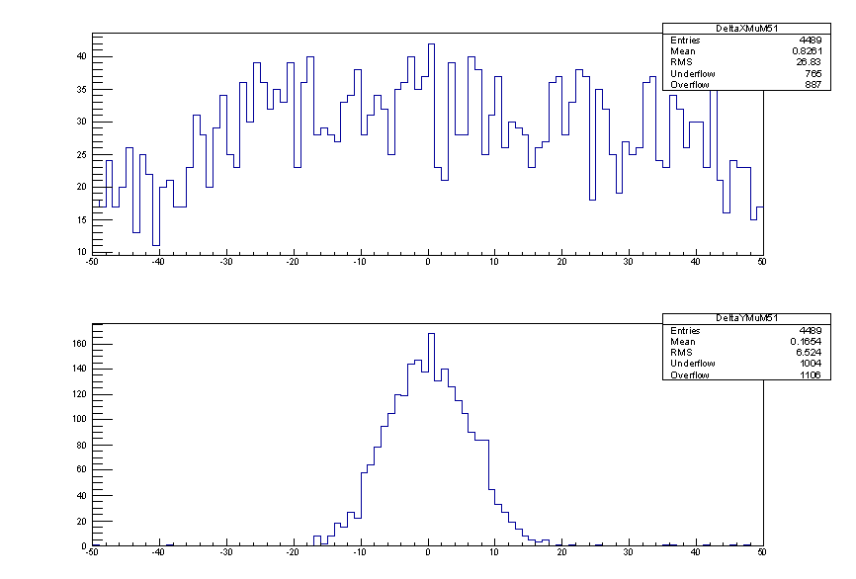
mu+ line, difference between the extrapolated and the MEASURED position
56
51
X
Y
X coordinate in the mu+ case shows a very poor resolution:
bug in the code we are trying to spot
or
due to multiple scattering in iron + air the RMS blows up to 40 mm (early studies on the mu+ line where made in vacuum using concrete as absorber)

Slide 11
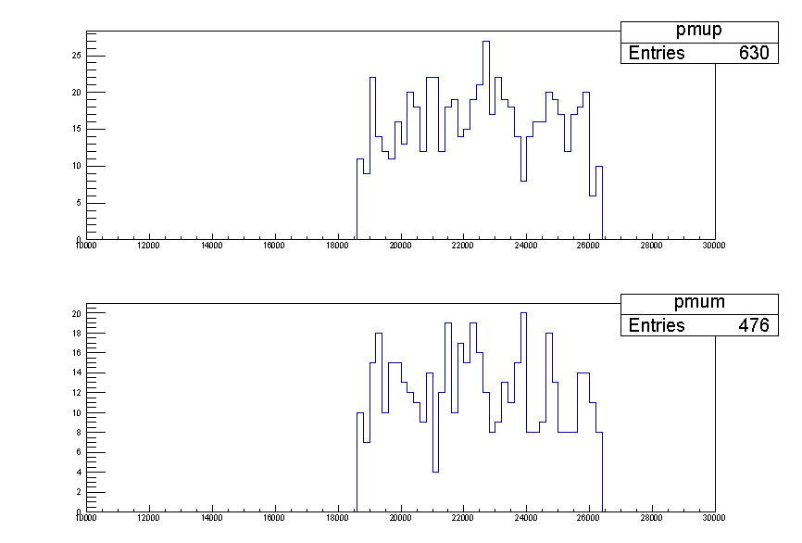
Special beam requests
mu- beam, as monochromatic as possible, at energies of 18, 20, 22, 24, 26, 28 GeV
need 1 k mu- per point
same reversing B or using mu+
x y distribution: ideally as for the e+ beam, flat over 2 cm x 2 cm
MCMC_v5_10k_mumu_air_gun4cmq_shield50cm.root

