Slide 1
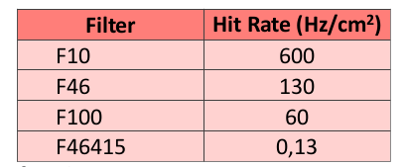
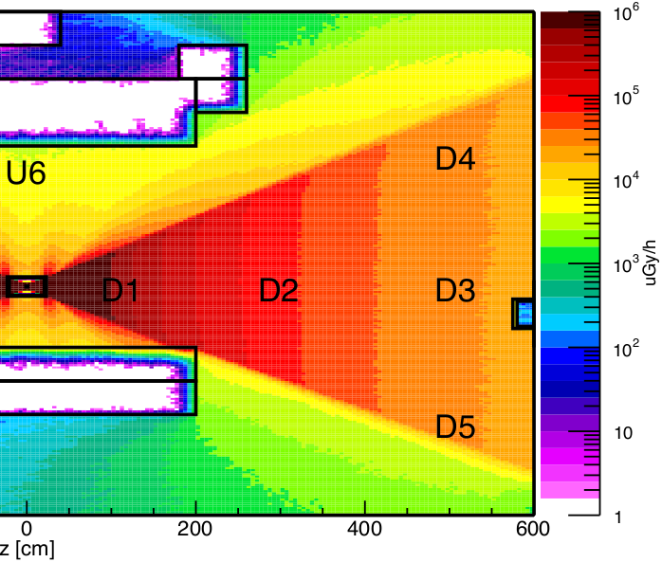
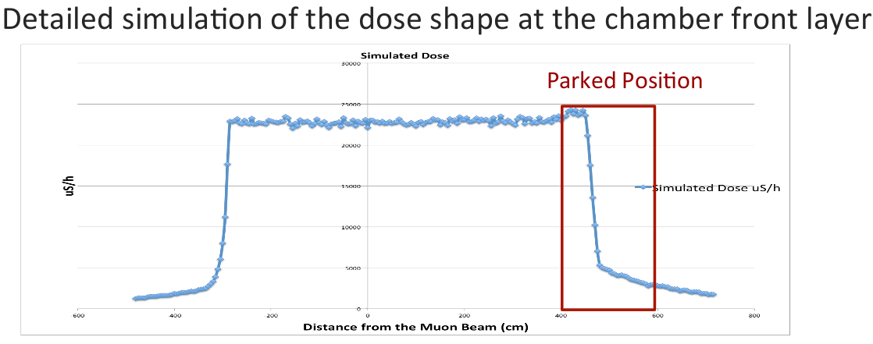
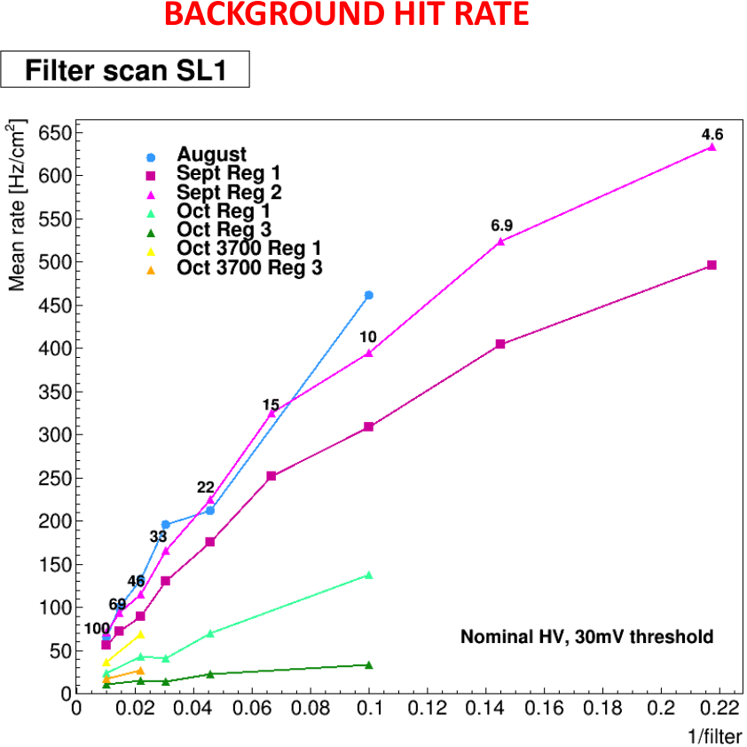
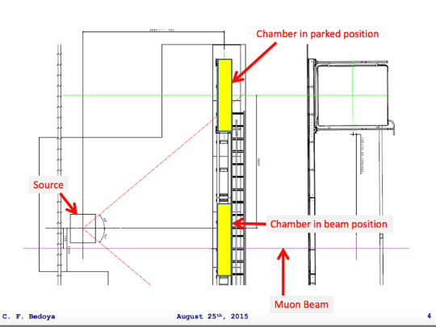
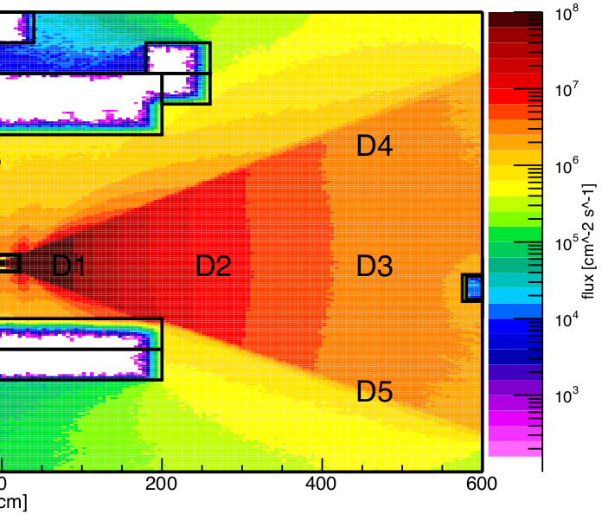
GIF++ 2015 : DT chamber γ exposure
Gamma Irradiation Facility at CERN: source of gammas to simulate background and see ageing effect on DT chamber. Cs-137 source (14TBq) emits photons with peak energy of 662 keV.
Muon beam: 100 GeV, 10 ⁴ muons/spill (spill = 15 s) → 667 Hz
GIF Gamma flux ( Geant4 simulation ):
At DT chamber surface:
Dose = 0.023 Gr/h
Flux = 3∙10⁶ gamma cm⁻² sec⁻¹ = γ_rate
GIF++ 2015 : DT chamber γ rate
Without filters:
Hit Rate = γ_rate * conversion_efficieny / filter_value ~ 6000 Hz cm⁻² NB conversion efficiency γ into electrons = 0.2 %
With filters:
measured
2.3∙10⁴ μSv/h
5.82 m

Slide 2
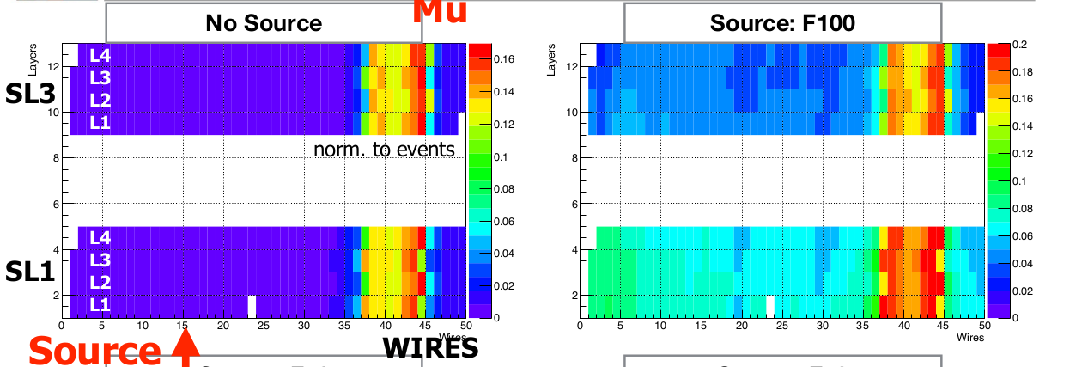
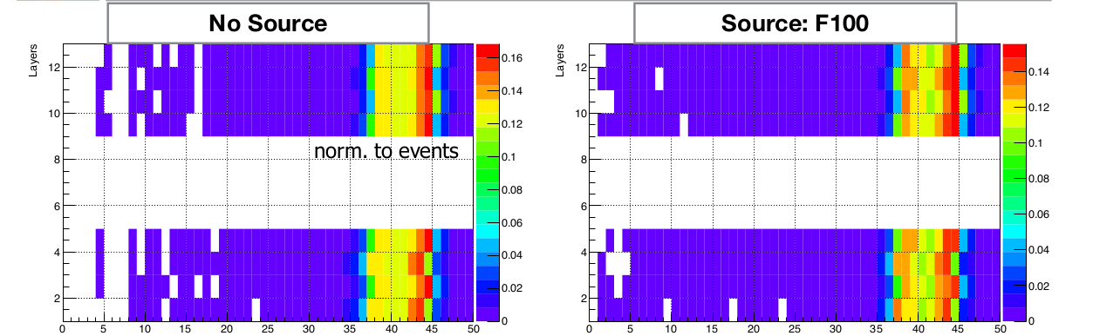
GIF++ 2015 results: occupancy
19 - 31 August 2015 : chamber in in beam position
HVO threshold 30 mV
external scitillator trigger, up-downstream coincidence
“Studies on GIF++ data”, Lisa Borgonovi, Luigi Guiducci
Università e INFN Bologna CMS Physics Week 07-11 Dec 2015
DIGI
HITS of segments with at least 5 hits

Slide 3
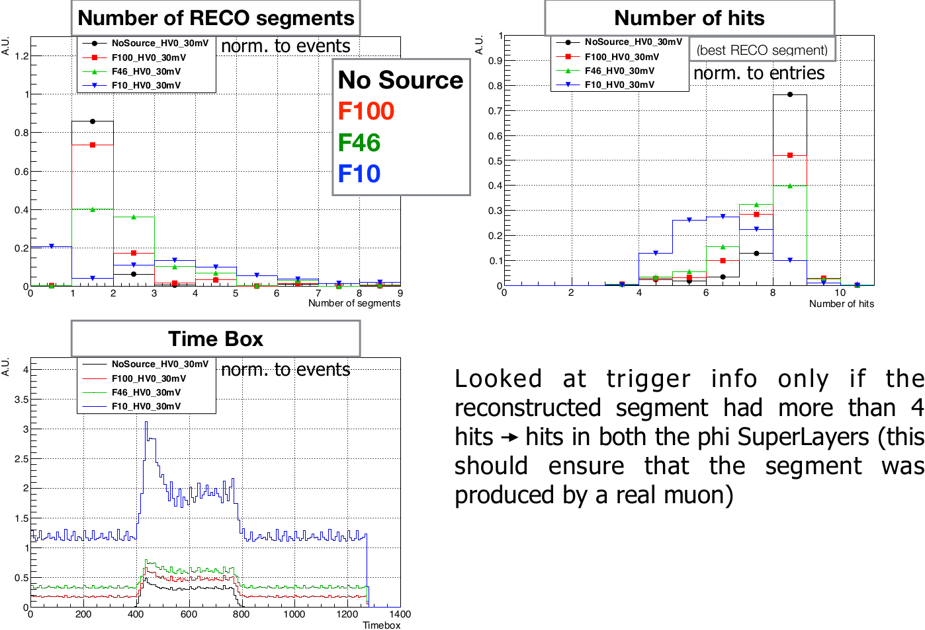
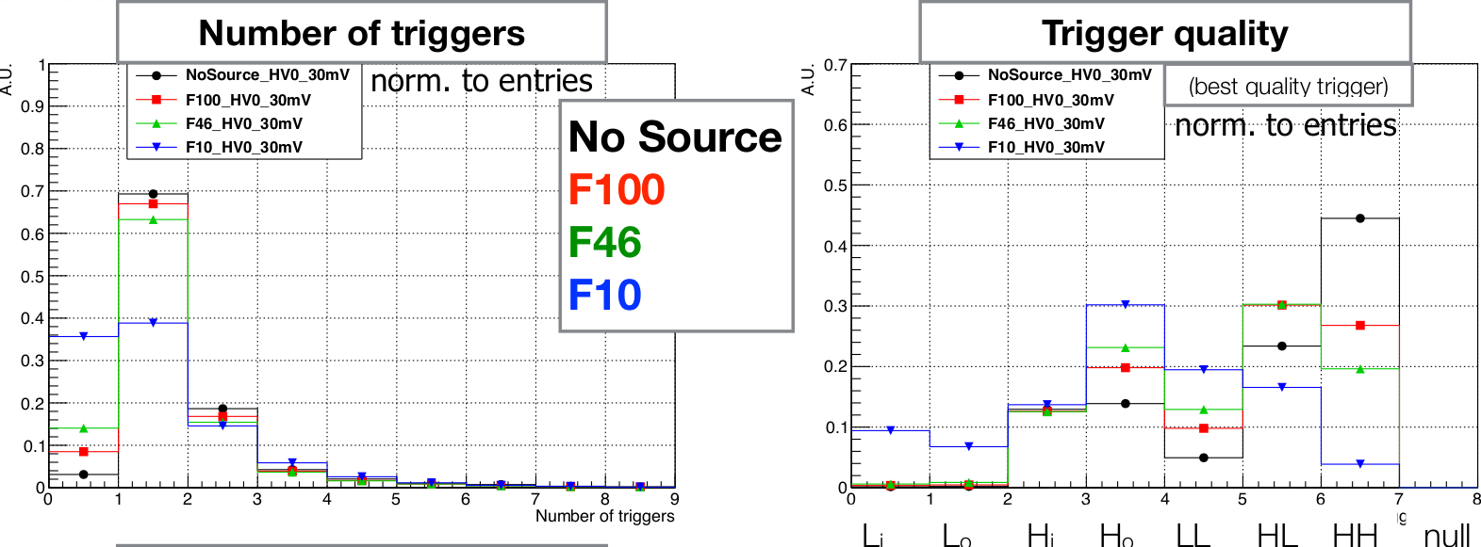
GIF++ 2015 results: hits, segments, trigger
“Studies on GIF++ data”, Lisa Borgonovi, Luigi Guiducci
Università e INFN Bologna CMS Physics Week 07-11 Dec 2015

Slide 4
References:
https://twiki.cern.ch/twiki/bin/viewauth/CMS/DtGIFDose
https://indico.cern.ch/event/387753/
https://twiki.cern.ch/twiki/bin/view/CMS/DtGIFHV
https://espace.cern.ch/sba-workspace/gifpp/SitePages/Home.aspx
CMS week December 2015 talks:
https://indico.cern.ch/event/465145/contributions/1972348/attachments/1201198/1749422/DT_GIF_08122015.pdf
https://indico.cern.ch/event/462466/contributions/1134862/attachments/1199909/1745516/GIF_cris_bckgeffic_v2.pdf

