Slide 1
11/4/2017
Pattern recognition studies
Bertolin (INFN-Padova)
L. Sestini (INFN and University of Padova)
μ⁻ geometrical acceptance
backward propagation studies

Slide 2
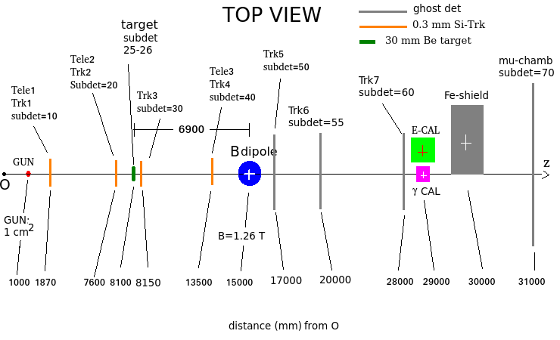
μ⁻

Slide 3
μ⁻ acceptance
A = (25 or 26) and 40 and 50 and 70 / (25 or 26)
with v3
subdet 40 (magnet entry): 2 cm x 2 cm, “small” beam spread (RMS_x,y)
A = 0.91
with v4
subdet 40 (magnet entry): 2 cm x 2 cm, “large” beam spread (RMS_x,y)
A = 0.41
TOO SMALL
with v4 sub40large
subdet 40 (magnet entry): 10 cm x 10 cm, “large” beam spread (RMS_x,y)
A = 1.0 (4145/4145)
no losses !
μ⁻ in acceptance and μ⁺ seen in muon chambers (hits in 70)
A = 1.0 (4145/4145)
no losses !
NB: subdet 70 is from -1 m to 1 m so
no losses due to geometry
no losses due to “absorption” in the dead material along the μ⁺ path (but “pointing power” strongly reduced due to multiple scattering)

Slide 4
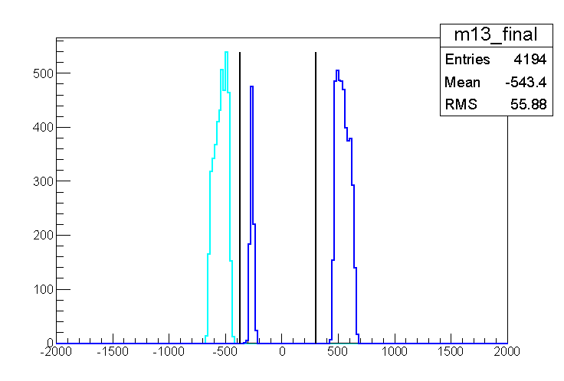
μ pairs from conversion in shield
μ⁺ from conversion in target
μ⁻ from conversion in target

Slide 5
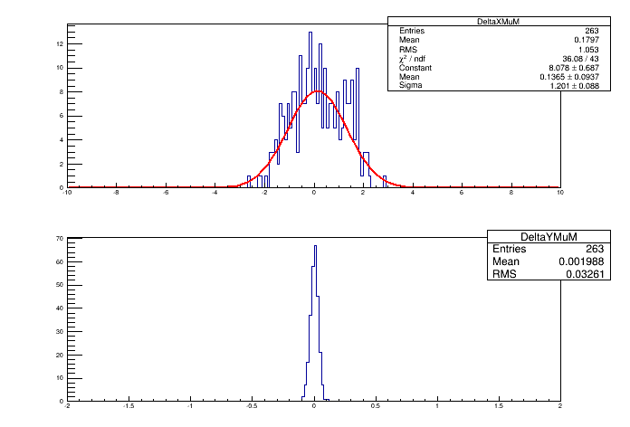
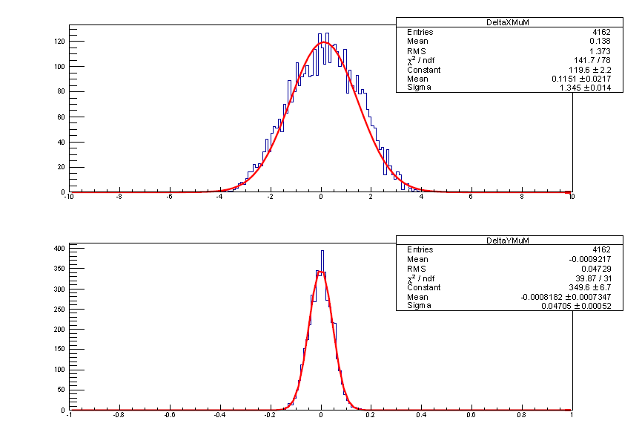
backward propagation to 40 (mag. entry) using:
70: 8 (150 mum) + 4 (200 mum) hits
50: 1 (5 mum) + 1 (15 mum) hits
70: 8 (150 mum) + 4 (200 mum) hits
50: 1 (30 mum) + 1 (30 mum) hits
55: 1 (30 mum) + 1 (30 mum) hits
backward propagated – Geant4
X
X
Y
Y
3 * sigma_x * 3 * RMS_y
= 3*1.201*3*0.03261
= 0.35 mm²
3 * sigma_x * 3 * sigma_y
= 3*1.345*3*0.04705
= 0.57 mm²

Slide 6
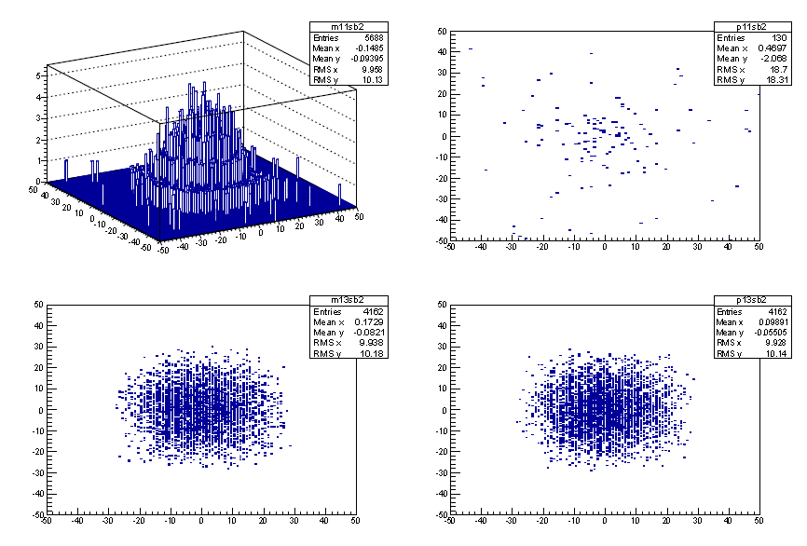
e-
e+
e+ per spill: 5e+6
spill time length: 4.8 s
spill time profile/density: uniform
event integration time: 5e-6 s
backward propagation spot: 0.6 mm²
mu+ mu- trigger
given the e+ profile given on the top left plot
how many extra e+ hits do we expect at subdetector 40 ?
mu+
mu-

