Slide 1
Report on recent LEMMA experimental setup studies
A. Bertolin, A. Lorenzon, L. Sestini

Slide 2
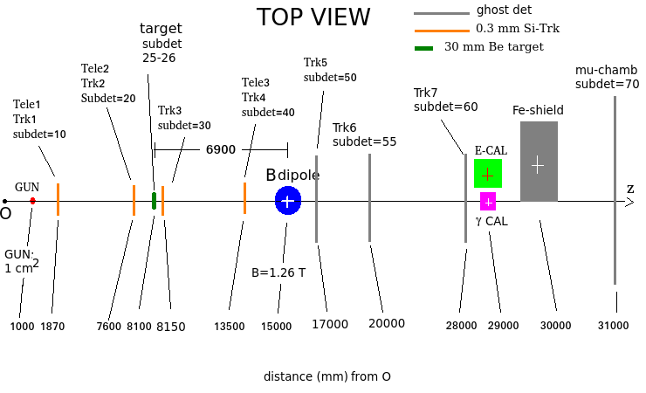
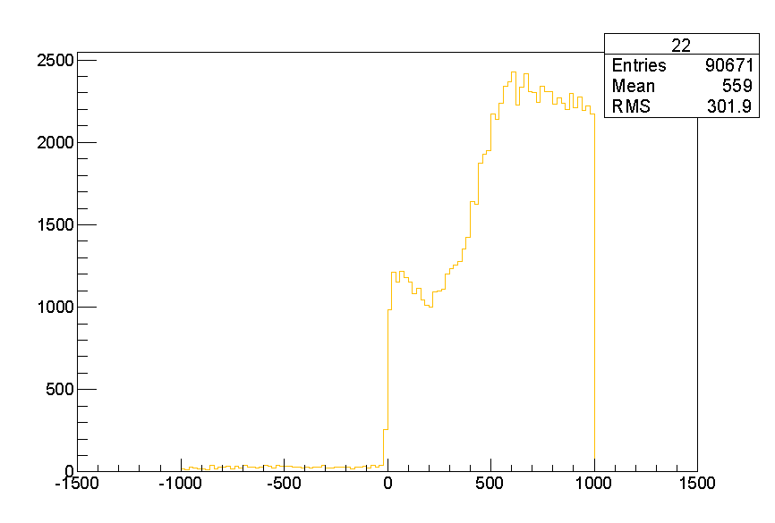
Tuning of Fe-shield position
x axis: from 0 mm to -1000 m
y axis: 1 m
z axis: 1 m
cross checked with Marco D.
MCMC_v4_10k_FTFP_air.root

Slide 3
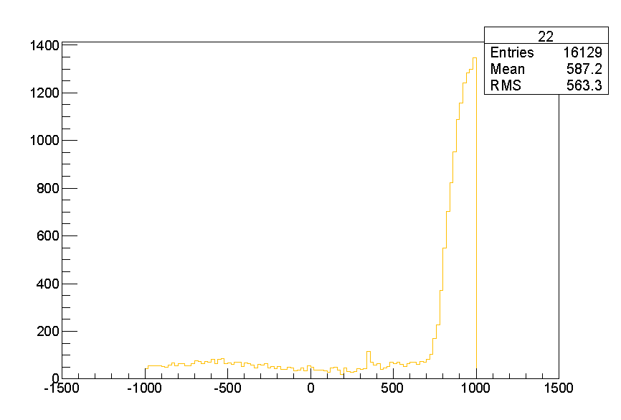
Tuning of Fe-shield position
x axis: from +325 mm to -1675 mm
y axis: 1 m
z axis: 0.5 m
MCMC_v5_20k_FTFP_air_gun4cmq_shield50cm.root
x = +325 mm does not intercept any of the mu- from annihilation

Slide 4
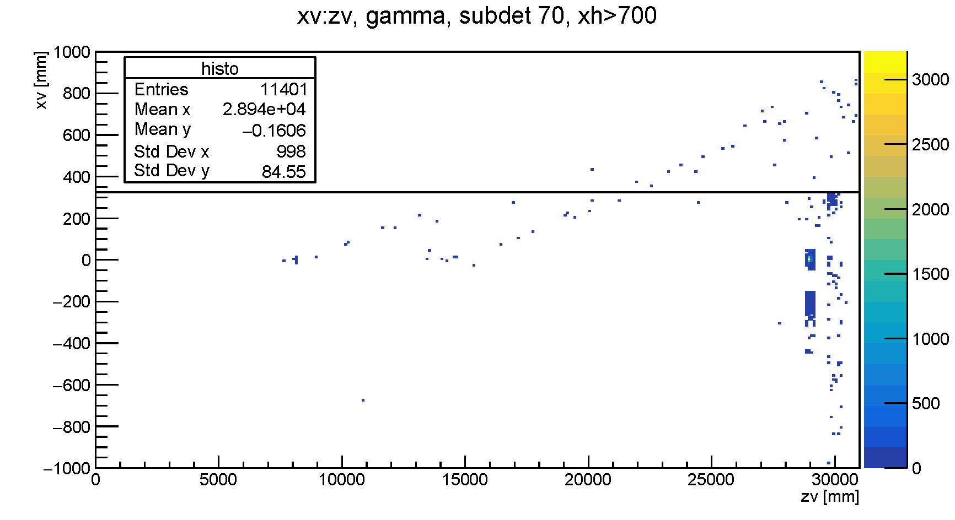
Tuning of Fe-shield position
xh > 700 mm
x = +325 mm
asked for a test with:
x = +390 mm

Slide 5
Background from the BERT physic list
Run Summary:
Number of events processed: 1M
Time: 162992s = 1d 21h 16min 32s
Dim: 5.8GB
physics list: BERT
data size: 1 M
“trigger”: mu- mu+ pair in subdet 70
MC generation trial:
one entry, out of the “signal xh range”
no entry

Slide 6
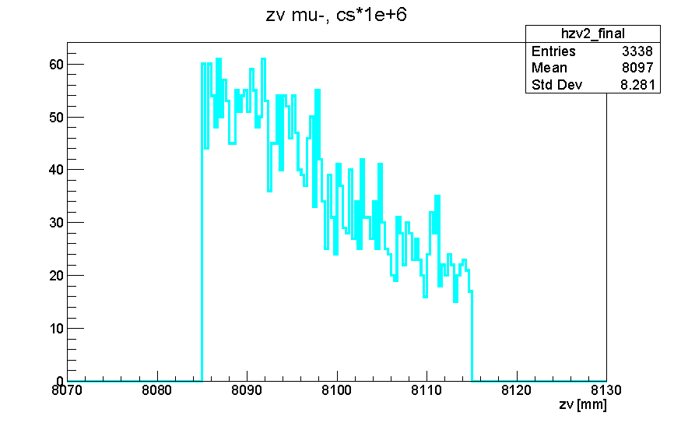
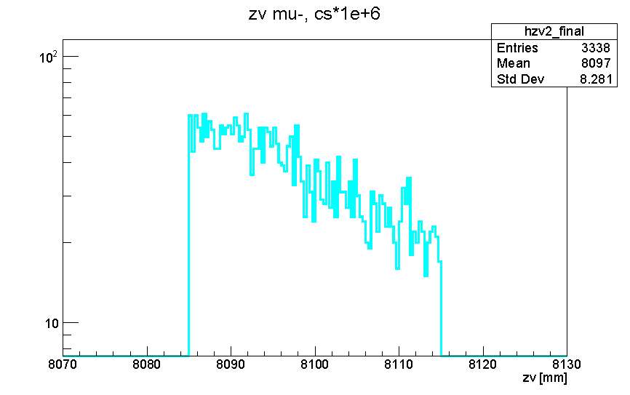
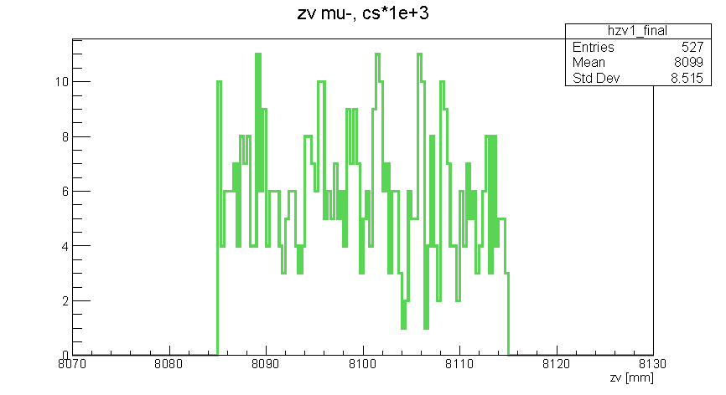
Run Summary:
Number of events processed: 1M
Time: 234632s = 2d 17h 10min 32s
Dim: 5.1GB
Signal generation with 1e+3 enhancement
10K 1e+6
2455 (reco) / 3086 (in acceptance)
integrated: 0.712605
1M 1e+3
402 (reco) / 516 (in acceptance)
integrated: 0.703869
root [0] 2455./402.
(const double)6.10696517412935336e+00
1M 1e+3
≡
1K 1e+6

Slide 7
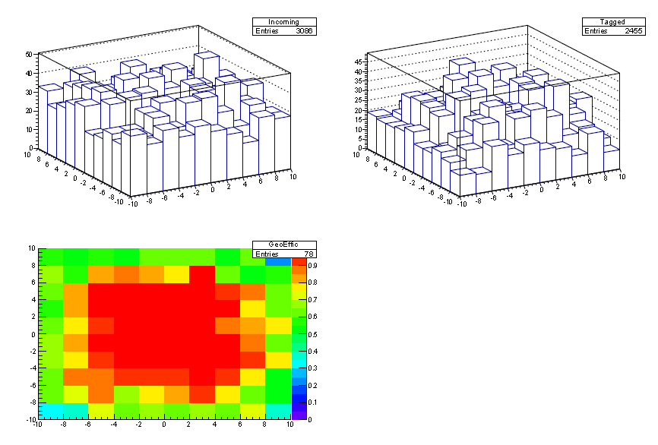
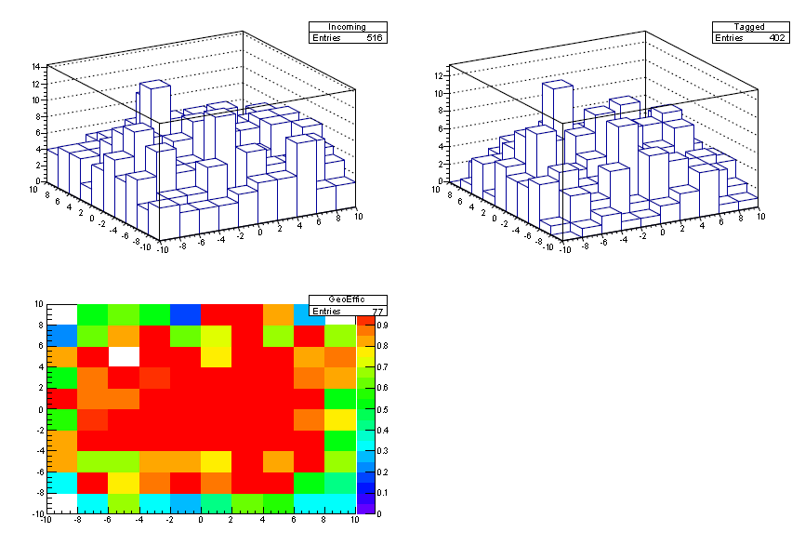
Run Summary:
Number of events processed: 1M
Time: 234632s = 2d 17h 10min 32s
Dim: 5.1GB
Signal generation with 1e+3 enhancement
MCMC_v5_10k_mumu_air_gun4cmq_shield50cm.root
MCMC_1M_signal.root

Slide 8
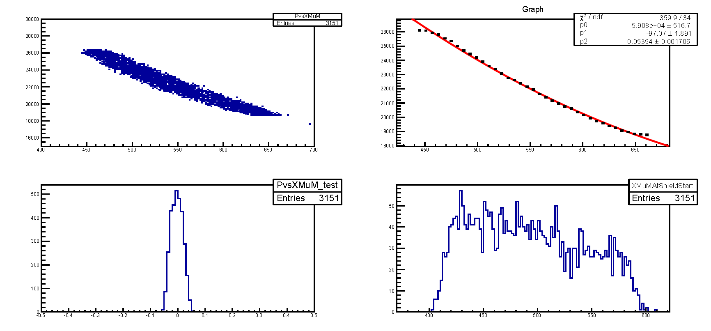
MCMC_v5_10k_mumu_air_gun4cmq_shield50cm.root

