Slide 1
Where do we want to Play? April 2011
Mobile App Strategy

Slide 2


Current State Assessment
Market Landscape
A new category of play has emerged with advanced mobile devices, such as iPhone, iPod and Android phones, becoming mainstream and a primary means of engagement for kids, teens and adults
We can take advantage of this broad audience (>160MM iOS devices alone!) and deliver value-based play experiences to our consumer – across our brands
Opportunity!

Slide 3

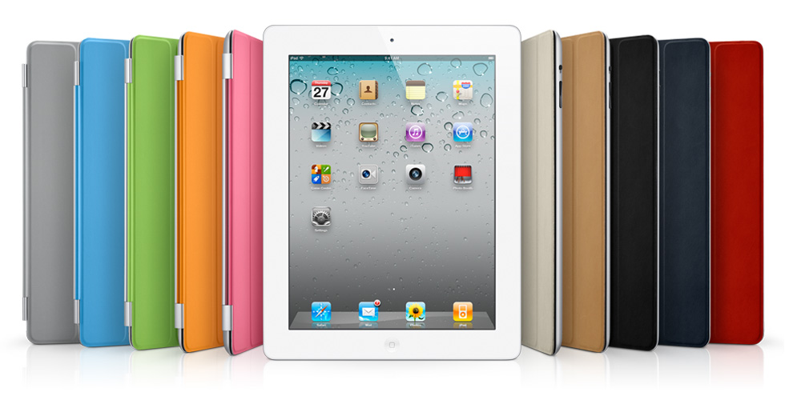
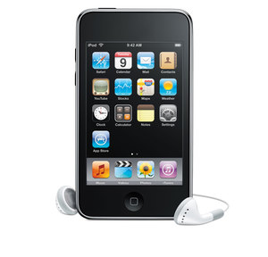
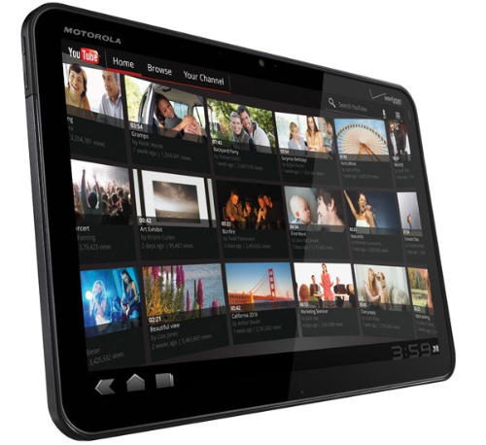

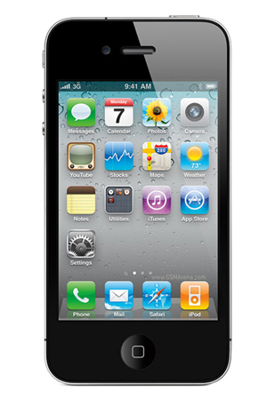
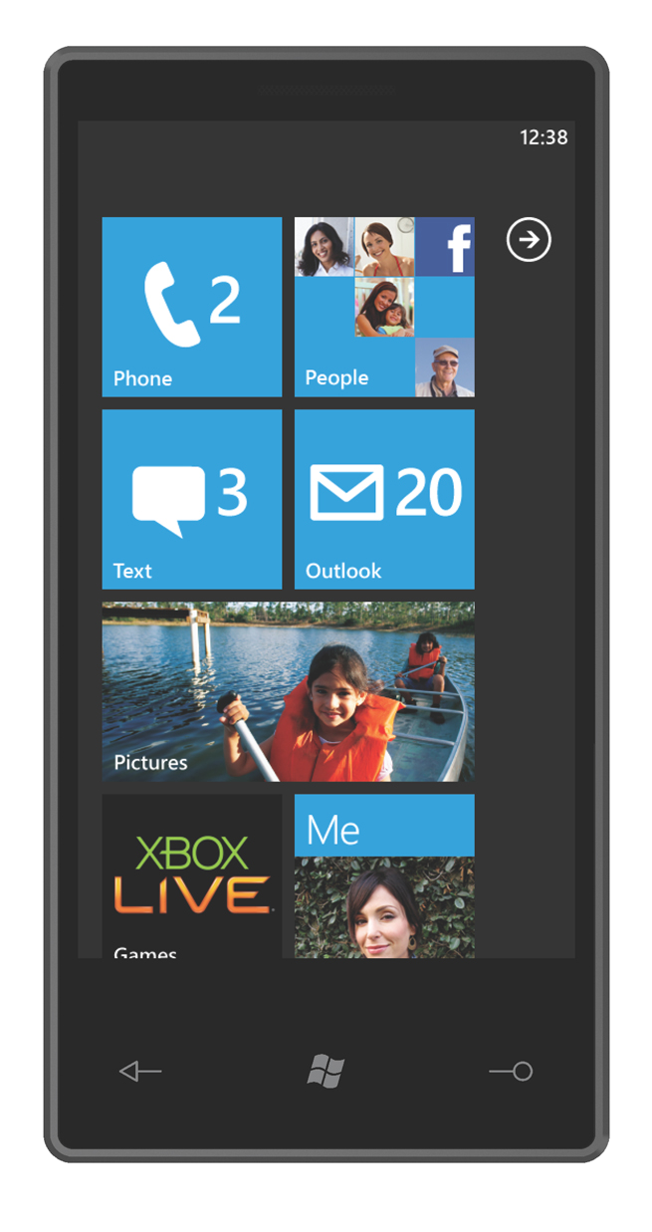

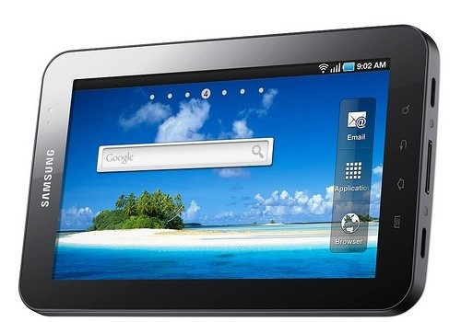

Our Approach
Avoid creating policies & approval hierarchies, rather,
build a platform with measurable results and criteria for “success”
New Ways to Play
Apps Value Chain
Methods, Measures & Improvement
Brand Engagement
Monetization
Consumer Insights
Digital Play Patterns
Measures
Improvement

Slide 4
New Ways to Play

Slide 5
Apps Value Chain
Brand Engagement
Monetization
Consumer Insights
Press/Buzz Generation
Platform for Physical Product Marketing
New ways to Play
Transition from “value-add” to premium paid experience
Generate untapped revenue (adverts, subscriptions, microtrans)
Consumer intimacy
Household/family engagement
Single View of the Customer across channels

Slide 6
Methods, Measures & Improvement

